Slide 1
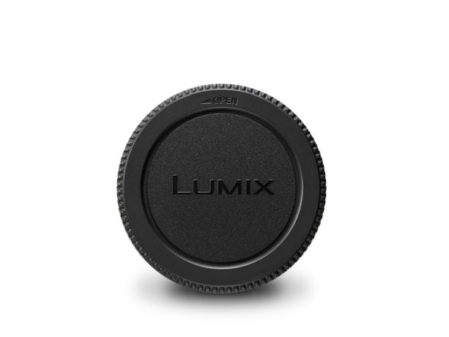
Lens Cap
Image
Text | Lens Rear Cap
Model Number | DMW-LRC1

