Slide 1
Simulation.py
Ningjing Liu

Slide 2
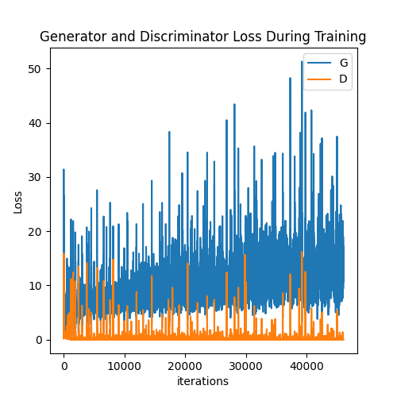
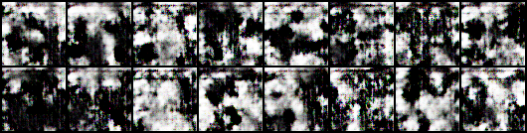
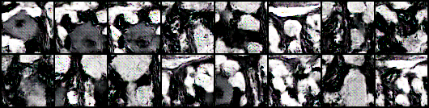
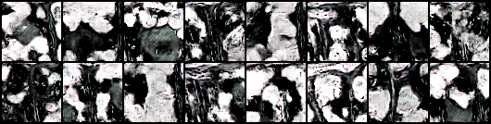
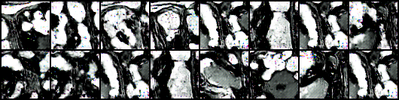
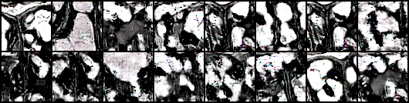
The best result in Simulation_VII.py
~4 h
epoch_10
workers = 1
batch_size = 32
nz = 100
ngf = 64
ndf = 64
num_epochs = 1000
lr = 0.0005
beta1 = 0.3
epoch_206
epoch_402
epoch_804

Slide 3
The best result in Simulation_VII.py
epoch_999

Slide 4
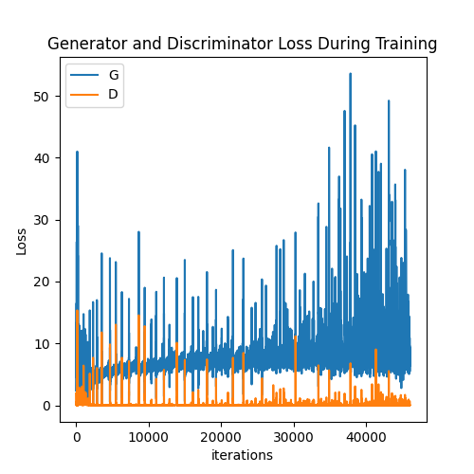
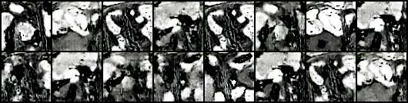
Lr modification result in Simulation_VII.py
~4 h
workers = 1
batch_size = 32
nz = 100
ngf = 64
ndf = 64
num_epochs = 1000
lr = 0.0001
beta1 = 0.3

Slide 5
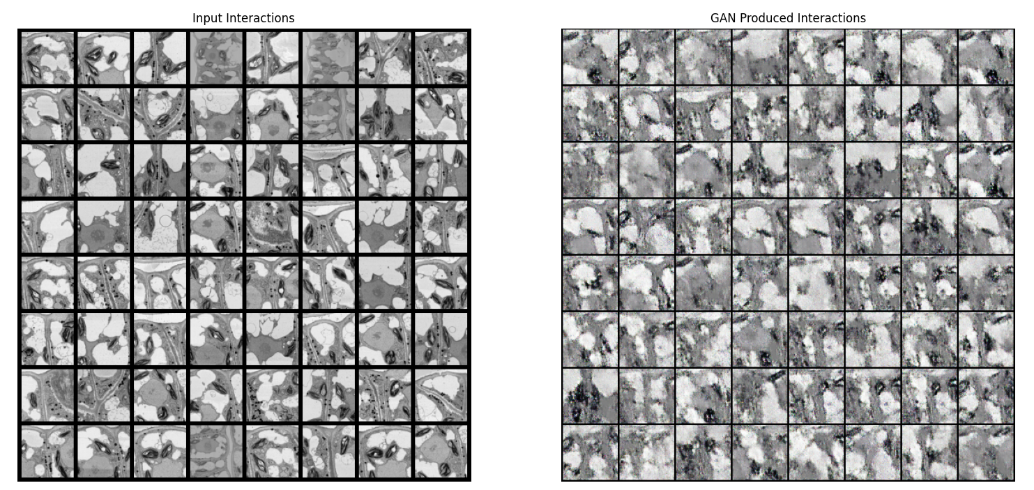
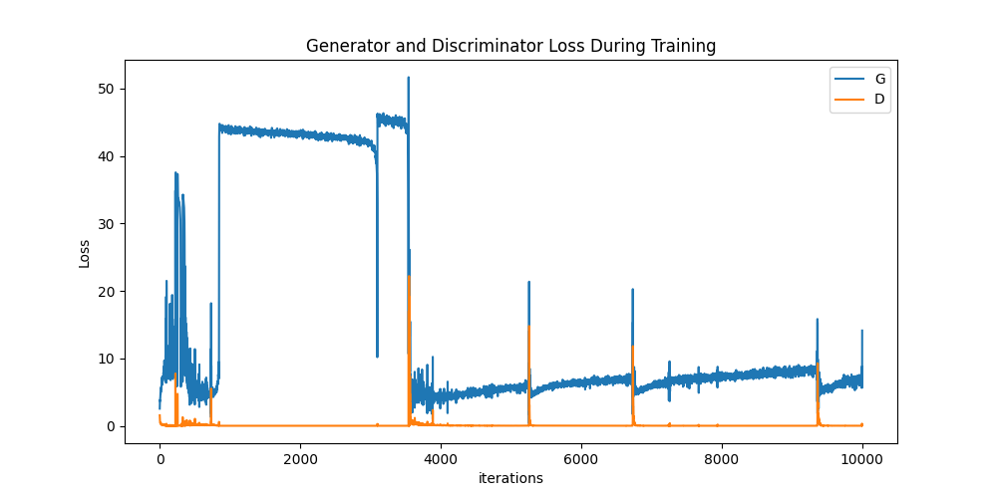
The best result in Simulation.py
~1 h
workers = 1
batch_size = 128
image_size = 64
nc = 3
nz = 100
ngf = 64
ndf = 64
num_epochs = 5000
lr = 0.0001
beta1 = 0.5
ngpu = 1
161 different images for trainning

Slide 6
问题：1、输入的图是灰度图，但是一直被当成RGB图去测试。我尝试了灰度图转换，好像是opencv的问题？
2、central crop问题，输入的图片在采集的时候，只采集中心部分学习么？像素太低了?

