Slide 1

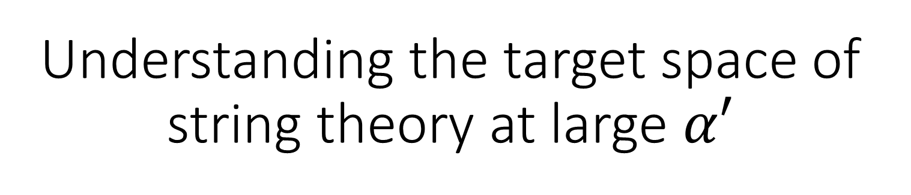
Understanding the target space of string theory at large $α′$
Nathan McStay
University of Cambridge
nm646@cam.ac.uk
Work done in collaboration with Dr R. A. Reid-Edwards

Slide 2
Introduction: String theory on curved spacetime

Slide 3
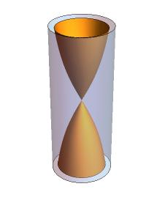
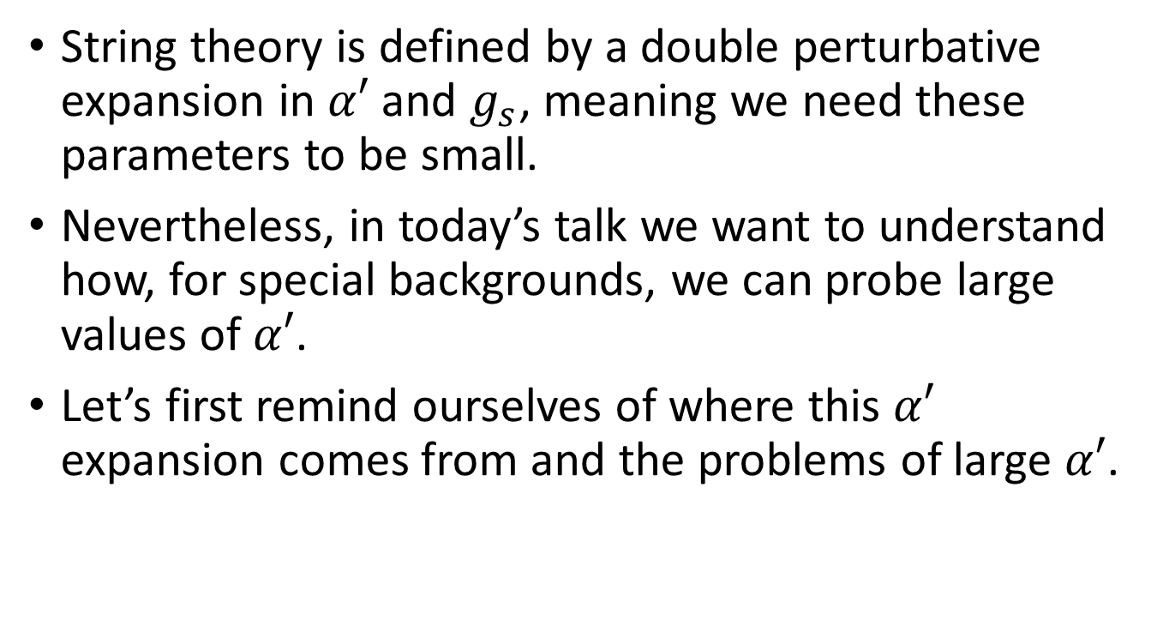
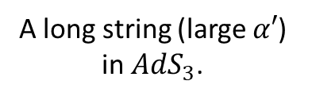
Introduction (1/4)
String theory is defined by a double perturbative expansion in $α′$ and $g_{s}$, meaning we need these parameters to be small.
Nevertheless, in today’s talk we want to understand how, for special backgrounds, we can probe large values of $α′$.
Let’s first remind ourselves of where this $α′$ expansion comes from and the problems of large $α′$.
A long string (large $α′$) in $AdS_{3}$.

Slide 4
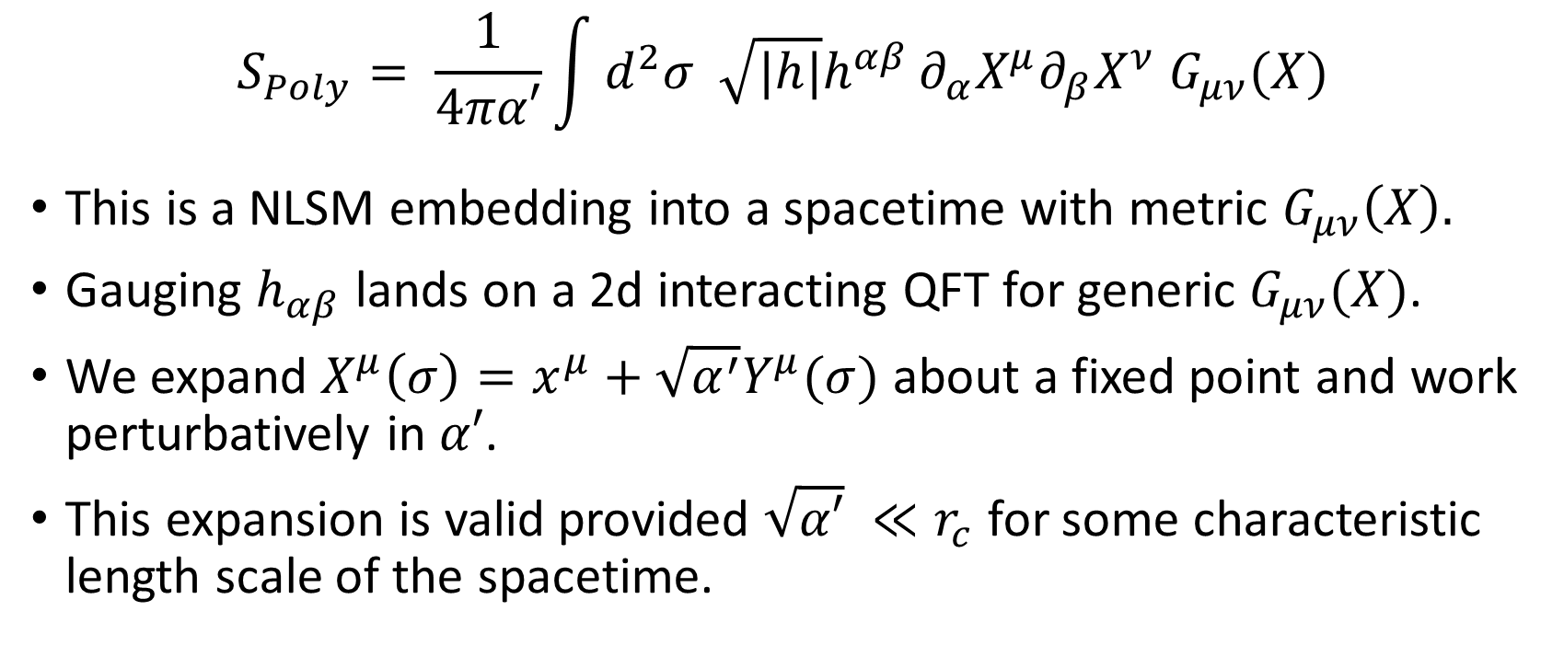
Introduction (2/4)
$$S_{Poly}= \frac{1}{4πα′}\int{d^{2}σ \sqrt{|h|}h^{αβ}}∂_{α}X^{μ}∂_{β}X^{ν} G_{μν}(X)$$
This is a NLSM embedding into a spacetime with metric $G_{μν}\left(X\right).$
Gauging $h_{αβ}$ lands on a 2d interacting QFT for generic $G_{μν}(X)$.
We expand $X^{μ}\left(σ\right)=x^{μ}+\sqrt{α^{′}}Y^{μ}(σ)$ about a fixed point and work perturbatively in $α′$.
This expansion is valid provided $\sqrt{α′} ≪r_{c}$ for some characteristic length scale of the spacetime.

Slide 5
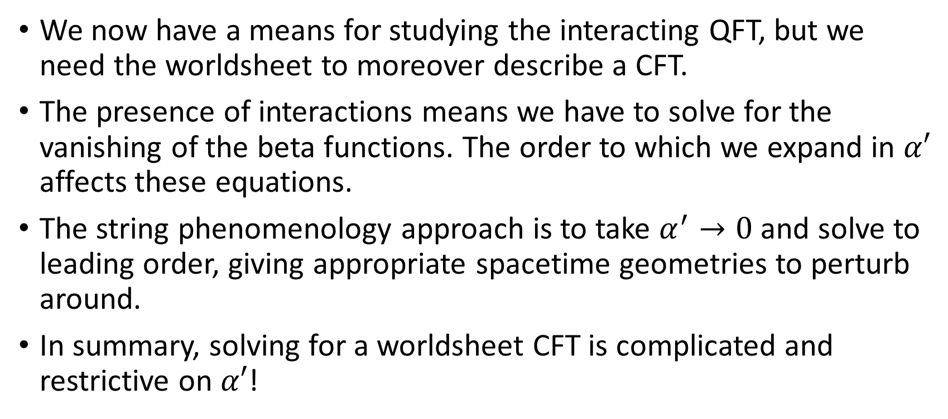
Introduction (3/4)
We now have a means for studying the interacting QFT, but we need the worldsheet to moreover describe a CFT.
The presence of interactions means we have to solve for the vanishing of the beta functions. The order to which we expand in $α′$ affects these equations.
The string phenomenology approach is to take $α^{′}→0$ and solve to leading order, giving appropriate spacetime geometries to perturb around.
In summary, solving for a worldsheet CFT is complicated and restrictive on $α′$!

Slide 6
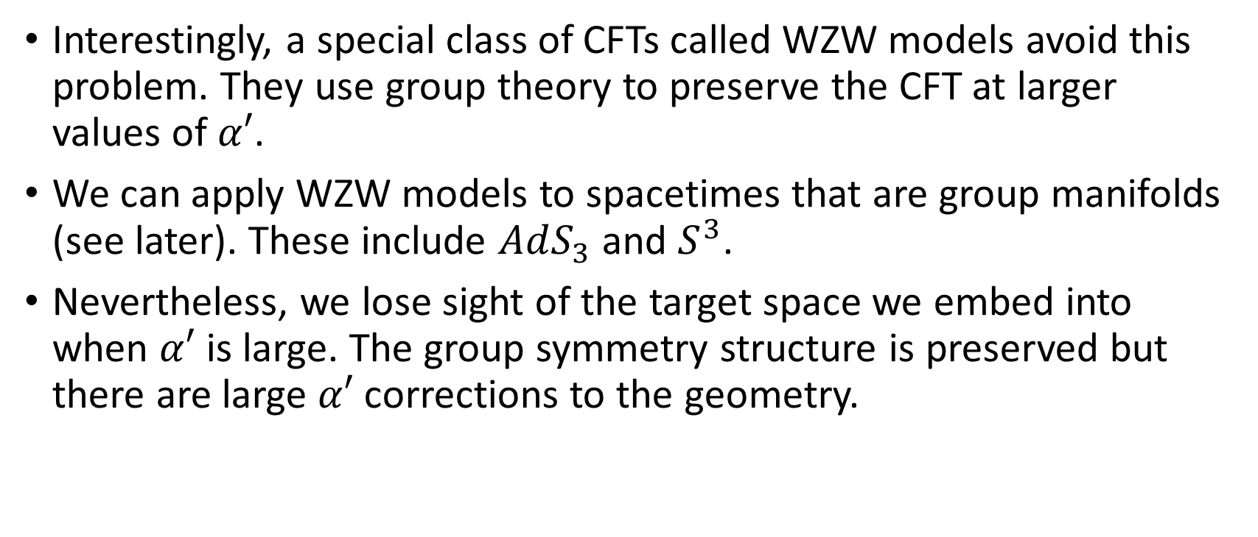
Introduction (4/4)
Interestingly, a special class of CFTs called WZW models avoid this problem. They use group theory to preserve the CFT at larger values of $α′$.
We can apply WZW models to spacetimes that are group manifolds (see later). These include $AdS_{3}$ and $S^{3}$.
Nevertheless, we lose sight of the target space we embed into when $α′$ is large. The group symmetry structure is preserved but there are large $α′$ corrections to the geometry.

Slide 7
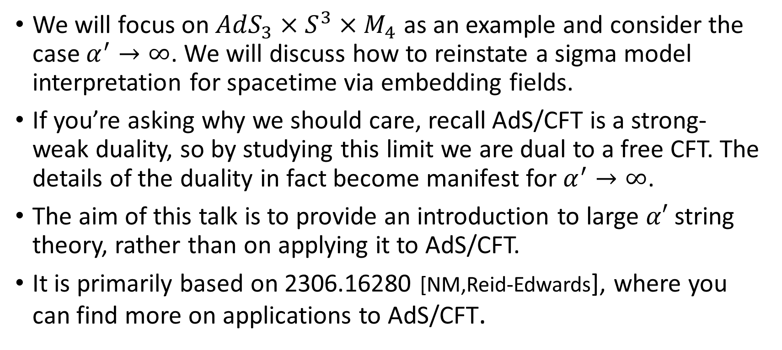
Plan for the rest of the talk (1/2)
We will focus on $AdS_{3}×S^{3}×M_{4}$ as an example and consider the case $α^{′}→∞$. We will discuss how to reinstate a sigma model interpretation for spacetime via embedding fields.
If you’re asking why we should care, recall AdS/CFT is a strong-weak duality, so by studying this limit we are dual to a free CFT. The details of the duality in fact become manifest for $α^{′}→∞$.
The aim of this talk is to provide an introduction to large $α′$ string theory, rather than on applying it to AdS/CFT.
It is primarily based on 2306.16280 [NM,Reid-Edwards], where you can find more on applications to AdS/CFT.

Slide 8
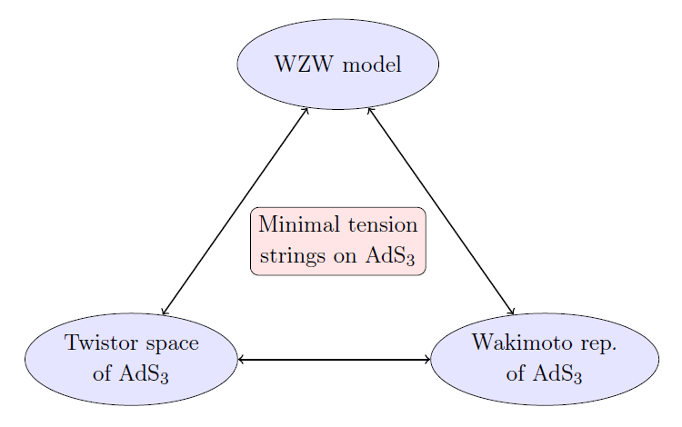
Plan for the rest of the talk (2/2)
We’ll discuss these two!

Slide 9
The WZW model

Slide 10
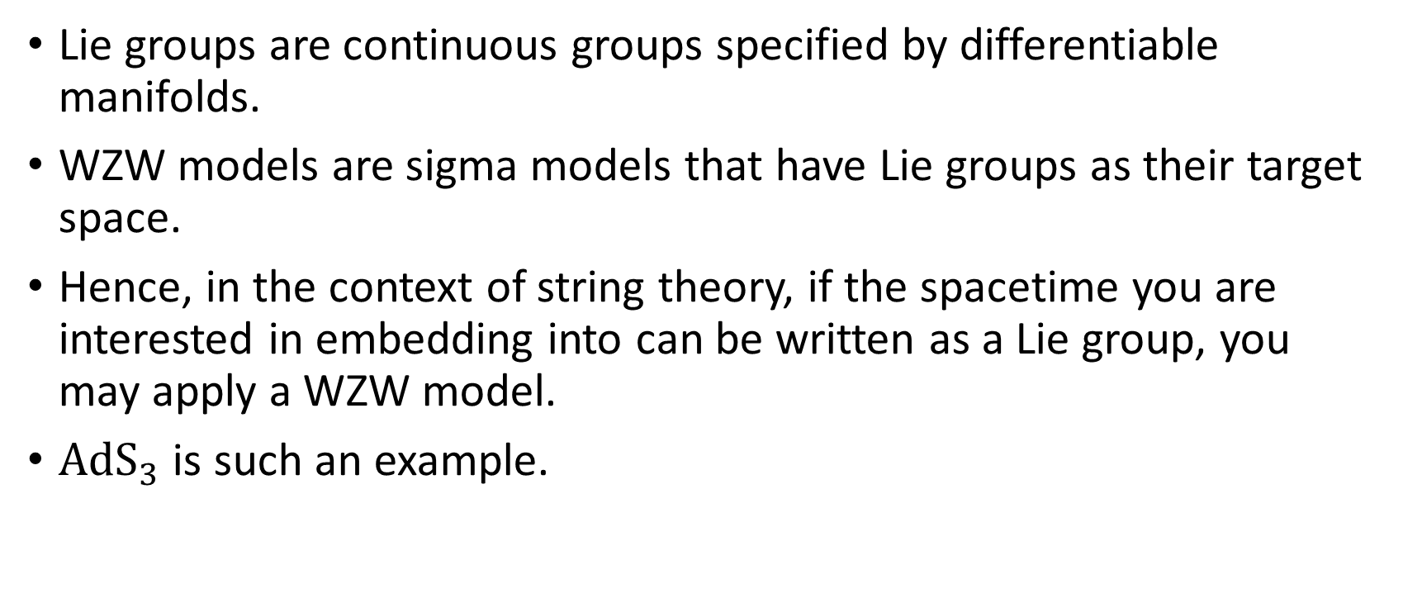
The WZW model (1/4)
Lie groups are continuous groups specified by differentiable manifolds.
WZW models are sigma models that have Lie groups as their target space.
Hence, in the context of string theory, if the spacetime you are interested in embedding into can be written as a Lie group, you may apply a WZW model.
${AdS}_{3}$ is such an example.

Slide 11
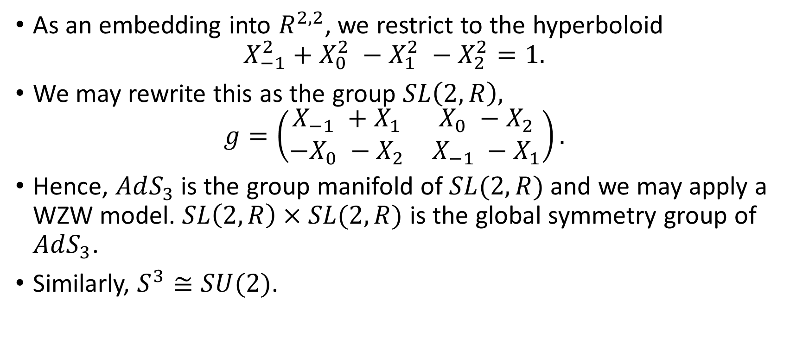
The WZW model (2/4)
As an embedding into $R^{2,2}$, we restrict to the hyperboloid
$$X_{−1}^{2}+X_{0}^{2} −X_{1}^{2} −X_{2}^{2}=1.$$
We may rewrite this as the group $SL\left(2,R\right),$
$$g=\left(\begin{matrix}X_{−1} +X_{1} & X_{0} −X_{2} \\ −X_{0} −X_{2} & X_{−1} −X_{1}\end{matrix}\right).$$
Hence, $AdS_{3}$ is the group manifold of $SL(2,R)$ and we may apply a WZW model. $SL\left(2,R\right)×SL(2,R)$ is the global symmetry group of $AdS_{3}$.
Similarly, $S^{3}≅SU(2)$.

Slide 12
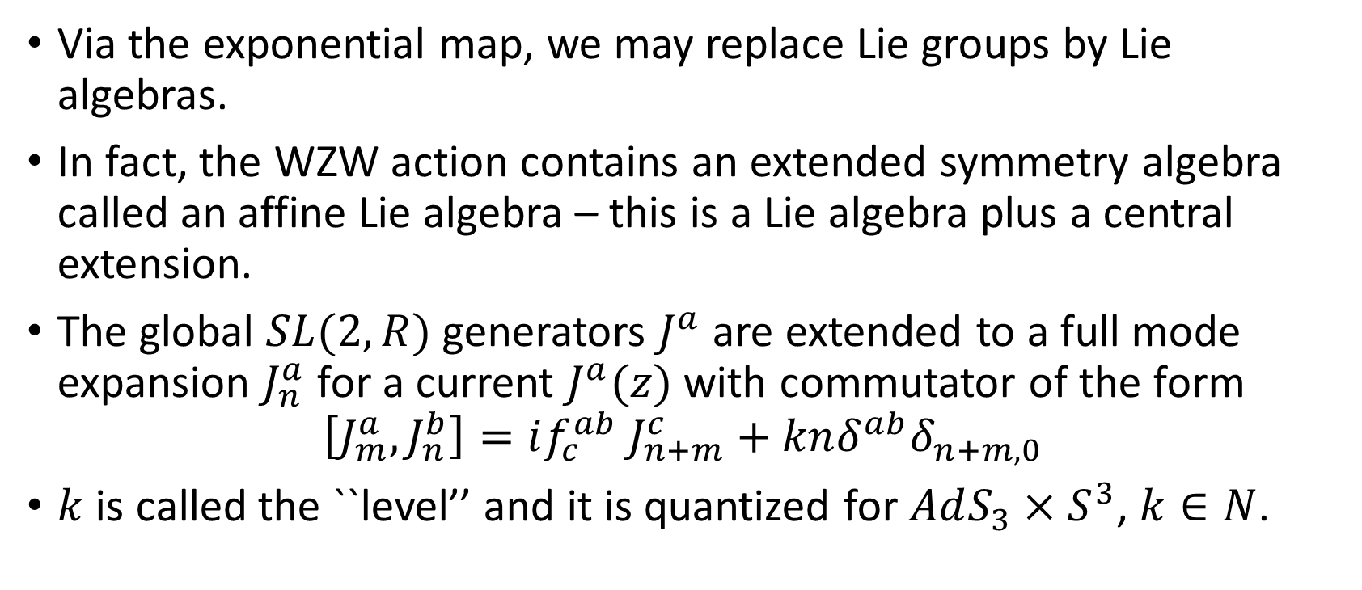
The WZW model (3/4)
Via the exponential map, we may replace Lie groups by Lie algebras.
In fact, the WZW action contains an extended symmetry algebra called an affine Lie algebra – this is a Lie algebra plus a central extension.
The global $SL(2,R)$ generators $J^{a}$ are extended to a full mode expansion $J_{n}^{a}$ for a current $J^{a}(z)$ with commutator of the form
$$\left[J_{m}^{a},J_{n}^{b}\right]=if_{c}^{ab} J_{n+m}^{c}+knδ^{ab}δ_{n+m,0}$$
$k$ is called the ``level’’ and it is quantized for $AdS_{3}×S^{3}$, $k∈N$.

Slide 13
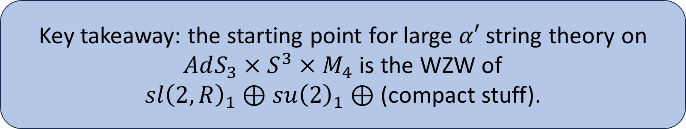
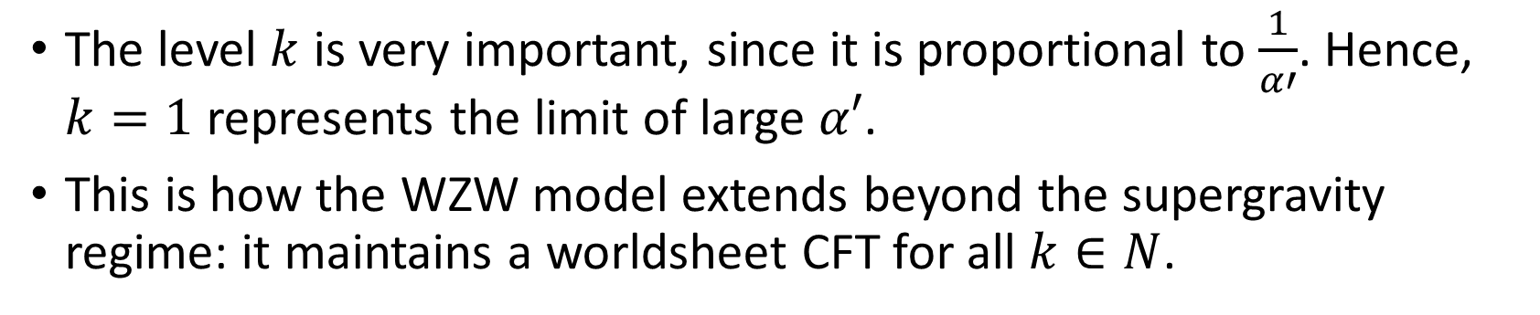
The WZW model (4/4)
The level $k$ is very important, since it is proportional to $\frac{1}{α′}$. Hence, $k=1$ represents the limit of large $α′$.
This is how the WZW model extends beyond the supergravity regime: it maintains a worldsheet CFT for all $k∈N$.
Key takeaway: the starting point for large $α′$ string theory on $AdS_{3}×S^{3}×M_{4}$ is the WZW of
$sl{\left(2,R\right)}_{1}⊕su{\left(2\right)}_{1}⊕$ (compact stuff).

Slide 14

The twistor space of $AdS_{3}$

Slide 15
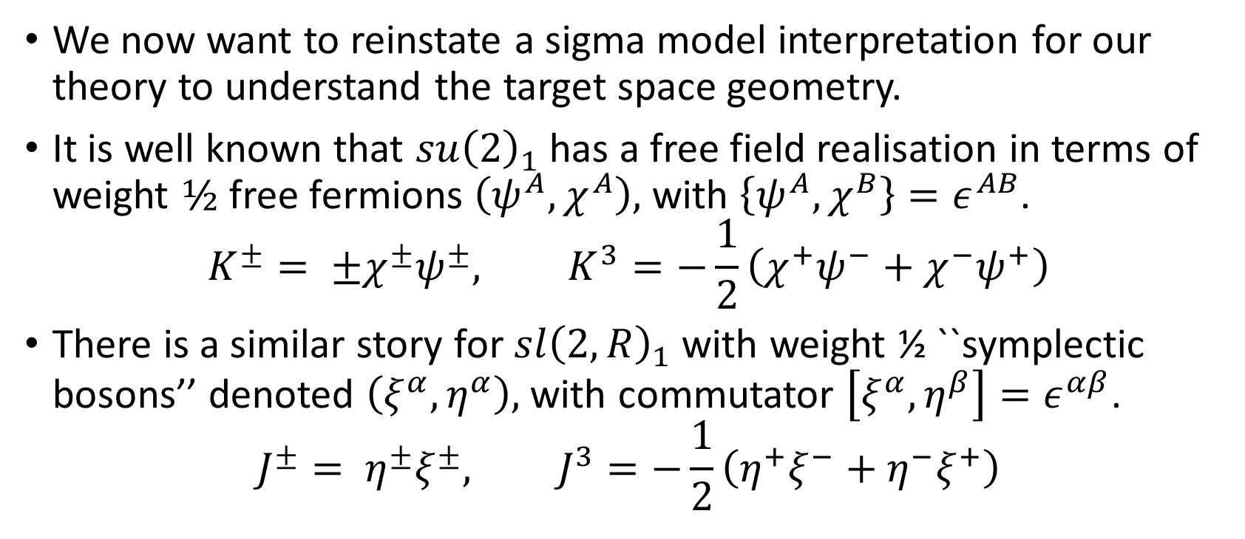

The twistor space of $AdS_{3}$ (1/4)
We now want to reinstate a sigma model interpretation for our theory to understand the target space geometry.
It is well known that $su{\left(2\right)}_{1}$ has a free field realisation in terms of weight $½$ free fermions $\left(ψ^{A},χ^{A}\right),$ with $\left\{ψ^{A},χ^{B}\right\}=ε^{AB}$.
$$K^{±}= ±χ^{±}ψ^{±}, K^{3}=−\frac{1}{2}\left(χ^{+}ψ^{−}+χ^{−}ψ^{+}\right)$$
There is a similar story for $sl{\left(2,R\right)}_{1}$ with weight ½ ``symplectic bosons’’ denoted $\left(ξ^{α},η^{α}\right),$ with commutator $\left[ξ^{α},η^{β}\right]=ε^{αβ}$.
$$J^{±}= η^{±}ξ^{±}, J^{3}=−\frac{1}{2}\left(η^{+}ξ^{−}+η^{−}ξ^{+}\right)$$

Slide 16
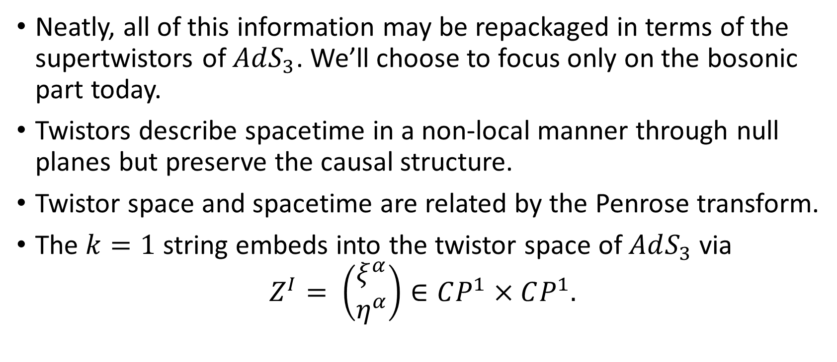

The twistor space of $AdS_{3}$ (2/4)
Neatly, all of this information may be repackaged in terms of the supertwistors of $AdS_{3}$. We’ll choose to focus only on the bosonic part today.
Twistors describe spacetime in a non-local manner through null planes but preserve the causal structure.
Twistor space and spacetime are related by the Penrose transform.
The $k=1$ string embeds into the twistor space of $AdS_{3}$ via
$$Z^{I}= \left(\begin{matrix}ξ^{α} \\ η^{α}\end{matrix}\right)∈CP^{1}×CP^{1}.$$

Slide 17
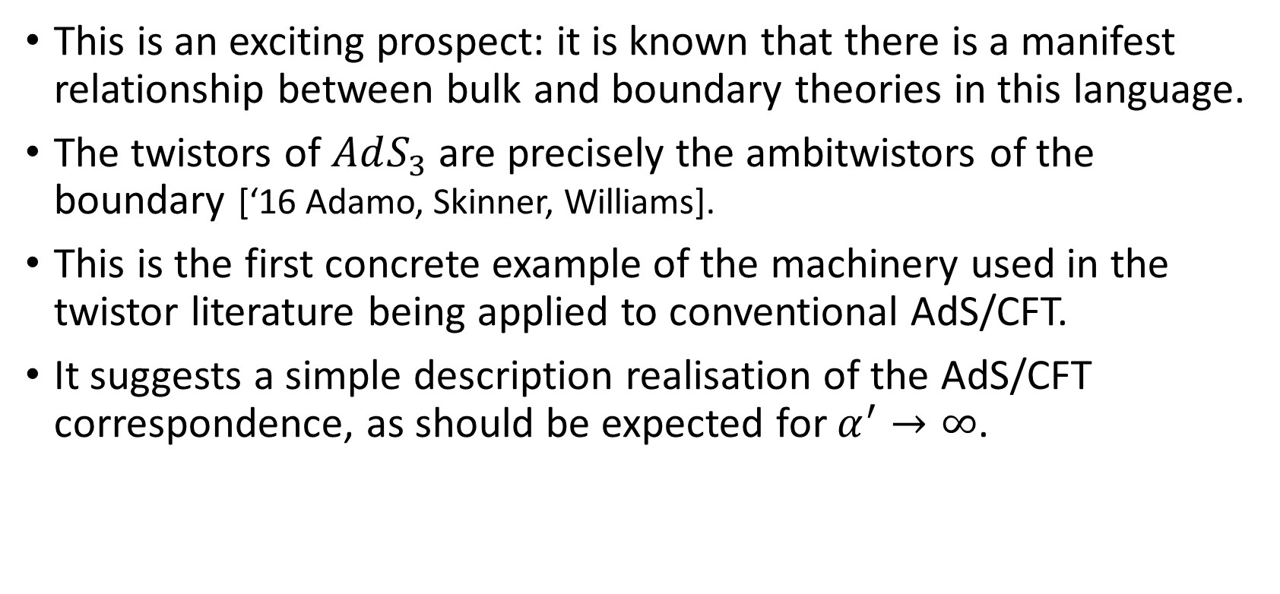

The twistor space of $AdS_{3}$ (3/4)
This is an exciting prospect: it is known that there is a manifest relationship between bulk and boundary theories in this language.
The twistors of $AdS_{3}$ are precisely the ambitwistors of the boundary [‘16 Adamo, Skinner, Williams].
This is the first concrete example of the machinery used in the twistor literature being applied to conventional AdS/CFT.
It suggests a simple description realisation of the AdS/CFT correspondence, as should be expected for $α^{′}→∞$.

Slide 18
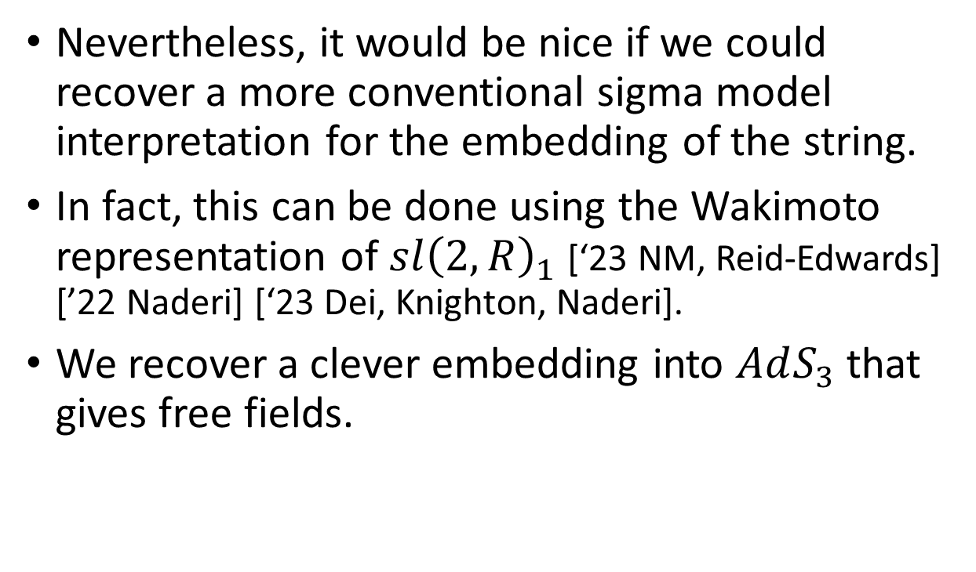

The twistor space of $AdS_{3}$ (4/4)
Nevertheless, it would be nice if we could recover a more conventional sigma model interpretation for the embedding of the string.
In fact, this can be done using the Wakimoto representation of $sl{\left(2,R\right)}_{1}$ [‘23 NM, Reid-Edwards] [’22 Naderi] [‘23 Dei, Knighton, Naderi].
We recover a clever embedding into $AdS_{3}$ that gives free fields.

Slide 19
Outlook

Slide 20
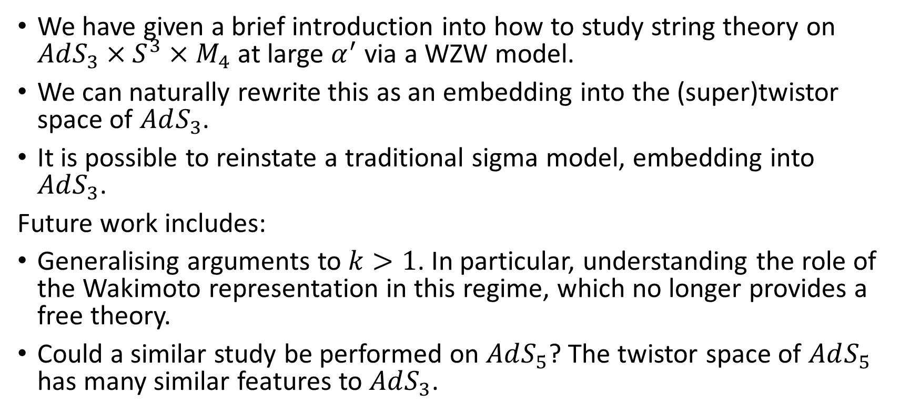
Summary
We have given a brief introduction into how to study string theory on $AdS_{3}×S^{3}×M_{4}$ at large $α^{′}$ via a WZW model.
We can naturally rewrite this as an embedding into the (super)twistor space of $AdS_{3}$.
It is possible to reinstate a traditional sigma model, embedding into $AdS_{3}$.
Future work includes:
Generalising arguments to $k>1$. In particular, understanding the role of the Wakimoto representation in this regime, which no longer provides a free theory.
Could a similar study be performed on $AdS_{5}$? The twistor space of $AdS_{5}$ has many similar features to $AdS_{3}$.

Slide 21
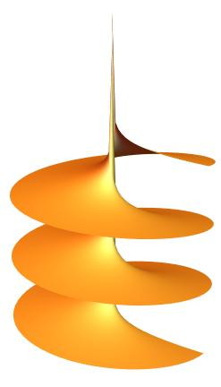
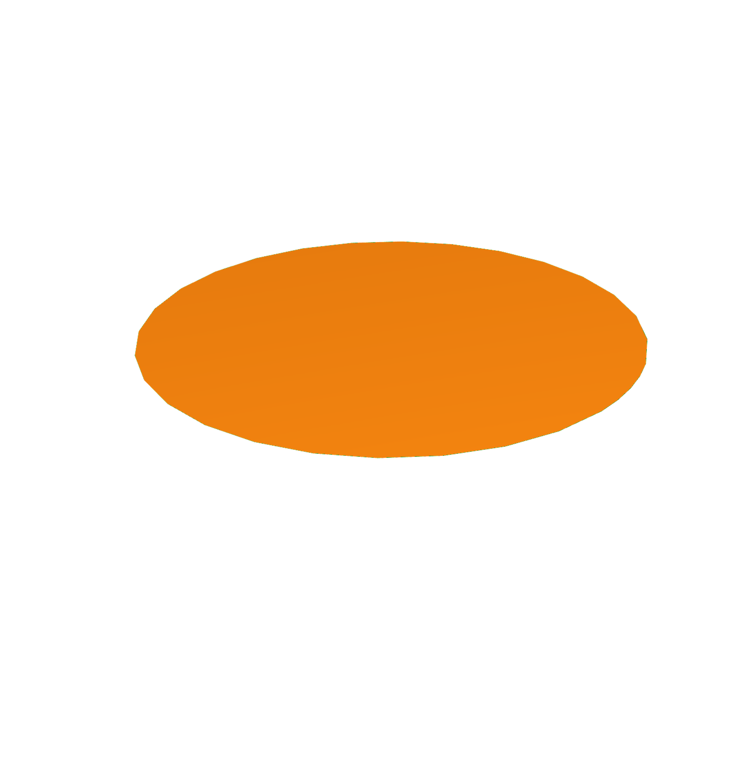

Topics to discuss
If you are interested, I’d love to chat more about:
How we can prove this example of AdS/CFT through covering maps.
How we uncover a global radial translation symmetry, explaining why the degrees of freedom live at the boundary.
Alternative perspectives on the spacetime geometry not discussed today and how they are connected.
$$Γ$$
A sketch of a covering map.

Slide 22

Thank you!
Questions?
2306.16280

