Slide 1
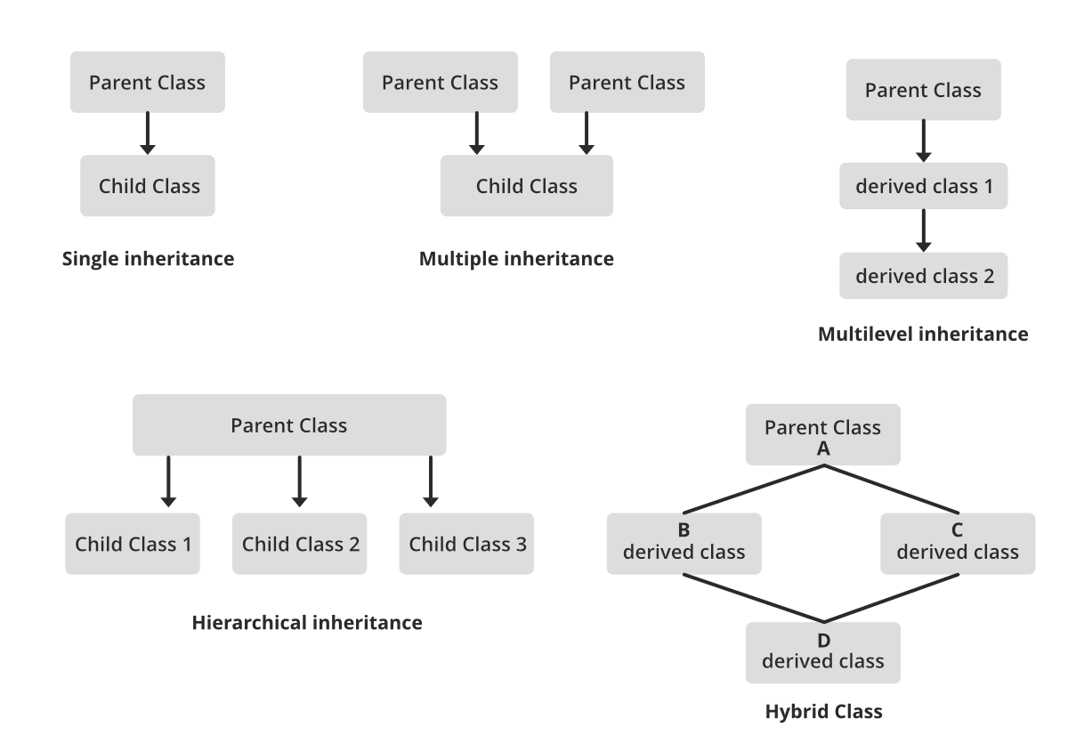
Introduction to Object Oriented Programming in R

Slide 2
Objects and Classes
Objects:
SUV
Sedan
Minivan
Hatchback
Sports car
Class:
Car
Objects:
“SUV”
“Sedan”
“Minivan”
“Hatchback”
“Sports car”
Class:
Character
Objects:
“Abd-B”, “RRRRTAFTHA…”
“Dlx1”, “RKPRTIYSSL…”
“HOXA5”, “KRARTAYTRY…”
“HOXD8”, “RRGRQTYSR…”
“Ubx”, “RRGRQTYTR…”
Class:
Proteins

Slide 3
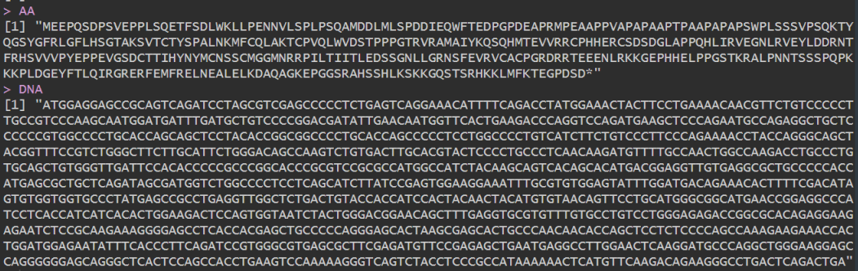
Why do we care about Objects and Classes
Imagine we are dealing with P53 sequencing data, but some of them are DNA sequences and some of them are Protein sequences.
We want to know what is the Amino Acid residue at the 5th position. What will be your approach?

Slide 4
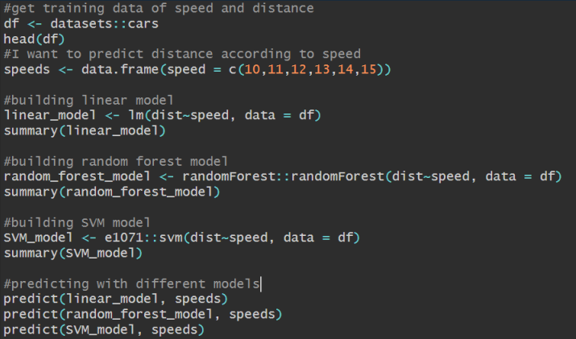
Predict: a function for different classes

Slide 5
Predict() is S3 Generic, what does it mean?
Three major systems of Object Oriented Programming (OOP)
S3
Most easy and simplistic way of OOP, based on R lists, prone to errors
S4
More stringent and restrictive than S3, sets a class before using
BioConductor uses S4 classes
Reference Classes (RC) / R6
Python/Java-esque class system, defines a reference of the class with associated local methods. Threading states, method chaining just like python.

Slide 6
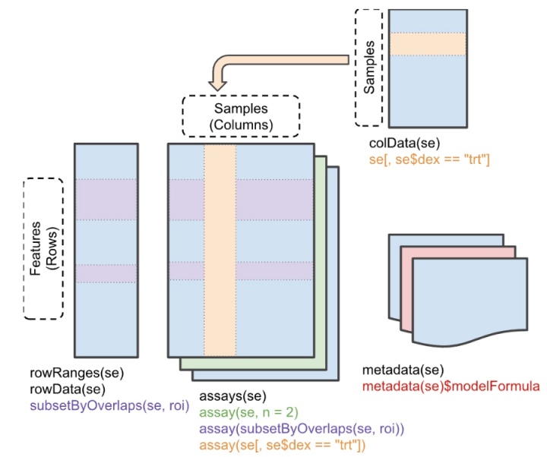
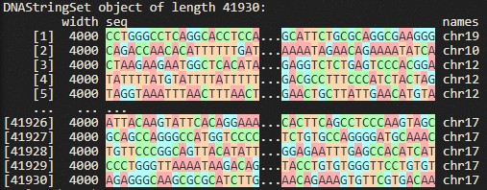
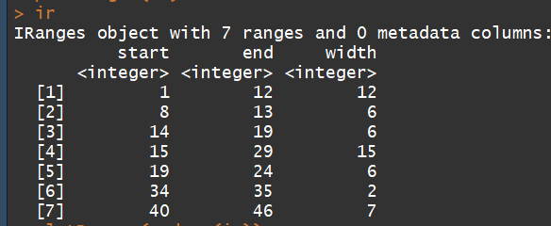
SE, BioStrings, Irange and more…

