Slide 1




















Chapter 23
Health Records and Health
Information Management

Slide 2





Health Information Management
All health care providers, regardless of setting, are required to maintain all patient care information that applies to an individual patient.

Slide 3



Health Information Department Functions
Support the current and continuing care of patients
Support the institution’s administrative processes
Maintain records for patient billing / accounting processes
Support medical education programs
Support health services research
Maintain records for utilization management, risk management, and quality management or performance improvement programs
Ensure patient privacy and security issues
Ensure compliance with legal requirements
Perform other extraneous patient services

Slide 4


What’s in the Health Record?
According to TJC
A medical record must contain sufficient information to identify the patient, support the diagnosis, justify the treatment, document the course and results, and promote the continuity of care among health care providers.
According to Medicare
…the medical record must contain information to justify the admission and continued hospitalization, support the diagnosis, and describe the patient’s progress and response to the medication and services.

Slide 5


Health Record Content
Standards for the maintenance and the adequacy of health records have been established by accrediting agencies such as TJC (JCAHO) or HFAP
Gives ability to track data over time
All departments that take part in the care of a patient
must document that care in the health record
Charting → Documenting in the patient’s record
Should be done when a patient receives either diagnostic or
therapeutic radiologic services
If it isn’t documented in the chart, it wasn’t done!

Slide 6

Health Record Information
Patient ID and demographics
Medical history
Psychological needs summary
Physical exam report
Clinical observations
Progress notes
Consultation reports
Diagnostic and therapeutic reports
Diagnostic and therapeutic orders including medication services
Treatment plan
Evidence of informed consents
•
•
•
•
•
•
•
•
Reports of surgical / invasive procedures
Records of donations and implants
Impression upon admission
Final diagnosis and prognosis Conclusions at termination of stay
Discharge info given to patient and family
Discharge summary Postmortem results

Slide 7

Traditional Health Records:
Paper-based medical record system
Practitioner stores test results/notes from each patient
consultation in a “patient chart”
Charts are created/stored in each distinct healthcare
location ER, physician's office, hospital floor, radiology…
Records can be misfiled, lost, or destroyed
Lack of communication can cause errors
Each practitioner has pt information vital to proper diagnosis
Chart is the legal document

Slide 8


Storage
Paper-based medical record system
Charts more than 7 years old are purged -legally
"inaccessible"
Storage of film requirements by legal precedent!
Keep film 5 – 7 years
Pediatric and litigation films stored indefinitely!
Need significant amount of space

Slide 9




What is an Electronic Medical Record?
Computerized means of storing patient's health data
Allows for digital order entry and management
Allows for communication/connectivity with other departments or providers
Stores patient’s health data indefinitely
Electronic data can almost always be recovered
Can be accessed from anywhere
Data is “searchable”
Metadata
Electronic Health Record – longitudinal electronic record of patient health information

Slide 10
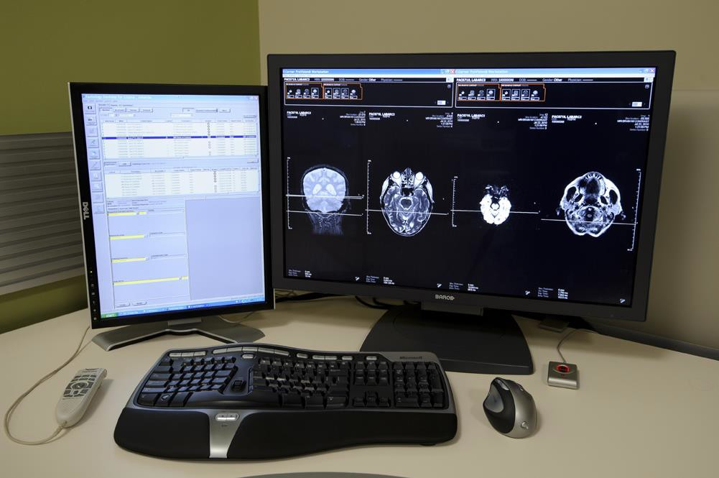
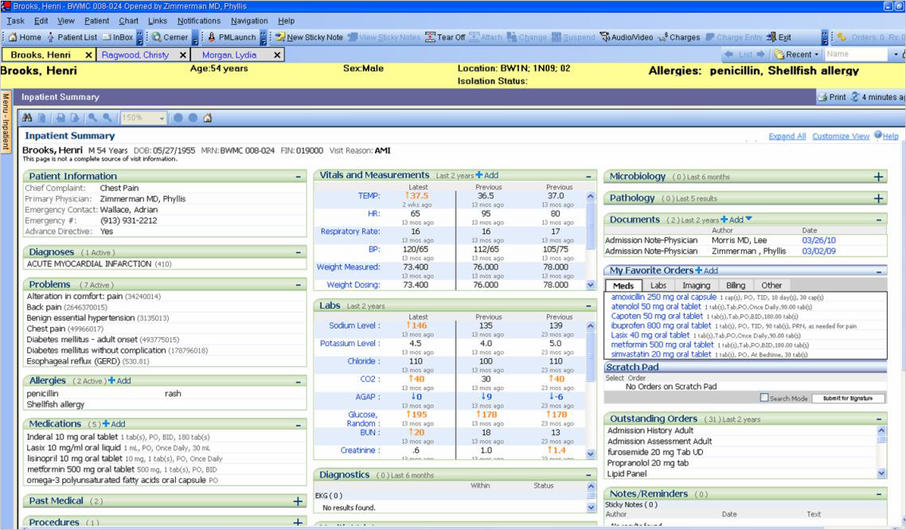
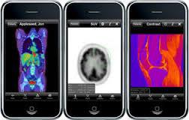

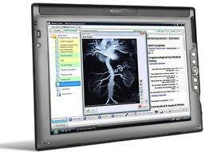
Storage:

Slide 11
Rules for the Health Record
Must be complete!
Readily accessible to anyone who has a right to
the information and the need to use it
Can be used for patient care, for hospital statistics and research, and for activities such as quality management and risk and utilization management
Radiology → make requests for data used for administrative, research, and applied health informatics activities
Hospitals and other types of health care facilities need high-quality health care data for operations

Slide 12
Health Information Terminology
APC—Ambulatory Payment Classification
Based on ICD-9-CM codes for diagnosis and CPT codes used for reimbursement to health care in an outpatient setting
CPT—Current Procedural Terminology
Listing of medical terms and codes for diagnostic and therapeutic procedures used for coding for physician reimbursement (used for both inpatient and outpatient)

Slide 13
Health Information Terminology
ICD-9-CM—International Classification of
Diseases, 9th edition, Clinical Modification
Universal classification system used throughout the United States and world for coding and reporting procedures and diagnoses
DRG—Diagnosis-Related Group
Categorizes into payment groups patients who are medically related with respect to diagnosis and treatment and statistically similar with regard to length of stay

Slide 14
Health Information Terminology
TJC—The Joint Commission
Formerly Joint Commision on Accreditation of Healthcare Organizations (JCAHO)
Organization that accredits hospitals and other
health care institutions in the United States
PPS—Prospective Payment System
System for Medicare hospital inpatients whereby payment groups are established in advance; hospitals get paid up front

Slide 15
Health Record Reimbursement
Medical records contain sufficient information to support the diagnosis for reimbursement purposes under the DRG and PPS implemented by the government in 1983
Coding of an imaging procedure requires one or more procedural (CPT) codes and one or more diagnostic (ninth revision of ICD) codes
Correct coding is critical to reimbursement and financial health of organization
Exact match is crucial!

Slide 16
c APClle&t | 73610 [] Hand 3,;,.,. 71010 [] Heel 2 Yiews
Cl Bone Slucios | 71072 [] - | 72090
[] Ches!llea.JbilU5 | 71035 Cl Unb!ral 2'1i!ws | 72070
[] Ches!ObliquH | 71022 Cl Hiinerus2W!ws | 711211
Cl Ches!PA& Lal | 71020 Cl IVP | 73590
 |  | 703JO
 |  | 73110
[] us BicphyM:al profile
93971 Cl US 06T"'°"YBQNI
76881 [] us P>tk
76536 [] usP\eur11EMiln Chesl
Cl US!iladd«
Cl USl!reasl
[]

Slide 17
For the Technologist:
Need an exact match of CPT code to the actual
procedure performed
Specific exam (including views)
Contrast administered?
Accessories required?
Abdomen/Pelvis CT for Kidney Stones
Abdomen/Pelvis CT for Bony Injury
Abdomen/Pelvis CT with contrast for Appendicitis
Abdomen/Pelvis CT with contrast for Abdomen pain
Abdomen/Pelvis CT with contrast Routine
Abdomen/Pelvis CT with contrast for Oncology
ETC ETC ETC

Slide 18
For the Radiologist:
Need a specific dx in order to match the ICD code with CPT code for reimbursement
Results that are “normal” or “without substantial findings” can be coded only with the supplied clinical information
■ + study findings allow the coder to refine dx
Chest pain, unspecified - ICD-9 code 786.50 which may not be a
reimbursable ICD-9 code
Pneumothorax allows specific coding of secondary dx (primary dx remains “chest pain”) of ICD-9 code 512, which typically allows reimbursement

Slide 19
What about Informed Consent?
Required by TJC
The policy on informed consent is typically developed by the medical staff and the hospital governing board, consistent with legal requirements for appropriate informed consent
Informed consent implies that the patient has been informed of the procedures or operation to be performed, of the risks involved, and of the possible consequences
By signing the consent form, the patient or the patient’s representative indicates that he or she has been informed of and consents to the procedure or treatment

Slide 20
Informed Consent
Not the same as an Authorization for Treatment
If the informed consent is not filed with the medical record:
The record must then indicate that an informed consent was obtained for a given procedure or treatment
The record must indicate where the informed consent
form is located

Slide 21
Incident Report
Contains information relative to patient incidences or occurrences that are out of the normal experience
Incidence be classified as sentinel event
Must be completed after an event

Slide 22
What does this have to do with
Radiology?
We use the Health Record in everything we do!
Before a radiologic procedure is performed, a radiology order or request for service is completed
A diagnosis or sign or symptom for which the test is being performed must accompany each request.
Results of the procedure sent to Health Record
Any special reports documenting evaluation or treatment of a patient must be made a part of the patient’s permanent record

Slide 23

How do we get Patient Info?
Hospital Information Systems (HIS)
Database containing all patient medical record information except for radiology
HIS registers patients and sends orders to RIS
Radiology Information Systems (RIS)
Radiology specific database
RIS generates examination worklist – sent to modalities
RIS then sends patient information to PACS
Picture Archiving and Communication System (PACS)
Hardware and software - images in electronic form (DICOM)
Integration of the EMR with Radiology Information System (RIS)
EMR info transferred from Hospital Information System (HIS)
PACS sends image and patient data to radiologist or clinician

Slide 24
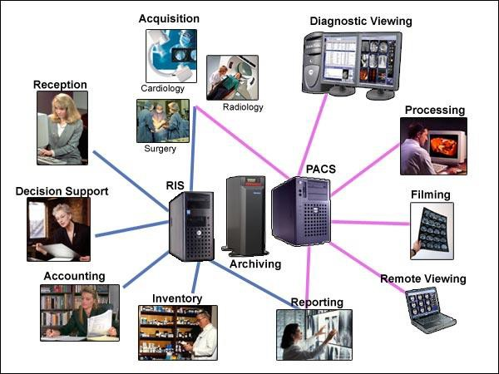
HIS/RIS Integration
24

Slide 25
Example of Workflow
Step 1: IDENTIFY – PATIENT
Step 2: VERIFY – ORDER
Step 3: BEGIN – Procedure in RIS cancel or change any exam info as necessary.
Step 4: SCAN – Perform Procedure
Step 5: STOP – Re-Verify Patient Info and edit as necessary, before sending to PACS
Step 6: SEND EXAM – to PACS
Step 7: SCAN DOC- to PACS
Step 8: CHECK – Images on PACS
Step 9: END – Procedure in RIS

Slide 26
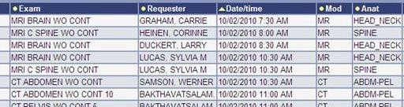
Radiology Worklist - Example

Slide 27
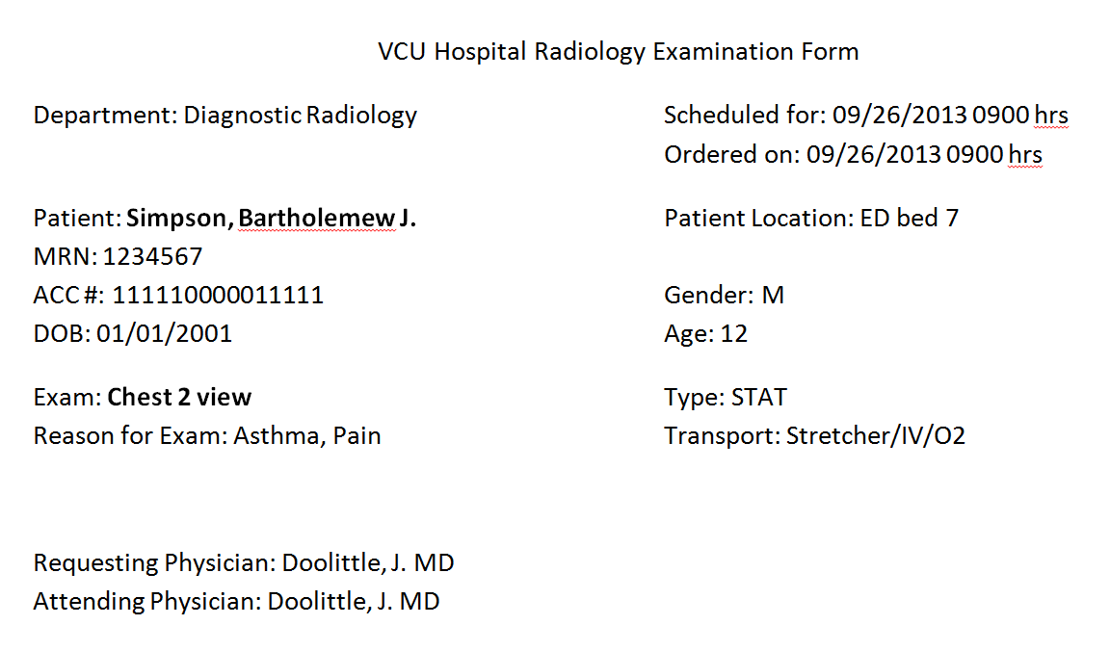
Radiology Request - Example

Slide 28
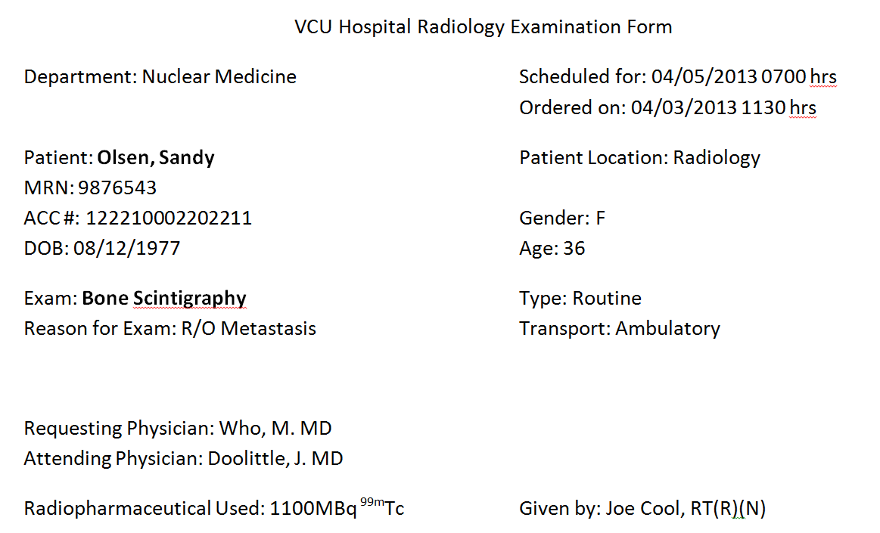
Radiology Request - Example

Slide 29
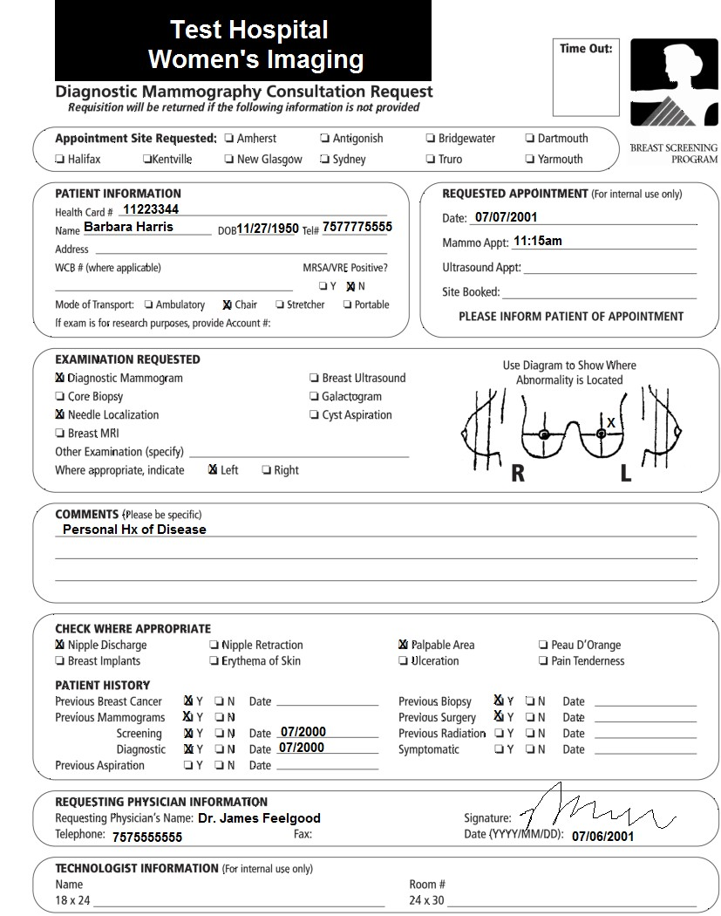
Radiology Request - Example

Slide 30

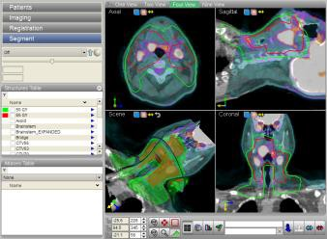
What else is in the Health Record?

Slide 31
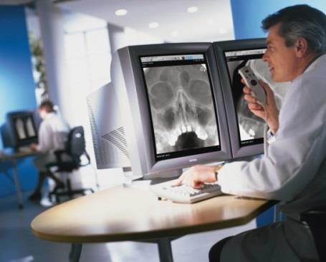
Standards
Digital Imaging and Communication in Medicine
Standards-based protocol (computer language) for exchanging and storing medical data (images and text)
around the world
HL-7
Comprehensive language framework for health information
all electronic
Gives interoperability between EMR, PACS, and other electronic platforms

Slide 32




Case - Confidentiality
RT working in private office recognizes a patient as someone she knew in high school
RT overheard co-workers discussing patient’s reason for treatment (STD) – patient did not need any radiologic exams
RT looked up patient’s info in EMR and emailed
specifics about the case to several of her friends

Slide 33

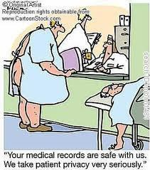
What is HIPAA?
Originally passed to help families carry health
insurance through job transitions
As of April 2003, all HCPs who transmit medical information electronically have to be HIPAA compliant
Patients have the right to privacy and confidentiality about their care, diagnosis, and medical information
HIPAA gives specific rules and regulations about privacy and security of patient personal health information

Slide 34





What is PHI?
Personal Health Information
ANY info that could identify or could be used to identify an individual
ANY health information relating to:
Past, present, or future physical or mental health or condition
Provision of healthcare
Past, present, or future payment for health care services
Verbal, Written, or Electronic

Slide 35

Security
HIPAA rules are same for EMRs as for Paper Records
Permission to Access, Use, or Disclose PHI is always determined by PURPOSE
Every time PHI accessed - must be permitted by HIPAA Authorization, Waiver, Review Preparatory to Research, Review of Decedent Information, Limited Data Set
Just because a clinician can access and run reports from
EMRs doesn’t mean they’re permitted to do so
What do you think happened in our Case?

Slide 36

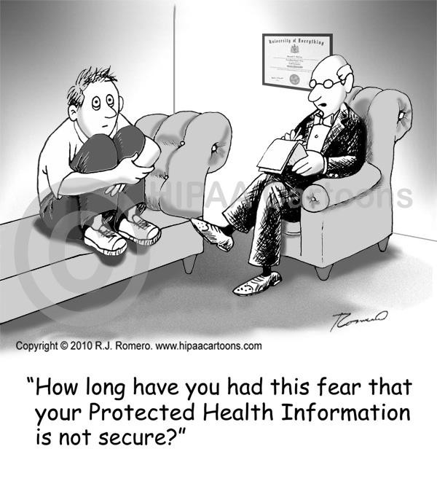
Ownership of Medical Records
Caregiver or facility owns the records
Patient has the right to the information included in the report except where prohibited by law or the patient’s medical condition.

Slide 37




Legal Aspects of Health Records
Health records are considered legal documents.
Radiologic technologists may be required to give depositions or testimony regarding information in the health record or, in the case of a radiograph, testimony regarding the procedures involved.
How do you correct an error?
The author draws a single line through the error (strikethrough),
write “ERROR,” and then record the correct information.
The individual then should date and authenticate the entry.

Slide 38
Legal Aspects of Health Records
Health records are considered to be confidential.
The original record is never left in court.
Informing patients of exam results is the physician’s responsibility, and the technologist should refer the patient to his or her physician.
HIPAA clearly outlines the confidentiality requirements of health records.

Slide 39



Medicolegal Issues with EMR
Errors lead to lawsuits!
Implementation of EMRs may increase the number of
medical malpractice suits
Raises the standard of care for practitioners and the healthcare facilities where they practice
Metadata
NO Copying/pasting
Document notes on EVERYTHING!
Thorough patient history every time!
Not just copy + paste

Slide 40


How Did They Find Out?
UCLA Medical Center
Imposed discipline actions against 13 employees who looked at Britney Spears’ medical records without permission
Analysis of EMR metadata allowed UCLA Medical Center to discover which of its employees were "snooping in“ Britney’s medical records

Slide 41
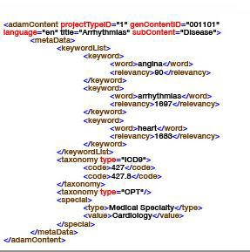
What is Metadata
Data about the data
Automatically generated computer record that certifies how an electronic document has been manipulated
Audit trail regarding PACS/EMR usage
Often without user’s knowledge
System vs Application
We will talk more about this in Medical Law

Slide 42
Performance Improvement
AKA Quality Assurance or Quality Assessment
A process that monitors and evaluates the quality of the care and services provided to patients within a health care facility
Includes many measurements
Quality improvement programs
Benchmarks

Slide 43

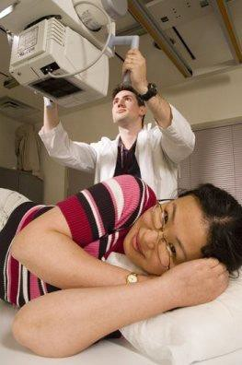
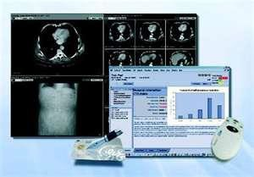
Best Practices
Think Work Flow!
Verify patient info before exam
Document notes on EVERYTHING!
Thorough patient history – not just copy + paste
If study is delayed, annotate why, when, and how long
Document everything related to contrast media!
Track procedures at actual time of service
Use lead radiographic markers instead of digital markers
Check previous exams – ethical duty!
If glitch occurs, inform admin right away!

Slide 44





































Recording Information in the Medical Record
Do
Write or type legibly
If writing, use ink; Black preferred Use correct spelling and standard abbreviations
Write accurate information, precisely and correctly Keep information concise
Begin each entry with the date and time (military) of the entry
Record the information as it occurs
Keep information confidential
Sign each entry with your name
and title
Don’t
Write in pencil
Block out or erase entries
Enter unnecessary details
Include critical comments about the patient or other health care professionals
Leave blank spaces in your notes
Use improper abbreviations
Record information for someone
Divulge information concerning the patient
Use initials when signing your
■
■
■
■
■
■
■
else
■
■
name

Slide 45

Any Questions?

