Slide 1




UNAM’s Virtual Institute for Scientific Computing and Artificial Intelligence
Prof Michael Backes
Department of Physics, Chemistry and Material Science

Slide 2
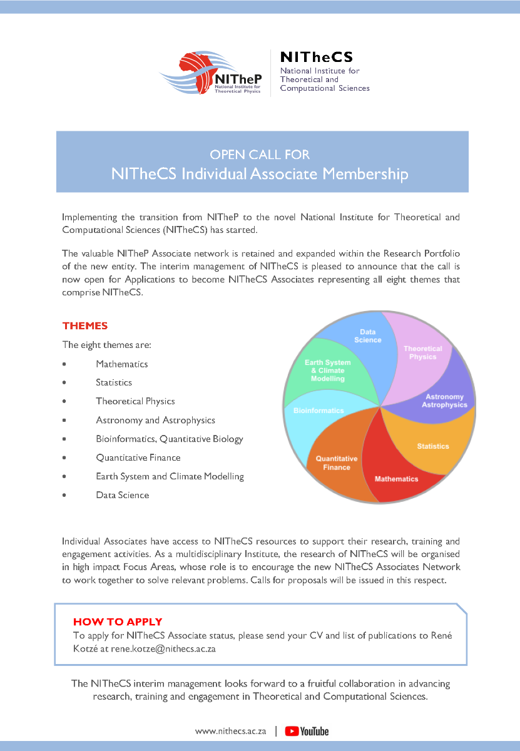
In SA: a National Institute

Slide 3
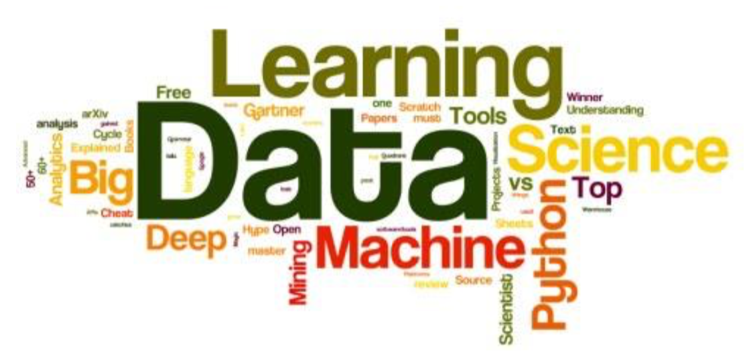
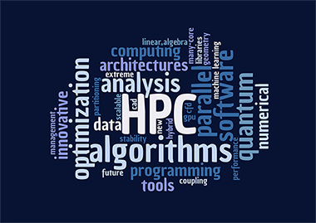
VI-SCAI
Virtual Institute for Scientific Computing
and Artificial Intelligence
Dpts. Physics, Env. Sc. & Computing
MB, R. Puente, H. Davids,
E. Kasai, A. Limbo, J. Shapopi,
R. Steenkamp, H. Katjaita
Supported by office PVC: RID
Running HPC
HPC capacity development
Astrophysics & AI research

Slide 4
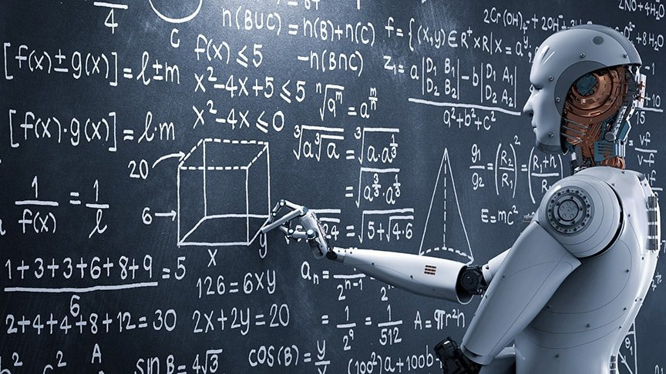
Artificial Intelligence

Slide 5
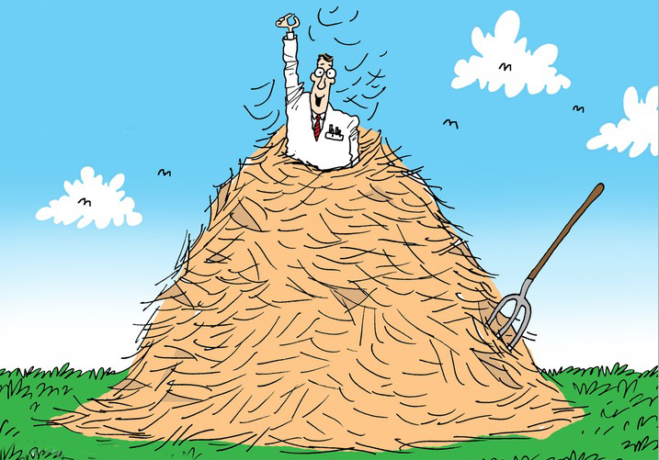
Artificial Intelligence: classification

Slide 6

Classification: ML as solution

Slide 7
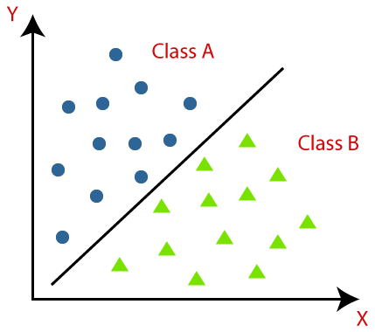
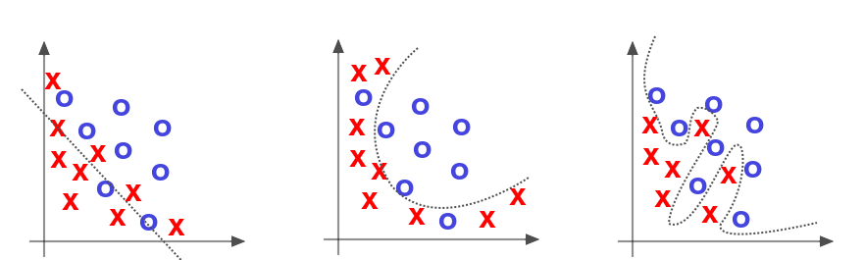
Classification Problems

Slide 8
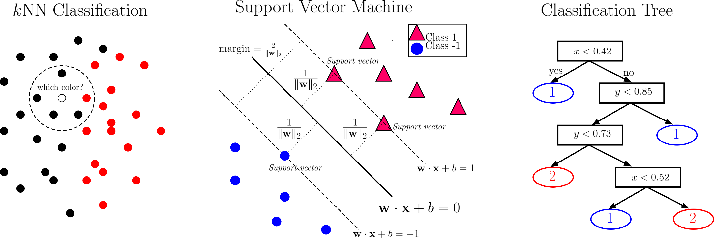
Classification: ML Algorithms

Slide 9

Any questions?

