Slide 1


Student Gadget Registration Management System
A Comprehensive Full-Stack Solution for Educational Institutions
Author
Date
Manus AI
December 2025

Slide 2


Streamlining Device Management in Education
1
Core Purpose
Manage student profiles, register personal electronic gadgets, and track device-related incidents within educational institutions.
2
Target Audience
Universities, colleges, and other educational institutions seeking centralized device management solutions.
3
Key Benefit
Centralized, efficient, and secure tracking of student-owned devices with comprehensive incident reporting.
4
Architecture
Full-stack application built with RESTful API design for seamless integration and scalability.

Slide 3





Modular Design for Comprehensive Control
Student Management
Gadget Registration
Register and maintain detailed student profiles with complete CRUD operations.
Track all registered electronic devices with detailed specifications.
• Emergency contact tracking
• Enrollment status monitoring
• Department filtering
• Serial/IMEI number tracking
• Warranty management
• Condition monitoring
Incident Reporting
Department Organization
Record and manage device-related incidents with comprehensive tracking.
Structure students and gadgets by academic department for easy management.
• Lost/stolen/damaged reports
• Status tracking
• Police report maintenance
• CRUD operations
• Department statistics
• Hierarchical filtering

Slide 4

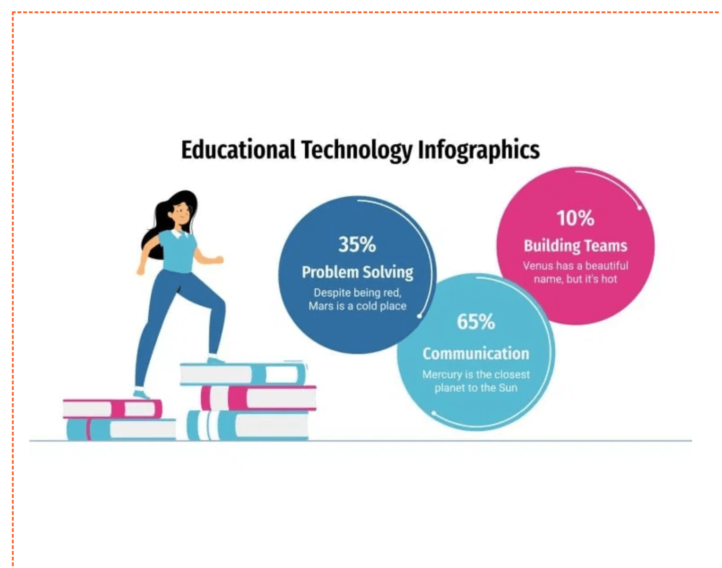
Advanced Tracking and Real-Time Analytics
1
Warranty & Insurance Tracking
Dedicated modules for managing policy details and monitoring expiry dates for comprehensive device protection.
2
Payment Records
Integration for tracking registration fees and related payments with transaction history and status monitoring.
3
Dashboard Analytics
Centralized view of key statistics including total students, gadgets, incidents, and system-wide insights.
4
Automated Alerts
Provides proactive notifications for gadgets with expiring registrations, warranties, or insurance policies.

Slide 5

Robust and Scalable Technical Stack
B
Backend
F
Frontend
Node.js
HTML5 & CSS3
Runtime environment for fast, non-blocking server operations
Semantic markup and modern styling for responsive design
Express.js
Vanilla JavaScript
Web framework for building scalable server applications and routing
Lightweight, high-performance client-side logic without frameworks
D
Database
A
API Architecture
MySQL
RESTful Design
Reliable relational database for structured data storage
Standard HTTP methods and JSON payloads for clear communication
mysql2/promise
CORS Enabled
Promise-based driver for efficient database connections and queries
Cross-origin resource sharing for secure frontend-backend integration

Slide 6

Relational Schema for Data Integrity (8 Main Tables)
DEPARTMENT
STUDENT
GADGET_CATEGORY
PK: department_code
PK: student_id
PK: category_id
department_name
first_name, last_name
category_name
faculty
email, phone_number
description
hod_name
FK: department_code
specifications
contact_email
level, enrollment_date
PAYMENT
GADGET_REGISTRATION
WARRANTY
PK: payment_id
PK: registration_id
PK: warranty_id
amount, payment_date
FK: student_id
FK: registration_id
payment_method
FK: category_id
start_date, end_date
transaction_reference
FK: payment_id
warranty_type, provider
status
device_name, brand, model
terms
serial_number, imei_number
INSURANCE_POLICY
INCIDENT_REPORT
PK: policy_id
PK: incident_id
FK: registration_id
FK: registration_id
policy_number, provider
FK: student_id
start_date, end_date
incident_date, incident_type
coverage_amount, premium
description, location
status, resolution_date

Slide 7

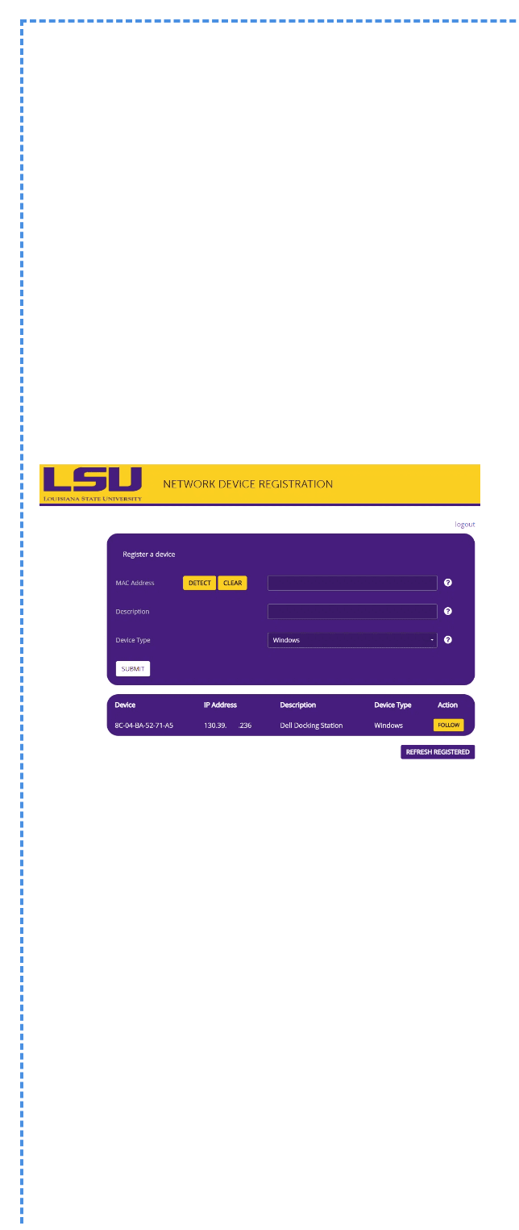
RESTful API for Core CRUD Operations
Students API (/api/students)
Gadgets API (/api/gadgets)
GET
/api/students
GET
/api/gadgets
Retrieve all students
Retrieve all registrations
POST
/api/students
POST
/api/gadgets
Create new student record
Register new gadget
GET
/api/students/:id
GET
/api/gadgets/:id
Retrieve student by ID
Retrieve gadget by ID
PUT
/api/students/:id
PUT
/api/gadgets/:id
Update student record
Update gadget registration
DEL
/api/students/:id
DEL
/api/gadgets/:id
Delete student record
Delete gadget registration
GET
/api/students/dept/:code
GET
/api/gadgets/student/:id
Filter students by department
Get gadgets by student

Slide 8

Getting Started in 4 Simple Steps
Prerequisites
Installation Steps
✓
Node.js
1
Install Dependencies
v14 or higher
✓
npm
Navigate to project root and run:
Bundled with Node.js
npm install
✓
MySQL Server
v5.7 or higher
Installs: express, cors, mysql2/promise
2
Setup MySQL Database
a)
Open MySQL Workbench or command line
b)
Execute sql script.txt file
c)
Creates student_gadget_system database

Slide 9

Configuration and Launch
3
Configure Database Connection
Edit config/database.js and set your MySQL password:
const mysql = require('mysql2/promise');
const pool = mysql.createPool({
host: 'localhost',
user: 'root',
password: 'YOUR_MYSQL_PASSWORD', // ← Replace with your password
database: 'student_gadget_system',
port: 3306
});
4
Start the Server
Run the following command:
npm start
Expected output:
Server running on http://localhost:3000
Access Application Pages:
Home:
http://localhost:3000/
Dashboard:
http://localhost:3000/dashboard
Students:
http://localhost:3000/students
Gadgets:
http://localhost:3000/gadgets
Incidents:
http://localhost:3000/incidents

Slide 10

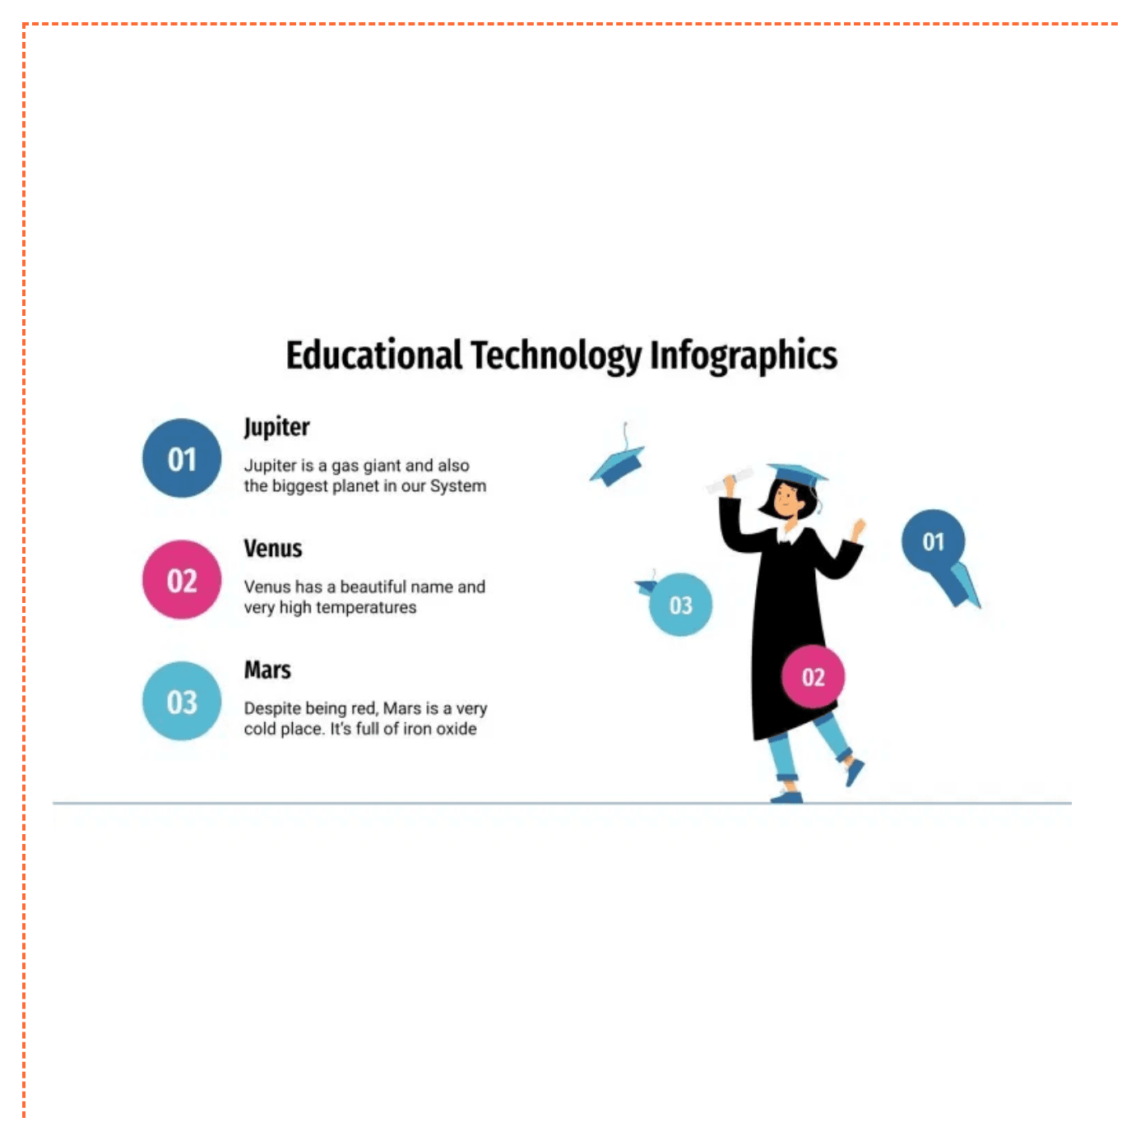
Troubleshooting and Support
Issue
Port 3000 Already in Use
Solution
Change the PORT variable in server.js or set the PORT environment variable to an available port number.
Issue
MySQL Connection Error
Solution
Verify MySQL server is running, check config/database.js for correct user and password credentials, and ensure the student_gadget_system database was created using sql script.txt.
Issue
API Returns 404 Error
Solution
Check the URL against the API Endpoints Reference documentation and verify that the server is running and accessible on localhost:3000.
Maintenance Best Practices
•
Clear, modular file structure for easy code maintenance
•
Comprehensive error handling in server.js
•
Regular database backups and monitoring
•
Keep dependencies updated for security

Slide 11


Next Steps for System Evolution
1
User Authentication & Authorization
Implement secure login system with role-based access control for Admin, Staff, and Student roles.
2
Email Notifications
Automated alerts for expiring warranties, insurance policies, and important system events.
3
Report Export Functionality
Export data tables and reports to PDF and Excel formats for administrative documentation.
4
Advanced Search & Filtering
Sophisticated search capabilities with multi-criteria filtering across all data tables.
5
Mobile Companion Application
Native mobile app for iOS and Android enabling on-the-go access and incident reporting.

Slide 12

SGRMS: Ready for Deployment
✓
📋
🔧
Complete
Documented
Extensible
Full-stack application with all core features implemented and tested
Comprehensive documentation and quick-start guide available for users
Modular architecture ready for future enhancements and integrations
Next Steps
1
2
3
Review Documentation
Begin Testing
Provide Feedback
The Student Gadget Registration Management System is ready for integration, deployment, and production use. All CRUD operations are functional, all pages are interactive, and all API endpoints are available.

