Slide 1

B.M.S. College of
Engineering
Bio Inspired Algorithm
23DS7BSBIO
Air Quality Index Prediction Using Random Forest Optimized with Particle Swarm Optimization (PSO)
Hemanth Raj MV (1BM23CD022)
Kushal KV (1BM23CD030)
Rohan R (1BM23CD051)
Shakthi Jashwanth C H (1BM23CD072)
Prof. Manoj Kumar S
Assistant Professor
Department of CSE(Data Science)
BMSCE, Bengaluru

Slide 2
Table of Contents
1.
Introduction to optimization problems
2.
What are nature inspired algorithms
3.
Problem statement
4.
Implementation and results
5.
Performance metrics and benchmarks
6.
Advantages and limitations
7.
References

Slide 3
1 .Introduction to Optimization Problems
What is Optimization?
  Finding the best solution from all possible solutions
  Minimizing or maximizing an objective function
  Subject to constraints and limitations
Optimization in this Project:
  Objective: minimize next-day AQI forecast error (RMSE)
  Discrete: number of trees, tree depth, split and leaf sizes
  Continuous: fraction of features and of days used by each tree
  Binary: include or exclude each of the 32 input features
  Mixed 38-dimensional search space with no gradients available

Slide 4
2 .Nature Inspired Algorithms
Definition:
  Optimization algorithms inspired by nature
  Mimic biological, physical or social processes
  Metaheuristics for hard, gradient-free problems
Popular Nature-Inspired Algorithms:
  Genetic Algorithm: natural selection
  Particle Swarm Optimization: bird flocking
  Ant Colony Optimization: ant foraging
  Grey Wolf Optimizer: pack hunting
  Differential Evolution: vector differences
Why PSO for this Project?
  Each particle remembers its own best position
  The swarm shares the global best position
  Natural fit for continuous, mixed search spaces
  Few settings to tune: w, c1, c2, swarm size
  Converges quickly with small evaluation budgets
Inspiration:
  Kennedy and Eberhart (1995): bird flocks find food by combining memory with social learning

Slide 5
3 .Problem Statement
Research Challenge:
  Delhi's AQI exceeded 300 (Very Poor or worse) on 22.7% of days in 2015–2026
  Next-day forecasts give time for health alerts and action
  Random Forest accuracy depends on its hyperparameters and inputs
  Manual tuning is time-consuming, biased and rarely optimal
Specific Problem:
  Forecast Delhi's next-day CPCB AQI from AQI history and weather
  Use PSO to tune 6 Random Forest hyperparameters and select features
  Beat persistence and default Random Forest baselines
  Evaluate honestly on unseen data (January 2024 – October 2026)

Slide 6
4 .Datasets and its Preprocessing
Dataset:
  CPCB daily AQI bulletins for Delhi
  ERA5 daily weather (Open-Meteo API)
  Period: May 2015 – Oct 2026 (4,170 days)
  Training: 2015–2023 (3,115 days)
  Testing: 2024–2026 (1,026 days)
Preprocessing:
  Forward fill only, so no future data leaks
  Target AQI never imputed (26 days dropped)
  Chronological split, no shuffling
Features (32):
  AQI today and lags of 1, 2, 3 and 7 days
  Rolling means of 3, 7, 14 and 30 days
  Temperature, humidity, dew point, pressure
  Rain, 3-day rain, wind speed and direction
  Solar radiation and day-on-day changes
  Cyclic day-of-year and day-of-week
Target:
  Next day's official CPCB AQI

Slide 7
4 .Implementation and Results
System Architecture:
  CPCB bulletins + ERA5 weather data
  Leakage-free feature engineering
  PSO framework built from scratch
  Random Forest with walk-forward validation
  Evaluation, statistics and visualization
Particle Encoding (38 dimensions):
  Number of trees: [50–300]
  Maximum depth: [3–30]
  Min samples split / leaf: [2–20] / [1–15]
  Feature / sample fraction: [0.1–1] / [0.4–1]
  32 feature switches: used if value ≥ 0.5
PSO Configuration:
  Swarm size: 12 particles
  Iterations: 25 (312 evaluations per run)
  Inertia weight: 0.9 → 0.4 (linear decrease)
  Cognitive and social: c1 = c2 = 1.5
  Velocity clamp: 0.2 per dimension
  Boundary handling: reflection
  Fitness: mean RMSE over 5 time-ordered folds
  Independent runs: 5 seeds

Slide 8
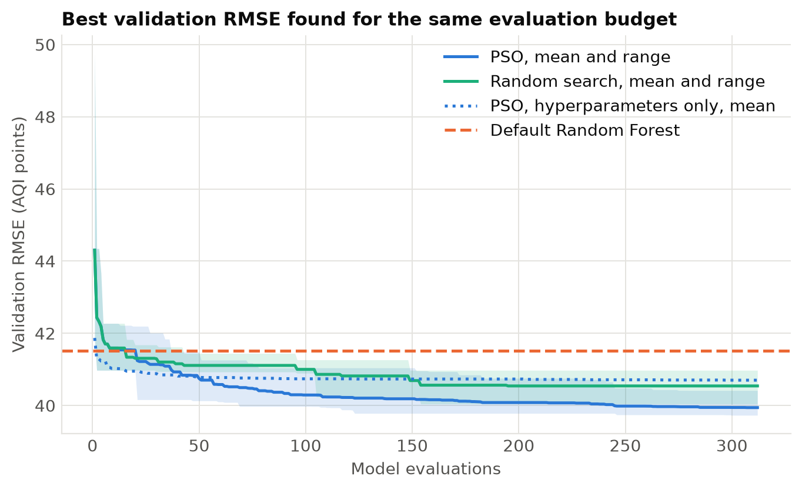
4 .Implementation and Results
PSO Operators:
  Velocity: v = w·v + c1·r1·(pbest − x) + c2·r2·(gbest − x)
  Clamp velocity to ±0.2
  Position: x = x + v, reflected at the walls
  Update personal and global bests
Search Results:
  Validation RMSE: 41.52 → 39.73 (4.3% lower)
  Kept 14 of 32 features
  Best: 224 trees, depth 18, leaf 2
  PSO beat random search: 39.94 vs 40.54
Best validation RMSE for the same 312-evaluation budget: PSO (blue) vs random search (green)

Slide 9
4 .Implementation and Results
Model (test: Jan 2024 – Oct 2026) | RMSE | MAE | R²
Persistence (tomorrow = today) | 40.21 | 28.97 | 0.832
Default Random Forest | 33.85 | 25.38 | 0.881
PSO RF (hyperparameters only) | 33.57 | 25.14 | 0.883
PSO RF (hyperparameters + features) | 33.77 | 25.15 | 0.882
Ridge regression (untuned) | 33.45 | 25.27 | 0.884
Key Results:
  16.0% lower RMSE than persistence (significant, p < 0.001)
  Mean of the 5 PSO runs: RMSE 33.47, 1.0% below the default Random Forest
  Selected model's gain over default RF is small (0.25%) and not significant (p = 0.76)
  Untuned ridge regression performs about as well: the features matter most

Slide 10
5 .Performance Metrics and Benchmarks
Evaluation Metrics Used:
  RMSE, MAE, MAPE and R²
  CPCB category accuracy, precision, recall, F1
  AUC for Very Poor or worse days (AQI > 300)
  Block bootstrap, paired t-test, Wilcoxon
Convergence Analysis:
  Mean global best: 41.22 → 40.20 → 39.94
  (iterations 1, 10 and 25)
  Swarm diversity: 1.28 → 0.19 (healthy convergence)
  About 20 minutes per PSO run
Benchmark Functions (6-D):
  Sphere: 1.9 × 10⁻¹⁷ (solved to machine precision)
  Rastrigin: 2.99 (multi-modal)
  Rosenbrock: 1.10 (narrow valley)
Final Model on Test Data:
  R² = 0.882, MAE = 25.15 AQI points
  Alert AUC (AQI > 300) = 0.986
  Category accuracy = 71.4%
  Category errors: 292 of 293 only one category off

Slide 11
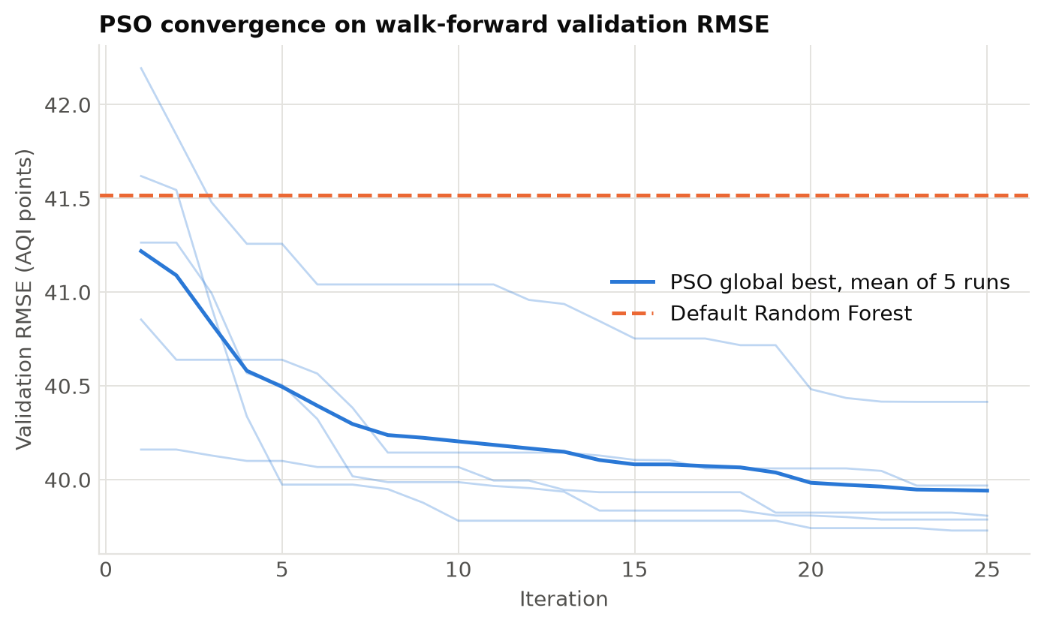
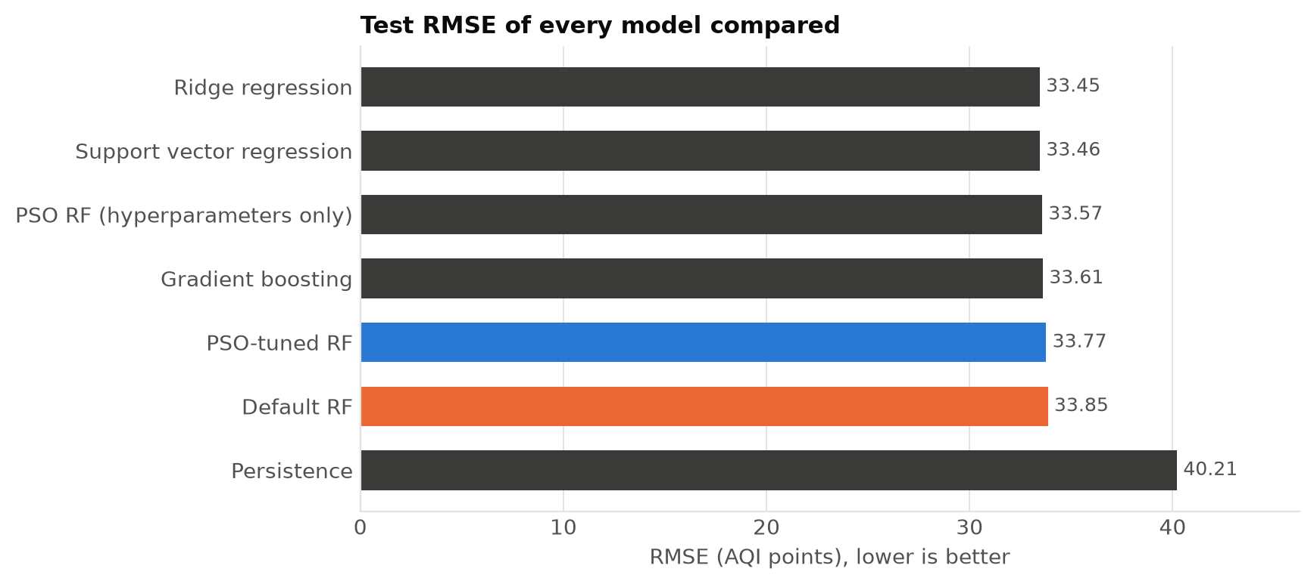
5 .Performance Metrics and Benchmarks
PSO convergence: validation RMSE over 25 iterations (5 runs)
Test RMSE of every model (lower is better)
Every PSO run passed the default forest within the first iteration and kept improving to iteration 22–25

Slide 12
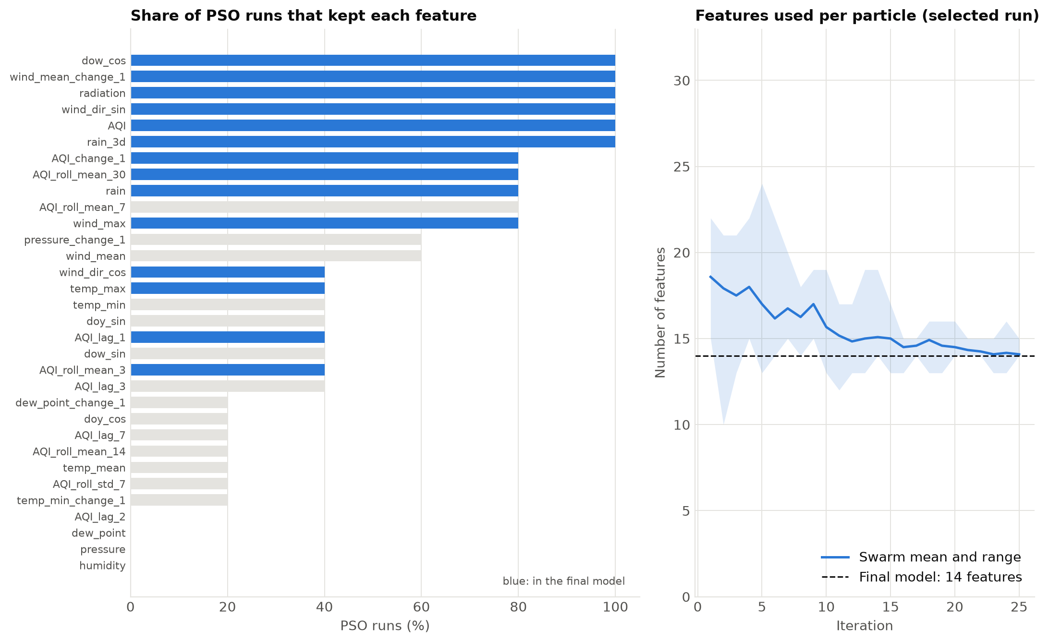
5 .Performance Metrics and Benchmarks
Feature Selection by PSO:
  Always kept: today's AQI, rain, solar radiation, wind
  Never kept: humidity, pressure, dew point
  Runs kept 12 to 18 of 32 features
  Physically sensible: wind disperses, rain washes out pollution

Slide 13
6 .Advantages
Advantages:
  Automation: tunes 6 hyperparameters and 32 feature choices together
  Better search: beat random search with the same budget
  Simpler model: 14 of 32 features, physically meaningful
  Strong forecasts: 16% better than persistence, R² = 0.882
  Reliable alerts: AUC 0.986 for Very Poor or worse days
  Robustness: consistent across 5 independent runs
  Reproducible: fixed seeds and 16 automated tests
  Leakage-free: trained on the past, tested on unseen 2024–2026 data

Slide 14
6 .Limitations
Limitations:
  Small test gain: 0.25% over default RF, not significant (p = 0.76)
  Overfitting risk: the 38-dimension search partly fitted its validation folds
  Linear models competitive: ridge regression RMSE 33.45
  Reactive forecasts: sharp AQI jumps are followed a day late
  Bias: over-predicts by about 8 AQI points (cleaner recent years)
  Rare events: 10 of 27 Severe days caught
  Computational cost: about 20 minutes per PSO run
  Single city: results apply to Delhi

Slide 15
7 .References
[1] J. Kennedy and R. Eberhart, “Particle swarm optimization,” Proc. IEEE ICNN, pp. 1942–1948, 1995.
[2] Y. Shi and R. Eberhart, “A modified particle swarm optimizer,” Proc. IEEE ICEC, pp. 69–73, 1998.
[3] L. Breiman, “Random forests,” Machine Learning, vol. 45, no. 1, pp. 5–32, 2001.
[4] J. Bergstra and Y. Bengio, “Random search for hyper-parameter optimization,” JMLR, vol. 13, pp. 281–305, 2012.
[5] P. Probst, M. N. Wright and A.-L. Boulesteix, “Hyperparameters and tuning strategies for random forest,” WIREs DMKD, vol. 9, no. 3, 2019.
[6] Central Pollution Control Board, National Air Quality Index, CUPS/82/2014-15, New Delhi, 2014.
[7] H. Hersbach et al., “The ERA5 global reanalysis,” Q. J. R. Meteorol. Soc., vol. 146, pp. 1999–2049, 2020.
[8] UrbanEmissions.info, AQI_bulletins: daily CPCB AQI bulletins, github.com/urbanemissions-info/AQI_bulletins.

Slide 16
THANK YOU

