Slide 1

Network Congestion Analysis in Campus WiFi Systems
Data-Driven Performance Optimization
Joonmoni Kakoty (CSD25009)
Muhammad Shaqil Shaheen (CSD25004)

Slide 2
Abstract
Campus WiFi is essential for academic and administrative tasks
Study analyzes real-world network data
Uses:
Data preprocessing
Visualization
Machine learning
Goal: Improve performance using data-driven insights

Slide 3
Problem Statement
Frequent WiFi issues across campus:
Slow speeds
High latency
Disconnections
Root Causes:
High device density
Uneven load distribution
Lack of monitoring systems

Slide 4
Objectives
Analyze network performance
Identify congestion patterns
Evaluate influencing factors
Suggest optimization strategies

Slide 5
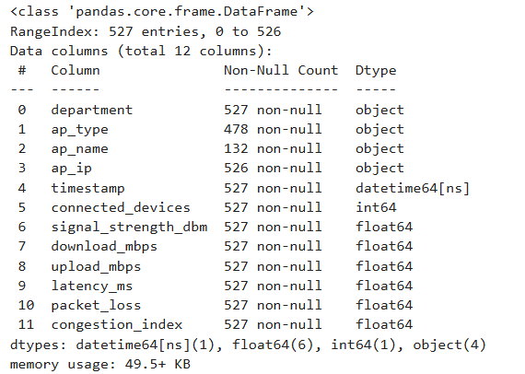
Dataset Description
Type: CSV (Structured Data)
Size: ~526 rows × 12 columns
Key Features:
Department / Hostel
Connected Devices
Speed (Download/Upload)
Latency, Packet Loss
Signal Strength
Congestion Index

Slide 6
Data Preprocessing
Removed duplicates
Handled missing values:
Median & Mean
Converted timestamp → datetime
Cleaned department names

Slide 7
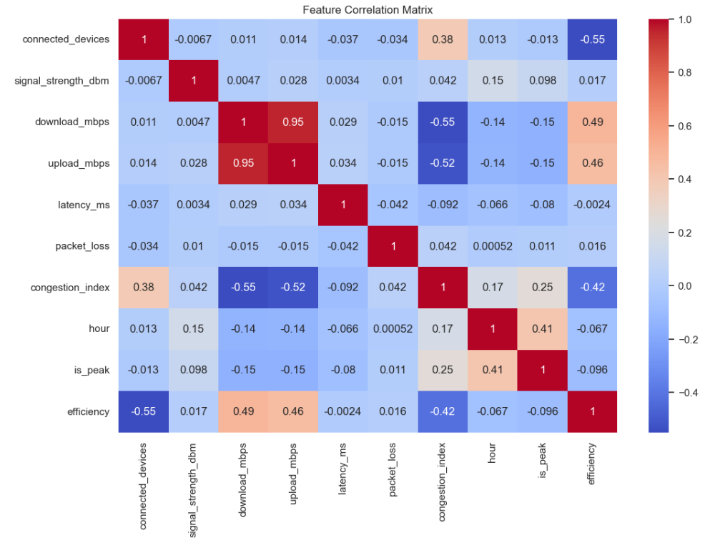
Feature Engineering
Hour of Day
Day of Week
Peak vs Non-Peak
Efficiency = Speed / Devices
Congestion Level (Low/Medium/High)

Slide 8
Data Classification
Academic Locations (Departments)
Residential Locations (Hostels)
New Fields:
Location Type
Department Name
Hostel Name

Slide 9
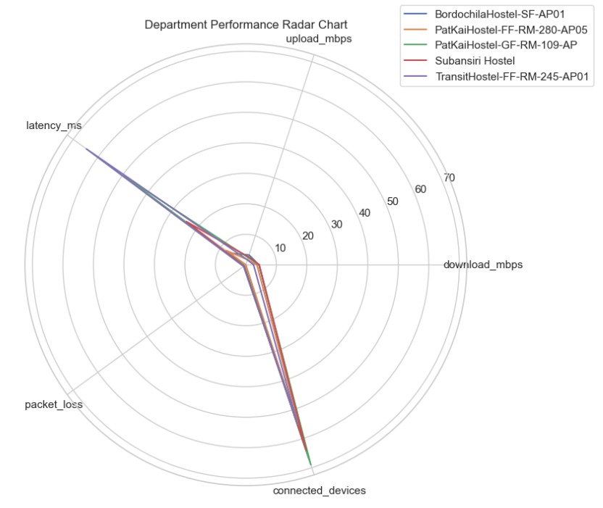
Exploratory Data Analysis (EDA)
Scatter Plots
Heatmaps
Line Charts
Boxplots & Violin Plots
Radar Charts
Bubble Charts
3D Visualization

Slide 10
Key Observations
More devices → Lower speed
Peak hours → High congestion
Latency & packet loss increase with congestion
Some locations consistently underperform

Slide 11
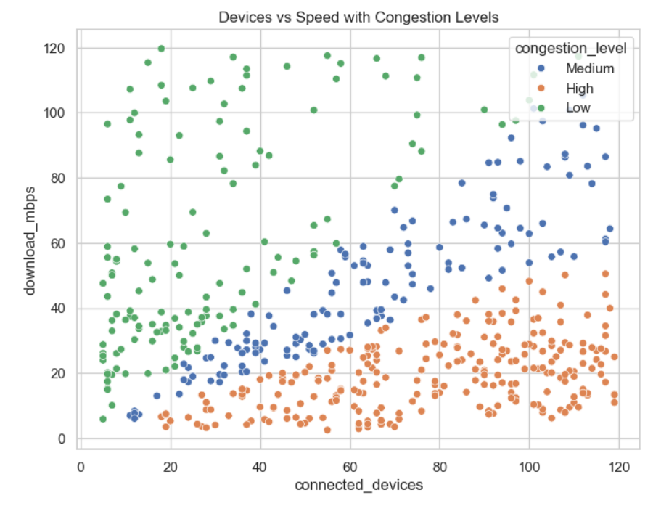
Scatter Plot Insight
Strong negative correlation:
Devices ↑ → Speed ↓
Shows network overload points

Slide 12
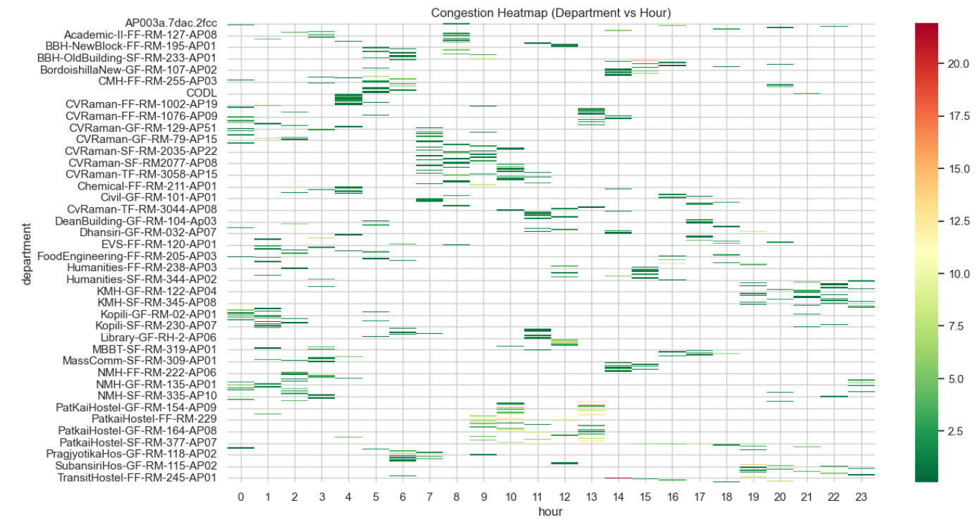
Heatmap & Time Analysis
Peak congestion: 9 AM – 6 PM
Some departments always congested
Shows time + location dependency

Slide 13
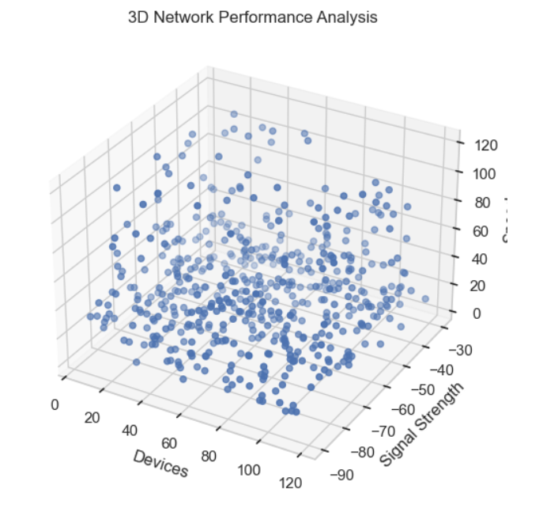
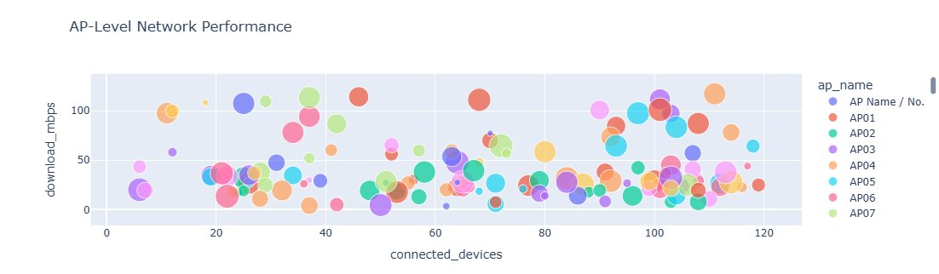
Advanced Visual Insights
Radar → Multi-metric comparison
Bubble → Latency impact
3D Plot → Multi-variable interaction
Bokeh → Interactive exploration

Slide 14
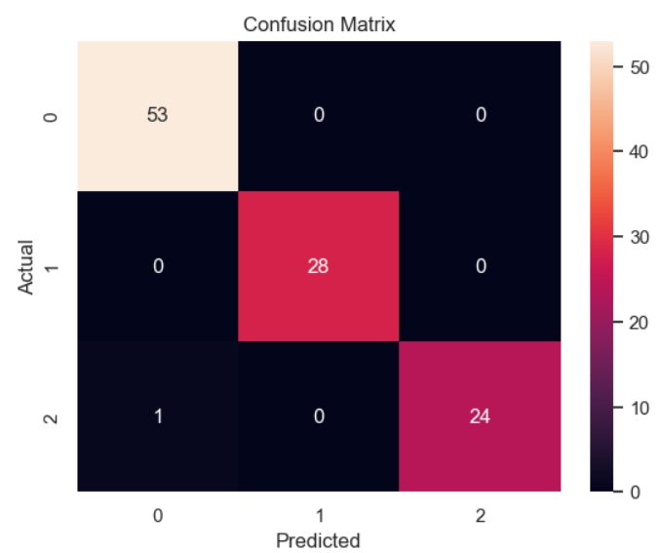
Machine Learning Model
Model: Random Forest Classifier
Predicts:
Congestion Level
Important Features:
Connected devices
Latency
Efficiency

Slide 15
Key Insights
Device count is the primary factor affecting performance
Peak hours significantly increase congestion
Some areas consistently underperform
Signal strength has secondary influence
Latency and packet loss rise sharply during congestion

Slide 16
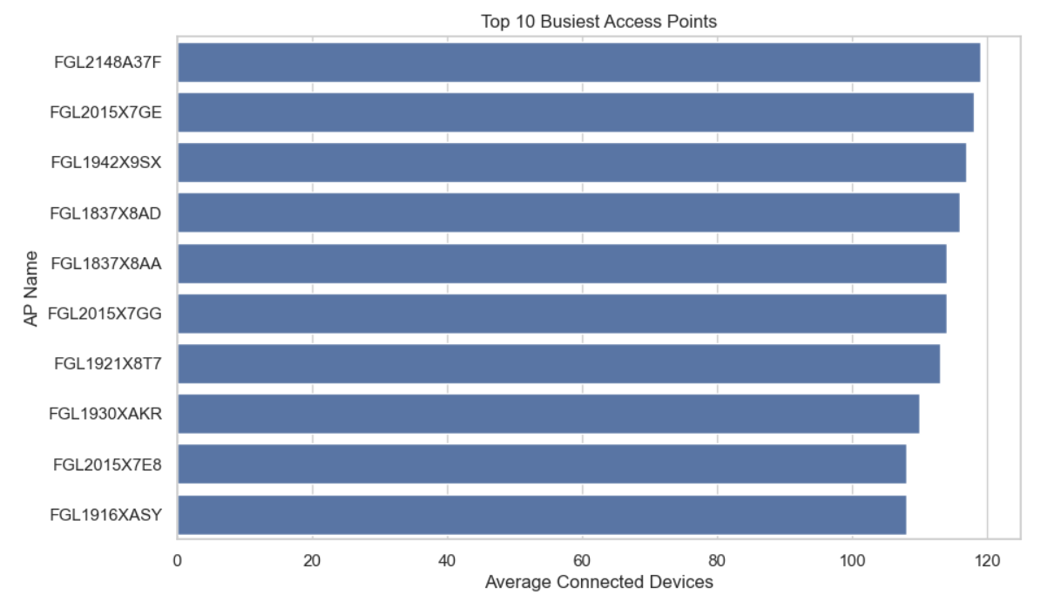
Top & Bottom Performing Areas
Top Performing:
Low device load
Stable speeds
Worst Performing:
High-density hostels
Overloaded departments

Slide 17
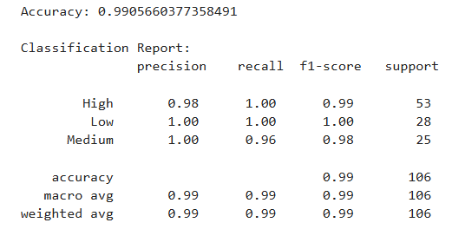
Empathy (Stakeholders)
Students: Learning disruption
Faculty: Teaching impact
IT Staff: Management challenges
Management: Efficiency issues

Slide 18
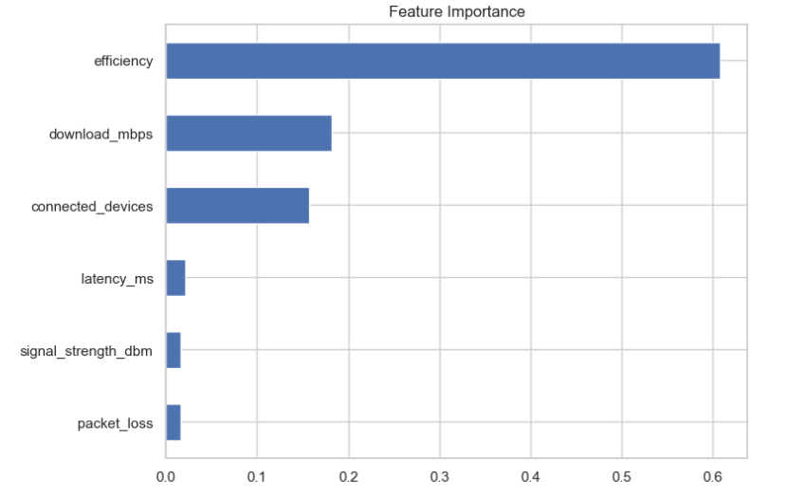
Critical & Divergent Thinking
Critical Thinking:
Congestion ≠ only time-based
Signal strength ≠ performance
Divergent Thinking:
Used:
ML models
Clustering
Visualization

Slide 19
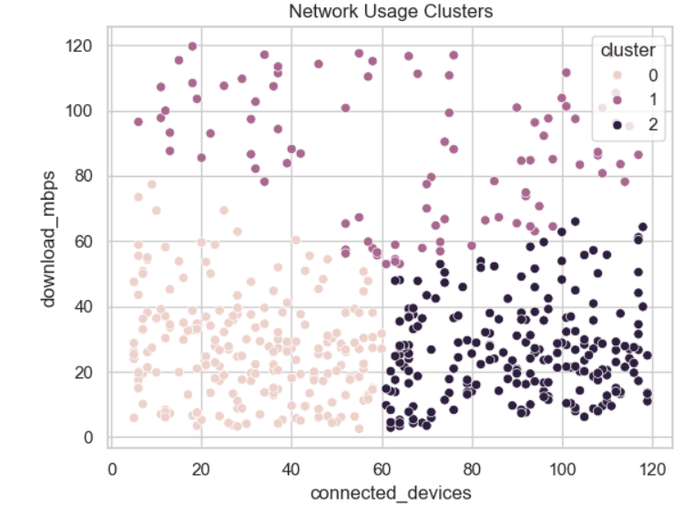
Recommendations
✅ Immediate:
Add Access Points
Optimize bandwidth
⚙️ Mid-Term:
Load balancing
Monitoring dashboards
🚀 Long-Term:
AI-based prediction
Smart WiFi systems

Slide 20
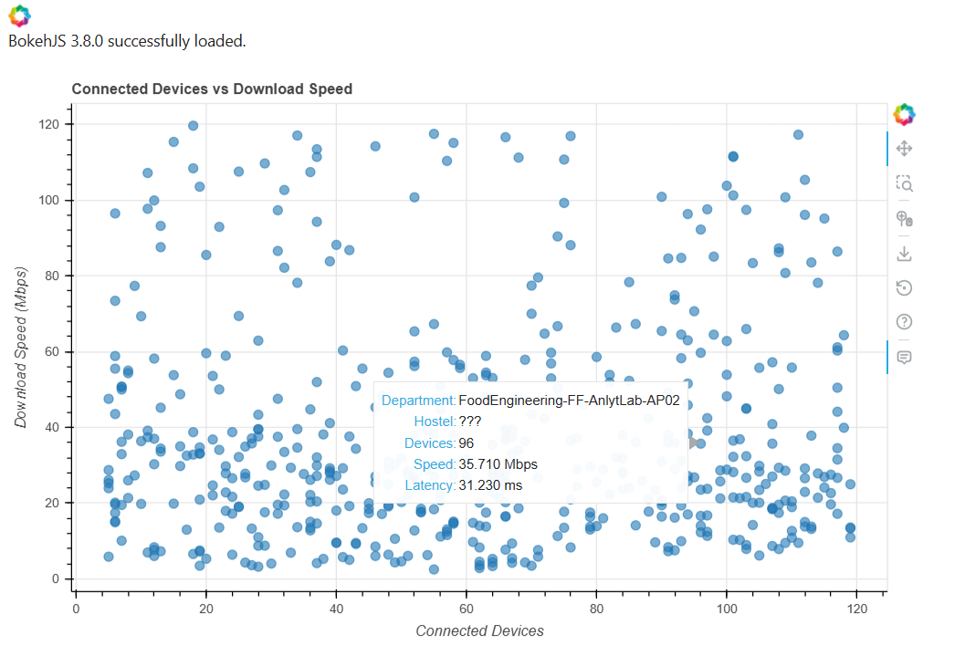
Future Scope
Real-time data integration
Predictive dashboards
IoT-based optimization
Automated network control

Slide 21
Conclusion
Device density + peak time → main causes
Data-driven approach improves decisions
Visualization + ML gives deep insights
This project demonstrates how data analytics and machine learning can transform campus WiFi systems into efficient, scalable, and intelligent infrastructures.
THANK YOU

