Slide 1

Features of Social Media Posts That Drive Higher Engagement
Sharon Smith CSCI 5010: Programming for Data Analytics Instructor: Dr. Ahmad Al Doulat
East Tennessee State University
Notes:
Hi everyone, my name is Sharon Smith, and today I’ll be presenting my project titled ‘Features of Social Media Posts That Drive Higher Engagement.’ This project explores what actually drives engagement across major social media platforms using real data.

Slide 2
Introduction & Motivation
Social media platforms host millions of posts daily, but engagement levels vary widely across content (CNBC, 2023)
Problem Statement: Creators and brands lack consistent, data driven guidance on which post features, such as content type, hashtags, platform and region, reliably increase engagement across social media platforms, even though research shows that these factors strongly influence user engagement. (Islam et al., 2020: Wang & Sun 2022)
Importance: Understanding these engagement drivers can help creators, businesses, and marketers make better content strategy decisions, improve reach, and invest resources more effectively.
This project analyzes how content type, platform, hashtags, and region relate to engagement in viral posts.
Goal: Identify consistent patterns that explain what makes certain posts perform better than others across major platforms.
Notes:
Brands and creators invest time and money into social media, but most of the time they’re guessing what will perform well.
Even though engagement is influenced by things like content type, platform, hashtags, and region, there's still no clear, consistent guidance across platforms. What performs well on Instagram may not perform well on TikTok or Twitter, and regional differences make it even more complicated.
My goal is simple: 👉 Use data to identify which post features genuinely drive higher engagement 👉 Compare patterns across platforms and regions 👉 And give clearer insights that people can actually use when planning content or ads.”**

Slide 3
Literature Review
Dataset Comparison
Prior Studies
Gap
Research one platform at a time, such as TikTok short videos (Feng et al., 2020), Instagram posts (Benaich & Hogarth., 2021)
Engagement is often studied using limited features
Prior datasets rarely combine multiple platforms in one place.
Studies typically examine only one feature
Few datasets include platform, content type, hashtags & engagement
My dataset provides 5,000 posts across multiple platforms.
Multiple content formats, hashtags & regions for a broader, cross-platform analysis that recent research has not combined in one place
Notes:
“A lot of previous studies have tried to explain engagement, but they usually focus on just one platform or one type of feature. For example, some look only at Instagram posts or only at hashtags.
The gap is that we don’t have a straightforward cross-platform view that looks at multiple features together — content type, platform, hashtags, and region — all in one dataset. There isn’t much accessible research showing how these features behave side-by-side across TikTok, Instagram, YouTube, and Twitter.
So this project fills that gap by combining all four platforms into one analysis and comparing engagement patterns across them

Slide 4
Dataset Overview
Dataset Description
Attributes
Justification
Post_ID: Unique identifier
Post_Date: Date posted
Platforms
Hashtag: Trending hashtag
Content_Type: Reel, video, post, tweet, shorts, livestream
Region: country it gained traction
Views, Likes, Comments, Shares: Engagement fields
Engagement_Level: Low/ Medium/High
Source: Viral Social Media Trends & Engagement Analysis (Soundankar, 2024)
Number of columns:11 Size: 5,000 viral posts Time Range: 2022–2023
Platforms: TikTok, Instagram, YouTube, Twitter
Multi-platform content and cross-platform media formats
Core engagement metrics to calculate engagement rate
Variation (hashtags, platforms, regions, content types) to answer your research questions
Clean structure allows straightforward EAD analysis
Notes:
The dataset I used comes from Kaggle and contains 5,000 viral posts across TikTok, Instagram, YouTube, and Twitter.
It includes: • Post platform • Content type (like video, shorts, reels, posts, tweets, livestreams) • Hashtag used • Region where the post gained traction • Engagement metrics — views, likes, comments, shares • And the post date
The dataset is clean, publicly available, and has a mix of numeric and categorical fields that make it suitable for exploratory data analysis.
The only issue was that content types didn’t always match the platform — for example, some YouTube rows were labeled as ‘tweet.’ I fixed that before analysis

Slide 5
Methodology
Data Cleaning
Feature Engineering
Analysis Approach
(Excel & Python: Pandas)
(Pandas & NumPy)
(Pandas, NumPy, Seaborn & Matplotlib)
Recoded content_types into 5 clear categories: Short-form video, Long-form video, Image post, Text post, Live stream
Separated categorical and numeric columns.
Missing values, duplicates, and inconsistencies
Standardized month names and removed unnecessary columns.
Created Engagement = Likes + Comments + Shares. (Islam et al., 2020: Wang & Sun 2022)
Calculated Engagement Rate (%) = (Engagement ÷ Views) × 100. (Islam et al)
Converted Post_Date to datetime and extracted Month and Year.
Merged cleaned categorical and numeric datasets into a single dataset.
Ran descriptive statistics on categorical and numeric fields
Used groupby to compute average engagement rate across: Content Type, Hashtags, Platform × Content Type, Month, Region
Generated bar charts for each research question
Notes:
For the methodology, I started by correcting the major content-type mismatches in Excel because Python’s replace function caused missing values. Once the structure was clean, I moved everything into Python.
Using Pandas, I inspected the dataset, cleaned the text columns, converted dates, and removed fields I didn’t need. Pandas relies on NumPy internally, so all my numeric calculations — like computing Engagement and Engagement Rate — were handled efficiently in the background.
I created two important metrics for the analysis. The first is Engagement, which is simply the total interactions on a post — likes, comments, and shares. The second is Engagement Rate, which shows how effective the post was by dividing total engagement by the number of views. This formula is widely used in social media analytics research, so it allowed me to compare posts fairly across platforms.Then, I used groupby operations to compare engagement by content type, platform, hashtag, and region. And finally, Seaborn and Matplotlib allowed me to visualize these patterns clearly. Everything was done in a Jupyter Notebook so the work is fully reproducible.

Slide 6
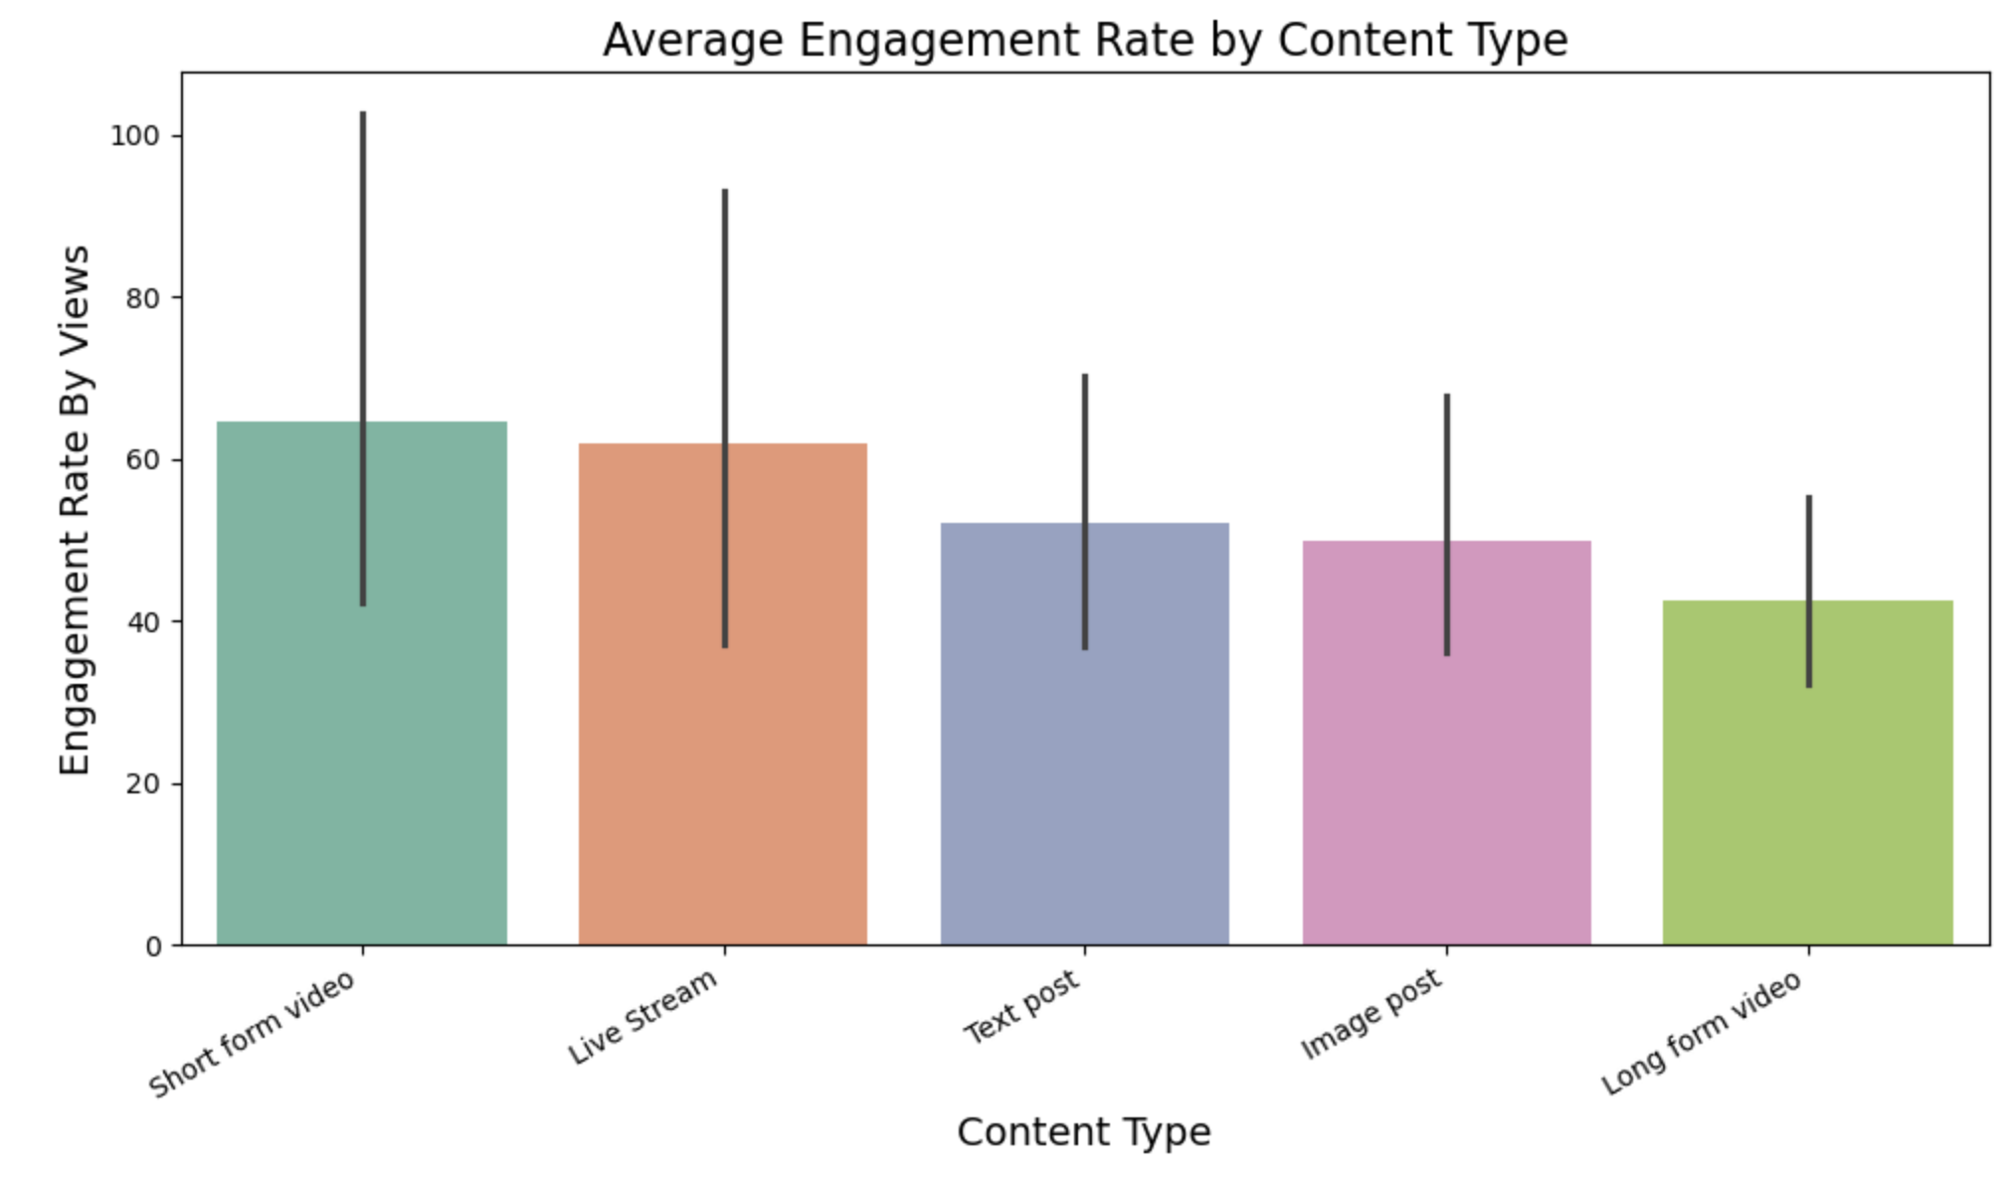
Results & Interpretation
RQ1: Which content types generate the highest engagement?
Results:
Short-form video has the highest average engagement rate across
Live stream has the second highest engagement rate
Long-form video shows the lowest engagement rate.
Image posts and text posts fall in the middle but still perform lower than videos.
Text posts have moderate engagement overall.
Interpretation:
Short videos clearly drive the strongest audience interaction.
Users prefer quick, high-impact content instead of long videos or static posts.

Slide 7
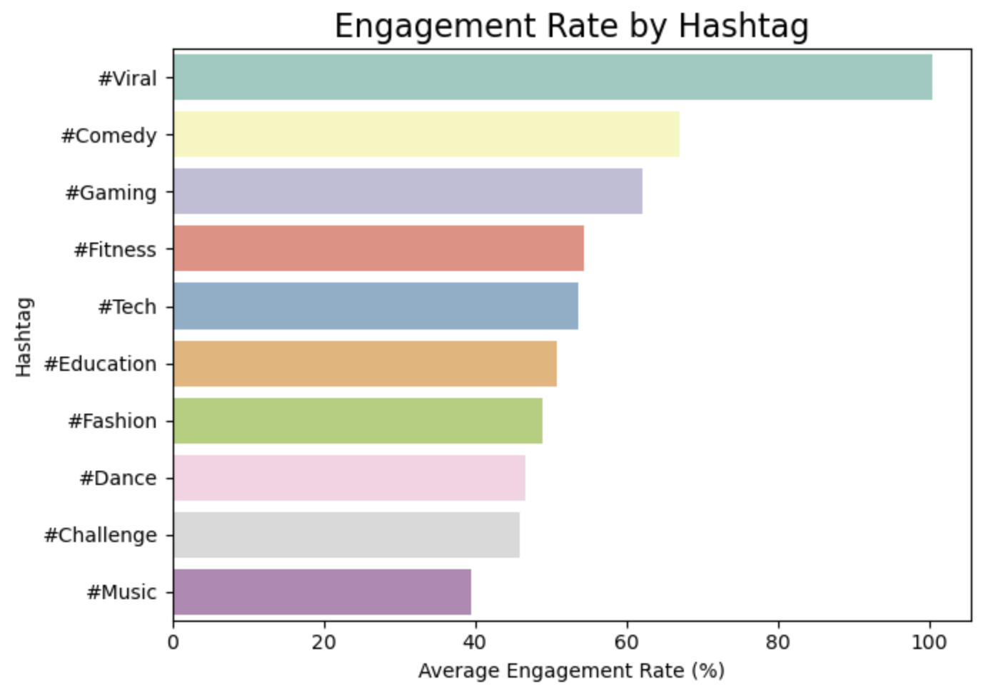
Results & Interpretation
RQ2: How do hashtags impact engagement rate?
Results (Findings):
#Viral has the highest engagement rate.
#Music has the lowest.
Other hashtags (e.g., #Education, #Comedy, #Tech) stayed in the middle range.
Interpretation:
Trending hashtags don’t automatically increase engagement. #Viral works well because it tends to appear on already engaging short-form videos. Topic-based hashtags like #Music may attract views but not active interaction.

Slide 8
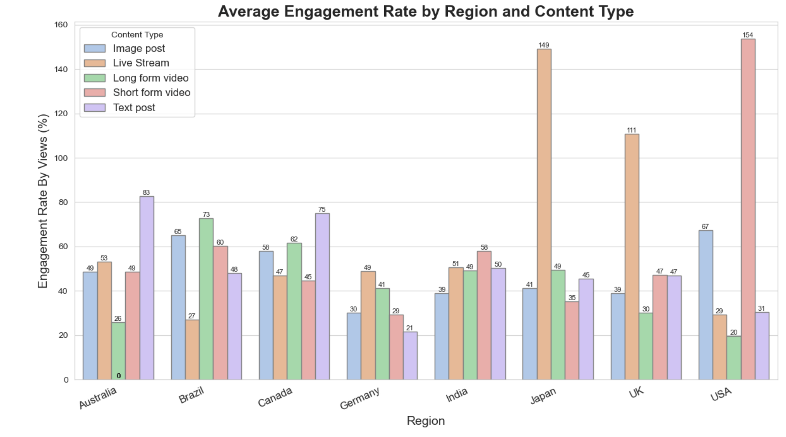
Results & Interpretation
RQ3: Which content type has the highest engagement rate across different regions?
Results:
Live Streams: Dominate in Japan, UK and strong in Australia.
Short-form videos perform well in USA and moderate in other regions
Image posts show moderate engagement across most regions.
Text posts vary but generally stay in the mid-range, higher in Australia & Canada
Long-form videos perform the high in Brazil & Canada but has low engagement in UK and USA.
Interpretation
The preference for short-form content is consistent across regions, even though the top content type varies slightly by country.
Live streams stand out in countries with strong real-time interaction cultures (Japan, UK), while short-form videos dominate in markets like the USA.
Despite these differences, user behavior globally leans toward high-impact, quickly consumable formats rather than long-form content.

Slide 9
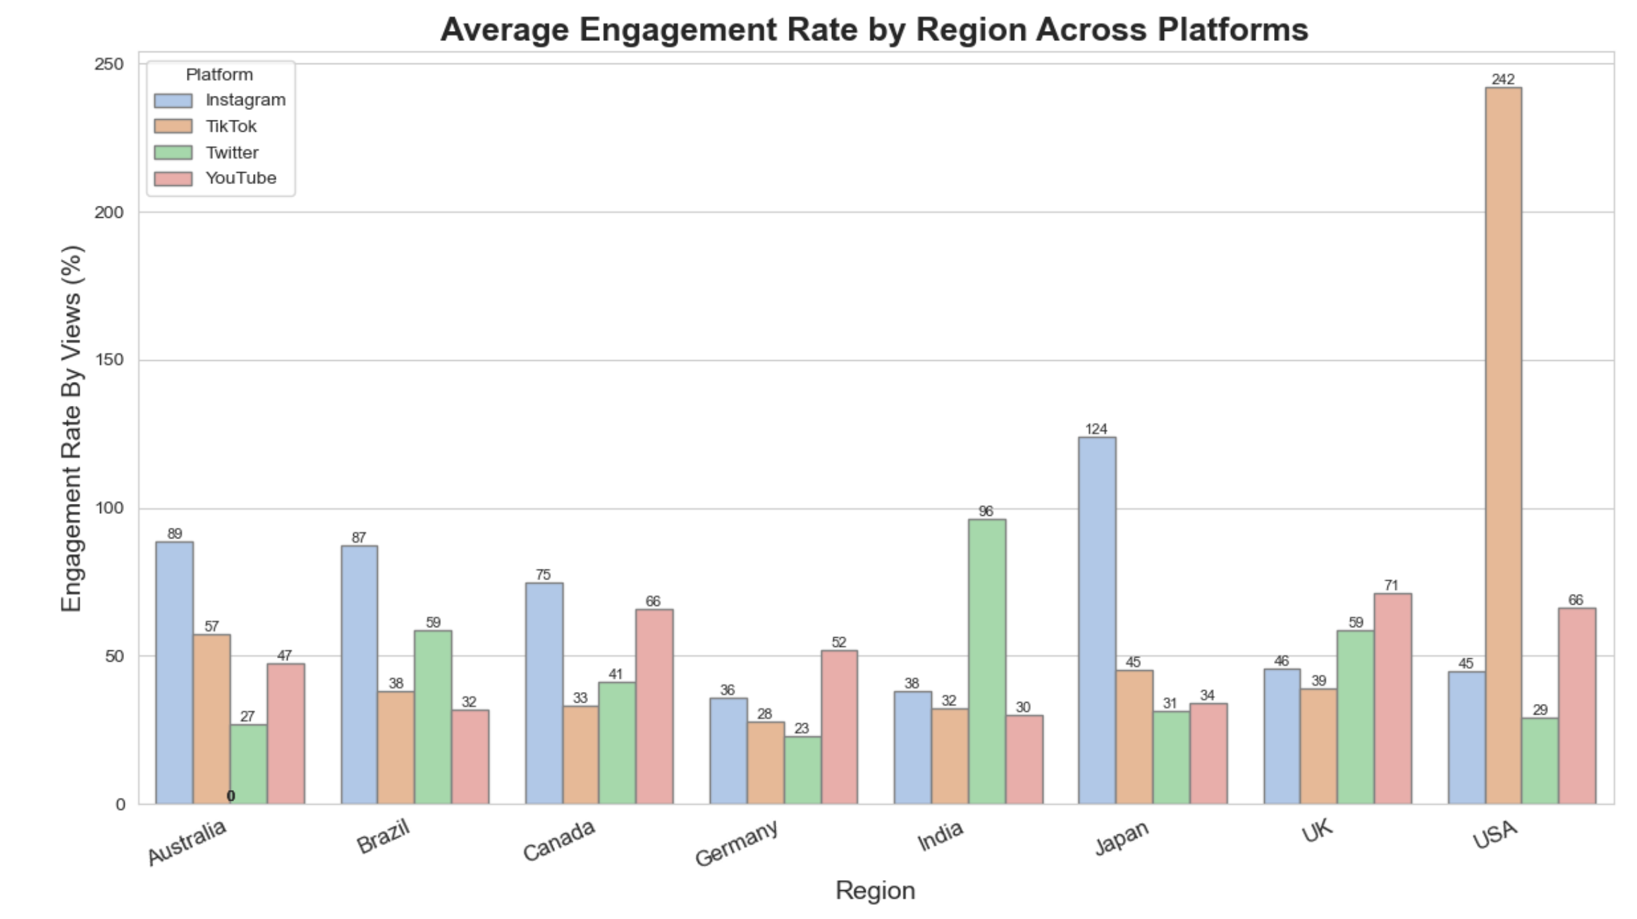
Results & Interpretation
RQ4: Which platform shows the highest engagement rate across regions?
Results:
Instagram: Leads half of the regions with strong engagement in Japan, Brazil, and Australia.
TikTok: Performs highest in USA, Japan, and Australia, but lower in some regions like Germany.
Twitter: India has the highest engagement overall. Moderate in UK, Brazil, Canada; lower in USA and Australia.
YouTube: Most consistent across all regions, with moderate engagement everywhere.
Interpretation:
There is no single best platform. Engagement depends on regional preferences and which platforms are most popular in each country..
Platforms perform strongest where their content style matches local user behavior (e.g., TikTok in the USA/Japan, Instagram in Brazil/Australia, Twitter in India).

Slide 10
Conclusion & Future Work
Conclusion
Future Work
Content type is the strongest driver of engagement, with short-form videos and live streams consistently outperforming other formats across platforms and regions.
Hashtags support engagement only when used on already strong content, as seen with #Viral outperforming #Music.
Platform engagement depends on regional user behavior, not the platform itself. Each region favors the content style that fits its culture (e.g., Twitter in India, Instagram in Brazil/Australia).
Engagement is shaped by the interaction of content format, platform environment, and region, not any single feature.
Extend the analysis with datasets that include caption text, sentiment, or caption length.
Incorporate posting times and weekly trends to understand time-based engagement patterns.
Build a simple predictive model to estimate engagement for different content types.
Compare findings with a newer or larger dataset to see if short-form video dominance remains consistent over time.

Slide 11
References
Franck, T. (2023). Instagram sees over 500 million daily active users posting stories. CNBC. https://www.cnbc.com/
Soundankar, A. (2024). Viral social media trends and engagement analysis [Data set]. Kaggle. https://www.kaggle.com/datasets/atharvasoundankar/viral-social-media-trends-and-engagement-analysis
Islam, A., Rahman, A., & Dey, L. (2020). Predicting the performance of social media posts using machine learning. IEEE Access, 8, 167601–167614. https://doi.org/10.1109/ACCESS.2020.3022937
Wang, T., & Sun, Y. (2022). Modeling user engagement dynamics on short-video platforms. ACM Transactions on Social Computing, 5(4), 1–23. https://doi.org/10.1145/3517342
Project Proposal Template. (2025). East Tennessee State University, Department of Computing (CSCI 5010 – Dr. Ahmad Al Doulat).

Slide 12
Thank you

