Slide 1
Phylogenetic Transmembrane Helix Prediction
Sharabesh Ramesh

Slide 2
Project Overview
This project seeks to use transmembrane helix information from homologous proteins to predict the membrane topology of a given protein
A consensus across homologs will be derived both using phylogenetic tree distances derived with RAxML’s maximum likelihood constructor and a simple column consensus score

Slide 3
Pseudocode
Gather_homologs(e-value = 0.005, query_coverage > 80%)
Generate_MSA_MAFFT()
Parse_TMHMM(proteins discovered in homolog gathering) {
For homolog in gather_homologs() {
Predict Transmembrane regions
}
For each sequence:
Annotate the sequence(I = intracellular, O = extracellular)
Generate Phylogenetic Tree(process described in slide 5)
Derive consensus and re-annotate target sequence
Benchmark against SwissProt

Slide 4
Phylogenetic Tree Pipeline

Slide 5
Figure 1: A pipeline for Phylogenetic Tree Construction given an input FASTA sequence.
Generate MSA Using MAFFT Command Line
BLASTP Against NR
(Specifying global/glocal alignment) . . .
Generate tree_RAxML()
Use 1/tree_distance to generate relative weights to query
Annotation Transfer Protocol and Benchmarking
Remove overly gappy sequences, redundancies (to improve tree construction speed) and gappy columns- Trimal
Input Fasta
Mask and Edit Alignment
Scoring Function
Scoring Function
Weight individual contributions to query topology using phylogenetic distance
Intermediate: Use Column conensus threshold of 80%
Clustering Protocol:
E-value Threshold: 0.005
Query Coverage: 70%
Database: NR
Mask_msa()

Slide 6
Consensus Transfer Procedure

Slide 7
Figure 2: A pipeline for Annotation Transfers between Homologs and a target sequence
Generate MSA Using MAFFT Command Line
See Accruacy Slide
BLASTP Against NR
(Specifying global/glocal alignment) . . .
Annotated
Sequence
Objects- Matrix of Aligned Proteins annotated with helix locations
Altered Target Sequence → Windowing Technique
Benchmarking Against SwissProt KCNA1_HUMAN Annotations
Submit sequence identifiers to TMHMM and scrape HTML to generate annotations.
{i,o}^{n}
.
Parse TMHMM
Target Includes predictions
Input Fasta
Msaprocess()
Generate_Rep
Residue Annotation Transfer
BLOSUM62 Sum of Pair Scores
Similarity of AA in Columns
Phylogenetic Tree Weighting

Slide 8
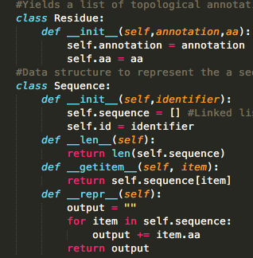
Matrix Representation
P A T C G - - - - - - L S S K G A F F Q Q F G S S A Q T F A S
P A T C G - - - - - - L S S K G A F F Q Q F G S S A Q T F A S
P A T C G - - - - - - L S S K G A F F Q Q F G S S A Q T F A S
P A T C G - - - - - - L S S K G A F F Q Q F G S S A Q T F A S
Annotations
Current Annotations:
i - Helix from intracellular to extracellular space
o – Helix from extracellular to intracellular space
Proposed Annotations:
E= Extracellular
I = Intracellular
H = Helical
E E E E E E E E E E E H H H H H H H H I I I I I I I I I
E E E E E E E E E E E E H H H H H H H H I I I I I I I I
E E E E E E E E E E E H H H H H H H H I I I I I I I I I
E E E E E E E E E E E H H H H H H H H I I I I I I I I I
Figure 3: The internal representation generated to process consensus annotations
E E E E E E E E E E E H H H H H H H H I I I I I I I I I

Slide 9
Benchmarking
Using Belvu and an initial MAFFT alignment of Blast against NR hits I selected homologs at 30-40%, 40-70%, and >70% identity to the target sequence (KCNA1_HUMAN)
Values were compared to the SwissProt Annotation for KCNA1_HUMAN, a protein with a 5/5 annotation score
Transmembrane Helix information for homologs is derived using TMHMM
My program yielded
76% accuracy for those >70% Identity
75.4% for 40-70%
75.1% for 30-40%
This process will be executed on several SwissProt Proteins with high annotations scores and experimental evidence (see benchmarking.py)

Slide 10
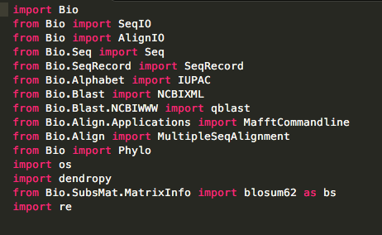
Implementation
Python-based statistical analysis and benchmarking
Mafft, RAxML, TrimAL, BLAST Command Line
Libraries

Slide 11
On the web
GitHub
https://github.com/Sharabesh/bioe144
Also includes secondary class project under the Project tab
MSA Analytics and relevant text files
To be added
A windowing function to ensure there are no outliers in the description of a helix
Potentially draw Transmembrane helix information from SwissProt when available rather than solely relying on TMHMM

