Slide 1
Phylogenetic Transmembrane Helix Prediction
Sharabesh Ramesh

Slide 2
Project Overview/Aims
This project seeks to use transmembrane helix information from homologous proteins to predict the membrane topology of a given target protein
A consensus across homologs will be derived both using phylogenetic tree distances derived with RAxML’s maximum likelihood constructor and a simple column consensus score

Slide 3
Pseudocode
Gather_homologs(e-value = 0.005, query_coverage > 80%)
Generate_MSA_MAFFT()
Parse_TMHMM(proteins discovered in homolog gathering) {
For homolog in gather_homologs() {
Predict Transmembrane regions
}
For each sequence:
Annotate the sequence (Extracellular, Intracellular, or Helical)
Generate Phylogenetic Tree(process described in slide 5)
Derive consensus and re-annotate target sequence
Benchmark against SwissProt

Slide 4
Phylogenetic Tree Pipeline
Protein 9
Lesser Weights: Less important in structure prediction
Figure 3:
This figure illustrates the fundamental assumption of the sequence weighting model. Sequences with less evolutionary distance should have greater similarity and this have more closely related membrane topologies.
Protein 8
Protein 7
Protein 6
Protein 5
Protein 4
Protein 3
Greater Weights, far more important
Protein 2
Protein 1

Slide 5
Figure 1: A pipeline for Phylogenetic Tree Construction given an input FASTA sequence.
Generate MSA Using MAFFT Command Line
BLASTP Against NR
(Specifying global/glocal alignment) . . .
Generate tree_RAxML()
Using a Variant on 1/Tree distance to weight sequences according to relative importance
Annotation Transfer Protocol and Benchmarking
Remove overly gappy sequences, redundancies (to improve tree construction speed) and gappy columns- Trimal
Input Fasta
Mask and Edit Alignment
Scoring Function
TRIMAL
Remove Gappy sequences (>50%)
Gappy and low entropy columns (default params)
Scoring Function
Weight individual contributions to query topology using phylogenetic distance
Intermediate: Use Column conensus threshold of 80%
Clustering Protocol:
E-value Threshold: 0.005
Query Coverage: 70%
Database: NR

Slide 6
Consensus Transfer Procedure
Each Homolog is equally weighted. It is the consensus agreement of all the homologs that determines the TMH prediction for the target

Slide 7
Figure 2: A pipeline for Annotation Transfers between Homologs and a target sequence
Generate MSA Using MAFFT Command Line
See Accruacy Slide
BLASTP Against NR
(Specifying global/glocal alignment) . . .
Annotated
Sequence
Objects- Matrix of Aligned Proteins annotated with helix locations
Altered Target Sequence → Windowing Technique
Benchmarking Against SwissProt Annotations
Submit sequence identifiers to TMHMM and scrape HTML to generate annotations.
{i,o}^{n}
.
Parse TMHMM
Target Includes predictions
Input Fasta
Msaprocess()
Generate_Rep
Residue Annotation Transfer
BLOSUM62 Sum of Pair Scores
Similarity of AA in Columns
Phylogenetic Tree Weighting

Slide 8
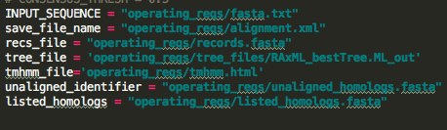
Method Inputs
Functionality
Inputs: *
*TMHMM does not support most modern operating systems so this was manually collected

Slide 9
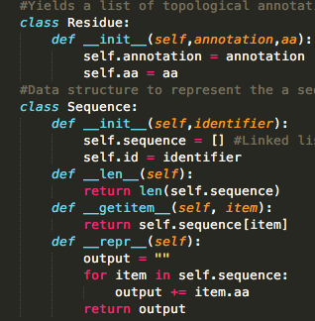
Matrix Representation
Residue Objects (Amino Acids)
MTVMSGENADEASTAPGHPQD
P A T C G - - - - - - L S S K G A F
P A T C G - - - - - - L S S K G A F
P A T C G - - - - - - L S S K G A F
Residue Object Annotations
E E E E E H H H I I I I I
Annotation:
E= Extracellular
I = Intracellular
H = Helical
E E E E E H H H I I I I I
E E E E E H H H I I I I I
E E E E E H H H I I I I I
E E E E E H H H I I I I I
Figure 3: The internal representation generated to process consensus annotations

Slide 10
Automating Benchmarking
Input: A SwissProt identifier (eg KCNA1_HUMAN), Target protein, TMHMM data, and unaligned homologs (BLAST E-value < 0.05, global alignment)
Phylogenetic Method
Tune Phylogenetic Consensus parameters (Conensus Threshold varies depending on the number and distance of the homologs)
Calculate the number of correctly identified helical regions/Total number of Transmembrane regions
Calculate the total number of correctly aligned regions/ Total length of the protein
Modify filtering parameters to evaluate accuracy
Consensus Method
Set Column consensus threshold to 70% and identified matches

Slide 11
Benchmark Selection
Proteins with 5/5 Annotation Scores in SwissProt with Experimental Evidence
KCNA1_HUMAN (Though there are concerns about interpreting Intramembrane regions, it appears the phylogenetic approach resolved some of these issues)
TLR1_HUMAN
ZYX_HUMAN
Z02_HUMAN

Slide 12




Phylogenetic Program outputs
KCNA1_HUMAN
ZO2_HUMAN
Handles issues with Intramembrane Regions
Tendency towards overprediction when no TMH Regions are present
TLR1_HUMAN
ZYX_HUMAN
By Observation, Threshold increased to 0.90
Easily Predicted Regions are also identified by this method
Figures 1-4: Accuracy given by 0.8-0.9 Thresholds
$$\frac{Correctly Predicted Transmembrane Regions}{Total Transmembrane Regions }, by SwissProt$$

Slide 13



Consensus Program outputs
KCNA1_HUMAN
TLR1_HUMAN
ZYX_HUMAN
Z02_HUMAN
Most consensus annotations struggle exceeding the accuracy of TMHMM alone

Slide 14

Filtering
Using Belvu and an initial MAFFT alignment of Blast against NR hits I selected homologs at 30-40%, 40-70%, and >70% identity to the target sequence (KCNA1_HUMAN)
Drastically reduced accuracies→ Large number of sequences are needed to accurately make predictions
Further efforts would try to find proteins with >80 homologs at any given level of sequence divergence in order to avoid the sparsity generated with filtering.
Accuracy drops to ~4%.

Slide 15
Difficulties
Determining Consensus Thresholds for Phylogenetic Tree Annotation Transfer
Varies depending on the topology of the tree
Number of sequences
Overall distance between sequences
This approach relied on a heuristic estimate (using the distance between sequences, but a more efficient mathematically based approach is required)
Tendency towards over-prediction
At low thresholds, almost every single amino acid is determined to be

Slide 16
Windowing
Windowing Approach
Difficulties stemmed from weighting the probabilities of seeing sequences
Naïve Approach (Main.py ~225)
Problem of Erasing data with each increasing window
Approach:
Increase the weight of the Transmembrane segments
Creates a realm of similar issues
Complex Approach (Attempted but not particularly effective)
Incorporated Evidence from nearby amino acids into probabilistic model
E E E E E E H H H I I I I
E E E E E H H H H I I I I
Weight Y_{i}= a(y_{i}) + b(y_{i}-1) + c(Y_{i} + 2) + d (Y_{i} -2)

Slide 17
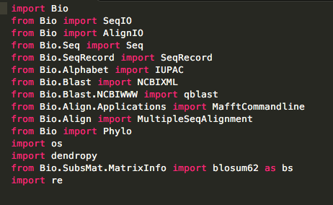
Implementation
Python-based statistical analysis and benchmarking
Mafft, RAxML, TrimAL, BLAST Command Line
Libraries

Slide 18
On the web
GitHub
https://github.com/Sharabesh/bioe144
Also includes secondary class project under the Project tab
MSA Analytics and relevant text files
Potential Modifications
Henikoff Sequence weighting procedure
A windowing function to ensure there are no outliers in the description of a helix
Potentially draw Transmembrane helix information from SwissProt when available rather than solely relying on TMHMM
After predictions are made re-evaluate regions of Transmembrane helices using amino acid characteristics (Eg hydrophobicity, secondary structure prediction)

