Slide 1

AVIATION-EDGE : Flight Tracking
By:
Julie, Giselle, Kelvin & Sharad

Slide 2

Aviation Edge Api

Slide 3

Key Features - Aviation Edge API:
Flight Data
Airline Information
Airport Information
Aircraft Information
Routes Information
Time zone and City Information
Aviation Edge is a provider of aviation-related data and services, offering APIs that allow developers to access a wide range of information related to the aviation industry.

Slide 4
Use Cases and Applications:
Flight Tracking Applications:
Developers can use the Aviation Edge API to build flight tracking applications that provide real-time information about flight positions, status, and schedules.
Travel Planning Tools:
Travel websites and applications can use the API to offer users information about airports, airlines, and flight schedules for travel planning purposes.
Aviation Analytics:
Analysts and researchers can leverage the API to gather data and insights for aviation-related research and analysis.
Airlines and Airport Services:
Airlines and airport service providers can use the API to obtain data about airports, airlines, and flights to enhance their services and operations.

Slide 5

What does the airplane icon color mean?

Slide 6




Color icons represents airplane status / type
These are the flights on the runway about to be started
All landed aircrafts
All aircrafts with any other status, including non-commercial passenger planes
These are the flights en-route towards its destination

Slide 7

An interactive Visual of Aviation Edge

Slide 8
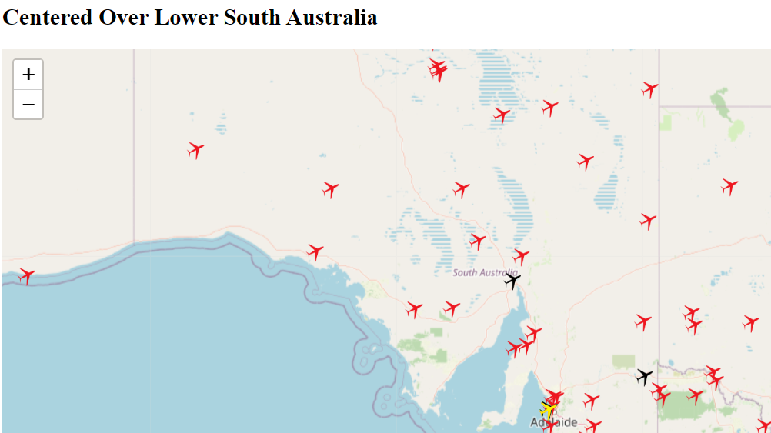
South Australian Live Airspace

Slide 9
Select plane by the call sign and see it moving

Slide 10

Thank You The crew is ready for questions.

