Slide 1
Automated Attendance Tracking System
Capstone Project 1
Domain: Business Intelligence & Automation Systems
by:
Munagala Lahari

Slide 2
Introduction
Attendance monitoring is crucial for discipline and productivity
Manual systems are time-consuming and error-prone
Power BI enables automated, real-time insights

Slide 3
Problem Statement
Inaccurate manual data
No centralized visual system
Time-consuming reporting
Limited management insights

Slide 4
Objectives
Automate attendance analysis
Visualize daily/monthly/yearly trends
Identify absenteeism & late trends
Support decision-making

Slide 5
Project Domain
Information Technology
Business Intelligence & Automation Systems
Attendance Management & Analytics

Slide 6
Tools & Technologies
Power BI – Dashboards & Visualization
Excel / CSV – Data source
Power Query – Data cleaning
DAX – Measures & Calculations

Slide 7
Methodology
Data collection from Excel/CSV
Data cleaning using Power Query
Data modeling & relationships
DAX calculations
Dashboard development

Slide 8
Data Description
Employee ID
Name
Date
Attendance status
Performance & Salary

Slide 9
Dashboard Design
Header section with employee details
Performance gauge
KPI cards
Monthly attendance chart
Salary analysis & slicers

Slide 10
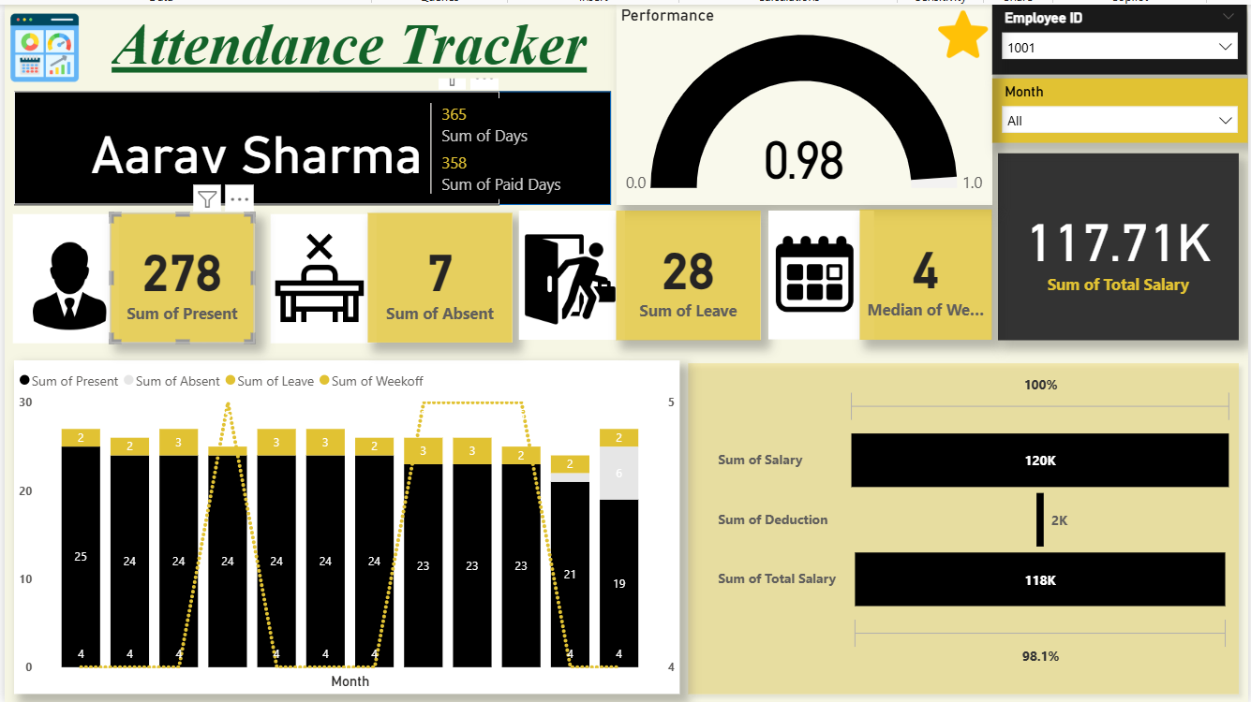
Dashboard

Slide 11
Key Insights
Attendance varies during specific periods
Late arrivals on certain days
Real-time performance monitoring

Slide 12
Advantages
Fully automated system
Real-time dashboards
Reduced manual effort
Scalable solution

Slide 13
Challenges Faced
Inconsistent raw data
Accurate DAX measures
Dashboard design
Data refresh accuracy

Slide 14
Real-Life Applications
Colleges – student attendance
Companies – employee attendance
HR & academic analytics
Compliance reporting

Slide 15
Conclusion
Transformed raw data into insights
Improved monitoring & decision-making
Effective real-world BI application

Slide 16
Future Enhancements
Biometric/face recognition integration
Real-time databases
Mobile dashboards
Predictive analytics
Cloud deployment

Slide 17
Thank You
Questions & Discussion

