Slide 1


Noida Institute of Engineering and Technology, Greater Noida
Function and Module
UNIT: III
Problem Solving using Python (ACSE0101)
(Asst. Professor)
Department
B.Tech 1st semester
faculty name Problem Solving using Python (ACSE0101) UNIT III

Slide 2
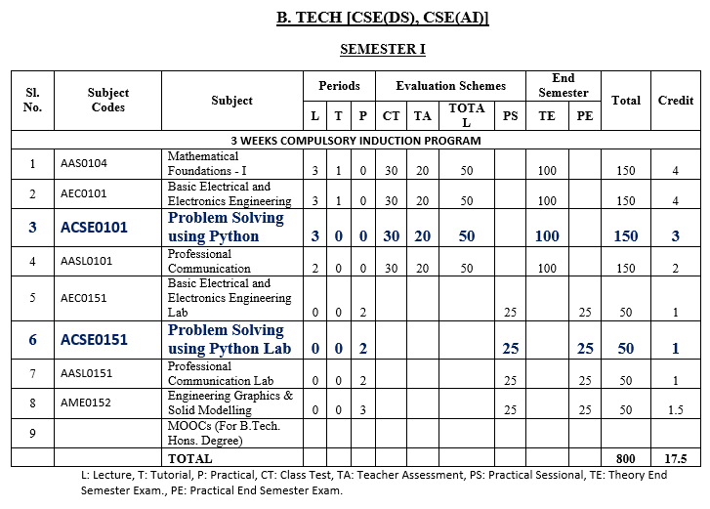
Evaluation Scheme
faculty name Problem Solving using Python (ACSE0101) UNIT III

Slide 3

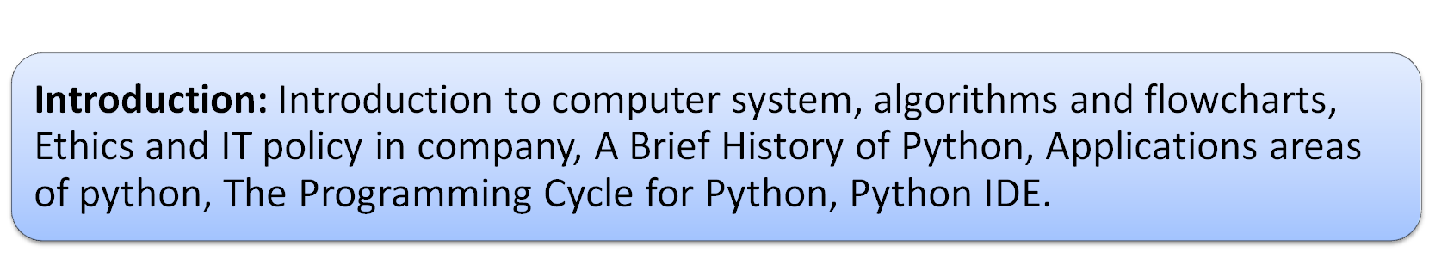
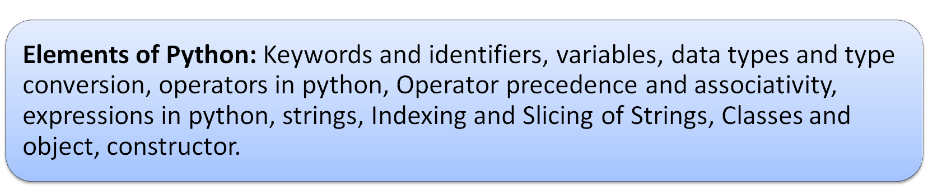
Syllabus
UNIT-I: Basics of python programming
faculty name Problem Solving using Python (ACSE0101) UNIT III

Slide 4
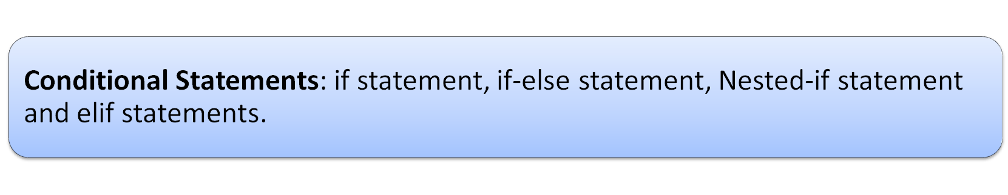
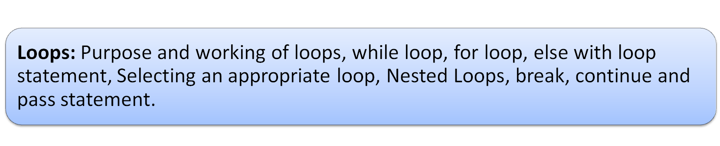
Syllabus
UNIT-II: Decision Control Statements
faculty name Problem Solving using Python (ACSE0101) UNIT III

Slide 5
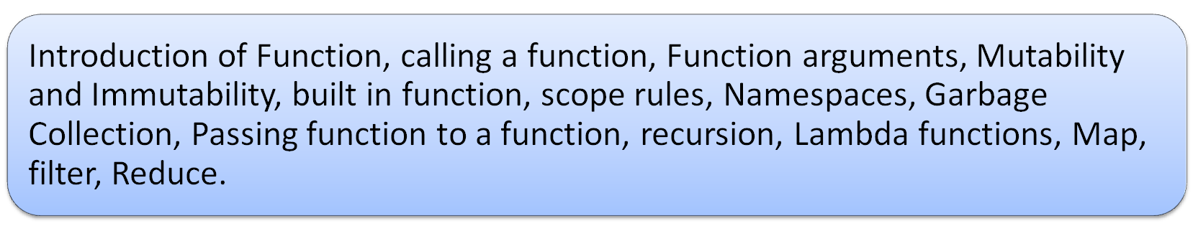
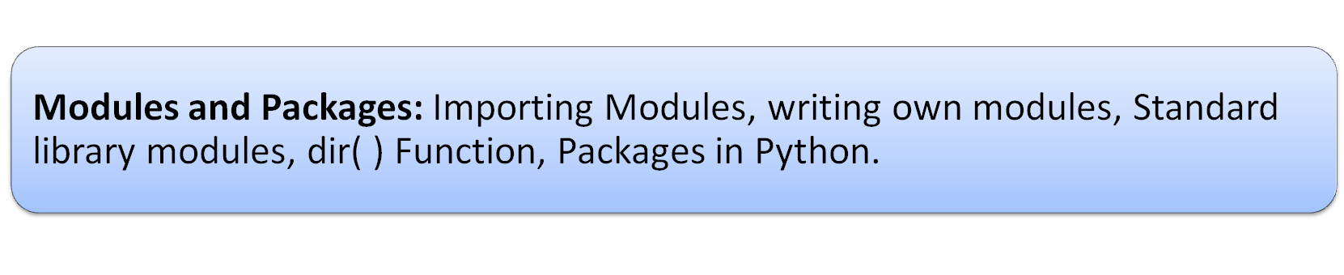
Syllabus
UNIT-III: Function and Modules
faculty name Problem Solving using Python (ACSE0101) UNIT III

Slide 6

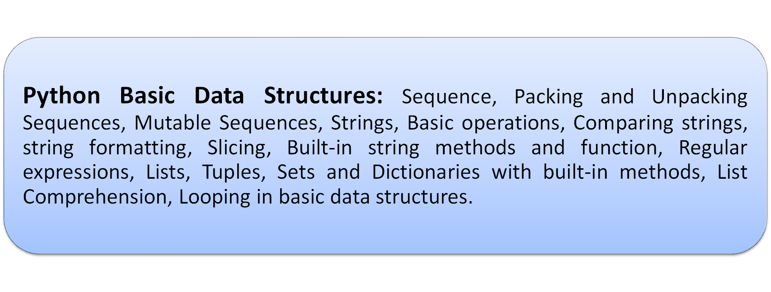
Syllabus
UNIT-IV: Basic Data structures in Python
faculty name Problem Solving using Python (ACSE0101) UNIT III

Slide 7
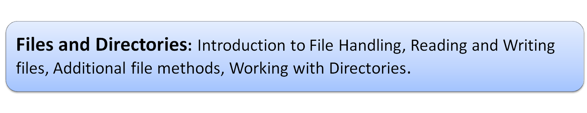
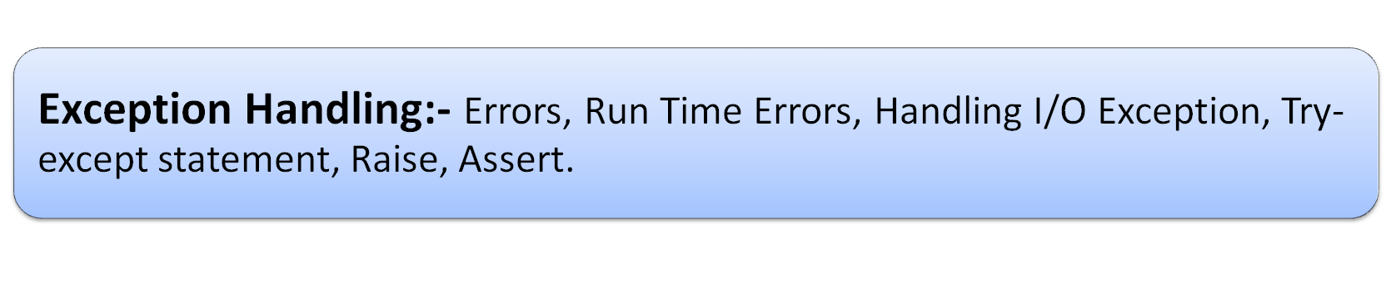
Syllabus
UNIT-V: File and Exception handling
faculty name Problem Solving using Python (ACSE0101) UNIT III

Slide 8
Difference between Python and C Language
Python Language | C Language
1. Python is an interpreted, high-level, general-purpose programming language. | 1. C is a general-purpose compiled, procedural computer programming language.
2. Interpreted programs execute slower as compared to compiled programs. | 2. Compiled programs execute faster as compared to interpreted programs.
3. It is easier to write a code in Python as the number of lines is less comparatively. | 3. Program syntax is harder than Python.
4. No pointers functionality available in Python | 4. Pointers are available in C.
faculty name Problem Solving using Python (ACSE0101) UNIT III

Slide 9
Branch Specified Example
Mechanical Engineering
Python is used in Mechanical Engineering in the areas of
  Numerical analysis
  Thermodynamics
  Computational fluid dynamics
  Vibrations and dynamic motion
  Simulation and modeling engineering
faculty name Problem Solving using Python (ACSE0101) UNIT III

Slide 10
Branch Specified Example
Biotechnology
Python is a high-level object-oriented programming language, ideal for biotech data analysis.
This practical course will introduce to Python basic concepts, such as data organization, file reading and writing, scripting.
faculty name Problem Solving using Python (ACSE0101) UNIT III

Slide 11
Branch Specified Example
Computer Science
Once an obscure scripting language, Python now powers some of the most complex applications on the cloud.
Quickly analyze and organize data, making it especially effective for streaming analytics apps built on the cloud.
Python is used extensively in the AWS Cloud and is natively supported by AWS Lambda.
Great language to use for developing serverless applications on Amazon Web Services.
faculty name Problem Solving using Python (ACSE0101) UNIT III

Slide 12
Branch Specified Example
AIML
It is used in applications like natural language processing (NLP) and sentiment analysis
Developers opted for Python, because it provides large collection of libraries that help to solve complex business problem easily
Build strong system and data application.
Python is an excellent choice for rapid prototyping of games. But it has limits with performance.
faculty name Problem Solving using Python (ACSE0101) UNIT III

Slide 13
Branch Specified Example
IOT (Internet of Things)
In IoT, Python is a great choice for the backend side of development as well as the software development of devices.
It can be used to build powerful and intelligent IoT systems with intuitive interfaces.
Some of the many advantages of working with Python for IoT devices are the speed at which the code can be developed and many libraries for all kinds of platforms.
faculty name Problem Solving using Python (ACSE0101) UNIT III

Slide 14
Branch Specified example
ECE
Python has found its extensive industrial applications in the areas of Electronics & Electrical engineering such as
  Signal processing
  image processing,
  control system engineering
  Embedded systems (MicroPython)
  Data visualization
  Automation
  Test equipment automation (HIL)
faculty name Problem Solving using Python (ACSE0101) UNIT III

Slide 15
Branch Specified example
CSE/IT
A Python programmer can work in a variety of industries and with different companies.
It helps to develop web applications and framework development.
From back-end to front-end development, full-stack and web-based options, Python programmers continue to find more economic prospects as the use of the language grows to encompass all areas of software and web development.
faculty name Problem Solving using Python (ACSE0101) UNIT III

Slide 16
Branch Specified example
AI
Python plays a vital role in AI coding language by providing it with good frameworks like scikit-learn.
Other than frameworks, its fast prototyping makes it an important language not to be ignored.
In Python, almost every idea can be quickly validated through 20-30 lines of code.
faculty name Problem Solving using Python (ACSE0101) UNIT III

Slide 17
Branch Specified example
DS
It is one of the best language used by data scientist for various data science projects/application.
It provides great functionality to deal with mathematics, statistics and scientific function.
It provides great libraries to deals with data science application.
Ease of use and simple syntax
More suited for quick prototyping.
faculty name Problem Solving using Python (ACSE0101) UNIT III

Slide 18
Branch Specified example
M. Tech Int. (CSE)
Python is a computer programming language often used to build
  websites and software,
  Automate tasks
  Conduct data analysis.
faculty name Problem Solving using Python (ACSE0101) UNIT III

Slide 19
Course Objective
To impart adequate knowledge on the need of programming languages
To develop programming skills using the fundamentals and basics of python language.
To enable effective usage of functions, module, lambda function and the packages.
To develop modules and import the packages .
faculty name Problem Solving using Python (ACSE0101) UNIT III

Slide 20
Course Outcome
Course Outcome ( CO) | At the end of course , the student will be able to: | Bloom’s Knowledge Level (KL)
CO1 | Analyse and implement simple python programs. | K3, K4
CO2 | Develop Python programs using decision control statements. | K3, K6
CO3 | Implement user defined functions and modules in python. | K2
CO4 | Implement python data structures –string, lists, tuples, set, dictionaries. | K3
CO5 | Perform input/output operations with files in python, apply exception handling for uninterrupted execution. | K3, K4
faculty name Problem Solving using Python (ACSE0101) UNIT III

Slide 21
Program Outcomes (PO’s)
Engineering Graduates will be able to:
PO1 : Engineering Knowledge: Apply the knowledge of mathematics, science, engineering fundamentals and an engineering specialization to the solution of complex engineering problems.
PO2 : Problem Analysis: Identify, formulate, review research literature, and analyze complex engineering problems reaching substantiated conclusions using first principles of mathematics, natural sciences and engineering sciences.
faculty name Problem Solving using Python (ACSE0101) UNIT III

Slide 22
Program Outcomes (PO’s)
PO3 : Design/Development of solutions: Design solutions for complex engineering problems and design system components or processes that meet the specified needs with appropriate considerations for the public health and safety, and the cultural, societal and environmental considerations.
PO4 : Conduct Investigations of complex problems: Use research-based knowledge and research methods including design of experiments, analysis and interpretation of data and synthesis of the information to provide valid conclusions.
faculty name Problem Solving using Python (ACSE0101) UNIT III

Slide 23
Program Outcomes (PO’s)
PO5 : Modern tool usage: Create, select and apply appropriate techniques, resources and modern engineering and IT tools including prediction and modeling to complex engineering activities with an understanding of the limitations
PO6 : The engineer and society: Apply reasoning informed by the contextual knowledge to assess societal, health, safety, legal and cultural issues and consequent responsibilities relevant to the professional engineering practice.
faculty name Problem Solving using Python (ACSE0101) UNIT III

Slide 24
Program Outcomes (PO’s)
PO7 : Environment and sustainability: Understand the impact of the professional engineering solutions in societal and environmental contexts, and demonstrate the knowledge of, and need for sustainable development
PO8 : Ethics: Apply the ethical principles and commit to professional ethics, responsibilities, and norms of engineering practice.
PO9 : Individual and teamwork: Function effectively as an individual, and as a member or leader in diverse teams and multidisciplinary settings.
faculty name Problem Solving using Python (ACSE0101) UNIT III

Slide 25
Program Outcomes (PO’s)
PO10 : Communication: Communicates effectively on complex engineering activities with the engineering community and with society such as being able to comprehend and write effective reports and design documentation, make effective presentations and give and receive clear instructions.
PO11 : Project management and finance: Demonstrate knowledge and understanding of the engineering and management principles and apply these to one’s own work, as a member and leader in team, to manage projects and in multidisciplinary environments.
PO12 : Life-long learning: Recognize the need for, and have the preparation and ability to engage in independent and life-long learning in the broadcast context of technological change.
faculty name Problem Solving using Python (ACSE0101) UNIT III

Slide 26
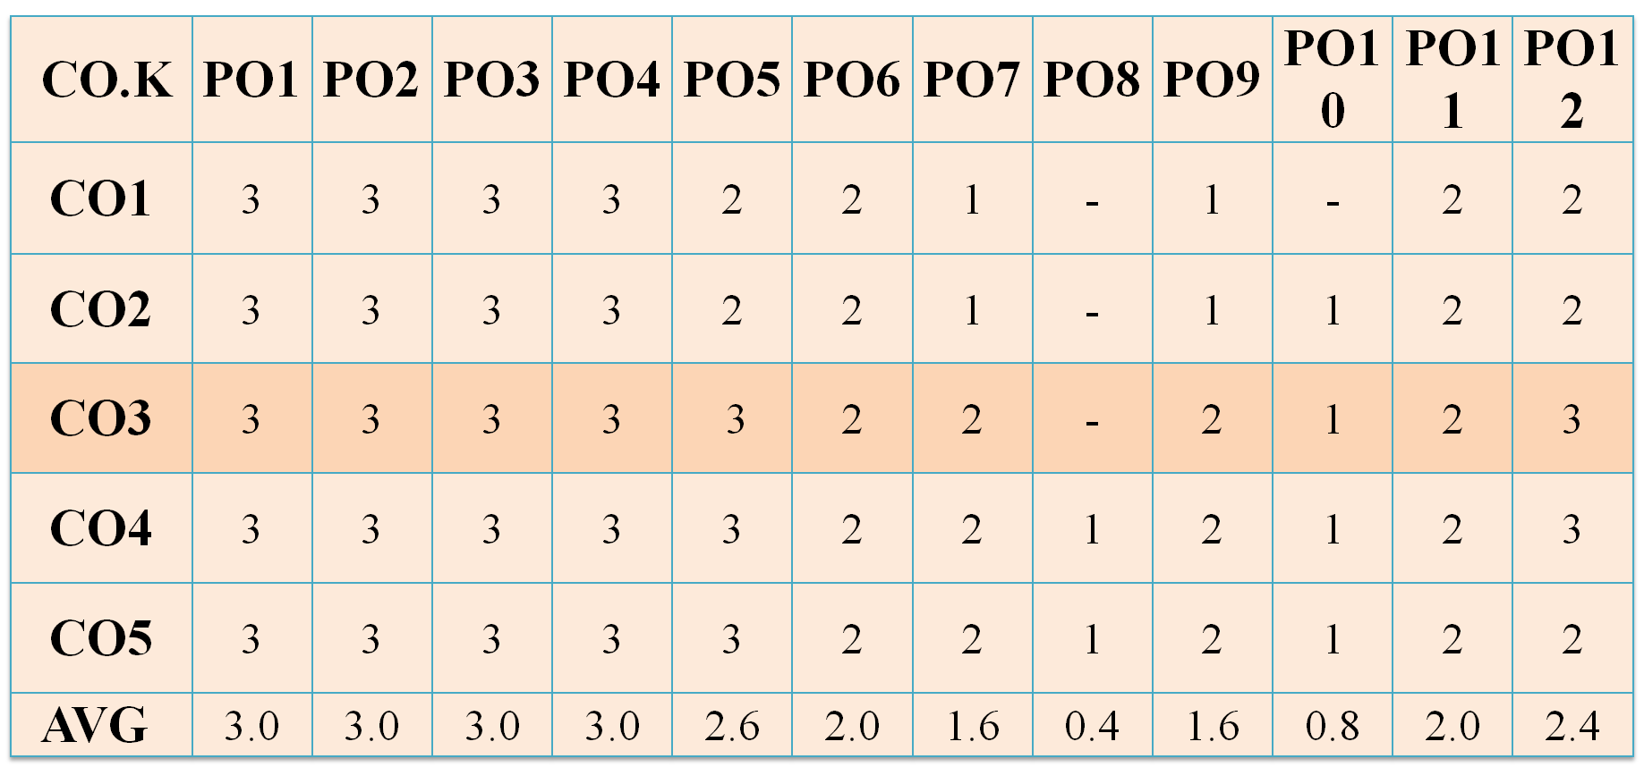
CO-PO Mapping
faculty name Problem Solving using Python (ACSE0101) UNIT III

Slide 27
Program Specific Outcomes (PSO’s)
PSO1:Work as a software developer, database administrator, tester or networking engineer for providing solutions to the real world and industrial problems.
PSO2:Apply core subjects of information technology related to data structure and algorithm, software engineering, web technology, operating system, database and networking to solve complex IT problems.
PSO3:Practice multi-disciplinary and modern computing techniques by lifelong learning to establish innovative career.
PSO4:Work in a team or individual to manage projects with ethical concern to be a successful employee or employer in IT industry.
faculty name Problem Solving using Python (ACSE0101) UNIT III

Slide 28
CO-PSO Mapping
 | PSO1 | PSO2 | PSO3 | PSO4
KCS301.1 | 3 | 3 | 3 | 3
KCS301.2 | 3 | 3 | 3 | 3
KCS301.3 | 2 | 2 | 2 | 2
KCS301.4 | 3 | 3 | 3 | 3
KCS301.5 | 2 | 2 | 2 | 2
Average | 2.6 | 2.6 | 2.6 | 2.6
faculty name Problem Solving using Python (ACSE0101) UNIT III

Slide 29
Program Education Objective (PEO’s)
PEO1: | Apply sound knowledge in the field of information technology to fulfill the needs of IT industry.
PEO2: | Design innovative and interdisciplinary systems through latest digital technologies.
PEO3: | Inculcate professional – social ethics, team work and leadership for serving the society.
PEO4: | Inculcate lifelong learning in the field of computing for successful career in organizations and R&D sectors.
faculty name Problem Solving using Python (ACSE0101) UNIT III

Slide 30
Content
Introduction of Function
Calling a function
Function arguments
Mutability and Immutability
Built in function
Scope rules
Namespaces
Garbage Collection
Passing function to a function
Recursion
Lambda functions
Map
Filter
Reduce
Introduction of Modules and Packages
Importing Modules
writing own modules
Standard library modules
dir( ) Function
Packages in Python
faculty name Problem Solving using Python (ACSE0101) UNIT III

Slide 31
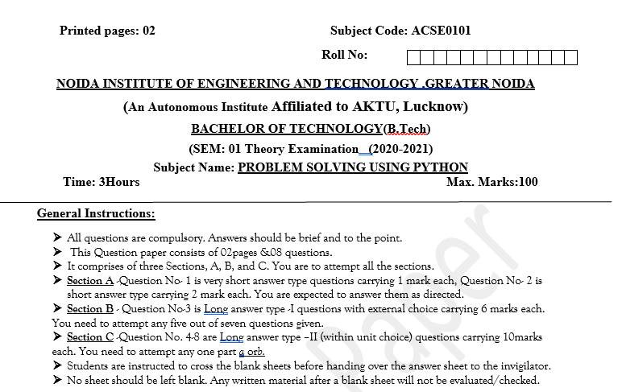

Pattern of Offline External Exam Question Paper (100 marks)
faculty name Problem Solving using Python (ACSE0101) UNIT III

Slide 32

Prerequisite and Recap
Conditional statement
Nested if else
loops
faculty name Problem Solving using Python (ACSE0101) UNIT III

Slide 33
Prerequisite and Recap
Conditional statement:
Syntax:
  if condition :
  statement
  else:
  statement
Loops
Syntax:
  for n in range():
faculty name Problem Solving using Python (ACSE0101) UNIT III

Slide 34
Unit Objective
To develop and use of functions in the python.
To implement lambda functions and its advantage in the python
To import the functions from module.
To understand and installation of packages.
faculty name Problem Solving using Python (ACSE0101) UNIT III

Slide 35
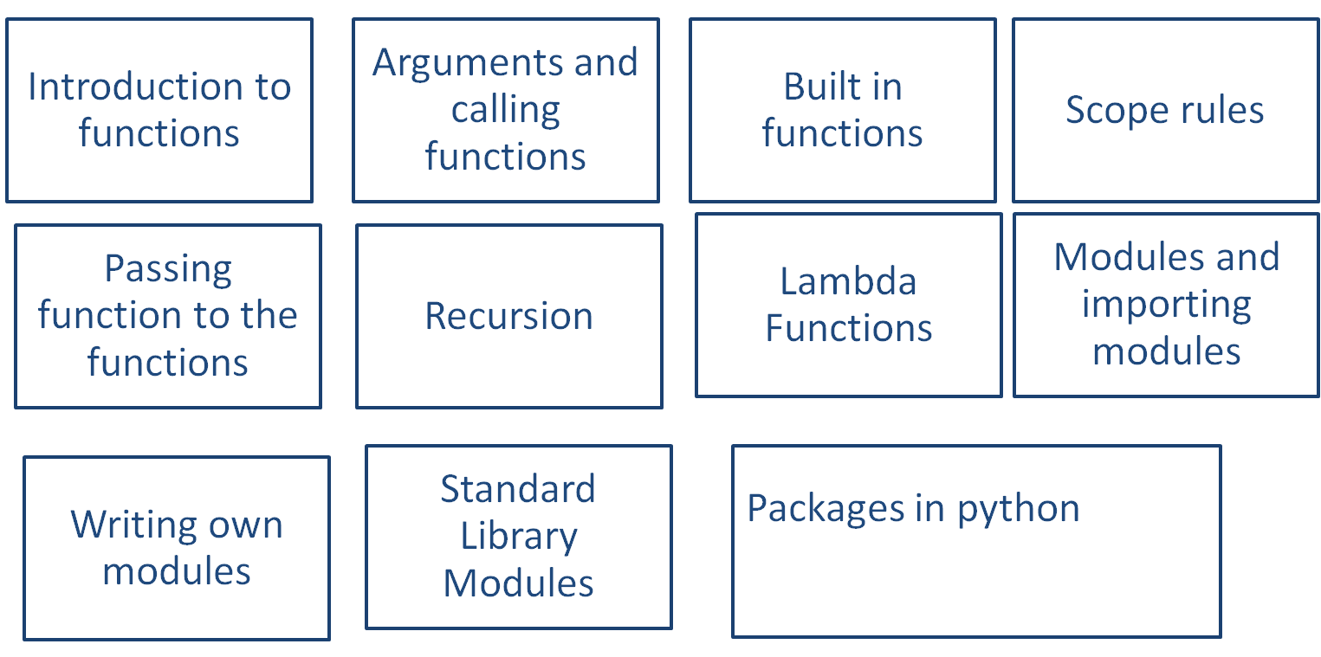
Function and Modules(CO3)
faculty name Problem Solving using Python (ACSE0101) UNIT III

Slide 36
Topic objective (CO3)
Objective:
  To develop and use of functions in the python.
  To implement lambda functions and its advantage in the python.
faculty name Problem Solving using Python (ACSE0101) UNIT III

Slide 37
Introduction to Functions (CO3)
A function is a block of organized, reusable code that is used to perform a single, related action.
Functions help break our program into smaller and modular chunks. As our program grows larger and larger, functions make it more organized and manageable.
Functions provide better modularity for your application and a high degree of code reusing.
Functions provide better modularity for your application and a high degree of code reusing.
faculty name Problem Solving using Python (ACSE0101) UNIT III

Slide 38

Introduction to Functions (CO3)
faculty name Problem Solving using Python (ACSE0101) UNIT III

Slide 39
Type of Functions(CO3)
Basically, we can divide functions into the following two types:
Built-in functions - Functions that are built into Python.
Example:
print(),input(),sum(),abs(),pow(), sqrt()etc.
User-defined functions - Functions defined by the users themselves.
Example:
def function():
print(‘hello’)
faculty name Problem Solving using Python (ACSE0101) UNIT III

Slide 40
Defining a User Defined Function(CO3)
Rules to define a function in Python:
  Function blocks begin with the keyword def followed by the function name and parentheses ( ) .
  Any input parameters or arguments should be placed within these parentheses.
  The first statement of a function can be an optional statement .
  The code block within every function starts with a colon (:) and is indented
  The statement return [expression] exits a function, optionally passing back an expression to the caller
  return[expression] can return value or can be empty.
  If return statement itself is not present inside a function, then the function will return the None object.
faculty name Problem Solving using Python (ACSE0101) UNIT III

Slide 41
Syntax to Define function:(CO3)
Syntax:
  def functionname( parameters ):
  '''function_docstring'''
  function_suite
  return [expression]
Example:
    def printme( str ):
    '''This prints a passed string into this function'''
    print (str)
    return
faculty name Problem Solving using Python (ACSE0101) UNIT III

Slide 42
doc string in function:(CO3)
Docstring:
Python docstrings are the string literals that appear right after the definition of a function, method, class, or module.
They are used to document our code.
- We can access these docstrings using the __doc__ attribute.
For example:
def square(n):
'''Takes in a number n, returns the square of n'''
return n**2
print(square.__doc__)
faculty name Problem Solving using Python (ACSE0101) UNIT III

Slide 43
Calling to the function:(CO3)
Once the basic structure of function is finalized function can be executed by calling it from the function or directly from python command prompt:
Example:
# function definition
def my_func():
x = 10
print("Value inside function:",x)
x = 20
my_func()
#Now call of function
print("Value outside function:",x)
Output
Value inside function: 10
Value outside function: 20
faculty name Problem Solving using Python (ACSE0101) UNIT III

Slide 44
Calling to the function:(CO3)
def absolute_value(num):
'''This function returns the absolute value of the entered number’’’
if num >= 0:
return num
else:
return -num
print(absolute_value(2))
print(absolute_value(-4))
Output:
2
4
faculty name Problem Solving using Python (ACSE0101) UNIT III

Slide 45
Functions in Python
M_Tutor Link:(Functions in Python)
https://www.m-tutor.com/courses-detail.php?tid=859128&topicid=198398&selectedcourse=&selectedsubject=5715&selectedunit=&searchtopics=Functions%20in%20Python
M_Tutor Link:(Parameters and Arguments)
https://www.m-tutor.com/courses-detail.php?tid=859179&topicid=198414&selectedcourse=&selectedsubject=5715&selectedunit=&searchtopics=Parameters%20and%20Arguments
M_Tutor Link:(Built-In Functions)
https://www.m-tutor.com/courses-detail.php?tid=859056&topicid=198300&selectedcourse=&selectedsubject=5715&selectedunit=&searchtopics=Built-In%20Functions
faculty name Problem Solving using Python (ACSE0101) UNIT III

Slide 46
Pass by reference vs value (CO3)
All parameters (arguments) in the Python language are passed by reference. It means ,the change also reflects in the calling function .
# Function definition is here
def changeme( mylist ):
mylist[1]=‘123’
print ("Values inside the function: ", mylist)
return
# Now you can call changeme function
mylist = [10,20,30]
print(“before calling values are”, mylist)
changeme( mylist )
print ("Values outside the function: ", mylist)
faculty name Problem Solving using Python (ACSE0101) UNIT III

Slide 47
Pass by reference vs value(CO3)
In case of immutable data types changes will not be reflected or raise error
# Function definition is here
def changeme( mylist ):
mylist[1]=‘123’
print ("Values inside the function: ", mylist)
return
# Now you can call changeme function
mylist = (10,20,30)
print(“before calling values are”, mylist)
changeme( mylist )
print ("Values outside the function: ", mylist)
### will raise error
faculty name Problem Solving using Python (ACSE0101) UNIT III

Slide 48
Pass by reference vs value(CO3)
def set_list(list):
list = ["A", "B", "C"]
return list
def add(list):
list.append("D")
return list
my_list = ["E"]
print(set_list(my_list))
print(add(my_list))
Output:
['A', 'B', 'C']
['E', 'D']
faculty name Problem Solving using Python (ACSE0101) UNIT III

Slide 49
Note: Pass by reference(CO3)
Passing objects by reference has two important conclusions:
The process is faster than is copies of objects were passed.
Mutable objects that are modified in functions are permanently changed.
faculty name Problem Solving using Python (ACSE0101) UNIT III

Slide 50
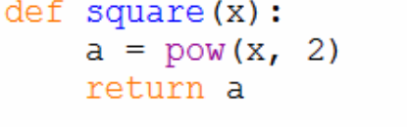
Daily Quiz
Which of the following is the valid way to begin the definition of a function in Python?
A. def some_function()
B. function some_function()
C. function some_function():
D. def some_function():
2.
A. def(1)
B. x=square( )
C. defSquare(4)
D. x=square(5)
Ans: D
Ans: D
faculty name Problem Solving using Python (ACSE0101) UNIT III

Slide 51
Daily Quiz
3. Which of the following is not a built-in function in python?
count() B. range() C. max() D. yield() Ans:A
4. When we pass arguments to a function having arbitrary arguments how is the data sent to the function?
A. In the form of a list. B. A tuple is generated C. A dictionary is generated D. They are passed on directly. Ans:B
5. Find the output of the code given below?
def funcGreet(text= “Good Morning ” , name):
print(text,name+”!”)
funcGreet(“John”)
A. Good Morning John! B. Good Morning John C. TypeError D. Syntax Error
Ans:D
faculty name Problem Solving using Python (ACSE0101) UNIT III

Slide 52
Function Arguments(CO3)
Arguments/parameters:
It is the information that are passed into a function.
Actual argument/parameter:
Arguments are passed to the functions at the time of calling.
Formal arguments/parameter:
Arguments are passed to the functions at the time of definition.
We can call a function by using the following types of formal arguments −
Required arguments/Positional arguments
Keyword arguments
Default arguments
Variable-length arguments
faculty name Problem Solving using Python (ACSE0101) UNIT III

Slide 53
Required Arguments(CO3)
Required arguments are the arguments passed to a function in correct positional order
The number of arguments in the function call should match exactly with the function definition.
Example:
# Function definition is here
def printme( str ):
"This prints a passed string into this function"
print (str)
return
# Now you can call printme function
printme()Note: at call of printme() will give syntax error
faculty name Problem Solving using Python (ACSE0101) UNIT III

Slide 54
Keyword Arguments(CO3)
Keyword arguments are related to the function calls
The caller identifies the arguments by the parameter name.
This allows to skip arguments or place them out of order because the Python interpreter can use the keywords provided to match the values with parameters.
Note:
A non keyword/positional argument can be followed by keyword argument, but keyword argument can not be followed by non keyword/positional argument
faculty name Problem Solving using Python (ACSE0101) UNIT III

Slide 55
Example Keyword Arguments(CO3)
# Function definition is here
def printinfo( name, age ):
"This prints a passed info into this function"
print ("Name: ", name)
print ("Age ", age)
return
# Now you can call printinfo function
printinfo( age=50, name=“Ram" )
Output
Name: Ram
Age 50
faculty name Problem Solving using Python (ACSE0101) UNIT III

Slide 56
Default Arguments(CO3)
A default argument is an argument that assumes a default value if a value is not provided in the function call for that argument.
Example:
# Function definition is here
def printinfo( name, age=20 ):
"This prints a passed info into this function"
print ("Name: ", name)
print ("Age ", age )
return
# Now you can call printinfo function
printinfo( age=50, name=“Ram" )
printfinfo( name =“Ram”)
Output
Name: Ram
Age 50
Name: Ram
Age 20
faculty name Problem Solving using Python (ACSE0101) UNIT III

Slide 57
Variable-length Arguments(CO3)
To process a function for more arguments than specified while defining the function. These arguments are called variable-length arguments and are not named in the function definition, unlike required and default arguments
*(var_name) creates tuple.
Syntax:
def functionname([formal_args,] *var_args_tuple ):
"function_docstring"
function_suite
return [expression]
Note: An asterisk (*) is placed before the variable name that holds the values of all non keyword variable arguments.
faculty name Problem Solving using Python (ACSE0101) UNIT III

Slide 58
Example Variable-length Arguments(CO3)
# Function definition is here
def printinfo( arg1, *vartuple ):
"This prints a variable passed arguments"
print ("Output is: “)
print (arg1)
for var in vartuple:
print (var)
return
# Now you can call printinfo function
printinfo( 10 )
printinfo( 70, 60, 50 )
Output
Output is:
10
Output is:
70
60
50
faculty name Problem Solving using Python (ACSE0101) UNIT III

Slide 59
Daily Quiz
1.Which type of arguments are being used in the code given below?
def funcSquare(*num):
for i in num:
print(i*i,end=” “)
funcSquare(1,7,3,4,2)
Default Arguments B. Arbitrary Arguments C. 1 7 3 4 2 D. A list of arguments. Ans:B
2. How do we write arbitrary arguments while defining a function?
A. arg# B. arg* C. arg_arbitrary D. All are correct Ans:B
3. Find output of this program.
def team(name, project):
print(name, "is working on an", project)
team(project = "Edpresso", name = 'FemCode') Ans: FemCode is working on an Edpresso
faculty name Problem Solving using Python (ACSE0101) UNIT III

Slide 60
Scope of Variables(CO3)
The scope of a variable determines the portion of the program where you can access a particular identifier.
There are two basic scopes of variables in Python:
  Global variables
  Local variables
Variables that are defined inside a function body have a local scope, and those defined outside have a global scope.
local variables can be accessed only inside the function in which they are declared, whereas global variables can be accessed throughout the program body by all functions.
faculty name Problem Solving using Python (ACSE0101) UNIT III

Slide 61
Global vs local(CO3)
EXAMPLE:
total = 0; # This is global variable.
# Function definition is here
def sum( arg1, arg2 ):
# Add both the parameters and return them."
total = arg1 + arg2; # Here total is local variable.
print ("Inside the function local total : ", total)
return
# Now you can call sum function
sum( 10, 20 )
print ("Outside the function global total : ", total)
Output
Inside the function local total : 30
Outside the function global total : 0
faculty name Problem Solving using Python (ACSE0101) UNIT III

Slide 62
The Scope of Variables
M_Tutor Link:(The Scope of Variables)
https://www.m-tutor.com/courses-detail.php?tid=859196&topicid=198433&selectedcourse=&selectedsubject=5715&selectedunit=&searchtopics=The%20Scope%20of%20Variables
faculty name Problem Solving using Python (ACSE0101) UNIT III

Slide 63
Namespaces in Python (CO3)
It is combination of name (refers to the name of object) and space ( location from where object is accessed).
A namespace is a collection of currently defined symbolic names along with information about the object that each name references.
A namespace can be as a dictionary in which the keys are the object names, and the values are the objects themselves.
Each key-value pair maps a name to its corresponding object.
In a Python program, there are four types of namespaces:
  Built-In
  Global
  Enclosing
  Local
faculty name Problem Solving using Python (ACSE0101) UNIT III

Slide 64
Namespaces in Python (CO3)
The Built-in namespace:
  The built-in namespace contains the names of all of Python’s built-in objects.
  These are always available when Python is running.
  we can list the objects in the built-in namespace with the following command:
>>> dir(__builtins__)
Note:
The Python interpreter creates the built-in namespace when it starts up.
This namespace remains in existence until the interpreter terminates.
faculty name Problem Solving using Python (ACSE0101) UNIT III

Slide 65
Namespaces in Python (CO3)
2. The Global namespace:
  The global namespace contains any names defined at the level of the main program.
  Python creates the global namespace when the main program body starts, and it remains in existence until the interpreter terminates.
x = 10 # x has global namespace
def myfun():
print(x)
myfun()
faculty name Problem Solving using Python (ACSE0101) UNIT III

Slide 66
Namespaces in Python (CO3)
Any variable defined inside a function using global keyword has also global namespace.
#Example
x = 10
def myfun():
global x # defined x using global keyword
x = 12 # access the global variable, does not creates the local variable
print(“Inside function definition”,x)
myfun()
print(“Outside function definition”,x)
Output
Inside function definition 12
Outside function definition 12
faculty name Problem Solving using Python (ACSE0101) UNIT III

Slide 67
Namespaces in Python (CO3)
Local namespace
  The local namespace contains any names defined at the block or function level of the main program.
  Python creates the local namespace when the execution of function body starts and terminates after the execution of body of function.
#Example
x = 10
def myfun():
x = 12 # Creates the local variable x
print(“Inside function definition”,x)
myfun()
print(“Outside function definition”,x)
Output
Inside function definition 12
Outside function definition 10
faculty name Problem Solving using Python (ACSE0101) UNIT III

Slide 68
Namespaces in Python (CO1)
4. Enclosing namespace
It refers the to the definition of inner() function and other statement nested inside the definition of outer() function.
It occurs only inside the nested function.
inner() function can access the enclosing namespace variable (also known as the non-local variable with respect to the inner() function) but can’t modify it.
If inner() function try to modify the enclosing variable, then a local variable is declared inside the inner() function namespace.
faculty name Problem Solving using Python (ACSE0101) UNIT III

Slide 69
Namespaces in Python (CO3)
# Example of enclosing namespace
x = 10
def outer():
x = 12 # Enclosing namespace starts here, x is defined inside the enclosing namespace
def inner():
print(“Inside the inner function”, x) # It refers to the enclosing namespace variable
inner()
print(“Inside outer definition”, x) # Enclosing namespace ends here
outer()
print(“Outside function definition”, x)
Output
Inside function definition 12
Inside outer definition 12
Outside function definition 10
faculty name Problem Solving using Python (ACSE0101) UNIT III

Slide 70
Namespaces in Python (CO3)
# Example of inner() trying to modify the enclosing variable
x = 10
def outer():
x = 12 # Enclosing namespace starts here, x is defined inside the enclosing namespace
def inner():
x = 7 # x now declared as local variable of inner
print(“Inside the inner function”, x) # It refers to the enclosing namespace variable
inner()
print(“Inside outer definition”, x) # Enclosing namespace ends here
outer()
print(“Outside function definition”, x)
Output
Inside function definition 7
Inside outer definition 12
Outside function definition 10
faculty name Problem Solving using Python (ACSE0101) UNIT III

Slide 71
Namespaces in Python (CO3)
# Example of inner() function modifying the enclosing variable using non-local keyword.
x = 10 # x is declared in global namespace
def outer():
x = 12 # Enclosing namespace starts here, x is defined inside the enclosing namespace
def inner():
nonlocal x # x is defined using global keyword
x = 7 # x now refers to enclosing variable of outer() function
print(“Inside the inner function”, x) # It refers to the enclosing namespace variable
inner()
print(“Inside outer definition”, x) # Enclosing namespace ends here
outer()
print(“Outside function definition”, x)
Output
Inside function definition 7
Inside outer definition 7
Outside function definition 10
faculty name Problem Solving using Python (ACSE0101) UNIT III

Slide 72
Namespaces in Python (CO3)
Namespace resolution rules.
First the environment looks for the variable (object) in local namespace.
If variable is not declared inside the local namespace, then it looks for the variable defined inside the enclosing namespace.
If variable is not declared inside the enclosing namespace, then it looks for the variable defined inside the global namespace.
If variable is not defined inside the global namespace, then it looks for the variable (object) in builtins namespace.
Finally, If variable is not present in builtins namespace, then “NameError” exception is raised by the environment.
faculty name Problem Solving using Python (ACSE0101) UNIT III

Slide 73
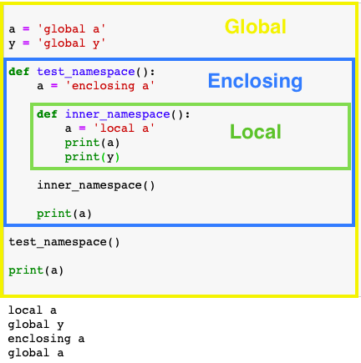
Example: Namespaces (CO3)
faculty name Problem Solving using Python (ACSE0101) UNIT III

Slide 74
Daily Quiz
1. This variable is created by assignment statement written outside all the functions.
Local variable B. Global variable C. Default variable D. Parameter variable Ans:- B
2. Which of the following is not a namespace in Python?
A. Built-in B. Global C. Non local D. Local Ans:- C
3. Which of the following are global variables in the below code?
var1=3.4
def func1():
var2=12
def func2():
var3=36
global var4
num4=9
func2()
A. var1, var2
B.var1, var3,
C.var1, var4
D.var1, var3, var4
faculty name Problem Solving using Python (ACSE0101) UNIT III

Slide 75
Daily Quiz
3. Which of the following are global variables in the below code?
var1=3.4
def func1():
var2=12
def func2():
var3=36
global var4
num4=9
func2()
Ans :C
A. var1, var2
B.var1, var3,
C.var1, var4
D.var1, var3, var4
faculty name Problem Solving using Python (ACSE0101) UNIT III

Slide 76
Garbage Collection (CO3)
It is the process by Python periodically reclaims unwanted memory.
Garbage collection in Python is automatic i.e. it deletes all the objects that are not needed or have gone out of scope to free the memory space.
It runs in the background during the program execution.
It immediately reclaims its memory as soon as the object’s reference count reaches to zero.
faculty name Problem Solving using Python (ACSE0101) UNIT III

Slide 77
Garbage Collection (CO3)
Object’s reference count increases when it is created, and its aliases are created.
That is, when object is assigned a new name, or it is referenced within in a list, tuple, or other data structure.
The object’s reference count decreases when it is being assigned to some other reference or its reference goes out of scope.
The object’ reference count can be decreased manually by deleting it with the del command.
faculty name Problem Solving using Python (ACSE0101) UNIT III

Slide 78
Garbage Collection (CO3)
# Example
A = 100 # Creates object A
B = A # Object’s reference count increases by 1-object assigned
C = [1,2,B] # Object’s reference count increases by 1-object used in list
B = 200 # Object’s reference count decreases by 1-Reassignment of B
C[2] = 3 # Object’s reference count decreases by 1- not used in list
del A # Object’s reference count is zero – object removed from memory
faculty name Problem Solving using Python (ACSE0101) UNIT III

Slide 79
Function as object
  Function variable (name of the function) is the object of function class , that can be reassigned to another function variable.
  # Function as object:::
  def fun(text):
  return text + ‘ Python’
  print(fun(‘hello’))
  fun_obj = fun # function treated as object. fun_obj refers to fun() function.
  print(fun_obj(‘hi’))
Output
hello Python
hi Python
faculty name Problem Solving using Python (ACSE0101) UNIT III

Slide 80
Defining Functions Inside other Functions(CO3)
  Function defined inside the function is also called inner function.
  # defining function inside function
  def plus_one(number):
  def add_one(num):
  return num + 1
  result = add_one(number)
  return result
  # call of function
  print(plus_one(4))
Output
5
faculty name Problem Solving using Python (ACSE0101) UNIT III

Slide 81
Passing Functions as Arguments to other Functions
  Functions can also be passed as parameters to other functions. Functions that can accept other function as argument are also called Higher-order functions.
  # Passing Functions as Arguments to other Functions
  def one(msg):
  return msg + ‘1’
  def two(msg):
  return msg + ‘2’
  def three(fun):
  x=fun(“Message inside”)
  print(x)
  three(one)
  three(two)
Output
Message inside 1
Message inside 2
faculty name Problem Solving using Python (ACSE0101) UNIT III

Slide 82
Functions Returning other Functions(CO3)
  # Defining Functions returning other Functions
  def hello_function():
  def say_hi():
  return "Hi"
  return say_hi
  hello = hello_function()
  print(hello())
Output
Hi
faculty name Problem Solving using Python (ACSE0101) UNIT III

Slide 83

Recursion(CO3)
faculty name Problem Solving using Python (ACSE0101) UNIT III

Slide 84
Recursion(CO3)
A recursive function is a function defined in terms of itself via self-referential expressions.
It means that the function will continue to call itself and repeat its behaviour until some condition is met to return a result.
All recursive functions share a common structure made up of two parts: base case and recursive case
faculty name Problem Solving using Python (ACSE0101) UNIT III

Slide 85
Demonstration of Recursion(CO3)
Recursive function for calculating n!
Decompose the original problem into simpler instances of the same problem:
n ! = n x (n−1) x (n−2) x (n−3) ⋅⋅⋅⋅ x 3 x 2 x 1
n! = n x (n−1)! ( Recursive case)
Recusrvie case repeated till than it reaches base case:
n! = n x (n−1)!
n! = n x (n−1) x (n−2)!
n! = n x (n−1) x (n−2) x (n−3)! ⋅ ⋅
n! = n x (n−1) x (n−2) x (n−3) ⋅⋅⋅⋅ x 3 x 2!
n! = n x (n−1) x (n−2) x (n−3) ⋅⋅⋅⋅ x 3 x 2 x 1! (1! Is base case)
faculty name Problem Solving using Python (ACSE0101) UNIT III

Slide 86
Demonstration of Recursion(CO3)
def factorial_recursive(n):
# Base case: 1! = 1
if n == 1: return 1
# Recursive case: n! = n * (n-1)!
else:
return n * factorial_recursive(n-1)
#Now call of function
factorial_recursive(5)
Output
120
faculty name Problem Solving using Python (ACSE0101) UNIT III

Slide 87
Program to create Fibonacci series using Recursion(CO3)
Program Explanation
1. User must enter the number of terms and store it in a variable.
2. The number is passed as an argument to a recursive function.
3. The base condition is that the number has to be lesser than or equal to 1.
4. Otherwise the function is called recursively with the argument as the number minus 1 added to the function called recursively with the argument as the number minus 2.
5. The result is returned and a for statement is used to print the fibonacci series.
faculty name Problem Solving using Python (ACSE0101) UNIT III

Slide 88
Recursion(CO3)
# Python program to display the Fibonacci sequence
def recur_fibo(n):
if n <= 1:
return n
else:
return(recur_fibo(n-1) + recur_fibo(n-2))
nterms = 10
# check if the number of terms is valid
if nterms <= 0:
print("Please enter a positive integer")
else:
print("Fibonacci sequence:")
for i in range(nterms):
print(recur_fibo(i))
Output
Fibonacci sequence:
0
1
1
2
3
5
8
13
21
34
faculty name Problem Solving using Python (ACSE0101) UNIT III

Slide 89
Recursion
What is the output of the below snippet of code?
def fact(n):
if n == 0:
return "good"
else:
return fact(n-4)
print(fact(16))
A. 16 B. good good good good C. good D. None of the above
2. Predict the output:
def fun(i,j):
if(i==0):
return j
else:
return fun(i-1,j+1)
print(fun(4,8))
A. 10 B. 11 C.12 D. 13
Ans:-C
Ans:-C
faculty name Problem Solving using Python (ACSE0101) UNIT III

Slide 90

The Anonymous/Lambda Functions (CO3)
faculty name Problem Solving using Python (ACSE0101) UNIT III

Slide 91
The Anonymous Functions (CO3)
These functions are called anonymous because they are not declared in the standard manner by using the def keyword
lambda keyword is used.
Lambda is inline function that do not have name.
Lambda forms can take any number of arguments but return just one value in the form of an expression.
An anonymous function cannot be a direct call to print because lambda requires an expression.
Lambda functions have their own local namespace.
It can access variables in their parameter list and those in the global namespace.
faculty name Problem Solving using Python (ACSE0101) UNIT III

Slide 92
The Anonymous Functions(CO3)
Syntax:
lambda [arg1 [,arg2,.....argn]]:expression
Example:
# Function definition is here
sum = lambda arg1, arg2: arg1 + arg2;
# Now you can call sum as a function
print ("Value of total : ", sum( 10, 20 ))
print ("Value of total : ", sum( 20, 20 ))
Output
Value of total : 30 Value of total : 40
faculty name Problem Solving using Python (ACSE0101) UNIT III

Slide 93
The Anonymous Functions(CO3)
Using lambda square the input value:
def square(x):
return x*x
lambda_sq=lambda x: x * x
print(“using regular function:”,square(3))
print(“using lambda function “,lambda_sq(4))
Output
using regular function : 9 using lambda function : 16
faculty name Problem Solving using Python (ACSE0101) UNIT III

Slide 94
map() Function (CO3)
It is a built in function that process all the items in an iterable without using an explicit for loop, also called mapping.
It is useful when it is required to apply a transformation into a new iterable.
It supports functional programming style in python.
Syntax:
map(function, iterable1[, iterable2, iterable3, …. ,iterableN])
map() applies function on each item in iterable and returns a new iterator that yields transformed items on demand.
faculty name Problem Solving using Python (ACSE0101) UNIT III

Slide 95
map() Function (CO3)
# Example: WAP to square the each element of the list
# using map() function, two things 1. function 2. iterable
def mysquare(x):
return x**2
mylist = [10,11,12,13, 14]
mob=map(mysquare, mylist) # mob is the map object
mylist1 = list(mob) # convert the map object into a list
print("Original List :", mylist)
print("New list :", mylist1)
Output
Original List : [10, 11, 12, 13, 14]
New list : [100, 121, 144, 169, 196]
faculty name Problem Solving using Python (ACSE0101) UNIT III

Slide 96
map() Function (CO3)
# Example: WAP to square the each element of the list using map() function
# Also use the lambda function to square each number of list.
mylist = [10,11,12,13,14]
mylist1 = list(map(lambda x:x**2,mylist))
print("Original List :", mylist)
print("New List :", mylist1)
Output
Original List : [10, 11, 12, 13, 14]
New list : [100, 121, 144, 169, 196]
faculty name Problem Solving using Python (ACSE0101) UNIT III

Slide 97
reduce() Function (CO3)
The reduce() function in Python takes in a function and a list as an argument.
The function is called with a lambda function and an iterable and a new reduced result is returned.
This performs a repetitive operation over the pairs of the iterable. The reduce() function belongs to the functools module.
faculty name Problem Solving using Python (ACSE0101) UNIT III

Slide 98
reduce() Function (CO3)
# Example : WAP to compute the sum of all numbers in the list
from functools import reduce
li = [1, 2, 3, 4, 5]
print(“Sum :”,reduce(lambda a, b : a+b, li))
Output
Sum : 15
faculty name Problem Solving using Python (ACSE0101) UNIT III

Slide 99
reduce() Function (CO3)
# Example : WAP to find the maximum element in the list.
from functools import reduce
li = [11,21,53,42,51]
print(“Maximum :”,reduce(lambda a, b : a if a>b else b, li))
Output
Maximum : 53
faculty name Problem Solving using Python (ACSE0101) UNIT III

Slide 100
filter() Function (CO3)
The filter() function in Python takes in a function and a list as arguments.
The function is called with all the items in the list and a new list is returned which contains items for which the function evaluates to True.
# Program to filter out only the even items from a list
my_list = [1, 5, 4, 6, 8, 11, 3, 12]
new_list = list(filter(lambda x: (x%2 == 0) , my_list))
print(new_list)
Output
[4, 6, 8, 12]
faculty name Problem Solving using Python (ACSE0101) UNIT III

Slide 101
Quiz-Function
1. What is the output of the following function call?
def fun1(name, place=‘Noida’):
print(name, place)
fun1(‘NIET', ‘GreaterNoida’)
  NIET GreaterNoida
  NIET Noida
2. Select which is true for Python function
  A Python function can return only a single value
  A function can take an unlimited number of arguments.
  A Python function can return multiple values
  Python function doesn’t return anything unless and until you add a return statement.
Ans
Option a
Ans:
b and c
faculty name Problem Solving using Python (ACSE0101) UNIT III

Slide 102
Quiz-Function(CO3)
3. What is the output of the add() function call
  def add(a, b):
  return a+5, b+5
  result = add(3, 2)
  print(result)
Ans:
Option c
Syntax Errror
8
(8,7)
15
faculty name Problem Solving using Python (ACSE0101) UNIT III

Slide 103
Quiz
4. What is the output of the following displayPerson() function call
def display(**kwargs):
for i in kwargs:
print(i)
display(emp="Kelly", salary=9000)
  TypeError
  Kelly
  9000
  (’emp’, ‘Kelly’)
  (‘salary’, 9000)
  emp
  salary
Ans
Option d
faculty name Problem Solving using Python (ACSE0101) UNIT III

Slide 104
Quiz
  5. What is the output of the following code snippet?
  def func(message, num = 1):
  print(message * num)
  func('Welcome')
  func('Viewers', 3)
Ans:
Option B
A. Welcome
Viewers
B. Welcome
Viewers Viewers Viewers
C. Welcome
Viewers , Viewers, Viewers
D. Welcome
faculty name Problem Solving using Python (ACSE0101) UNIT III

Slide 105
Weekly Assignment
Define Function and Explain different types of argument of function.
Write a Python function to find the Max of three numbers.
Write a python function to check number passed as argument is perfect number or not.
Python program to check string is palindrome or not using functions.
Write a Python function to create and print a list where the values are square of numbers between 1 and 30.
Differentiate the concept of lambda function with normal function with one example.
Write a Python program to detect the number of local variables declared in a function.
Python program to count the even, odd numbers in a given array of integers using lambda function.
faculty name Problem Solving using Python (ACSE0101) UNIT III

Slide 106
Prerequisite and Recap(CO3)
Functions
Lambda functions
Passing function to the functions
faculty name Problem Solving using Python (ACSE0101) UNIT III

Slide 107
Prerequisite and Recap(CO3)
Functions
  Arguments and its use
  Scope rules
Lambda functions
Syntax:
lambda [arg1 [,arg2,.....argn]]:expression
faculty name Problem Solving using Python (ACSE0101) UNIT III

Slide 108
Topic objective(CO3)
Objective:
To import the functions from module.
To understand and installation of packages.
faculty name Problem Solving using Python (ACSE0101) UNIT III

Slide 109
Module Definition(CO3)
A module allows to logically organize Python code.
A module makes the code easier to understand and use.
A module is a Python object with arbitrarily named attributes that can bind and reference.
A module is a file consisting of Python code.
A module can define functions, classes and variables.
A module can also include runnable code.
faculty name Problem Solving using Python (ACSE0101) UNIT III

Slide 110
import Module(CO3)
Python source file as a module by executing an import statement in some other Python source file.
The import has the following syntax −
  import module1[, module2[,... moduleN]
  Hello.py
  def SayHello(name):
  print(“Hello”, name,“! How are you?”)
  return
# Import module hello
import Hello
Hello.SayHello(“Students”)
Output
Hello Students! How are you?
faculty name Problem Solving using Python (ACSE0101) UNIT III

Slide 111
The from...import Statement(CO3)
Python's from statement lets you import specific attributes from a module into the current namespace.
The from...import has the following syntax −
  from modname import name1[, name2[, ... nameN]
For example,
To import the function Fibonacci from the module fib, use the following statement
from fib import fibonacci
faculty name Problem Solving using Python (ACSE0101) UNIT III

Slide 112
Locating Modules(CO3)
When you import a module, the Python interpreter searches for the module in the following sequences −
  The current directory.
  If the module isn't found, Python then searches each directory in the shell variable PYTHONPATH.
  If all else fails, Python checks the default path.
  Note: The module search path is stored in the system module sys as the sys.path variable. The sys.path variable contains the current directory, PYTHONPATH, and the installation-dependent default.
faculty name Problem Solving using Python (ACSE0101) UNIT III

Slide 113
Renaming the Imported Module(CO3)
use the as keyword to rename the imported module as shown below:
Example:
import math as cal
cal.log(4)
Output
1.3862943611198906
faculty name Problem Solving using Python (ACSE0101) UNIT III

Slide 114
dir() function(CO3)
The dir() function returns all properties and methods of the specified object, without the values.
This function will return all the properties and methods, even built-in properties which are default for all object.
Syntax:
dir(object)
Note: Object that want to see the attributes
Example:
dir(math)
dir(io)
faculty name Problem Solving using Python (ACSE0101) UNIT III

Slide 115
Standard library module's function(CO3)
The Python interpreter has several built-in functions.
They are loaded automatically as the interpreter starts and are always available.
Built-in modules are written in C and integrated with the Python interpreter
Each built-in module contains resources for certain system-specific functionalities such as OS management, disk IO, etc
Some of listing is as follows:
  os module
  math module
  statistics module
  random module
faculty name Problem Solving using Python (ACSE0101) UNIT III

Slide 116
OS Module(CO3)
The OS module in Python provides functions for creating and removing a directory (folder), fetching its contents, changing and identifying the current directory etc.
Creating Directory
mkdir() function create directory
Removing a Directory
rmdir() function removes directory
List Files and Sub-directories
listdir() function returns the list of all files and directory.
Changing the Current Working Directory
chdir() function to change current directory.
faculty name Problem Solving using Python (ACSE0101) UNIT III

Slide 117
sys Module(CO3)
The sys module provides functions and variables used to manipulate different parts of the Python runtime environment.
sys.version
is used which returns a string containing the version of Python Interpreter with some additional information.
sys.argv
returns a list of command line arguments passed to a Python script
sys.exit
This causes the script to exit back to either the Python console or the command prompt.
sys.path
This is an environment variable that is a search path for all Python modules.
faculty name Problem Solving using Python (ACSE0101) UNIT III

Slide 118
math module(CO3)
Some of the most popular mathematical functions are defined in the math module.
These include trigonometric functions, representation functions, logarithmic functions, angle conversion functions, etc.
Example are:
math.pow()
math.log()
math.log10()
math.exp()
faculty name Problem Solving using Python (ACSE0101) UNIT III

Slide 119
statistics module(CO3)
The statistics module provides functions to mathematical statistics of numeric data.
The following popular statistical functions are defined in this module.
  mean()
  median()
  mode()
  stdev()
faculty name Problem Solving using Python (ACSE0101) UNIT III

Slide 120
random module(CO3)
Functions in the random module depend on a pseudo-random number generator function random(), which generates a random float number between 0.0 and 1.0.
The following popular random functions are defined in this module.
  random.random()
  random.randint ()
  random.randrange()
  random.choice()
  random.shuffle()
faculty name Problem Solving using Python (ACSE0101) UNIT III

Slide 121
Creating and Installing Packages in Python(CO3)
A package in Python takes the concept of the modular approach to next logical level..
A package can contain one or more relevant modules. Physically, a package is actually a folder containing one or more module files.
Steps to create packages:
  Create a new folder named D:\MyApp.
  Inside MyApp, create a subfolder with the name 'mypackage'.
  Create an empty __init__.py file in the mypackage folder.
  Using a Python-aware editor like IDLE, create modules greet.py and functions.py with following code:
faculty name Problem Solving using Python (ACSE0101) UNIT III

Slide 122
More in Creating and Installing Packages in Python(CO3)
greet.py
def SayHello(name):
print("Hello " + name)
return
functions.py
def sum(x,y):
return x+y
def average(x,y):
return (x+y)/2
def power(x,y):
return x**y
faculty name Problem Solving using Python (ACSE0101) UNIT III

Slide 123
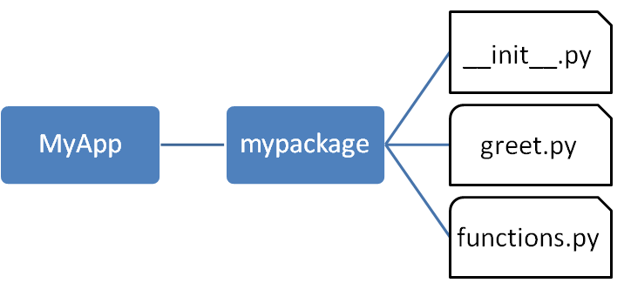
More in Creating and Installing Packages in Python (CO3)
We have created our package called mypackage. The following is a folder structure:
faculty name Problem Solving using Python (ACSE0101) UNIT III

Slide 124
Importing a Module from a Package(CO3)
Invoke the Python prompt from the MyApp folder.
D:\MyApp>python
Import the functions module from the mypackage package and call its power() function
from mypackage import functions
>>> functions.power(3,2)
9
It is also possible to import specific functions from a module in the package
from mypackage.functions import sum
>>> sum(10,20)
30
faculty name Problem Solving using Python (ACSE0101) UNIT III

Slide 125
__init__.py(CO3)
The package folder contains a special file called __init__.py, which stores the package's content.
It serves two purposes:
  The Python interpreter recognizes a folder as the package if it contains __init__.py file.
  __init__.py exposes specified resources from its modules to be imported.
Note that __init__.py is essential for the folder to be recognized by Python as a package. You can optionally define functions from individual modules to be made available.
faculty name Problem Solving using Python (ACSE0101) UNIT III

Slide 126
__init__.py(CO3)
The __init__.py file is normally kept empty.
However, it can also be used to choose specific functions from modules in the package folder and make them available for import.
Modify __init__.py as below:
  from .functions import average, power
  from .greet import SayHello
The specified functions can now be imported in the interpreter session or another executable script.
faculty name Problem Solving using Python (ACSE0101) UNIT III

Slide 127
__init__.py(CO3)
Create test.py in the MyApp folder to test mypackage.
test.py
from mypackage import power, average
SayHello SayHello()
x=power(3,2)
print("power(3,2) : ", x)
Output of above script:
D:\MyApp>python test.py
Hello world
power(3,2) : 9
faculty name Problem Solving using Python (ACSE0101) UNIT III

Slide 128
Installing packages(CO3)
Once a package is created, it can be installed for system wide use by running the setup script. The script calls setup() function from setup tools module.
Steps are as follows:
Save the following code as setup.py in the parent folder 'MyApp'.
The script calls the setup() function from the setup tools module.
The setup() function takes various arguments such as name, version, author, list of dependencies etc.
The zip_safe argument defines whether the package is installed in compressed mode or regular mode.
faculty name Problem Solving using Python (ACSE0101) UNIT III

Slide 129
Installing packages(CO3)
Example: setup.py:
from setuptools import setup
setup(name='mypackage',
version='0.1',
description='Testing installation of Package',
url='#', author='malhar', author_email='mlathkar@gmail.com',
license='MIT', packages=['mypackage'],
zip_safe=False)
faculty name Problem Solving using Python (ACSE0101) UNIT III

Slide 130
Installing packages(CO3)
Now execute the following command to install mypack using the pip utility. Ensure that the command prompt is in the parent folder, in this case D:\MyApp
D:\MyApp>pip install .
Processing d:\MyApp
Installing collected packages: mypack
Running setup.py install for mypack ... done
Successfully installed mypackage-0.1
Now mypackage is available for system-wide use and can be imported in any script or interpreter.
D:\>python
>>> import mypackage
>>>mypackage.average(10,20)
>>>mypackage.power(10,2)
Output:
15.0
10
faculty name Problem Solving using Python (ACSE0101) UNIT III

Slide 131
Quiz-Module
Ans: b
1.Which of these definitions correctly describes a module?
a) Denoted by triple quotes for providing the specification of certain program elements
b) Design and implementation of specific functionality to be incorporated into a program
c) Defines the specification of how it is to be used
d) Any program that reuses code
2. Which of the following is not an advantage of using modules?
a) Provides a means of reuse of program code
b) Provides a means of dividing up tasks
c) Provides a means of reducing the size of the program
d) Provides a means of testing individual parts of the program
3. Program code making use of a given module is called a ______ of the module.
a) Client
b) Docstring
c) Interface
d) Modularit
4. Which of the following is not a valid namespace?
a) Global namespace b) Public namespace
c) Built-in namespace d) Local namespac
Ans: c
Ans: a
Ans: b
faculty name Problem Solving using Python (ACSE0101) UNIT III

Slide 132
Quiz-Module
1.Which of these definitions correctly describes a module?
a) Denoted by triple quotes for providing the specification of certain program elements
b) Design and implementation of specific functionality to be incorporated into a program
c) Defines the specification of how it is to be used
d) Any program that reuses code
2. Which of the following is not an advantage of using modules?
a) Provides a means of reuse of program code
b) Provides a means of dividing up tasks
c) Provides a means of reducing the size of the program
d) Provides a means of testing individual parts of the program
Ans: b
Ans: c
faculty name Problem Solving using Python (ACSE0101) UNIT III

Slide 133
Weekly Assignment
Differentiate the concept of Modules and package in python with example.
Create and install packages in the system with example.
Explain the standard library modules with example.
What is the working of dir() function? .
What is __init__?
Write a Python program to select a random element from a list, set, dictionary (value) and a file from a directory. Use random.choice().
Python program to find sum of n numbers using recursive functions.
faculty name Problem Solving using Python (ACSE0101) UNIT III

Slide 134
Weekly Assignment
Write a module in python to implement arithmetic calculator that has following user-defined functions: add(), sub(), mul(), div(). Write a python program to import this module and perform any operation.
Differentiate between global and non-local variables.
Python program to demonstrate the variable length arguments in functions.
faculty name Problem Solving using Python (ACSE0101) UNIT III

Slide 135
Faculty Video Links, You tube & NPTEL Video Links and Online Courses Details(CO3)
Youtube/other Video Links
Functions:
  https://youtu.be/oSPMmeaiQ68
Module:
  https://www.youtube.com/watch?v=Uei2ILcxuPs
  https://www.youtube.com/watch?v=W4HSsPPQLtk
faculty name Problem Solving using Python (ACSE0101) UNIT III

Slide 136
MCQ
What is the output of the following code : (CO1)
print (9//2)
1. 4.5
2. 4
3. 4.0 Ans: 2
4. None
2. Select the right way to create a string literal
Rama's City . (CO1)
1. str1 = 'Rama\\'s City'
2. str1 = 'Rama\'s City' Ans:2
3. str1 = 'Rama's City'
4. str1 = '''Rama\\'s City'''
faculty name Problem Solving using Python (ACSE0101) UNIT III

Slide 137
MCQ
3. What is the output of the following loop? (CO2)
for i in 'NIET':
if i == 'E':
pass print(i, end=", ")
1. N, I, E, T 2. N, I, T 3. E 4. Error Ans-1
4. What is the output of the following if statement? (CO2)
a, b = 12, 5
if a + b:
print('True')
else:
print('False')
1. True 2. False 3. 17 4. Error Ans-4
faculty name Problem Solving using Python (ACSE0101) UNIT III

Slide 138
MCQ
5. Choose the correct function declaration of fun1() so that we can execute the following function call successfully
fun1(25, 75, 55)
fun1(10, 20)
  def fun1(**kwargs)
  No, it is not possible in Python
  def fun1(args*)
  def fun1(*data)
faculty name Problem Solving using Python (ACSE0101) UNIT III

Slide 139
Old Question Papers
What is the advantage of recursion as compared to iteration? [NIET Autonomous 2021-22 (Odd) Marks-2]
Elaborate various types of actual and formal arguments used in functions. Give example of each type of arguments.
[NIET Autonomous 2021-22 (Odd) Marks-6]
Explain recursion. Write a program to reverse a string using recursion
[NIET Autonomous 2021-22 (Odd) Marks-10]
Write a program to find sum of odd digits of a given number using recursion.
[NIET Autonomous 2021-22 (Odd) Marks-6]
faculty name Problem Solving using Python (ACSE0101) UNIT III

Slide 140
Old Question Papers
Discuss functions in python with its part and scope. Explain with example(Take simple calculator with add , subtract , multiplication and division.) [AKTU 2019-2020(odd), 10 marks]
Explain higher order functions with respect to lambda expressions. Write a python code to count occurrences of an element in the list.
[AKTU 2019-2020(odd), 10 marks]
Write a program to sort list of dictionaries by value in python-using lambda functions. [AKTU 2019-2020(odd), 2 marks]
Differentiate iterators and recursion. Write a program for recursive Fibonacci series. [AKTU 2019-2020(odd), 2 marks]
faculty name Problem Solving using Python (ACSE0101) UNIT III

Slide 141
Expected Questions for University Exam
Explain keyword and default argument in function with example
Write a program to implement simple calculator with add , subtract , multiplication and division
Explain higher order functions with respect to lambda expressions. Write a python code to count occurrences of an element in the list.
Explain packages in the python with installation steps.
Differentiate iterators and recursion. Write a program for recursive factorial of a number.
faculty name Problem Solving using Python (ACSE0101) UNIT III

Slide 142
Summary
A function is a block of organized, reusable code that is used to perform a single, related action.
A module is a Python object with arbitrarily named attributes that can bind and reference.
Package can be installed for system wide use by running the setup script.
faculty name Problem Solving using Python (ACSE0101) UNIT III

Slide 143
References
Python Programming using problem solving Approach by Reema Thareja
Think Python: An Introduction to Software Design by Allen B. Downey
www.python.org
www.w3schools.com
faculty name Problem Solving using Python (ACSE0101) UNIT III

Slide 144

faculty name Problem Solving using Python (ACSE0101) UNIT III

