Slide 1







2019 Technology Situations and Trend for 2020
Abdullah Sharaf
12/5/2020

Slide 2



OUTLINE
Executive Summary
Introduction
Methodology
Results
Visualization – Charts
Dashboard
Discussion
Findings & Implications
Conclusion
Appendix

Slide 3

EXECUTIVE SUMMARY
Data Collection
• APIs
• Web Scraping
• Public Data Resources
• Data Wrangling
• Duplicates Handling
• Missing Values Handling
• Data Standardization
• Found the current situation and future trends of changing
technologies
• Analyzed the correlations of different features
• Visualized data and generated Dashboards by Python and
Cognos

Slide 4

INTRODUCTION
Situations
• Technologies are being developed rapidly
• Keep pace with changing technologies and remain
competitive
• Important and necessary to know the trend
• Stack Overflow developer surveys since 2011
• Clear view of the developing trend of programming languages as
well as databases
Our Analysis
• Current situation in 2019 and future trend in 2020
• Correlations between different features

Slide 5

METHODOLOGY: Data collection
GitHub Jobs API
• Number of jobs currently open for various technologies
Web Scraping
• Programming Languages and corresponding salaries
Open-Sourced Data
• 2019 Stack Overflow Developer Survey

Slide 6
METHODOLOGY: Data Wrangling
• Duplicates Handling
• Finding and Removing
• Missing Values Handling
• Finding and Imputing
• Data Normalization
• E.g. Transform all the salaries (Weekly/Monthly/Yearly) to Yearly

Slide 7
METHODOLOGY: Exploratory Data Analysis
• Determine how data is distributed
• Identify and remove outliers
• Find the correlations between different features

Slide 8
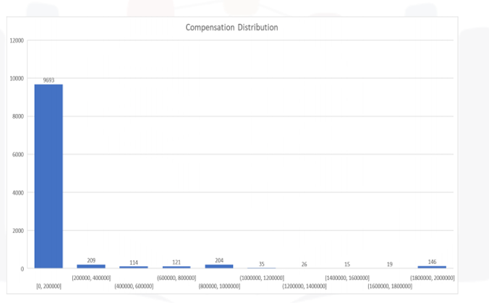
RESULTS – Distribution of Compensation

Slide 9
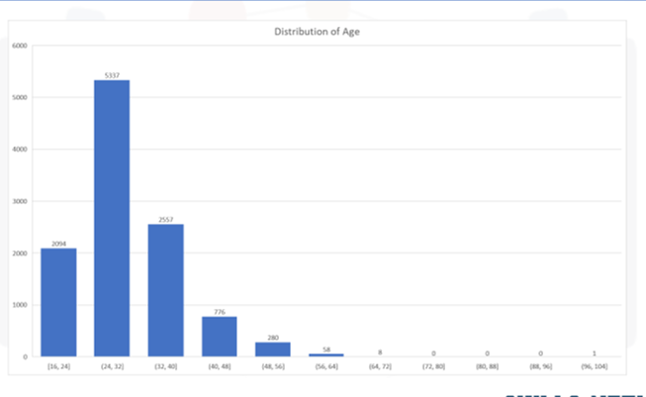
RESULTS – Distribution of Age

Slide 10
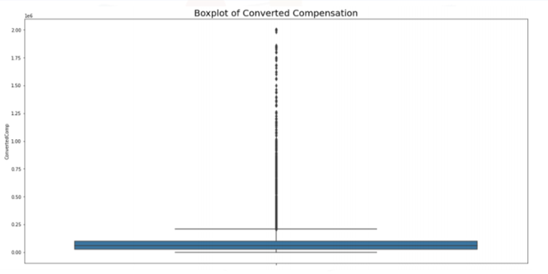
RESULTS – Boxplot of Compensation

Slide 11
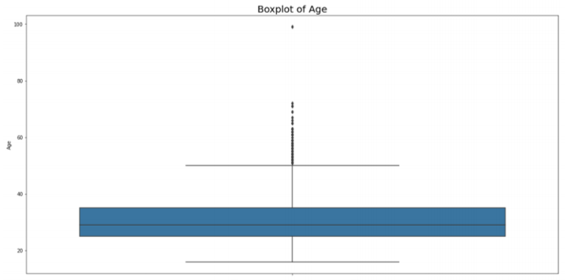
RESULTS – Boxplot of Age

Slide 12
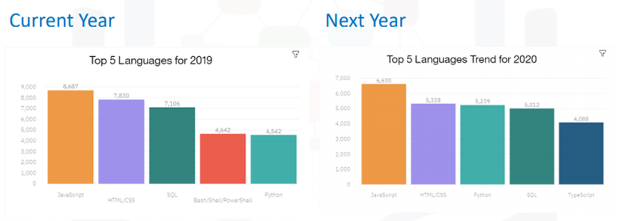
PROGRAMMING LANGUAGE TRENDS

Slide 13
PROGRAMMING LANGUAGE TRENDS - FINDINGS & IMPLICATIONS
Findings
• Average number of desires drops
for top 5 languages
• Python remains in top 5 and
desire is increased
• Typescript replaces
Bash/Shell/PowerShell in top 5
Implications
• The non-top 5 languages has the
trend to occupy more shares
• Python is becoming more
competitive
• The competitive power of Shell
Language has a dropping trend

Slide 14
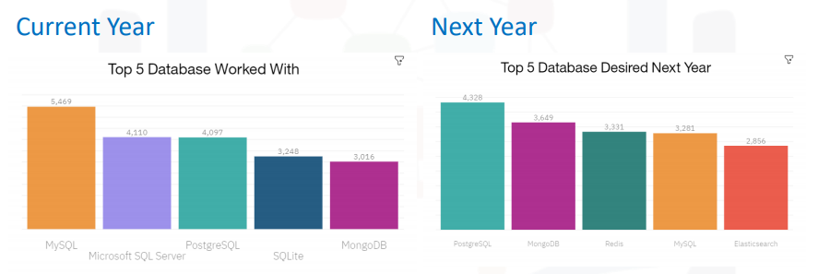
DATABASE TRENDS

Slide 15
DATABASE TRENDS - FINDINGS & IMPLICATIONS
Findings
• SQL DB occupies 4 of top 5 in
2019 but only occupies 2 of top
5 in 2020 trend
• MySQL/PostgreSQL/Mongo DB
remains top 5
• Redis and Elasticsearch step in
top 5 trend
Implications
• SQL DB is losing power
• Open-sourced SQL DB is still
competitive
• Cloud-based/No-SQL DB
becoming more competitive

Slide 16

DASHBOARD
IBM Cognos Dashboard Link:
https://dataplatform.cloud.ibm.com/dashboards/93db381f-225d-4824-8d16-d477f609dfb8/view/771fd77f358b368d76ecc4e407ca7a542e32205cb2bb8152d5807b490e637897a83f14c7c87a490cd9420c31a0ea410ac0

Slide 17
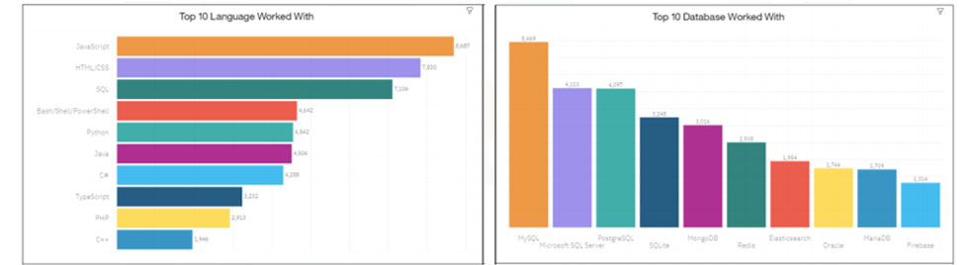
DASHBOARD – Current Technology Usage

Slide 18
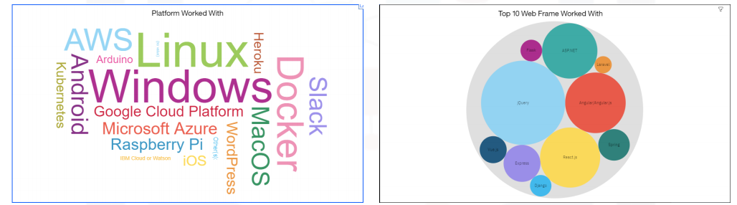
DASHBOARD – Current Technology Usage

Slide 19
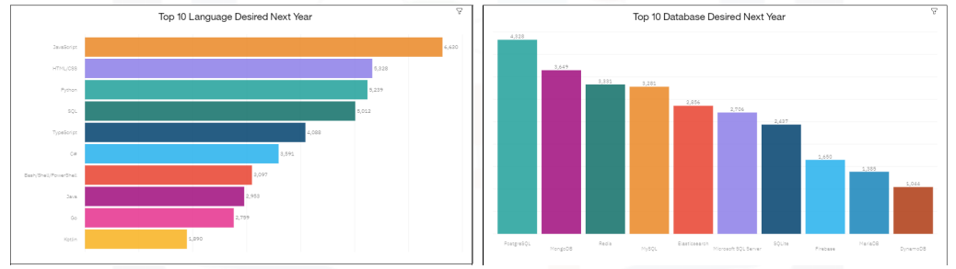
DASHBOARD – Future Technology Trend

Slide 20
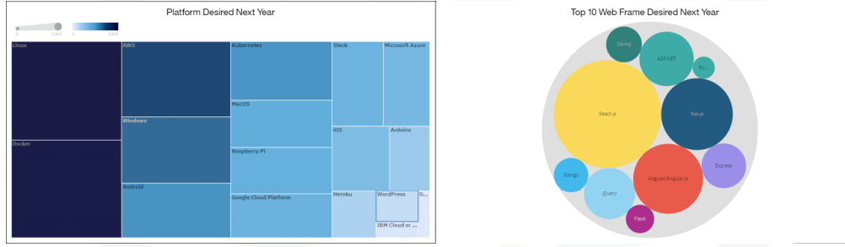
DASHBOARD – Future Technology Trend

Slide 21
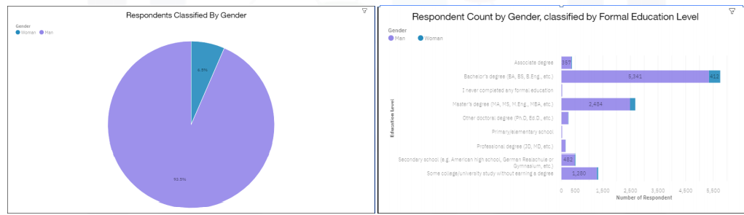
DASHBOARD - Demographics

Slide 22
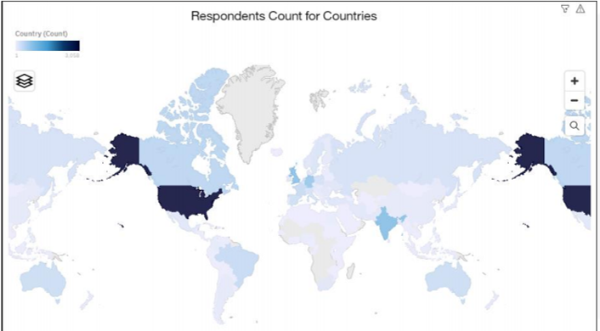
DASHBOARD - Demographics

Slide 23
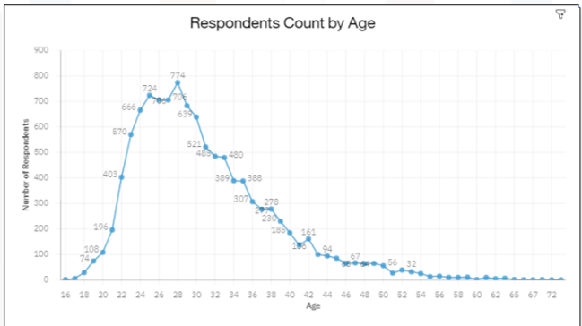
DASHBOARD - Demographics

Slide 24
DISCUSSION
The actual power of programming languages is
when the right programmer uses them with the
right features to solve a specific problem or for
any other specific purpose

Slide 25
OVERALL FINDINGS & IMPLICATIONS
Findings
• Men forms a large proportion of
coding industry
• Most developers are between 20
to 40 years old(especially 24~32)
• Most developers hold a
Bachelor’s or Master’s degree
Implications
• Industry should make some
efforts to balance the gender
• A good age for coding is less
than 40 years old, step into
management level after 40

Slide 26

CONCLUSION
Python as an open-sourced, easy-to-use
language is becoming more competitive
• Cloud based database is turning desirable
because of efficiency and mobility
• No-SQL seems more important as data is
not just in tabular form
• Windows and Linus are still the most
important platform for development

Slide 27

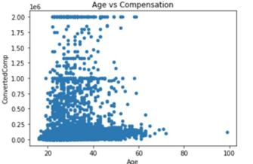
APPENDIX

Slide 28
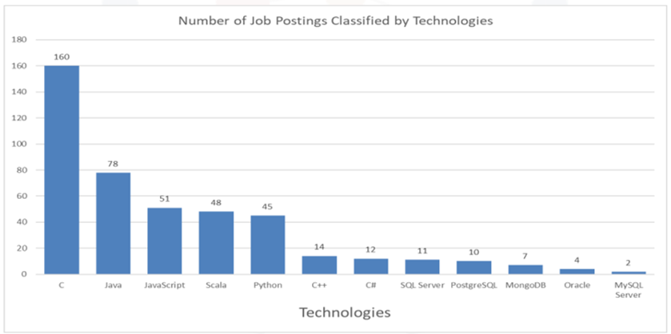
GITHUB JOB POSTINGS
.

Slide 29
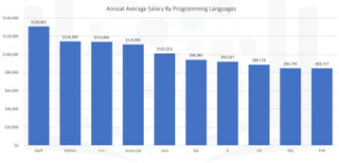
POPULAR LANGUAGES

