Slide 1








Customer Churn Analysis for Telecom Company
Abdullah Sharaf
07/07/2025

Slide 2


OUTLINE
Overview of the Project and Business Goals
Project Objective: To explore customer churn data, identify key churn drivers, and uncover patterns in customer behavior that can inform strategic decisions to reduce churn and retain high-value customers.
Business Goals:
Reduce Customer Churn Rate by identifying the main reasons behind subscriber cancellations and analyzing age group distributions to better understand customer behaviors.

Slide 3
OUTLINE
Optimize Retention Strategies: Use customer churn data insights to adjust strategies that enhance customer loyalty and maximize long-term value.
Identify Improvement Areas: Pinpoint specific service aspects or customer segments that require focused interventions, such as tailored offers, improved customer support, or marketing efforts.

Slide 4

Problem Addressed
Data Quality: By cleaning and standardizing customer and service data by Power Query Editor, the analysis ensures a consistent and reliable dataset ready for accurate churn analysis.
Estimation: Imputing missing values in key customer and usage variables helps create a complete picture of churn patterns and customer behavior.
Retention Strategy: Insights from the analysis clarify which factors that most influence churn, guiding targeted customer retention efforts and strategic decision-making.

Slide 5
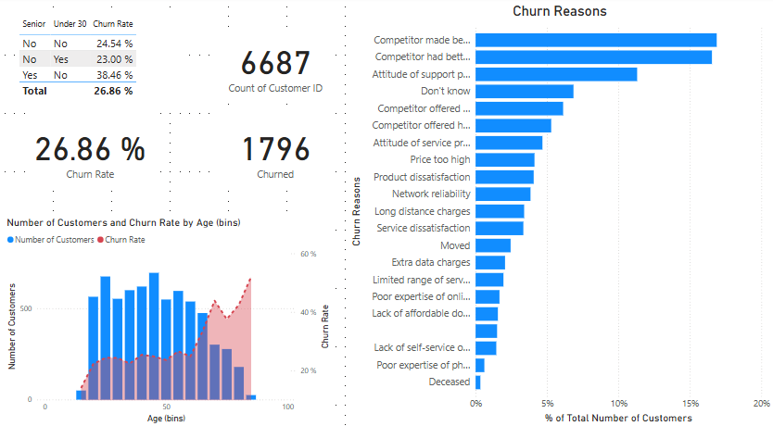
Churn Demographics Dashboard

Slide 6
Key Findings
Overall churn rate is 26.86%, with the highest churn among customers under 30 (38.46%) and spikes again for customers aged 50+.
Top reasons for churn:
Competitors offering better price promotions.
Competitors providing superior and newer devices (5G phones, smart routers).
Poor customer support experience.
Strong overlap between price-sensitive and device-driven churn groups: Customers value a combination of competitive pricing and device quality rather than focusing on just one factor.
Strategic need: Develop integrated bundled offers that combine:Competitive pricing plans,Modern devices with upgrade options,Enhanced customer support, especially for vulnerable age groups.

Slide 7
Recommendations to the Business
Create bundled plans that integrate attractive pricing with the latest devices.
Focus on age-sensitive packages tailored for younger tech-savvy customers and seniors.
Improve customer support experience to reduce churn caused by poor service.

Slide 8
Thank you

