Slide 1


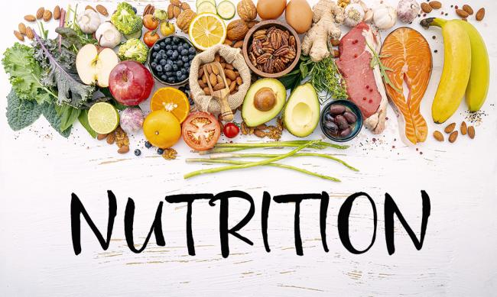
Predicting COVID-19 Mortality Using Machine Learning and Regression Analysis Based on Multiple Health-Related Factors
Supervisor
Dr. Alma Raha
Student
Abdullah Sharaf 2139533

Slide 2

Problem Description
The COVID-19 pandemic has severely impacted over 200 countries, COVID-19 has evolved into a major healthcare industry concern as well as a public health emergency. The World Health Organization estimates that COVID-19 has caused over 7 million deaths, or about 0.09% of the 8 billion global population, so stressing the extreme damage the epidemic has done on human life.

Slide 3
Motivation
Improved Public Health Approaches
Explaining Mortality Trends Using XAI
Data Science

Slide 4

Tools and Techniques
Programming Python
Machine Learning Techniques: PL-LR, SVM, RF,KNR,GBR, MLP
Explainable Artificial
Intelligence:
LIME
Data Analysis

Slide 5


Finding and Results
Higher consumption of animal products such as fats and milk linked to increased mortality, while a balanced diet with sufficient plant-based foods is crucial for reducing health risks.
High alcohol consumption is linked to increased COVID19 mortality. Smoking, obesity also impact health but less than alcohol consumption.

Slide 6


the analysis indicated a connection between mortality risks and older age, with a slightly higher risk for females.
The environment has no noticeable impact on COVID-19 mortality

Slide 7
Nutrition

Slide 8
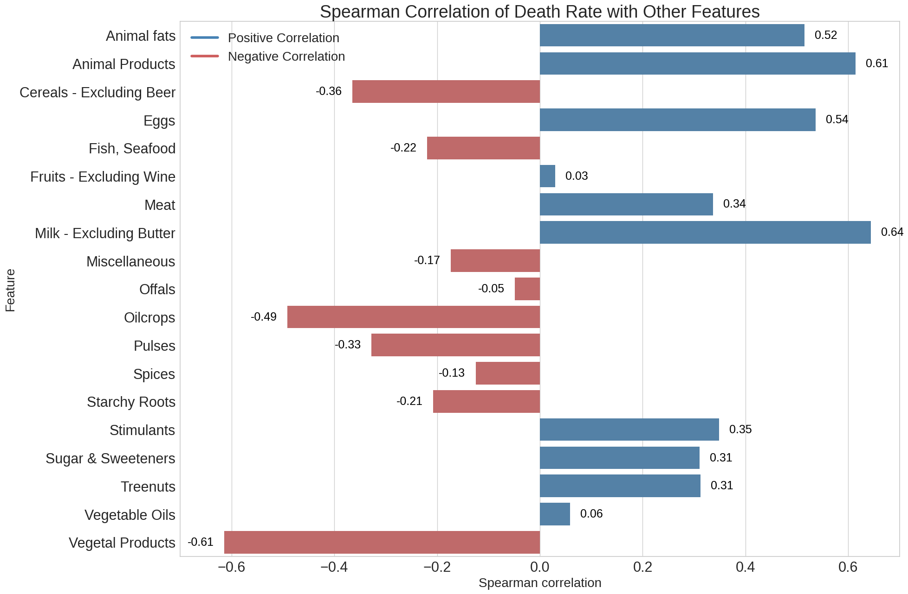

Slide 9
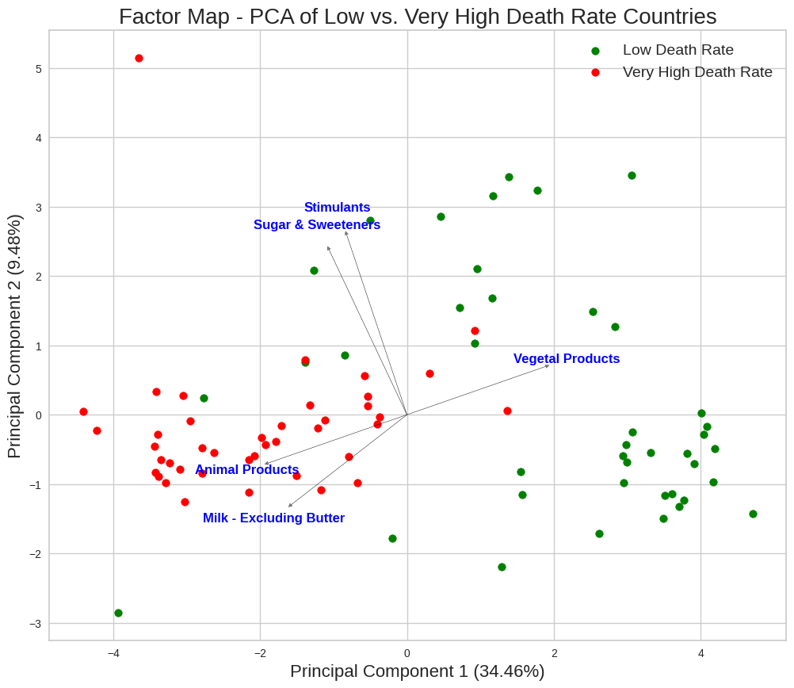

Slide 10
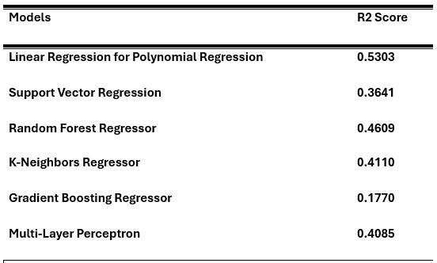
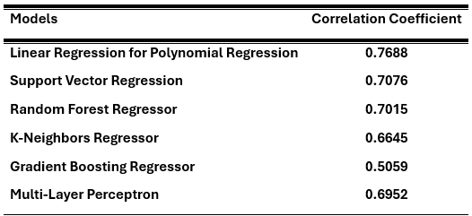

Slide 11
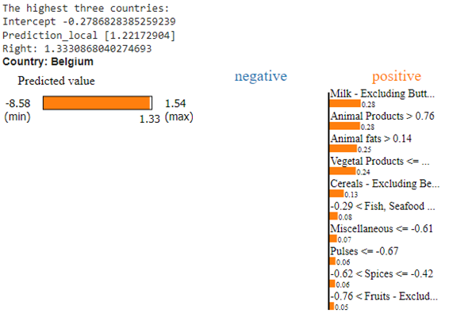
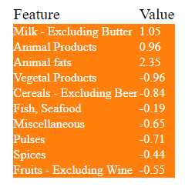

Slide 12
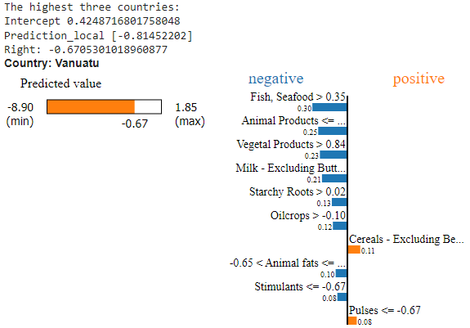
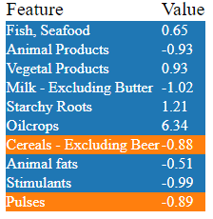

Slide 13
Lifestyle And Health

Slide 14
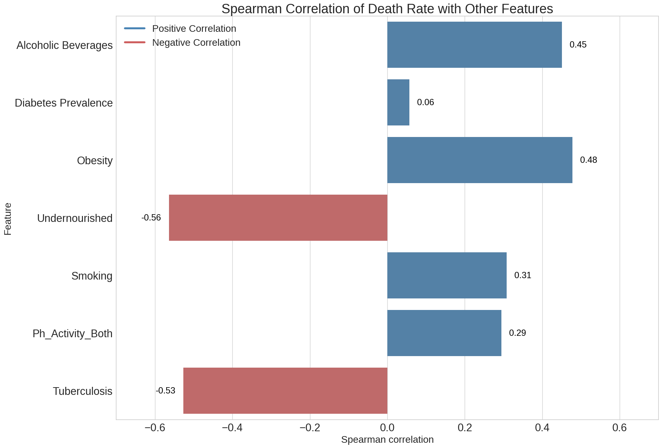

Slide 15
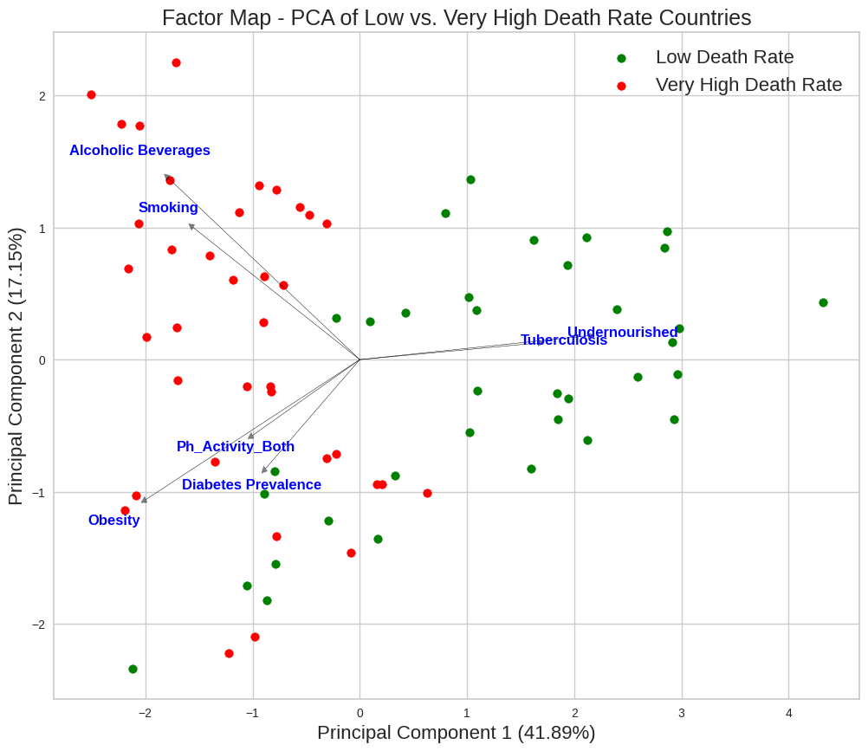

Slide 16
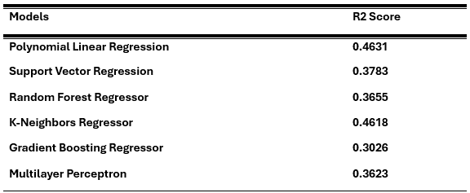
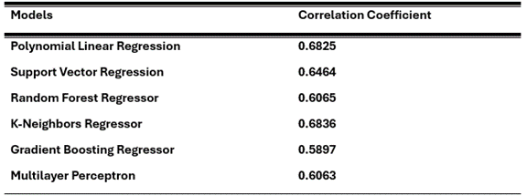

Slide 17
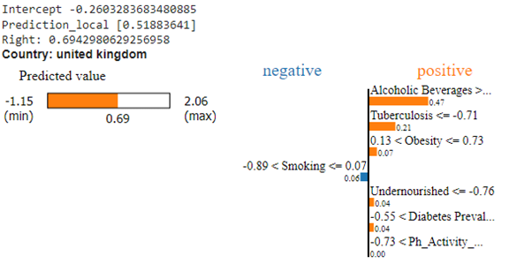
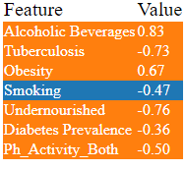

Slide 18
demographics

Slide 19
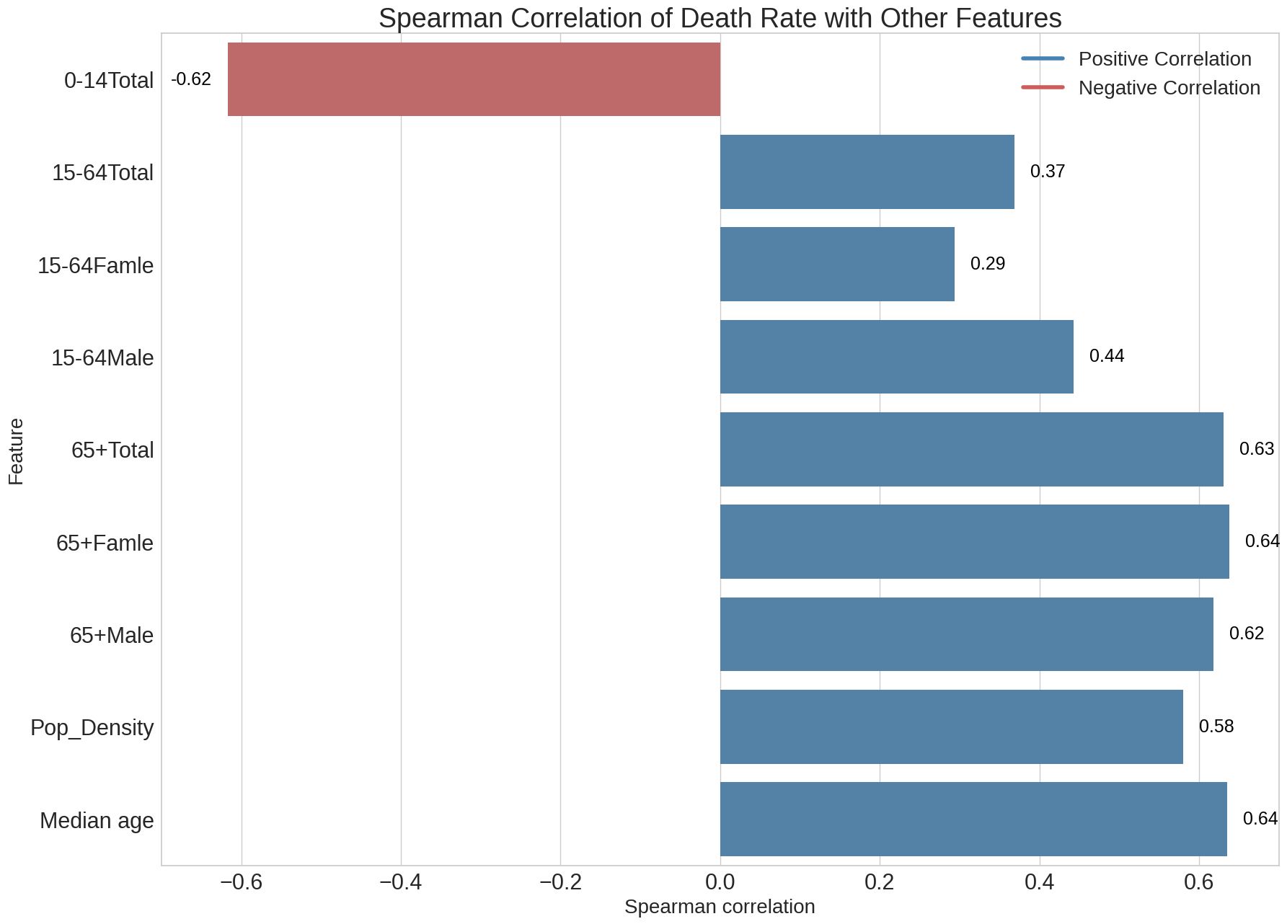

Slide 20
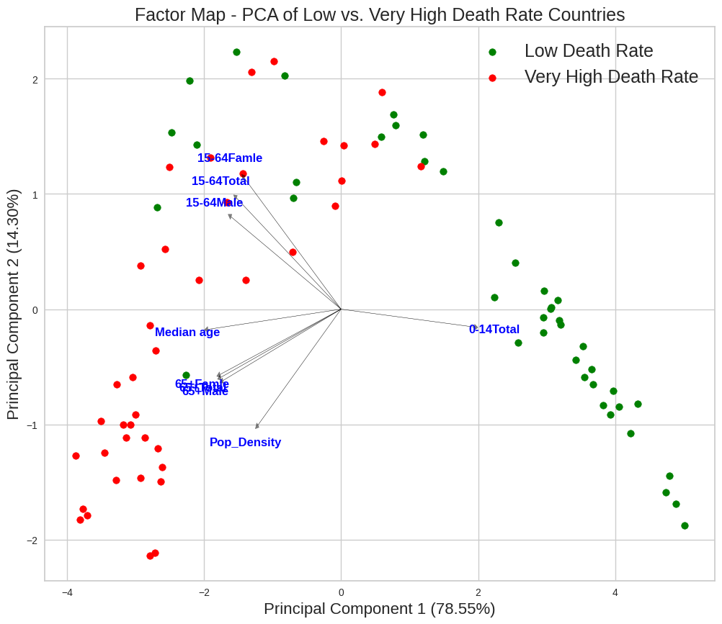

Slide 21
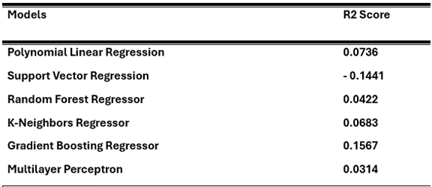
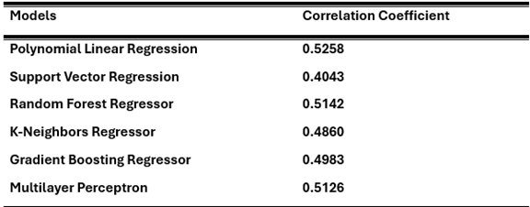

Slide 22
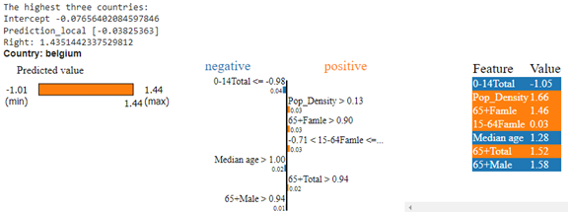

Slide 23
Environment pollutions

Slide 24
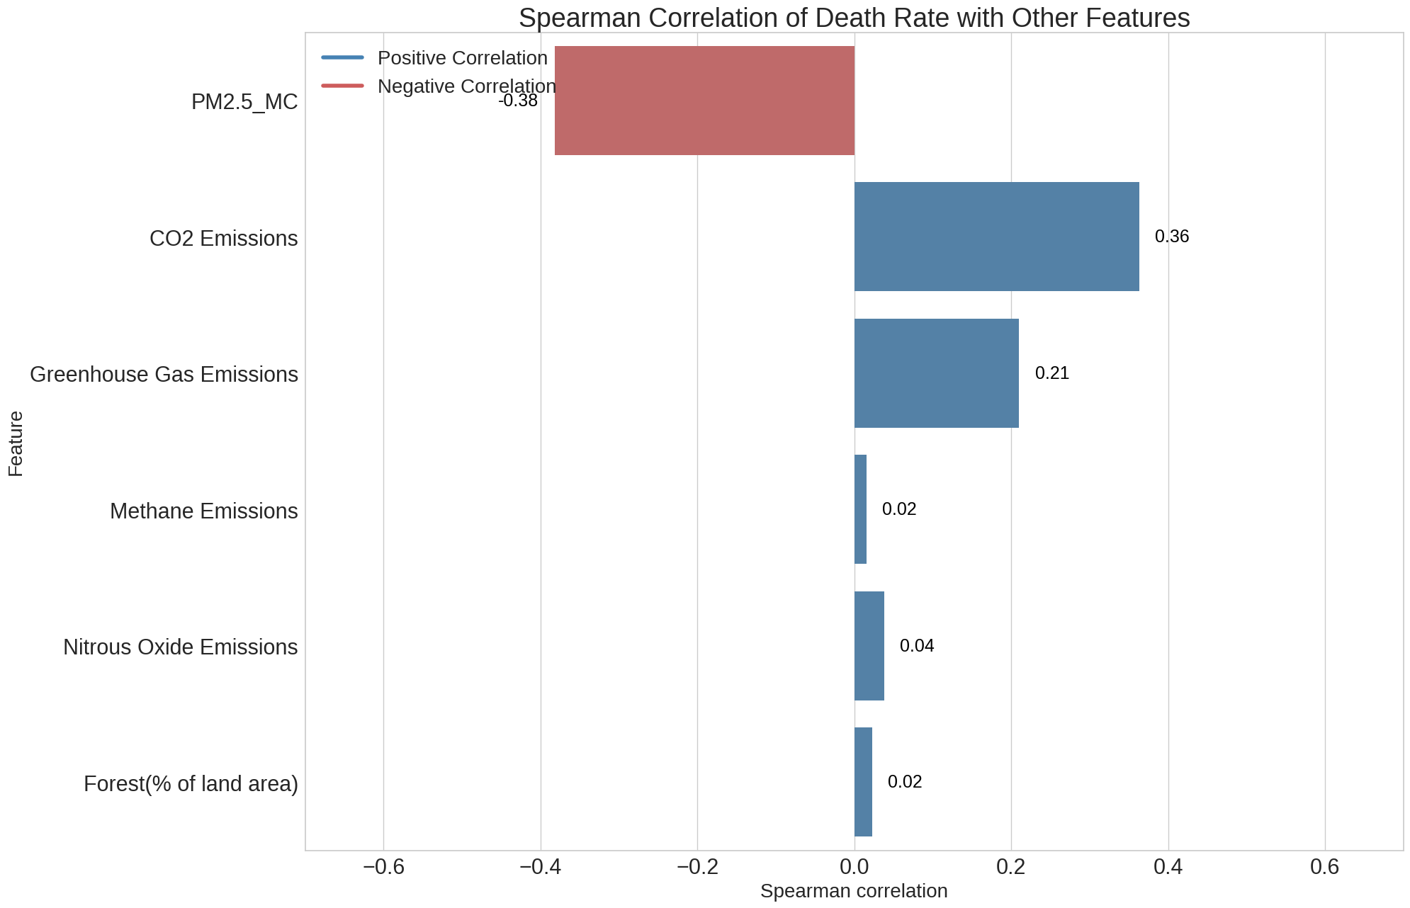

Slide 25
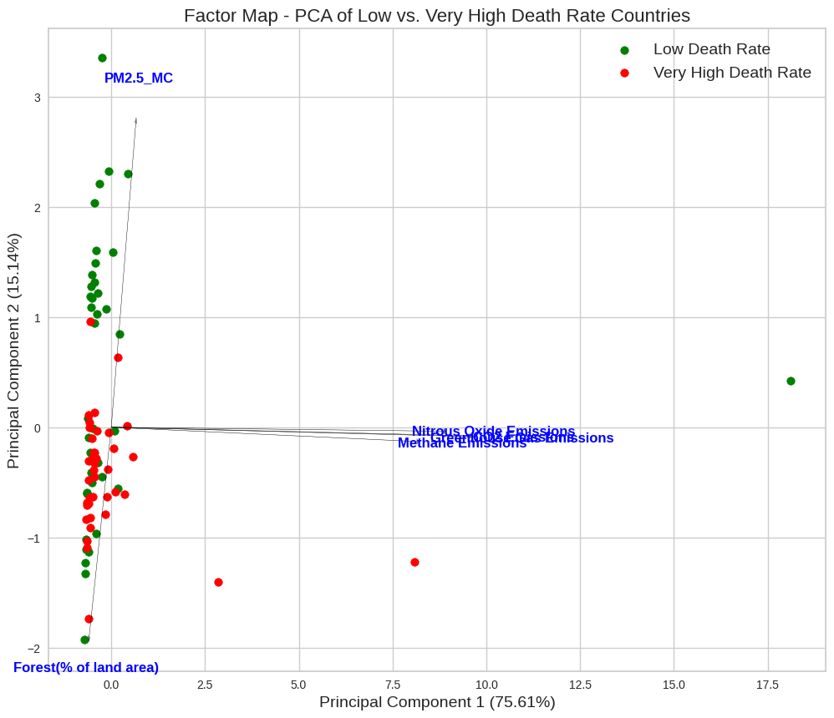

Slide 26
END

