Slide 1








Used Toyota Car Price Prediction for Discount Motors in the UK
Improving Price Accuracy with Machine Learning
Abdullah Sharaf
12/03/2025

Slide 2



OUTLINE
Business Problem
Data validation
Features Engineering
Exploratory Data Analysis and result Visualization
Model Fitting
Model Performance & Key Findings
Model Evaluation
Business Focus
Business Metrics
XAI (Explainable Artificial Intelligence)

Slide 3

Business Problem
Loss of expert estimator.
Sales team’s price estimates are 30% off.
Goal: Achieve 10% pricing accuracy with a predictive model.

Slide 4
Overview Data & Features
Column Name | Description
model | The model of the car (string type).
year | The manufacturing year of the car (integer).
price | The price of the car in monetary units (integer).
Transmission | The type of transmission (e.g., automatic or manual).
mileage | The distance the car has traveled in miles (integer).
fuelType | The type of fuel the car uses (string type).
tax | The annual tax for the car (integer).
mpg | The car's miles per gallon (float).
engineSize | The size of the engine in liters (float).

Slide 5

Data validation
Check Features Data type and Range
Duplicates Handling
Finding and Removing (39 removed)
Missing Values Handling
Finding and Imputing (No missing vales)

Slide 6
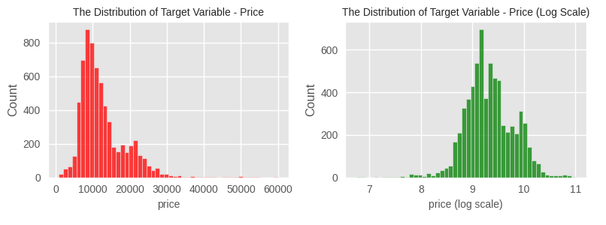
Feature Engineering.
Log Transform to the (price)
Encoding categorical variables into numerical representations (model, transmission, fuel Type).

Slide 7
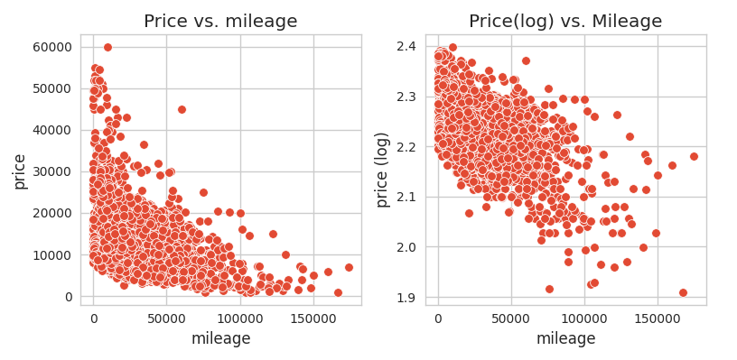
Feature Engineering.
Power Transform to the (Mileage)

Slide 8
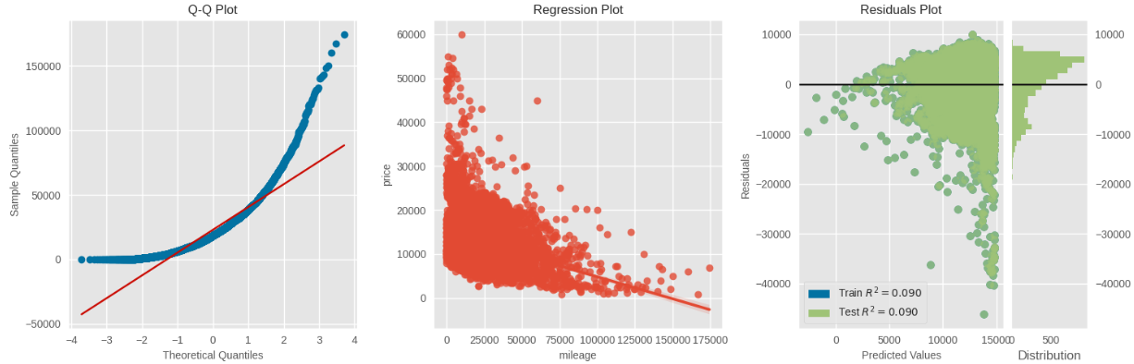
Exploratory Data Analysis
•Check linearity Problem (Single Features):

Slide 9
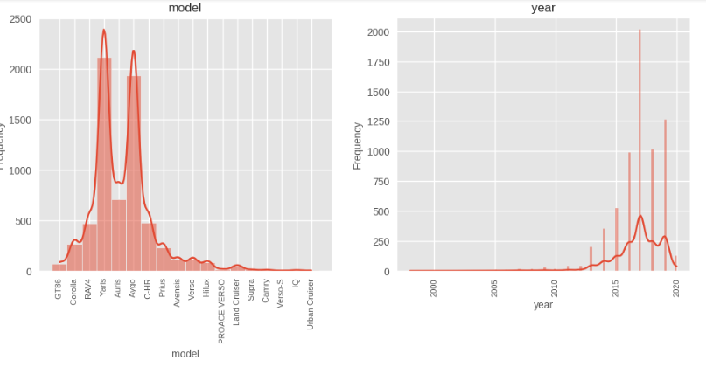
Exploratory Data Analysis
Distribution (Single Features):

Slide 10
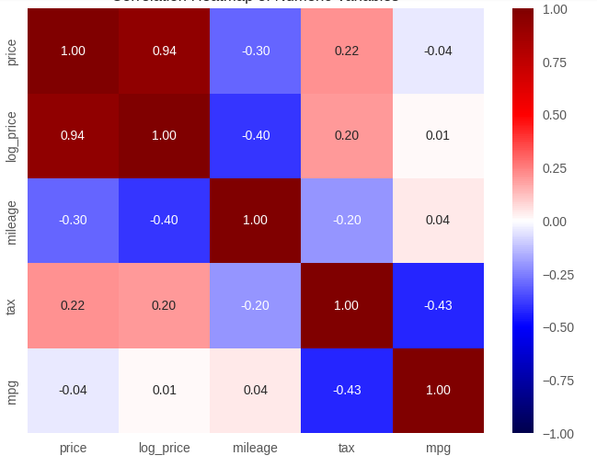
Heatmap Correlation(Two Features)

Slide 11
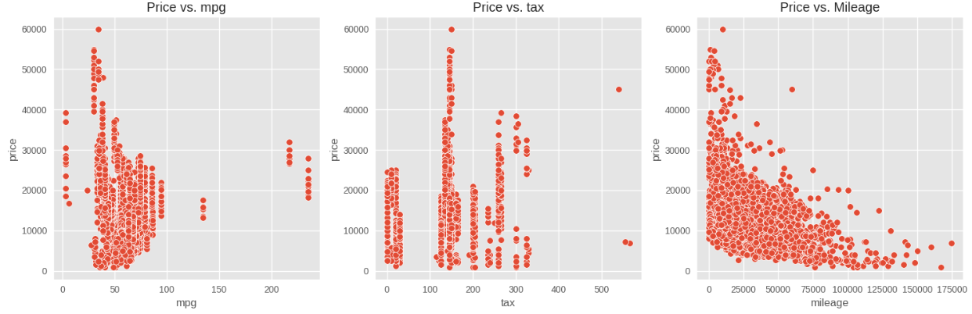
Scatter plot Correlation (Two Features)

Slide 12
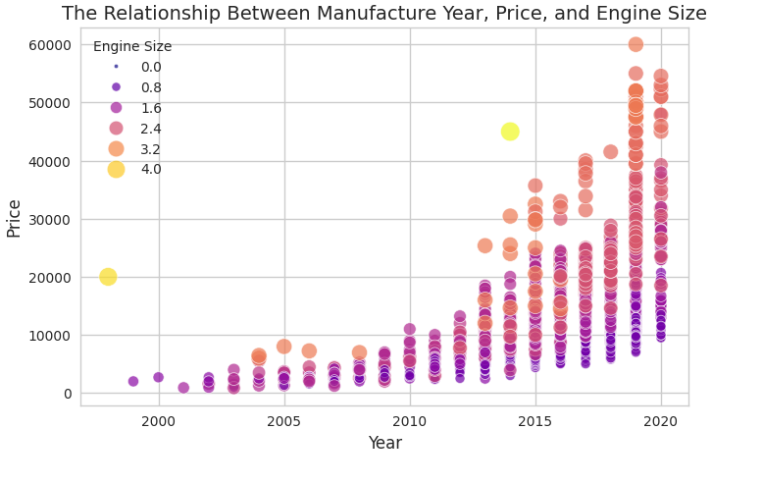
Scatter plot (Three features)

Slide 13
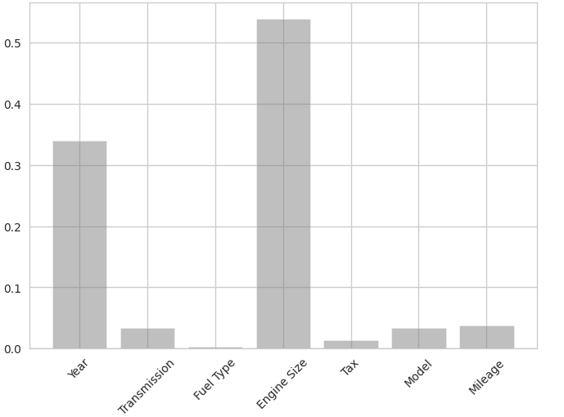
Result Visualization

Slide 14
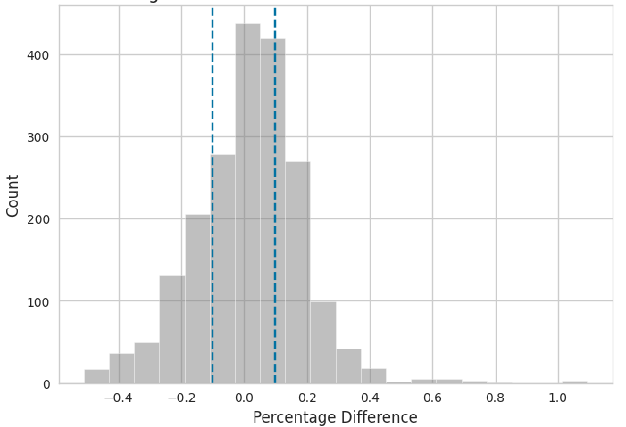
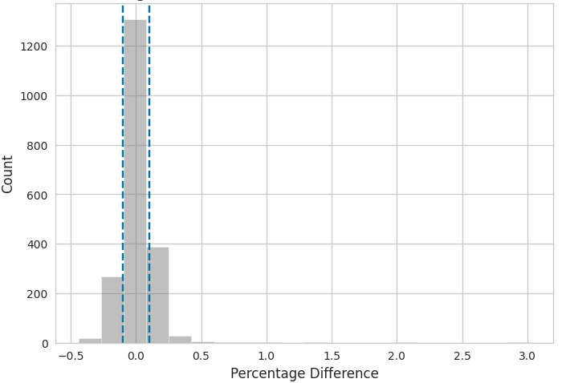
Finding Visualization

Slide 15
Fit Models
Models Tested: We used Supervised
Baseline Model: Linear Regression.
Advanced Model: Decision Tree Regression(DT).
Best Model: DT Captures non-linear patterns in the data.

Slide 16
Model Performance & Key Findings
Root Mean Squared Error (RMSE):
Measures the average error in price prediction.
Linear Regression(2483.69) , Decision Tree Regression ( 0.0139)
R-Square (R²):
Measures how well the model explains price variations.
Linear Regression(0.86) , Decision Tree Regression (0.938)

Slide 17
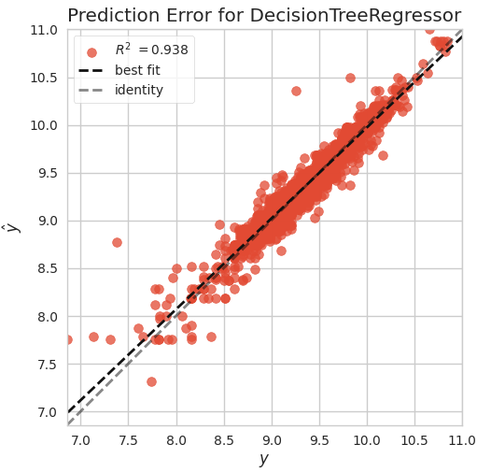
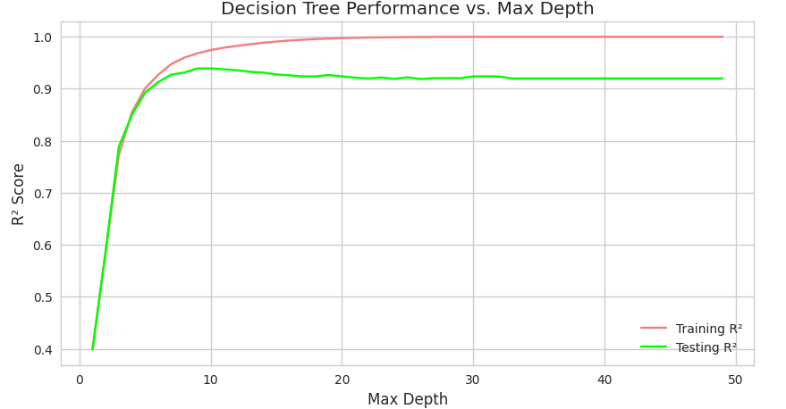
DT performance

Slide 18
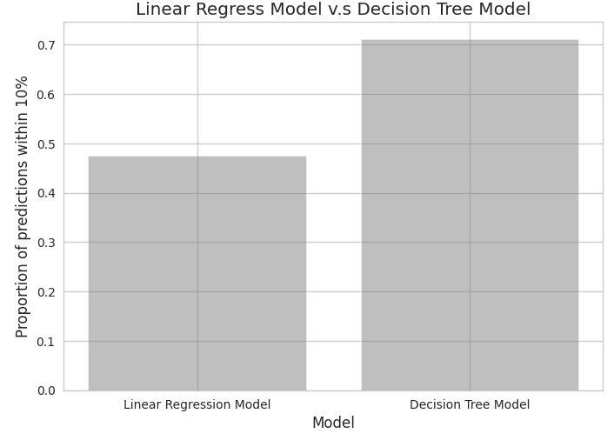
Model Evaluation

Slide 19
Business Focus
Business Goal 🎯
The company aims to ensure accurate price predictions for used Toyota cars, keeping them within ±10% of the actual sale price. This improves pricing strategy, customer trust, and sales efficiency while minimizing revenue loss due to inaccurate pricing.
🔹 We developed and compared two predictive models to determine the most accurate approach for price estimation:
Decision Tree Regressor, Linear Regression

Slide 20
Business Recommendation
Adopt the Decision Tree Regressor as the primary pricing model for used Toyota cars, as it provides higher prediction accuracy (71%).
Continuously monitor model performance and explore further refinements (e.g., ensemble models like Random Forest or Deep learning).
Integrate the model into the pricing workflow to support sales teams with data-driven price recommendations, reducing reliance on manual estimates.
By implementing these recommendations, the company can enhance pricing accuracy, increase competitiveness, and improve overall sales performance.

Slide 21
Business Metrics
Define a KPI:
Compare model performance to business targets (Goal: ≤10% error).
Decision Tree Regressor: 71% of predictions fell within the ±10% range.
Linear Regression: Only 47.5% of predictions met the accuracy target

Slide 22
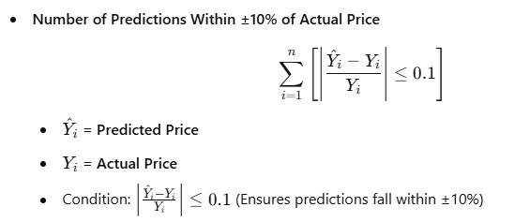
Formula Of KPI Used

Slide 23

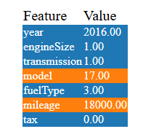
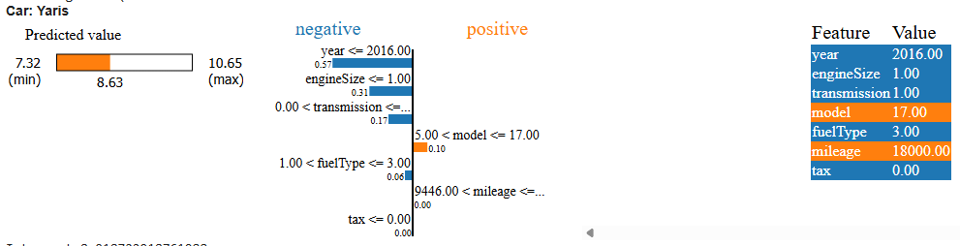
XAI

Slide 24

DISCUSSION
XAI allows us to assess prediction quality and understand how different features influence the model's predictions. Year and the engine size the most influence features.

