Slide 1

01 / 10
BLOCKCHAIN BASED VOTING SYSTEM
Voter
Website
Project Proposal
Smart Contract
Presented by:
Sharaiz Ahmed (57288)
Abdul Moiz (54482)
Blockchain
Course: Introduction to Crypto & Blockchain
Submitted to: Sir Mubariz Rehman

Slide 2
02 / 10
Introduction
1
Administrator
What is the Project?
2
Voting Website
A web based voting application
Designed for university or class elections
Registered users can cast their vote
Votes are recorded on blockchain
Results can be checked easily
3
Registered Voter
4
Smart Contract
5
Blockchain

Slide 3
03 / 10
Problem Statement
Current Problems
Our Focus
Traditional voting can involve paperwork
Manual work can take more time
Online voting can raise concerns about changing records
Voting records may need stronger protection
Use blockchain to store voting records in a way that is difficult to change after recording.
Traditional Process
Proposed Process
Paperwork → Manual Checking → Vote Records
Online Vote → Smart Contract → Blockchain Record

Slide 4
04 / 10
Proposed Solution
Admin Creates Election
↓
Add Candidates
↓
Our Proposed System
Register Voters
↓
Administrator creates an election
Administrator adds candidates
Eligible voters are registered
Voter connects MetaMask
Voter casts one vote
Smart contract records the vote
Results are displayed after voting ends
Voter Connects MetaMask
↓
Select Candidate
↓
Smart Contract Checks Voter
↓
Vote Recorded on Blockchain
↓
Results Displayed

Slide 5






05 / 10
Project Objectives
Objectives
Develop an online voting system using blockchain
Use a smart contract for recording votes
Allow each registered voter to vote only once
Let the administrator manage elections and candidates
Display voting results clearly
Understand blockchain and smart contract usage
Blockchain
Smart Contract
One Vote
Admin Control
Results
Learning

Slide 6
06 / 10
Main Features
Admin
Voter
Blockchain
Results
Create and manage elections
Add candidates
Register eligible voters
Connect MetaMask
Cast one vote
Record votes
Prevent repeated voting
Store the voting transaction
View results after the election ends
Admin Panel
Voter Panel
Blockchain Layer
Results Page
→ Election Management
→ MetaMask → Vote
→ Smart Contract → Vote Record
→ Candidate Vote Counts

Slide 7
07 / 10
Technology Stack
User Interface (HTML + CSS + JavaScript)
1
Technologies
Technology | Purpose
Solidity | Smart contract development
Ethereum | Blockchain testing
MetaMask | Wallet connection
Ethers.js | Website connection with smart contract
HTML | Website structure
CSS | Website styling
JavaScript | Website functionality
Blockchain Connection (Ethers.js)
2
3
Wallet (MetaMask)
Smart Contract (Solidity)
4
Blockchain (Ethereum)
5

Slide 8
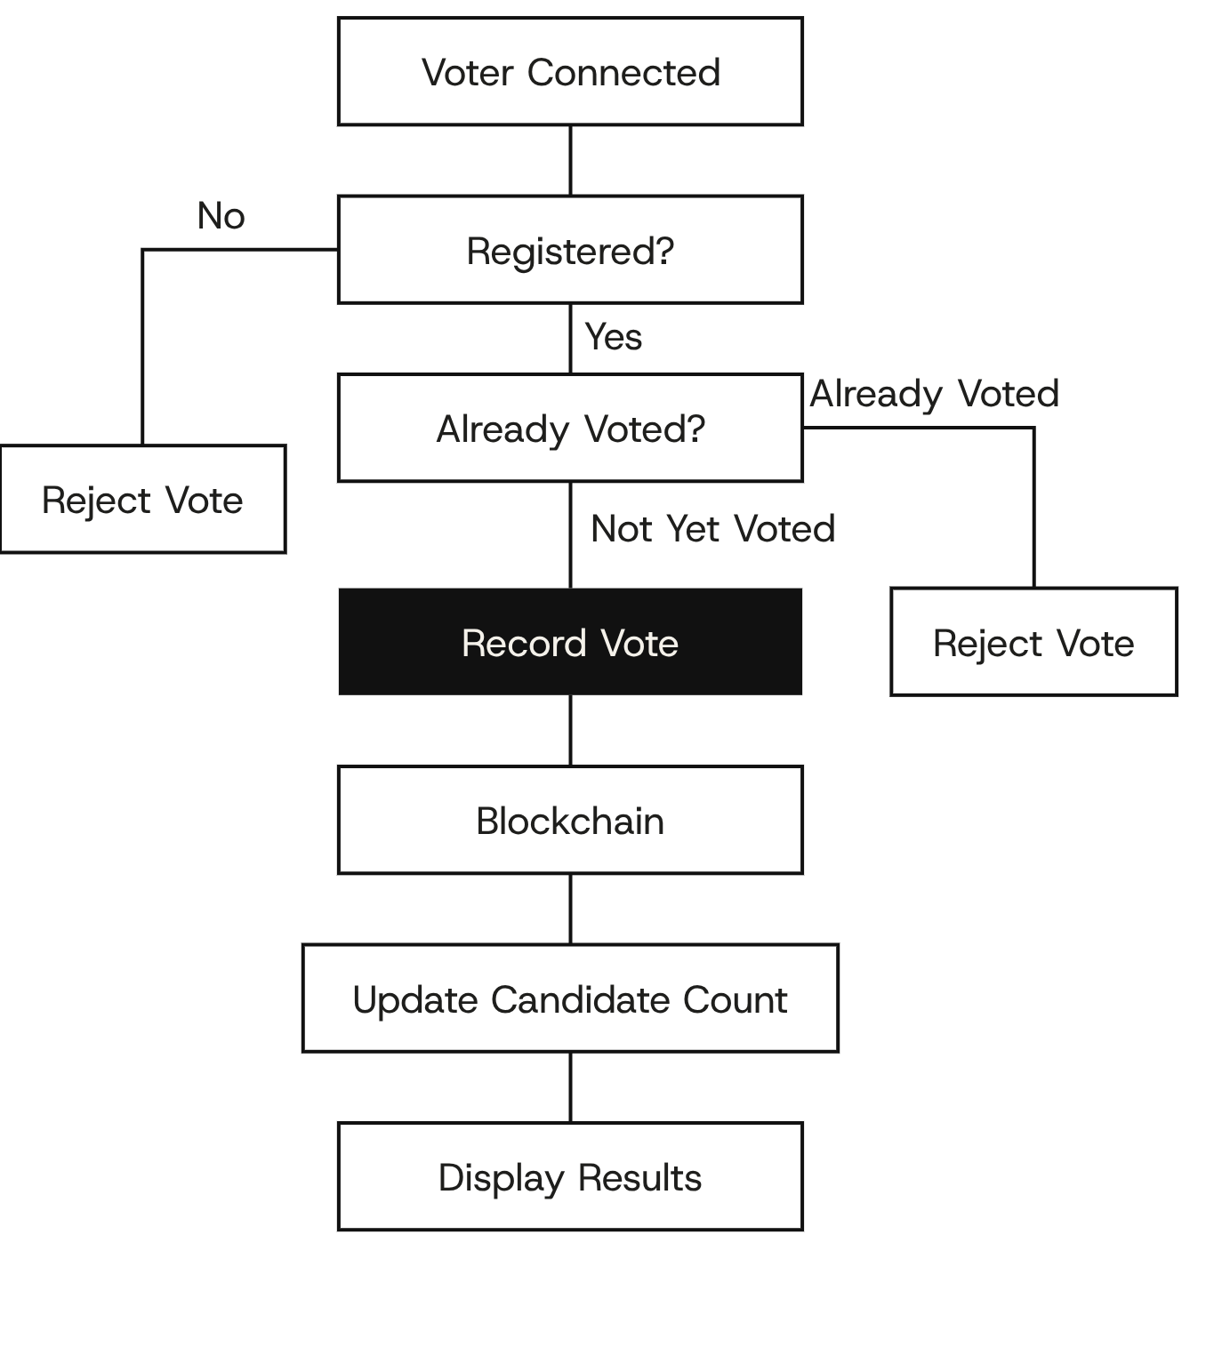
08 / 10
How the System Will Work
Voting Process
Administrator creates an election
Candidates are added
Eligible voters are registered
Voter connects MetaMask
Voter selects a candidate
Smart contract checks registration
Smart contract checks whether the voter already voted
Valid vote is recorded on blockchain
Results are shown after the election ends

Slide 9
09 / 10
Expected Outcome and Project Scope
Expected Outcome
Project Scope
A working web voting application
Suitable for a small university or class election
Votes recorded through blockchain
Voting transactions can be demonstrated and verified
Results shown clearly
Educational prototype
University or classroom elections
Focus on learning blockchain concepts
Not designed for national or government elections
INSIDE
OUTSIDE
University Election
Class Election
Societies Election
Blockchain Demonstration
Smart Contract Learning
National Elections
Government Elections

Slide 10
10 / 10
Conclusion
Conclusion
Simple practical use of blockchain in voting
Demonstrates smart contract based vote recording
Shows how digital wallets connect with blockchain
Helps understand blockchain transactions
Demonstrates a decentralized application
Final Flow: Voter → Website → MetaMask → Smart Contract → Blockchain → Results
Voter
Website
MetaMask
Smart Contract
Blockchain
Results

Slide 11
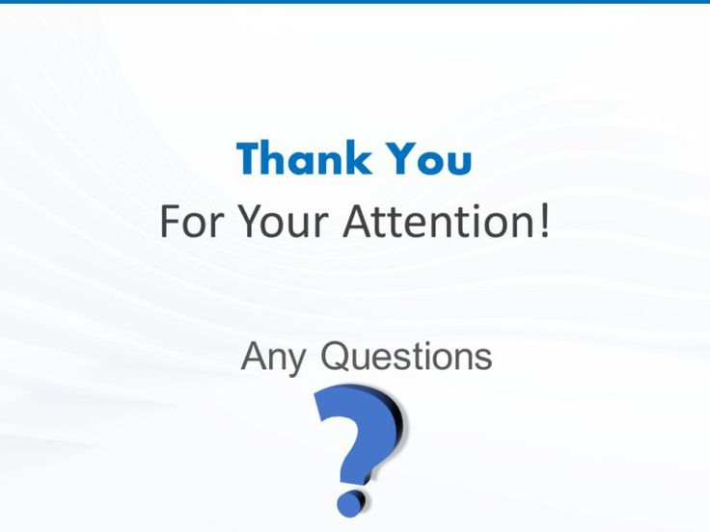
11 / 10

