Slide 1


Final Year Project Proposal
Digital FIR
A Blockchain Based Secure First Information Report Management System
Supervised By: Tabassum Javed

Slide 2
Project Team
Sharaiz Ahmed (57288)
Abdul Moiz (54482)
Basit Ali (54596)

Slide 3
Table of Content
Introduction and Background
Existing Systems in Pakistan
Gap Analysis
Problem Statement
Proposed Solution and Methodology
System Architecture
Project Scope
Work Breakdown Structure
Roles and Responsibilities
Constraints and Limitations
Expected Benefits and Success Criteria
Conclusion and Q&A

Slide 4
INTRODUCTION AND BACKGROUND

Slide 5
Introduction and Background
What is an FIR?
Current situation
An FIR formally opens the criminal justice process. It records the reported offence, identifies the parties and starts investigation.
Punjab, Sindh and KP already use digital complaint and record systems. The project does not aim to replace these systems.
What this project adds
A permissioned Hyperledger Fabric layer for integrity, traceability and tamper evident auditing, while sensitive FIR data stays off chain.

Slide 6
EXISTING SYSTEMS IN PAKISTAN

Slide 7
Existing Systems and Comparison
Capability | Punjab | Sindh | KP | Digital FIR
Digital complaint submission | ✓ | ✓ | ✓ | ✓
Digital FIR / case records | ✓ | ✓ | ✓ | ✓
Case tracking | ✓ | ✓ | ✓ | ✓
Officer assignment | ✓ | ✓ | ✓ | ✓
Document hashing | Not documented | Not documented | Not documented | SHA 256
Permissioned blockchain | ✗ | ✗ | ✗ | ✓
Tamper evident audit | Conventional logs | Conventional logs | Conventional logs | Blockchain + logs

Slide 8
Digital police systems are already being used in Punjab, Sindh and Khyber Pakhtunkhwa for complaints, FIR records, case tracking and officer management.
These systems have improved the way police records are created, stored and accessed.
However, most existing systems mainly depend on centralized databases and conventional audit logs.
Blockchain can provide a more reliable way to maintain a tamper-evident history of important FIR activities.
SHA-256 hashing can be used to check whether FIR documents or evidence have been changed.
A permissioned blockchain is more suitable for police data because access can be restricted to authorized organizations and officers.
Based on the reviewed systems, there is an opportunity to combine digital FIR management, blockchain, hashing, RBAC and audit tracking in one system.

Slide 9
GAP ANALYSIS

Slide 10
Research Gap and Novelty
Existing capability
Identified gap
Digital complaints, FIR records, tracking, assignment and supervisory monitoring already exist.
Publicly documented systems do not identify permissioned blockchain integrity as a core feature.
Project novelty
Integration of FIR workflow + permissioned blockchain + SHA 256 integrity checks + role based authorization + auditable evidence metadata.
Research focus: strengthen integrity verification, traceability and tamper evident auditing.

Slide 11
PROBLEM STATEMENT

Slide 12
Problem Statement and Objectives
Centralized police information systems rely on trusted administrators and application level audit logs. The project needs a way to verify who changed a record, when it changed and whether related documents were altered.
Core objectives
Create a role based digital FIR interface
Secure authentication and backend authorization
Integrate Hyperledger Fabric and chaincode
Use SHA 256 for record and document integrity
Track FIRs from registration to closure
Maintain a chronological audit history
Register evidence metadata and hashes
Provide dashboards and reports
Notify users about important workflow events
Protect confidential information with controlled access

Slide 13
PROPOSED SOLUTION AND METHODOLOGY

Slide 14
Hybrid On Chain and Off Chain Design
OFF CHAIN | Sensitive Data
ON CHAIN | Integrity Metadata
Complainant personal data
CNIC and contact information
FIR narrative
Suspect and witness information
Investigation notes
Documents, images and PDFs
Storage: PostgreSQL + protected file storage
FIR identifier
Transaction identifier
Record and document hashes
Operation type and status
Officer / organization identifier
Timestamp and workflow state
Approval and audit events
Platform: Hyperledger Fabric
SHA 256
Sensitive information never needs to be stored on the blockchain.

Slide 15
System Architecture and Technology Stack
Presentation
React, TypeScript, Tailwind CSS, Axios
Application
Python, FastAPI, validation, notifications
Data
PostgreSQL + protected file storage
Blockchain
Hyperledger Fabric, peers, CA, MSP, channels, chaincode
Security
Authentication, RBAC, TLS, hashing, access logs
Methodology: Agile and Scrum inspired, 12 iterative sprints.

Slide 16
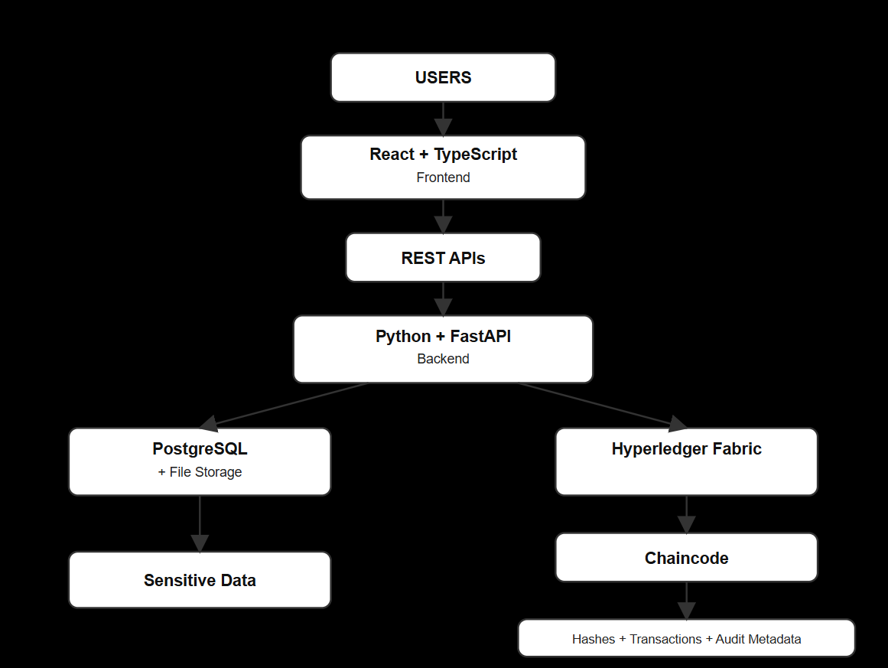

Slide 17
PROJECT SCOPE

Slide 18
Project Scope
IN SCOPE
OUT OF SCOPE
Authentication and identity
Citizen complaint portal
FIR creation, approval, tracking
Police station management
Investigation and officer assignment
Evidence and SHA 256 hashing
Hyperledger Fabric transactions
Audit trail and history
Notifications, analytics, administration
Live Pakistan Police integration
Real NADRA verification
Real criminal history data
AI based profiling or prediction
Production deployment
Legal authorization of real FIRs
All testing uses synthetic or demonstration data.

Slide 19
Work Breakdown Structure
1. Research
2. Design
3. Core Development
Requirements, background, gap analysis, planning
Architecture, database model, workflow, security design
Frontend, FastAPI backend, authentication, FIR modules
4. Blockchain
5. Evidence + Testing
6. Delivery
Fabric network, chaincode, transactions, integration
SHA 256, integrity checks, security testing, UI testing
Deployment packaging, documentation, presentation, viva
Work packages follow the proposal’s 12 sprint development plan.

Slide 20
Roles and Responsibilities
Sharaiz Ahmed | 57288
Abdul Moiz | 54482
Basit Ali | 54596
System Architecture and Blockchain Lead
Architecture and requirements coordination
Hyperledger Fabric and chaincode coordination
Hash and integrity architecture
Security architecture and integration
GitHub and deployment coordination
Backend and Database Lead
Python and FastAPI
REST APIs and PostgreSQL
Authentication and RBAC
FIR, investigation, evidence APIs
Backend testing
Frontend and Testing Lead
React and TypeScript
UI and UX
Dashboards and forms
Audit and charts interface
UI and usability testing
Shared: research, documentation, GitHub, code review, integration, security testing, final report, presentation and viva preparation.

Slide 21
CONSTRAINTS AND LIMITATIONS

Slide 22
Constraints and Limitations
Academic prototype only, not a production police system
Synthetic or demonstration data only
No NADRA, live police, or government system integration
Small controlled blockchain network for demonstration
Performance and scale testing limited by available student infrastructure
No legally binding digital FIR functionality
Scope boundary
The project investigates technical feasibility and does not claim operational or legal deployment.

Slide 23
Expected Benefits and Success Criteria
Expected benefits
Success criteria
Improved record integrity through cryptographic verification
Stronger accountability through RBAC and blockchain audit trails
Clearer visibility into the FIR lifecycle
Tamper evident evidence and document history
Practical demonstration of permissioned blockchain in a public sector workflow
Authorized users authenticate and roles are enforced
FIRs move through defined workflow states
Evidence hashes are generated and verified
Key operations produce blockchain transactions
History can be retrieved and reconstructed
Unauthorized actions are rejected
End to end prototype works with synthetic data

Slide 24
CONCLUSION

Slide 25
Digital FIR combines a conventional secure database with a permissioned Hyperledger Fabric layer to improve integrity, traceability and auditability of FIR workflows.
Core idea
Sensitive information stays off chain. Hashes, transactions, workflow events and integrity metadata provide the verifiable audit layer.
Thank You
Questions?

