Slide 1
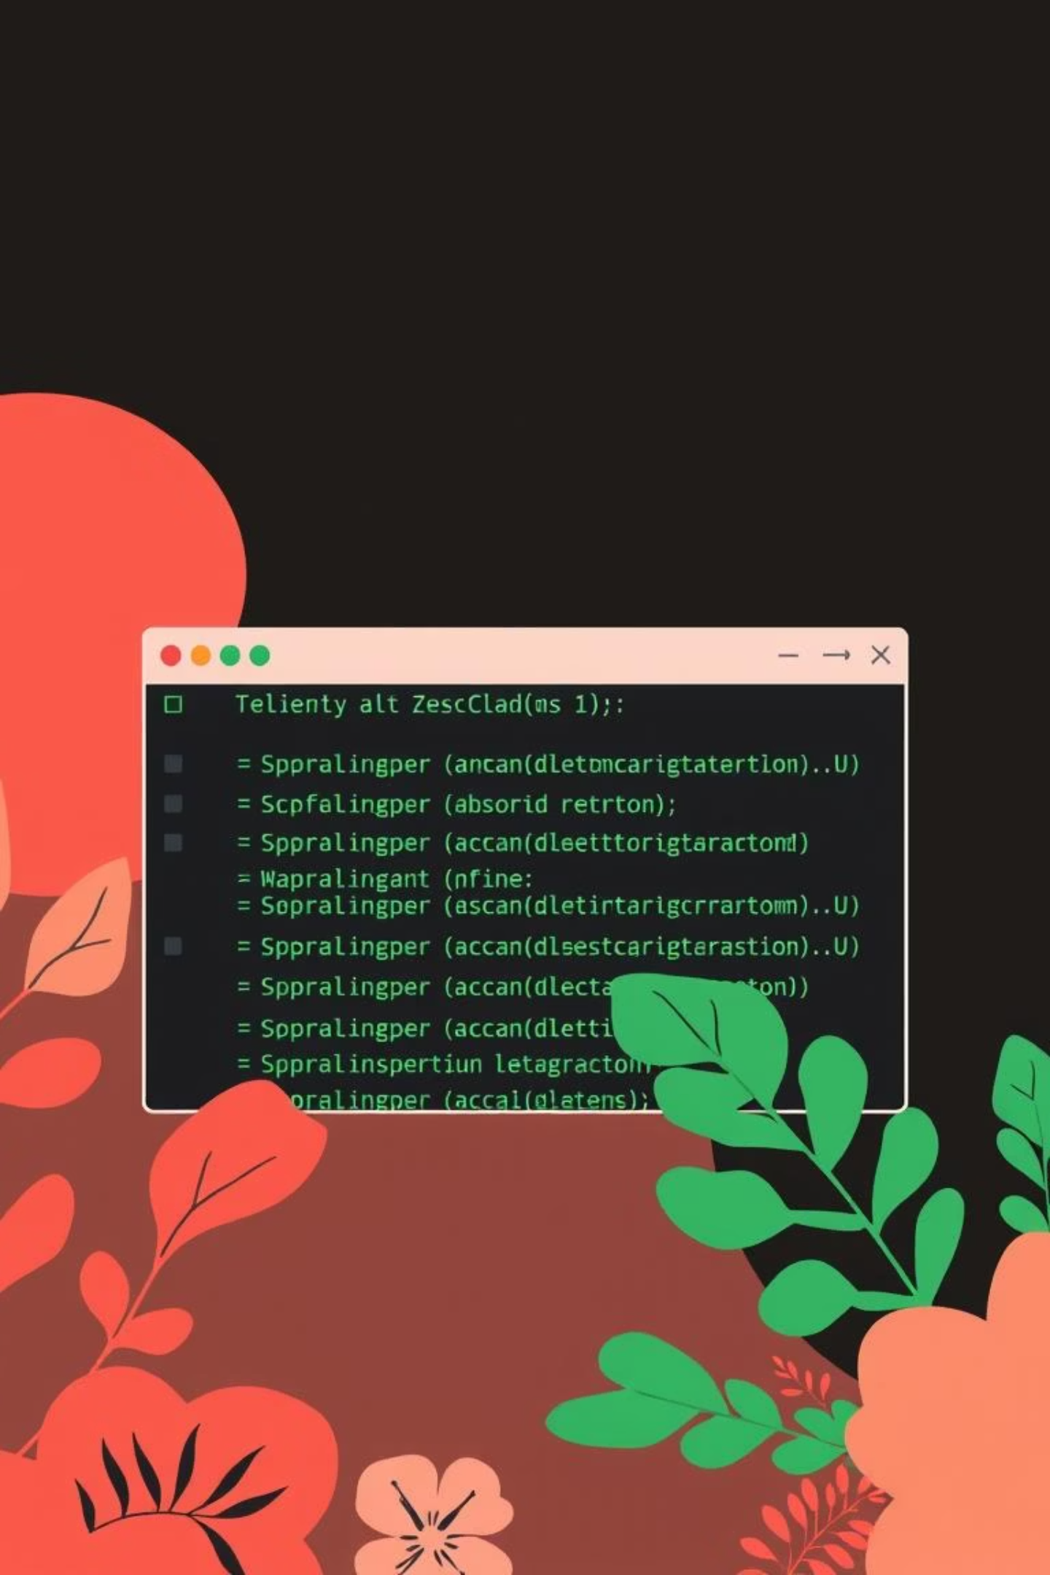
MiniShell – A Beginner-Friendly Linux Shell
Members: Sharaiz Ahmed [57288] & Abdul Moiz [54482]
A comprehensive exploration of operating system concepts through the development of a custom Linux shell with process control block visualization and resource monitoring.
Semester: BSCS 5-1, Riphah International University
Supervisor: Sir Zeeshan Ali

Slide 2
Introduction & Overview
A shell is a command-line interface that interprets user commands and executes them by interacting with the operating system kernel. It serves as the bridge between users and the system's core functionality.
Learning OS Concepts
Process Handling
Understanding process creation, management, and lifecycle through hands-on implementation.
Mastering fork(), exec(), and process synchronization mechanisms in C++.
PCB Visualization
Resource Monitoring
Simulating and displaying Process Control Block snapshots for educational insight.
Tracking CPU time, memory usage, and file descriptors for active processes.

Slide 3
Project Objectives
1
Build a simple Linux shell
Supporting basic commands and external program execution with proper process management.
2
Simulate PCB snapshots
Creating realistic Process Control Block representations to visualize process state and metadata.
3
Track process resources
Monitoring CPU time, memory usage, and open file descriptors for comprehensive resource analysis.
4
Display kernel/user PCB information
Presenting Process Control Block data in colored, user-friendly format for easy interpretation.
5
Master OS programming concepts
Learning process creation, forking, execution, and resource usage monitoring in C++.

Slide 4
Key Features
User Interface
Process Execution
Colored welcome message and prompts
External command execution using fork() + execvp()
HCI-friendly prompt design
Proper parent-child process synchronization
Enhanced readability with color coding
Safe process termination and cleanup
Built-in Commands
Resource Monitoring
cd – Change directory
CPU time tracking via getrusage()
exit – Terminate shell
Memory usage from /proc/[pid]/statm
help – Display command help
Open file descriptors from /proc/[pid]/fd
pcb – Show PCB snapshot
Kernel/user PCB tracking with summary and detailed views
resources – Display resource usage
kpcb – Kernel/user PCB tracking

Slide 5

Architecture Diagram
The MiniShell follows a systematic flow from user input to output generation, with clear separation between user-space and kernel interactions:
User Input
Tokenization
Command Type Check
Handler / Fork & Exec
Each stage processes the command progressively, ensuring proper resource tracking and accurate PCB representation before final output to the user.

Slide 6
Tokenization & Command Parsing
The shell splits user input into individual tokens (command and arguments) for processing. The tokenize() function handles this critical step:
vector<string> tokenize(const string& input) { vector<string> tokens; stringstream ss(input); string token; while (ss >> token) { tokens.push_back(token); } return tokens;}
Once tokenized, the make_exec_args() function converts tokens into a char** array required by execvp():
char** make_exec_args(const vector<string>& tokens) { char** args = new char*[tokens.size() + 1]; for (size_t i = 0; i < tokens.size(); i++) { args[i] = new char[tokens[i].length() + 1]; strcpy(args[i], tokens[i].c_str()); } args[tokens.size()] = nullptr; return args;}
This two-stage parsing ensures robust command interpretation and proper argument passing to external programs.

Slide 7
Built-in Commands
Command
Functionality
cd
Changes the current working directory using chdir(). Supports relative and absolute paths.
exit
Terminates the shell process gracefully with optional exit code.
help
Displays comprehensive help information for all available commands in colored format.
pcb
Shows a simulated Process Control Block snapshot for the current shell process with PID, PPID, state, and memory information.
resources
Displays detailed resource usage including CPU time, virtual memory, resident set size, and open file descriptors.
kpcb
Kernel/user PCB tracking with options: -u (user threads), -k (kernel threads), -m (memory summary only).
All built-in commands produce colored output for enhanced readability and visual distinction.

Slide 8

External Command Execution
The shell executes external commands using the fork() and execvp() system calls, creating child processes that run independently:
Parent Process
Shell process receives user command and prepares for forking.
Fork System Call
Creates a child process with identical memory space and file descriptors.
Child Execution
Child process calls execvp() to replace its image with the requested program.
Parent Waits
Parent process calls waitpid() to synchronize and collect child exit status.
Resource Cleanup
Parent resumes shell loop after child termination, ready for next command.
This architecture ensures proper process isolation, resource management, and shell responsiveness.

Slide 9
PCB Simulation
A Process Control Block (PCB) is a kernel data structure that stores all information about a process. Our simulation captures essential PCB fields:
struct SimulatedPCB { pid_t pid; // Process ID pid_t ppid; // Parent Process ID string state; // Process state (Running, Sleeping, etc.) unsigned long sp; // Stack pointer unsigned long ra; // Return address long timestamp; // Creation timestamp unsigned long vm; // Virtual memory size unsigned long rss; // Resident set size (physical memory)};
The capture_simulated_pcb() function gathers this data from /proc/[pid]/stat and /proc/[pid]/statm:
PID: Unique process identifier assigned by the kernel
PPID: Parent process ID for process hierarchy tracking
State: Current process state (R=Running, S=Sleeping, Z=Zombie, etc.)
Stack Pointer & Return Address: CPU register values for context switching
Timestamp: Process creation time for lifecycle analysis
VM & RSS: Memory usage metrics for resource monitoring

Slide 10
Resource Tracking & Monitoring
The shell implements comprehensive resource monitoring using multiple Linux interfaces:
1
2
Memory Tracking
CPU Time Tracking
Reads /proc/[pid]/statm to obtain virtual memory (VM) and resident set size (RSS). VM represents total allocated memory, while RSS shows physical memory pages currently in RAM.
Uses getrusage() system call to retrieve user CPU time and system CPU time. Provides accurate measurement of processor utilization for the shell process.
3
4
File Descriptor Tracking
Kernel/User PCB Tracking
Counts open file descriptors by examining /proc/[pid]/fd directory. Each file, socket, or pipe opened by the process appears as a symbolic link in this directory.
Parses /proc/[pid]/status to distinguish between kernel threads and user threads. Displays state information with color-coded indicators for easy identification.
These monitoring mechanisms provide real-time visibility into process behaviour and resource consumption, essential for understanding OS-level operations.

