Slide 1


Placement &
Education
VelaiVaasal
SEVA FEST HACKATHON 2026
VelaiVaasal: your gateway from classroom to career, in every learner’s own language
Team Members : Sharan Anandan Sujatha,
Chennai Institute of Technology

Slide 2
Learning and a first job are still out of reach for many students
THE PROBLEM
44%
Many learners do not know what to study, have little chance to practise interviews, and never meet an employer.
Talent is everywhere. Access is not.
of graduates tested were not job-ready in 2026. Source: India Skills Report 2026

Slide 3



Where students get stuck
THREE GAPS
Learning gap
Readiness gap
Access gap
Content is scattered and not matched to what employers ask for.
Few chances to practise resumes, aptitude tests and mock interviews.
Rural and first-generation learners rarely reach mentors or recruiters.

Slide 4
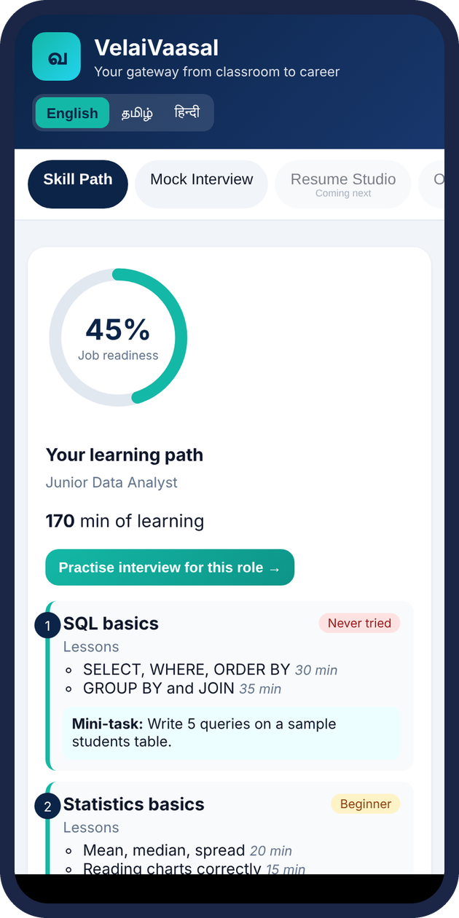
VelaiVaasal connects learning to a first job.
OUR SOLUTION
One platform where students learn skills, practise for interviews and meet opportunities, in their own language.

Slide 5
From learner to hired in three steps
HOW IT WORKS
01
02
03
Learn
Practise
Get placed
Short guided paths for IT, finance and service roles, in Tamil, Hindi and English.
Mock interviews, aptitude tests and resume feedback.
Profile matched to local employers and volunteer mentors.

Slide 6
FEATURES
What the platform does
AI Readiness Analyzer
Skill Gap Detector
Mock Interview Coach
Baseline assessment of technical, aptitude, communication and problem-solving. Evidence-backed scores.
Compare competencies against target role requirements. Show strengths, missing skills and priorities.
Role-specific technical & HR practice with feedback on relevance, clarity and correctness.
Personalised Roadmap
Company Readiness
TPO Intelligence
Weekly plan based on measured gaps. Adapts as the student improves and reassesses.
Compare demonstrated skills to selected job-role profiles. Role-readiness score (not a hiring guarantee).
Department trends, common gaps, students needing support. Actionable insights for placement officers.
Seva Fest Hackathon · Placement & Education
6

Slide 7
CORE INNOVATION
Evidence-to-Readiness Engine
Assessment
evidence
Competency
profile
Role
requirements
Skill-gap
diagnosis
Action plan
+ reassess
→
→
→
→
Illustrative example (sample data, not from real students)
Student targeting Java Backend Developer
Java fundamentals:
78/100
DSA:
52/100
SQL:
65/100
DBMS:
70/100
Spring Boot:
35/100
Communication:
72/100
Priority gaps: DSA & Spring Boot → targeted weekly plan. Same student has different readiness for Data Analyst.

Slide 8
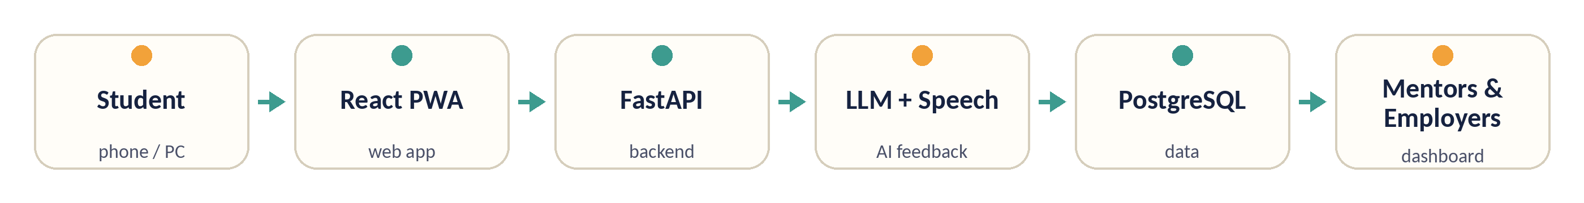
Tech stack
TECHNOLOGY
Layer | Our choice | Why it fits
Frontend | React web app (PWA) | Runs well on low-end phones
Backend | Python (FastAPI) | Quick to build and easy to scale
AI layer | LLM API + Tamil/Hindi speech | Interview feedback and recommendations
Data | PostgreSQL (Supabase) | Profiles, progress and job listings
Target architecture. The hackathon prototype runs React, Flask, a rule-based scorer and SQLite.

Slide 9
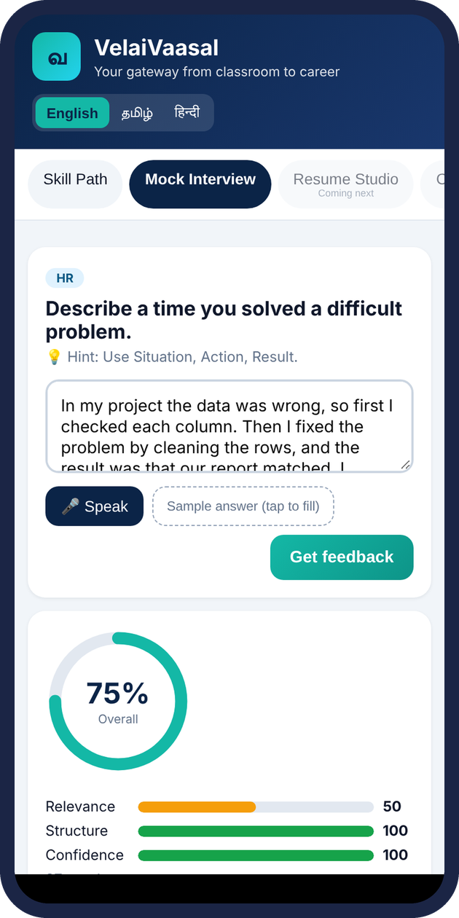
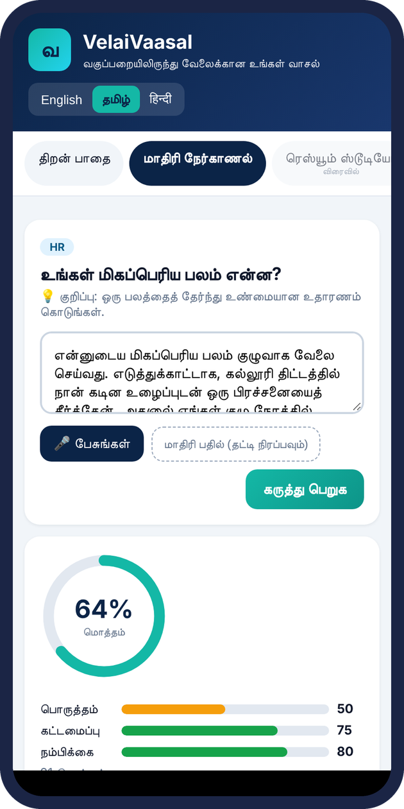
Built and tested
WORKING PROTOTYPE
Working today
3 roles · 4-level skill check · readiness score
Gap-ranked roadmap with lessons and mini-tasks
Mock interview: 9 questions, voice or text
English, Tamil and Hindi throughout
7 automated tests pass; browser-tested
Stand-ins until the pilot
Skill check is self-rated, not yet assessed
Rule-based scoring now; LLM feedback planned
Flask + SQLite now; FastAPI + PostgreSQL next
No real-student testing yet
Skill-gap roadmap
Mock interview feedback
Tamil interface

Slide 10
THE INNOVATION GAP
Existing platforms vs VelaiVaasal
Area
Existing landscape
VelaiVaasal approach
Skill-gap analysis
Varies; often self-reported
Evidence-backed competency profile
Personalised plan
Generic or content-based
Prioritised by measured weaknesses
Mock interviews
Available on some platforms
Linked to continuous preparation plan
TPO insights
Placement cycle tracking
Department competency trends & support flags
Company readiness
Varies by platform
Demonstrated skills vs role requirements
Opportunity: a connected evidence → diagnosis → personalised practice → reassessment loop — not just another portal.
Seva Fest Hackathon · Placement & Education
10

Slide 11
What success looks like in year one
IMPACT
5,000
10,000
500
students trained
mock interviews completed
internships or jobs facilitated
Pilot targets: 10 partner colleges × 500 learners, 2 mock interviews each, 10% reaching an internship or job.
Evaluation focus: improvement in assessment scores, reduction in unaddressed priority gaps, learning-plan completion, and TPO intervention reach.
For students: clearer direction & visible progress · For colleges: data-driven training · For TPOs: actionable insights

Slide 12
ROADMAP
From hackathon to real classrooms
Phase 1 · Hackathon
Phase 2 · Pilot
Phase 3 · Scale
Working prototype
Test with learners
Reach more people
Role selection, skill check, skill-gap roadmap and mock interview coach in English, Tamil and Hindi.
Add login, baseline assessments and competency profile. Run with a partner college and collect feedback.
TPO dashboard, additional languages, NGO partners and recruiter connections.
Seva Fest Hackathon · Placement & Education
12

Slide 13
Thank you
VelaiVaasal
SEVA MEANS SERVICE
Don't wait for placement results to discover the skill gap.
Discover it, close it, and prove your readiness — with VelaiVaasal.
Every learner deserves a fair start.
Team Members : Sharan Anandan Sujatha,
Github Source: https://github.com/Sharan-4223/VelaiVasal

