Slide 1


Recommendation System
5th INTER-IIT Tech Meet 2017
March 26th, 2017
YASH GANGRADE DEEPIKA SHARMA LAKSHAY GABA SANYAM RAJPAL

Slide 2

Outline
Prerequisite Skills
Introduction
What is ReCourse?
Features
Present Limitations
Future Prospective

Slide 3
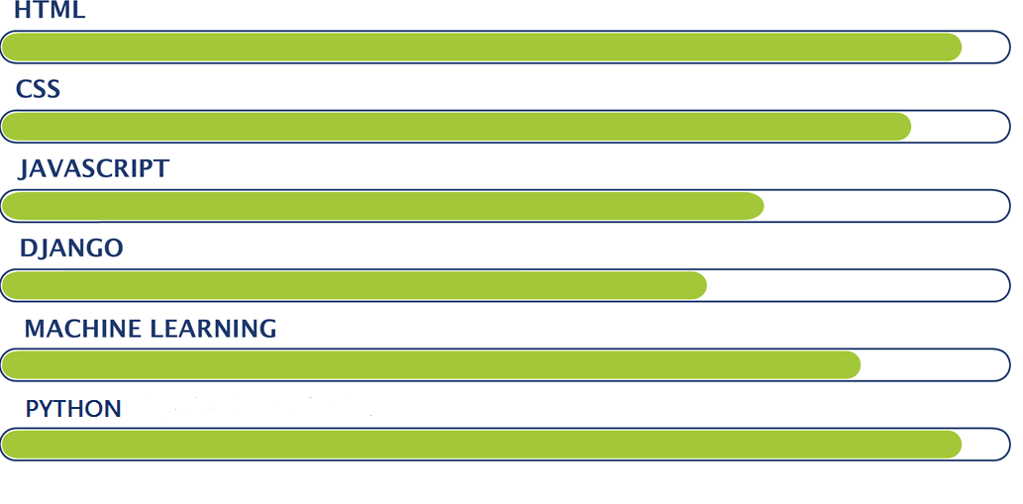
Skills needed for this project
Notes:
Python choot gaya

Slide 4
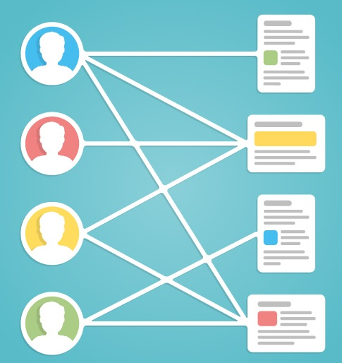
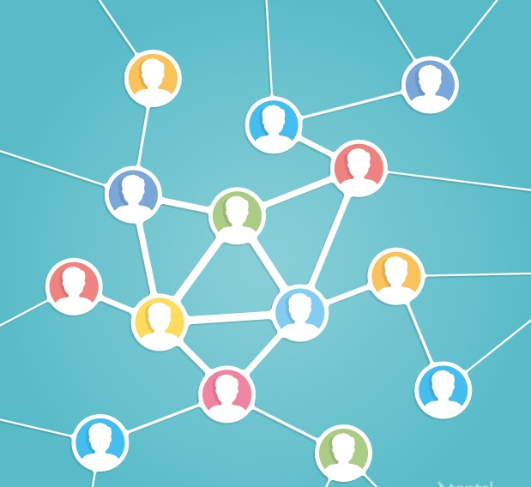
Recommendation System
Notes:
Python choot gaya

Slide 5
Recommendation System
Notes:
Slide no 5 mein image add karna hain

Slide 6
Recommendation System
Do you find the “customers who bought this also bought these items” useful?
Recommender systems provide a scalable way of personalizing content for users in scenarios with many items.
There are several applications of this system including but not limited to finding your books, news, movies etc.
Online course recommendation for students is one of the main applications of Recommendation systems.

Slide 7
Objectives of XXXXXX
To assist students by finding the similarity of the user with the existing users in database and then predicting the appropriate course.
Several techniques can be used to implement this system, one of these is collaborative filtering.
This system can also be extended to several other things like clustering students with similar interests in a class, clustering projects which might interest you.
There are several applications of this system including but not limited to books, news, movies etc.

Slide 8
Collaborative Filtering
User ↓
User1
User2
User3
User4
User5
Obj1 | Obj2 | Obj3 | Obj4
✓ | ✗ | ✓ | ✓
 | ✓ | ✗ | ✗
✓ | ✓ | ✗
✗ |  | ✓ | ✗
✓ | ✓ | ? | ✗
Courtesy: http://rethink-iot.com

Slide 9
Collaborative Filtering
User ↓
User1
User2
User3
User4
User5
Obj1 | Obj2 | Obj3 | Obj4
✓ | ✗ | ✓ | ✓
 | ✓ | ✗ | ✗
✓ | ✓ | ✗
✗ |  | ✓ | ✗
✓ | ✓ | ? | ✗
Courtesy: http://rethink-iot.com

Slide 10
Collaborative Filtering
User ↓
User1
User2
User3
User4
User5
Obj1 | Obj2 | Obj3 | Obj4
✓ | ✗ | ✓ | ✓
 | ✓ | ✗ | ✗
✓ | ✓ | ✗
✗ |  | ✓ | ✗
✓ | ✓ | ✗ | ✗
Courtesy: http://rethink-iot.com

Slide 11
Present Limitations
Air quality sensors (MQ135) are capable of measuring benzene, alcohol, ammonia, etc. But we have used it for CO₂ only.
After switching from manual mode to automatic mode, last saved automatic database will be incorporated.
Switching modes is possible only through mobile or web. So if these are inaccessible, the user becomes helpless.
Data in the website does not update dynamically. We have to refresh the page to see the new data.

Slide 12
Future Prospect
Recommendation system for a university can be used in various fields like choosing among various events to participate and also among various student groups to get enrolled.
It can serve great as a common platform for campus students.
xxx

Slide 13
Thank You !
“
In the new era, recommender systems are systems that help users discover themselves.
- Yanir Seroussi
“
This presentation bears an imprint of many people,
we sincerely thank them for their support:
Sharan Lobana, Kunal Bansal & Rahul Ratan Mirdha

