Slide 1
2D Hybrid Magnetic Field Model Performance Optimization for Linear Induction Motors
1st MaSc Seminar
Michael Thamm, MaSc
05/28/2021
Supervisor: Dr. Narayan Kar

Slide 2
Outline
Objectives
Performance Modelling Standards
Research Contributions & Novelty
Implementing GA on DSLIM
Results
Conclusion
Future Work & Timeline

Slide 3
Objectives

Slide 4
Overall Objective
The objective of my research is to produce an optimized LIM design through a general relationship between performance variables and motor parameter inputs created by GA.

Slide 5
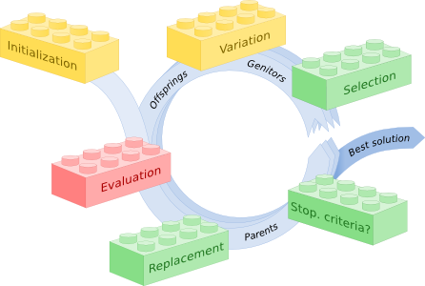
Defining Objectives
Relating Performance Variables to Slot and Poles
Find the best slot-pole combination for a motor application
Trial and error through FEA simulations or trend data is tedious
Create a metaheuristic algorithm can solve this as they introduce their own variables and modify weights to produce an equation.
Requires:
A flexible model
Computational efficiency
Accuracy in results
[1]
Figure 1: Algorithm Phases

Slide 6
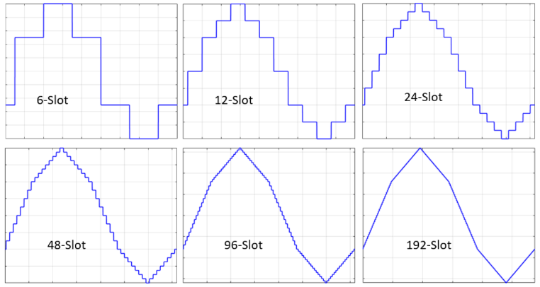

Slot Optimization
Pros
The field produced by the primary becomes more sinusoidal (efficient)
End effect is a much lower percentage of the total power loss
Cons
Thins the stator teeth causing higher flux densities, instability, and saturation
Winding complexity
[2]
Figure 2: Slotting Effect On Primary Field Waveform

Slide 7
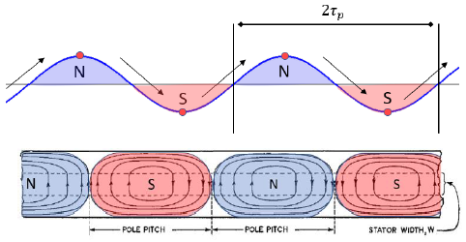
Pole Optimization
The number of poles greatly affects the performance of the motor through these equations:
V_{s} = 2f_{s}T_{p}
Pole pitch changes with poles which means the poles directly affect speed and frequency of operation.
Q = slots/poles/phases
High Q value motors will operate at higher driving thrust but loses efficiency.
High Q values require lower operating frequencies (skin effect).
[2]
Figure 3: Magnetic Poles Related To Primary Field Waveform

Slide 8
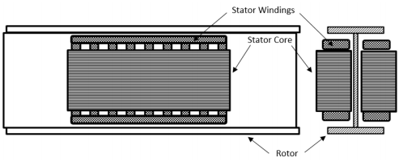
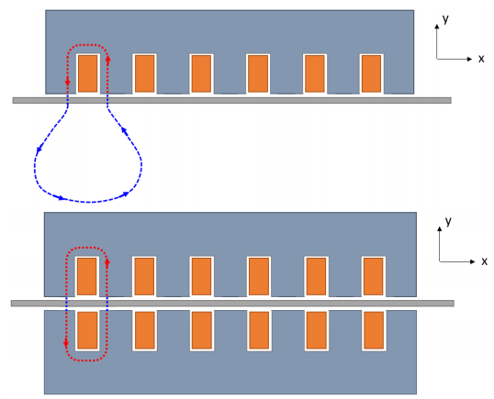
SLIM vs. DSLIM
Single-Sided LIM (SLIM) vs Double-Sided LIM (DLIM)[1]
SLIM is less efficient due to the longer flux path through the air gap
Therefore, SLIMs use back iron to shorten this path length
DLIM produces roughly twice the thrust for the same amount of rotor area used by the stator
DLIM is only possible if both faces of the blade rotor are exposed
For example, an I-beam, otherwise a SLIM is required
[2]
[2]
Figure 4: DLIM with I-beam Blade Rotor
Figure 5: SLIM vs. DSLIM Flux Paths

Slide 9
Performance Modelling Standards

Slide 10
Literature Survey
Fourier Based Harmonic Modelling (HM) [2]
Computationally efficient
Modelling accuracy depends on harmonics considered
Limited modelling geometries
Magnetic Equivalent Circuit Modelling (MEC) [3]
Accurate modelling of flux paths
Ability to model complex geometries
Modelling accuracy depends on mesh density
Computationally intensive
Hybrid Analytical Modelling (HAM) [1], [3]
Computationally efficient
Modelling accuracy depends on harmonics and meshing density considered
Flexible for all geometries
Little error compared to FEA at sufficient parameters

Slide 11
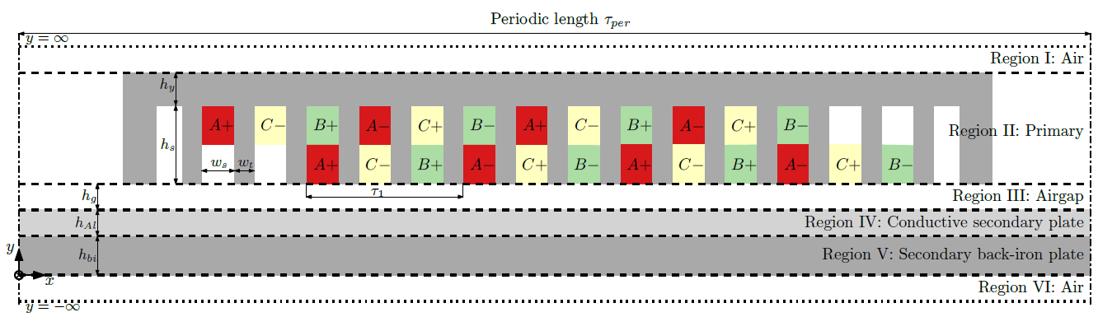
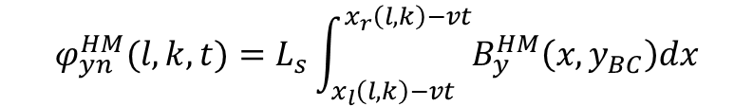
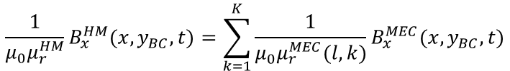
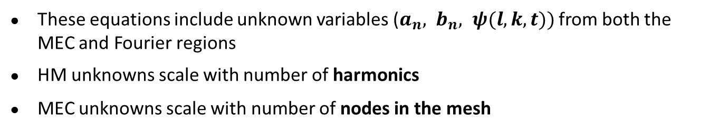
Background Study
At the boundary between MEC and Fourier regions the continuity of By and Hx must hold through these equations:
$$φ_{yn}^{HM}(l,k,t)=L_{s}\int_{x_{l}\left(l,k\right)−vt}^{x_{r}\left(l,k\right)−vt}{B_{y}^{HM}\left(x,y_{BC}\right)dx}$$
$$\frac{1}{μ_{0}μ_{r}^{HM}}B_{x}^{HM}(x,y_{BC},t)=\sum_{k=1}^{K}{\frac{1}{μ_{0}μ_{r}^{MEC}(l,k)}B_{x}^{MEC}(x,y_{BC},t)}$$
,
These equations include unknown variables ($a_{n}{, b}_{n}, ψ(l,k,t))$ from both the MEC and Fourier regions
HM unknowns scale with number of harmonics
MEC unknowns scale with number of nodes in the mesh
[3]
Figure 6: SLIM Modelled in Regions

Slide 12
Research Contributions & Novelty

Slide 13
Research Contributions
The proposed extended hybrid model considers the following:
Incorporates MEC & Fourier modelling
Stator modelled as MEC for complex winding configurations and stator designs
Incorporates time & velocity of the stator operation
Averaging of the staircase-shaped magnetic flux density function
DLIM modelling
Flexible motor input parameters that produces a new model
Metaheuristic optimization on a range of motors
Test input range of motor parameters for performance trends
Converge on optimal motor design

Slide 14
Novelty
Producing an innovative motor design application that is competitive with industry motor simulation software
Optimize over a range of motors
ANSYS has optimization algorithms, single variable optimization
Contributions towards DSLIM design theory
Produce a novel, general relationship between slot-pole combination and motor performance
GA creates its own equation through weights and biases

Slide 15
Constrain Motor Parameters
It is important to constrain well defined parameters for computational efficiency and feasibility
Constants – if the value is known
Defined range – if the upper and lower limits are known
Ratio – if there is a linear relationship between 2 variables (introduces manageable error)
Constant |  | Range | Ratio
Stator Length | Back Iron Height | Slots | Slot Width
Stator Height | Input Current | Poles | Tooth Width
Stator Depth | Velocity |  | Fill Factor
Yoke Height | Winding Turns
Slot Height | Frequency
Air Gap | Time
Rotor Height
Table 1: Variable Constraints for Proposed Algorithm

Slide 16
Implementing GA on DSLIM

Slide 17
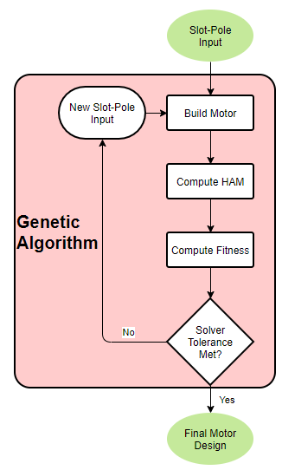
GA Framework
The state diagram takes in an original slot-pole combination guess
Build Motor calculates the remaining motor parameters and builds the model mesh
Compute HAM builds the matrix equation Ex=Y to solve for the unknown variables.
Compute Fitness takes the performance parameters and calculates the fitness value of that given slot-pole combination
Figure 7: State Diagram of Model Algorithm

Slide 18
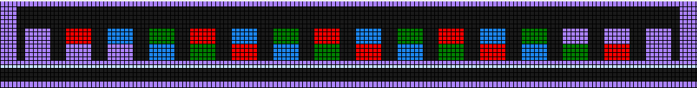

Flexible Computing
The metaheuristic algorithm requires a flexible model to quantify the performance of a wide range of motors
Stator & rotor geometries, air gap, winding configuration, power requirements, velocity, time and mesh density are configurable!
The motor designs below are made from the same model but have drastically different motor parameters
Figure 8: SLIM with Unique Motor Design Parameters
Figure 9: SLIM with Flexible, Modified Motor Design Parameters

Slide 19
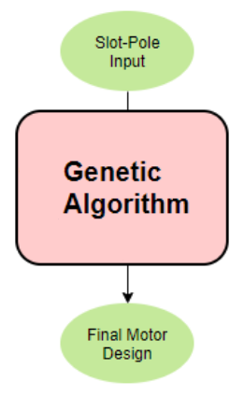
Inputs & Outputs
Choose useful motor inputs and outputs which will produce the most improvement on the motor performance
Inputs for parametric and correlation testing
Slots, Poles, Length, Width, Air gap, ...
Outputs of important performance parameters
Thrust, Max frequency, B field, Loss, ...
Figure 10: Black-Boxed Algorithm

Slide 20
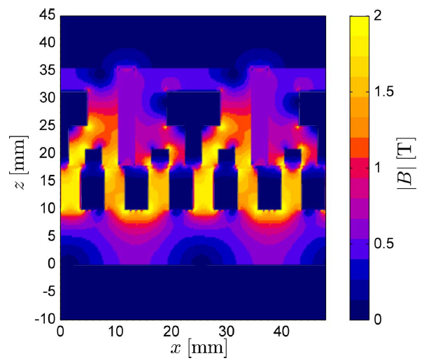
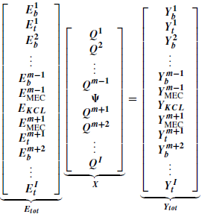
Model Methodology
Define all boundary conditions and solve the matrix equation Ex=Y
E - 2D matrix of unknown coefficients
Q - 1D matrix of unknown variables
Y – 1D matrix of resulting constants
Substitute solution back into the equations for magnetic flux density to produce a plot on the entire model
[4]
[4]
Figure 11: Matrix Equation Solving for Unknown Variables
Figure 12: B Field Plot of a PMSM Using HAM

Slide 21
Results

Slide 22
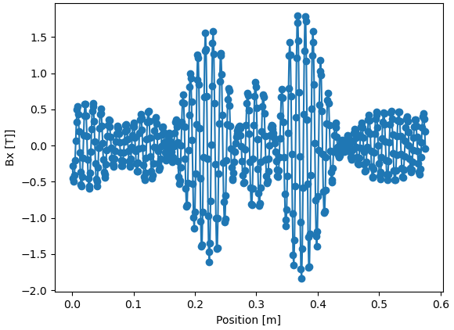
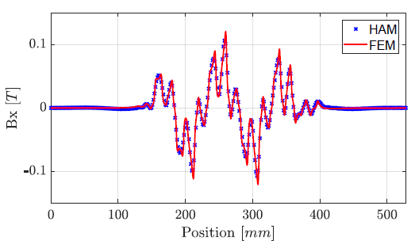
Results
The resulting B field in the air gap is used to calculate the motor’s performance
The plot on the right compares the HAM solution to FEA analysis
The plot on the left is the proposed algorithm’s solution reproduced for this model
This is the basis of producing ground truth data
[3]
Figure 13: Bx Field Plot of Proposed Model Algorithm
Figure 14: Bx Field Plot of SLIM Reference Paper

Slide 23
Results
Figure 15: Model Without Field Plot
Figure 16: MMF Field Plot of Entire Model

Slide 24

Results
The field plot can be filtered on any region to highlight any parameter
Stator core B field highlights magnetic saturation
B field in the air gap defines performance
Figure 17: B Field Plot of Core and Airgap

Slide 25
Conclusion

Slide 26
Conclusions
HAM vs FEA
GA Convergence
Within 5% error compared to FEA
Convergence within 1000 iterations
Flexible Modelling
Slot-Pole Ratio Equation
Handles all linear IM motor types
Relating performance to slot-pole ratio
Airgap Waveform & Amplitude
Computation Time
Difficulty achieving the correct result
Estimated 1 min per simulation

Slide 27
Future Work & Timeline

Slide 28
Future Work
Objective 1: 2D Hybrid Steady-State Magnetic Field Model for SLIM
Solve for the B field in the air gap and validate against the results of the paper for ground truth
Modify the model to account for DLIM motor designs
Create an FEA equivalent to compare against since no paper results exist for this model and design
Objective 2: GA Optimization on the Performance Characteristics of the DLIM
Pass the HAM model results to GA to validate convergence
Solution shall be feasible and the optimized solution

Slide 29
References
Team, E. (n.d.). Evolving objects (eo): An evolutionary computation framework. Retrieved April 17, 2021, from http://eodev.sourceforge.net/
Timperio, C. L. (2018). Linear Induction Motor (LIM) for Hyperloop Pod Prototypes (Doctoral dissertation, ETH ZÜRICH, 2018).
Aleksandrov, Samuil & Overboom, Timo & Lomonova, Elena. (2019). 2D Hybrid Steady-State Magnetic Field Model for Linear Induction Motors. Mathematical and Computational Applications. 24. 74. 10.3390/mca24030074.
K. J. W. Pluk, J. W. Jansen and E. A. Lomonova, "Hybrid Analytical Modeling: Fourier Modeling Combined With Mesh-Based Magnetic Equivalent Circuits," in IEEE Transactions on Magnetics, vol. 51, no. 8, pp. 1-12, Aug. 2015, Art no. 8106812, doi: 10.1109/TMAG.2015.2419197.
S. Aleksandrov, T. Overboom and E. Lomonova, "Design Optimization and Performance Comparison of Two Linear Motor Topologies with PM-less Tracks. (Invited)," 2018 IEEE International Magnetics Conference (INTERMAG), Singapore, 2018, pp. 1-2, doi: 10.1109/INTMAG.2018.8508565.
B. L. J. Gysen, K. J. Meessen, J. J. H. Paulides and E. A. Lomonova, "General Formulation of the Electromagnetic Field Distribution in Machines and Devices Using Fourier Analysis," in IEEE Transactions on Magnetics, vol. 46, no. 1, pp. 39-52, Jan. 2010, doi: 10.1109/TMAG.2009.2027598.
B. L. J. Gysen, E. Ilhan, K. J. Meessen, J. J. H. Paulides and E. A. Lomonova, "Modeling of Flux Switching Permanent Magnet Machines With Fourier Analysis," in IEEE Transactions on Magnetics, vol. 46, no. 6, pp. 1499-1502, June 2010, doi: 10.1109/TMAG.2009.2039921.
Collins, D. (2019, September 11). What are linear induction motors? Retrieved April 17, 2021, from https://www.linearmotiontips.com/what-are-linear-induction-motors/
S. D. Immanuel and U. K. Chakraborty, "Genetic Algorithm: An Approach on Optimization," 2019 International Conference on Communication and Electronics Systems (ICCES), 2019, pp. 701-708, doi: 10.1109/ICCES45898.2019.9002372.
S. Pravesjit and K. Kantawong, "An improvement of genetic algorithm for optimization problem," 2017 International Conference on Digital Arts, Media and Technology (ICDAMT), 2017, pp. 226-229, doi: 10.1109/ICDAMT.2017.7904966.
S. Lan and W. Lin, "Genetic algorithm optimization research based on simulated annealing," 2016 17th IEEE/ACIS International Conference on Software Engineering, Artificial Intelligence, Networking and Parallel/Distributed Computing (SNPD), 2016, pp. 491-494, doi: 10.1109/SNPD.2016.7515946.

