Slide 1
Job Application Tracker Dashboard
Created by Saranya | Excel & Power BI Project

Slide 2
Purpose of the Project
Track job applications across multiple companies and roles.
Visualize progress, status, and platforms used.
Build insights into hiring outcomes and personal outreach effectiveness.

Slide 3
Tools & Technologies
✅ Microsoft Excel (Pivot Tables, Charts, Slicers)
✅ Microsoft Power BI (Dashboards, Slicers, Visual Interactions)
✅ Data Cleaning & Formatting

Slide 4
Data Overview
✔️ 20+ job applications across various companies.
✔️ Fields: Company, Role, Date, Status, Platform, Notes.
✔️ Tracked application stages and outcomes over time.

Slide 5
Dashboard Visuals
📊 Pie Chart: Application Status Breakdown
📉 Line Chart: Applications Over Time
📋 Bar Chart: Applications by Platform
🎯 Slicers: Interactive filters by status, platform

Slide 6
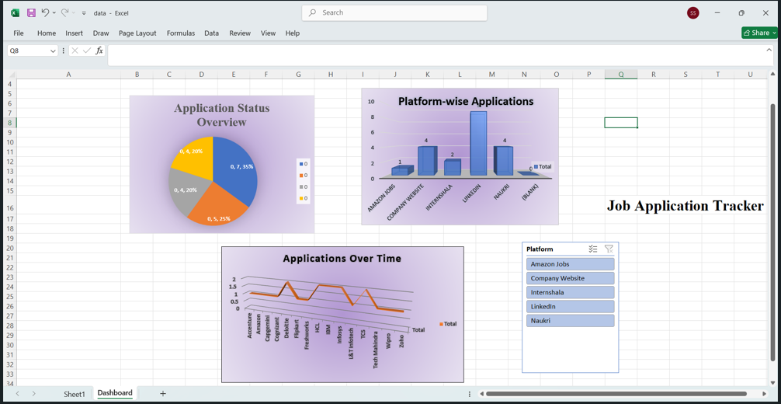
EXCEL

Slide 7
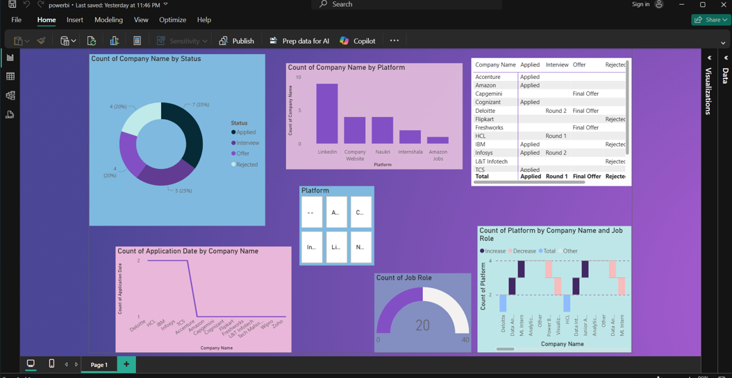
POWERBI

Slide 8
Key Insights Gained
✅ Most applications were submitted via LinkedIn.
✅ Offer and interview rates visualized easily.
✅ Rejections often occur at early stages.
✅ Trends over time show peak application dates.

Slide 9
Challenges & Learnings
🔧 Building dynamic filters using PivotTables.
📌 Creating clean data for Power BI ingestion.
🎨 Designing visually consistent charts.
📚 Learned real-world dashboard building skills.

Slide 10
Conclusion & Contact
📌 This dashboard helped streamline my job tracking.
📈 Demonstrates practical Excel & Power BI skills.
📬 Contact: saranyasubramanian80@gmail.com

