Slide 1

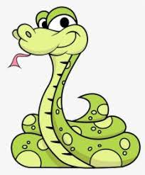
With OpenCV
GAME
Presented By Sharan S
Guided By Dr. A. SHAMILA EBENEZER

Slide 2
Objective
The background of the implementation lies in the idea:
To Develop an interesting gaming application for the children
The game should be so involving that they have a fabulous time and get immersed in it
The game should be addictive.
The game should provide a strong will to succeed and stay in the game
The aim in this game was to provide error free calculation of score

Slide 3
Company Profile
Computer vision is a field of artificial intelligence (AI) that enables computers and systems to derive meaningful information from digital images, videos and other visual inputs — and take actions or make recommendations based on that information.
OpenCV (Open Source Computer Vision Library) is an open source computer vision and machine learning software library. OpenCV was built to provide a common infrastructure for computer vision applications and to accelerate the use of machine perception in the commercial products.

Slide 4
Application
• Google revealed it has been testing self-driving cars on public roads for over a year now. These make extensive use of video cameras, which are complemented by radar sensors and lasers, to pilot the cars in busy traffic.
• CCTV is common-place now and there are commercial systems available that analyse the images and inform users of potential threats such as unattended bags.
• Movie studios are using computer vision to capture actor expressions and translate them into animated character expressions.
• Even the rapid rise of smart-phones has led to novel new ways to use computer vision to exploit on-board cameras and processing power

Slide 5
Overview of the project
We are creating a Classic Snake game using OpenCv
In this game, using opencv we are creating a window which is our play area
The snake moves arounds in this play area in search of food.
We can control the snake by moving our index finger in front of webcam.
The objective is to eat as much food to gain points.
The size of the snake increases as we eat more and more food.
And if the snakes eats itself/collide with itself then the game gets over

Slide 6
Modules/Libraries used
Opencv is a great tool for image processing and performing computer vision tasks. It is an open-source library that can be used to perform tasks like face detection, objection tracking, landmark detection, and much more.
Cvzone is a computer vision package that makes us easy to run like face detection, hand tracking, pose estimation, etc., and also image processing and other AI functions.
MediaPipe is the simplest way for researchers and developers to build world-class ML solutions and applications for mobile, edge, cloud and the web.

Slide 7
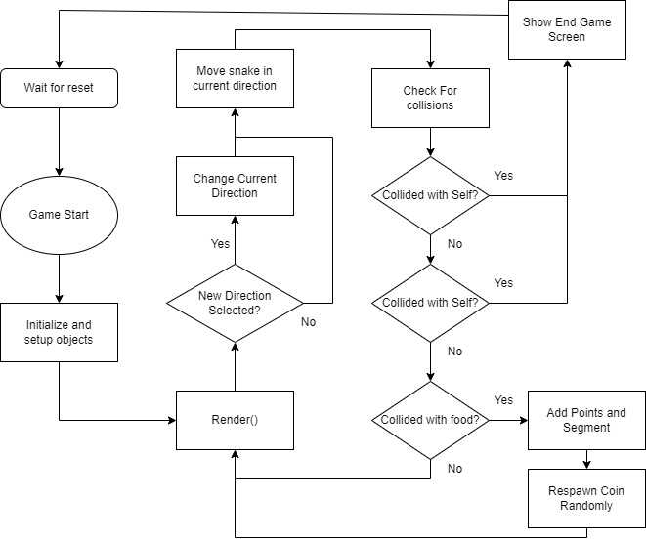
Project Implemented

Slide 8
Implementation Details
First we importing all the libraries which are cvzone, cv2, numpy and Handtracker
We are detecting our hand using the HandDetector() under cvzone
We are creating a Class named SnakeGameClass
In this we are creating RandFoodLocation() to place food randomly anywhere.
We are creating a Update() in which we draw the snake and the food
And check if the snake has eaten the food, if so the length reduces
We also check for collision.
We also check if hand is detected then we choose the index finger to control the snake

Slide 9
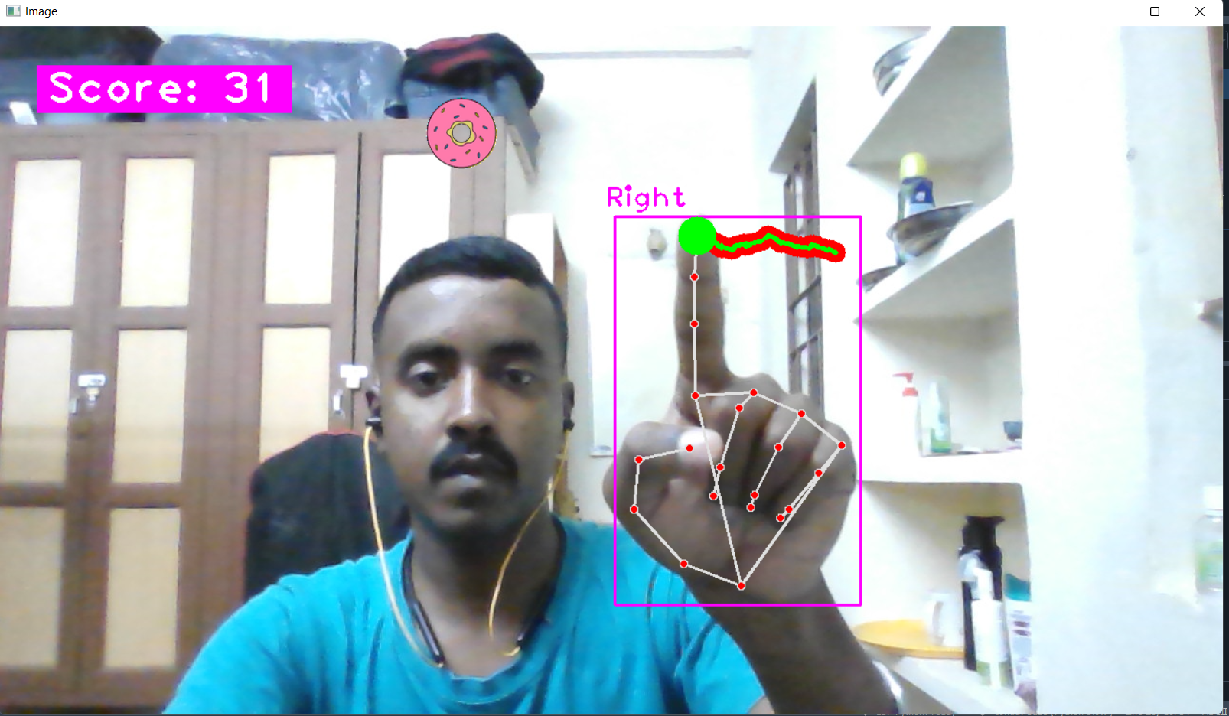
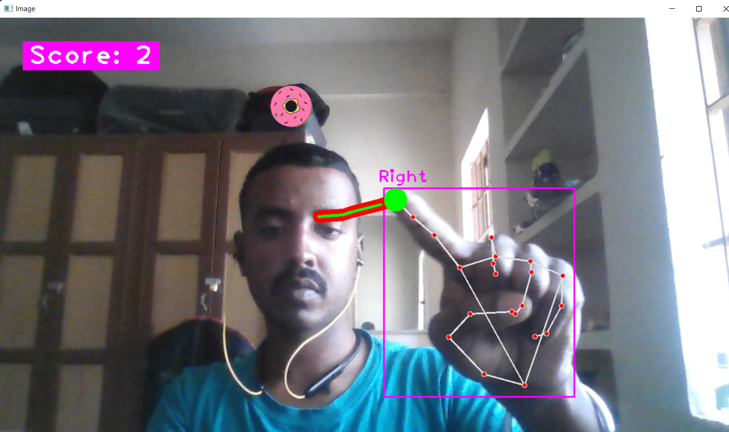
Output - Screenshots

Slide 10
Outcome of the Mini Project
We can control the snake with our index finger and move anywhere in the playarea
We move the snake to the food to gain points
When the snake eats the food, its size increases
And the score also increases
The snake grows until it collides to itself
We can reset the game by pressing R key.

Slide 11
Conclusion
Computer vision is as yet a creating discipline, it has not been developed to that level where it very well may be applied legitimately to genuine issues.
With further research on and refinement of the technology, the future of computer vision will see it perform a broader range of functions.
Not only will computer vision technologies be easier to train but also be able to discern more from images than they do now.
Considering the capabilities of present-day computer vision, it might be hard to believe that there are more benefits and applications of the technology that remain unexplored
The future of computer vision will pave the way for artificial intelligence systems that are as human as us.

Slide 12
THANK YOU

