Slide 1

Probabilistic Split Point Decision Trees
Master’s Thesis
Sharanya D. Aavunoori
Advisor: Dr. Doug Talbert

Slide 2
Outline
Problem statement
Research Questions and Contribution
Background
Solution approach
PSPDT algorithm
Methodology
Results
Conclusion
Future works

Slide 3
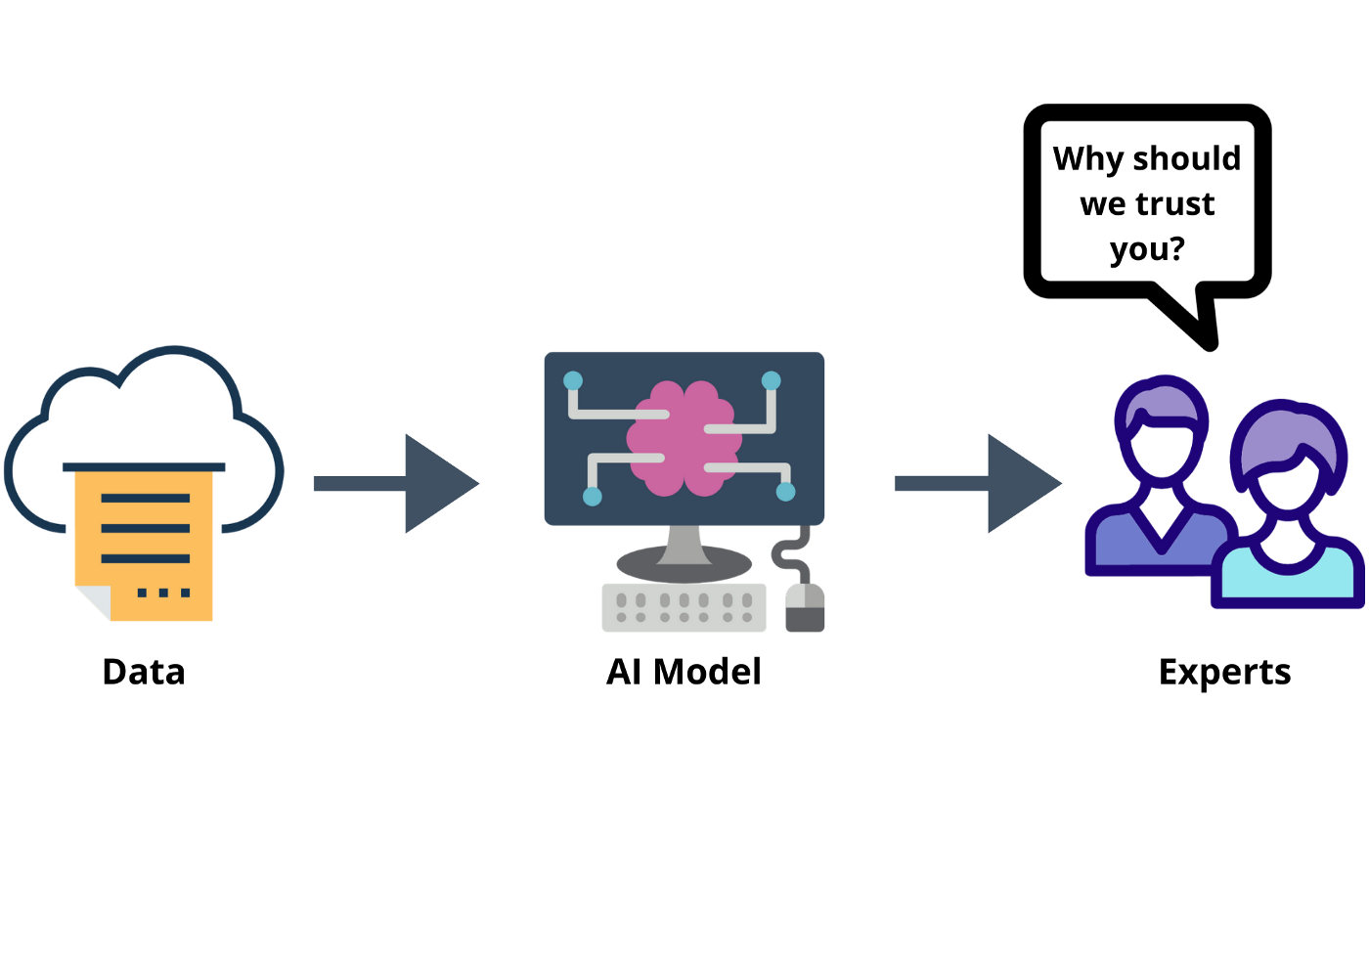
Problem Statement
Decision trees
Classification and prediction
Transparent
Unstable and might not match mental model (can make trust more difficult)
Decision tree explanations
Decision Trees in fields like medicine
Not just transparency but also trust
Believability - Why the model chose a certain output value, thus helping the user like medical experts believe in the algorithm and the results
Notes:
We don’t think DT match the mental model of physicians . Hard split point, unstable – data variation (motivation for CTC)

Slide 4

Motivation:
Clinicians need to reconcile the decision made by the algorithm with their own domain knowledge.
A decision tree with the below properties :
High accuracy
Transparency
Reflective real-world variability
Honest with respect to uncertainties involved
Stable
Motivated by a desire to increase trust and transparency in classification decisions
Notes:
Transparency - data variability is increased transparent

Slide 5
Hypothesis
Combining existing techniques that have been used to increase trust in data-driven decision models to generate a novel decision tree induction algorithm that we call Probabilistic-Split Point Decision Trees (PSPDTs) and seeks to test the following hypothesis:
Modeling continuous decision boundaries as Gaussian distributions learned by a consolidated decision tree approach creates a valid and useful classification model
Notes:
This work combines existing techniques that have been used to increase trust in data-driven decision models to generate a novel decision tree induction algorithm that we call Probabilistic-Split Point Decision Trees (PSPDTs) and seeks to test the following hypothesis

Slide 6

Research Questions:
Do PSPDTs generate split point distributions that are consistent with a Gaussian distribution?
"valid" part of hypothesis
Do PSPDTs have an average accuracy that is not statistically significantly different (at the p=0.05 level) than traditional decision trees built using CART or CTC with similar hyperparameters?
"useful" part of hypothesis

Slide 7
Contributions
Initial implementation of the novel PSPDT algorithm
pspdt.fit
pspdt.predict
Validation that split points follow a Gaussian distribution
An initial assessment of PSPDT accuracy through a comparison to other selected decision tree induction algorithms(CART and CTC)
Comparison of PSPDTs and their classification accuracy when varying the probabilistic approach to classification

Slide 8
Background(1/2):
Machine learning
Decision Tree
ID3,C4.5,CART
Attributes, Split criteria etc.
Rule Induction
C4.5 Rules, PART
Sequential rule induction
IREP and Ripper
Ensemble of Trees
Black box models
Bagging and boosting – improves performance but lacks explainability
Notes:
medical decision-making is the decision tree
effective, reliable, and easy to interpret, and their entire structure can be visualized in a simple flow chart, making them ``white box'' models.
Rule induction: Rule induction is an area of machine learning in which formal rules are extracted from a set of observations. Rule induction is a data mining process of deducing if-then rules from a data set. These symbolic decision rules explain an inherent relationship between the attributes and class labels in the data set.
Decision tree – sensitive to data variation- ensembles – blackbox . Famous – bagging boosting
Combined Multiple Models (CMM) – There have been attempts to compress an ensemble into a single tree.

Slide 9
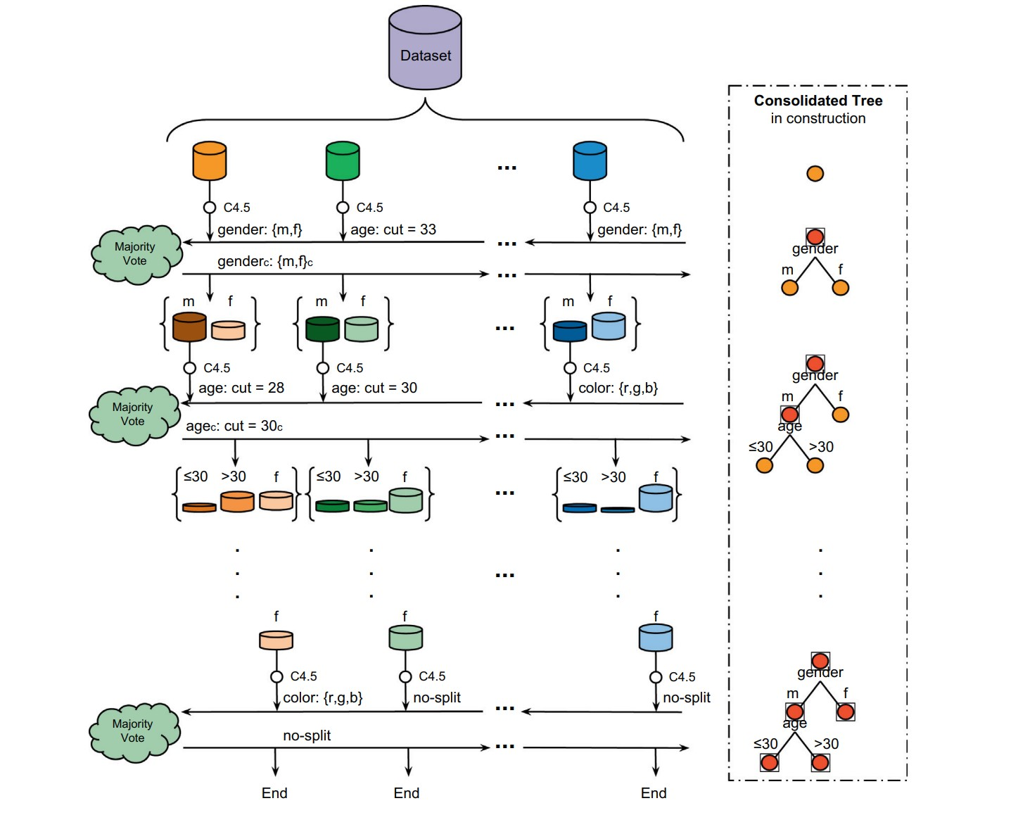
Background(2/2)
Consolidated Tree Construction (CTC)
Construction of decision trees with the Consolidated Tree Construction algorithm by Perez
CTC balances the performance of ensemble algorithms like Bagging and the explainability of individual decision trees
Bootstrapping Rule Induction by Waitman R.
Increases the believability and stability of the rule induction process by inducing Gaussian distribution
Bootstrapping can help extract reliable and concise rules from complex datasets, making them more interpretable and robust
Consolidated Tree Construction
Notes:
bootstrapping, a re-sampling technique, in rule induction.

Slide 10
Solution Approach
Probabilistic Split Point Decision Trees seek to improve the trust/believability and the transparency of decision trees by:
Using Consolidated Tree Construction to create a more stable tree and to generate a distribution of split point values
Using ideas from bootstrapping rule induction method to induce Gaussian estimations for rules (making variability transparent)
PSPDT algorithm consists of:
Learning the structure of the tree – Consolidated Tree Construction
Estimating the Gaussian distributions of split points
Probabilistic classification
Notes:
DT lacks probabilistic output, complex decision rules
Sensitive to data variations
Lack of global optimization
Model accuracy and interpretability trade-off

Slide 11
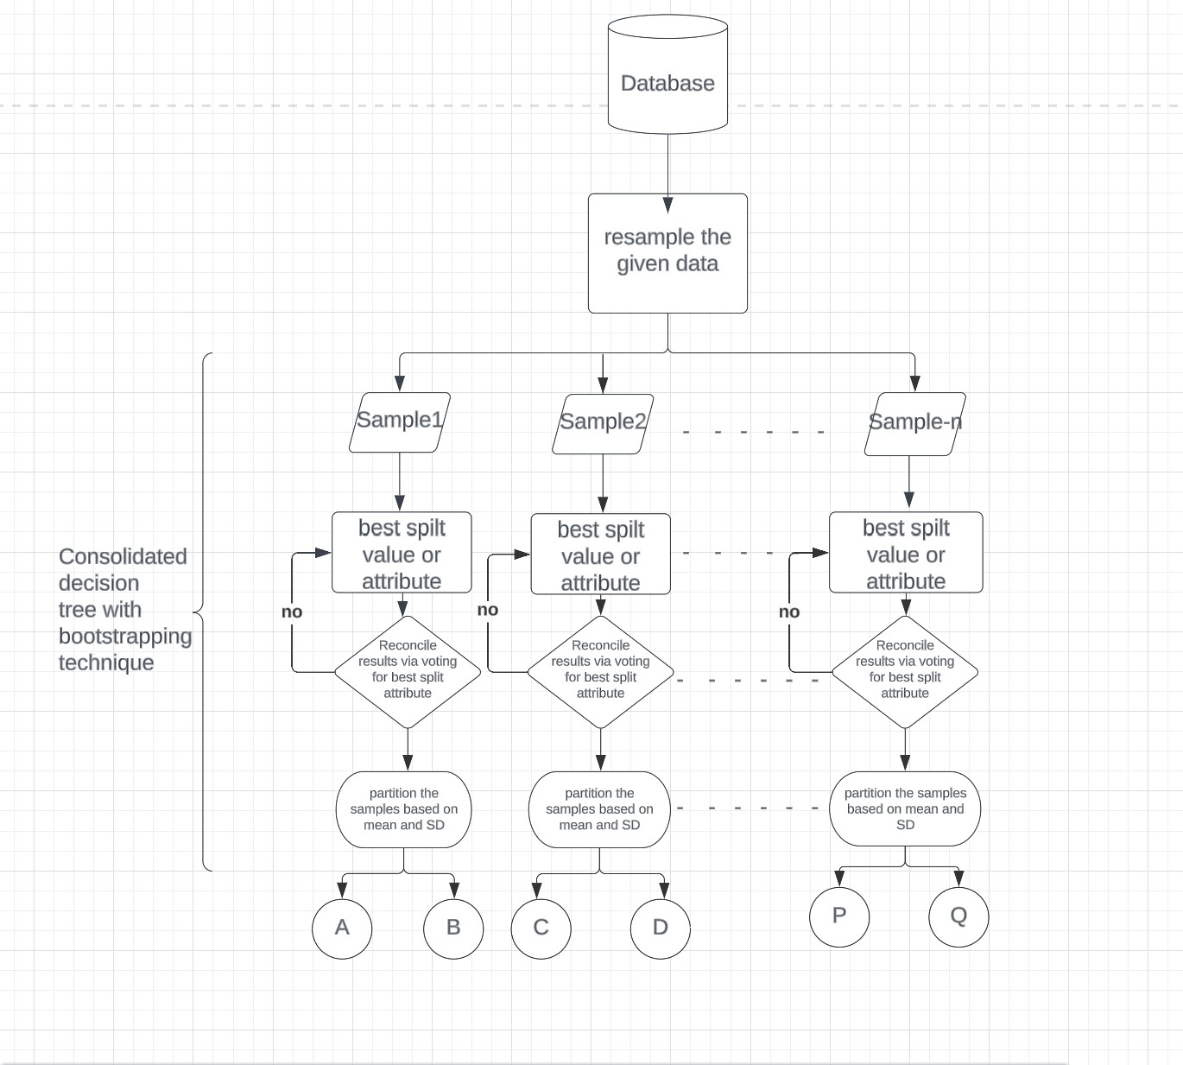
Flow Chart

Slide 12
PSPDT Algorithm (1/3):
Construction of PSPDT (PSPDT.fit):
Use the Consolidated Tree using the CTC algorithm but by using bootstrapping rule induction technique
For a given dataset
Partition into train and test (and validation)
stratified resampling – 70:30
Use bootstrapping to create multiple samples
At each node, have all the samples vote for the best attribute.
If appropriate, make it a leaf node
Otherwise, split each sample using the winning attribute
Store median, mean, and std dev

Slide 13
PSPDT Algorithm (2/3):
Classification using a PSPDT (PSPDT.predict):
For each data sample in test:
Using the likelihood function based on induced Gaussian distributions - compute the probability that the data point is classified down each path in the tree
Compute the probability that the data point should be classified to each leaf in the tree.
The probability at a leaf is the product of probabilities along each of the paths from the root node to the corresponding leaf node thus, presenting us with a probabilistic tree.
Use these probabilities to select the leaf (or leaves) used for classification.

Slide 14
PSPDT Algorithm (3/3):
Leaf selection options:
PSPDT –MP: classification based on the leaf with the highest probability among all the leaves
PSPDT-ε:
All the leaves with probabilities greater than or equal to ε are considered,
A weighted average is calculated for each class present
The class with the highest value is selected as the prediction for that data sample.

Slide 15
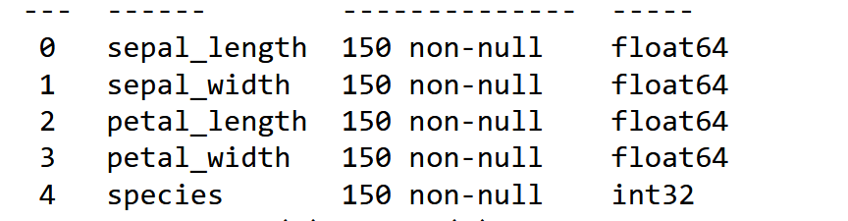
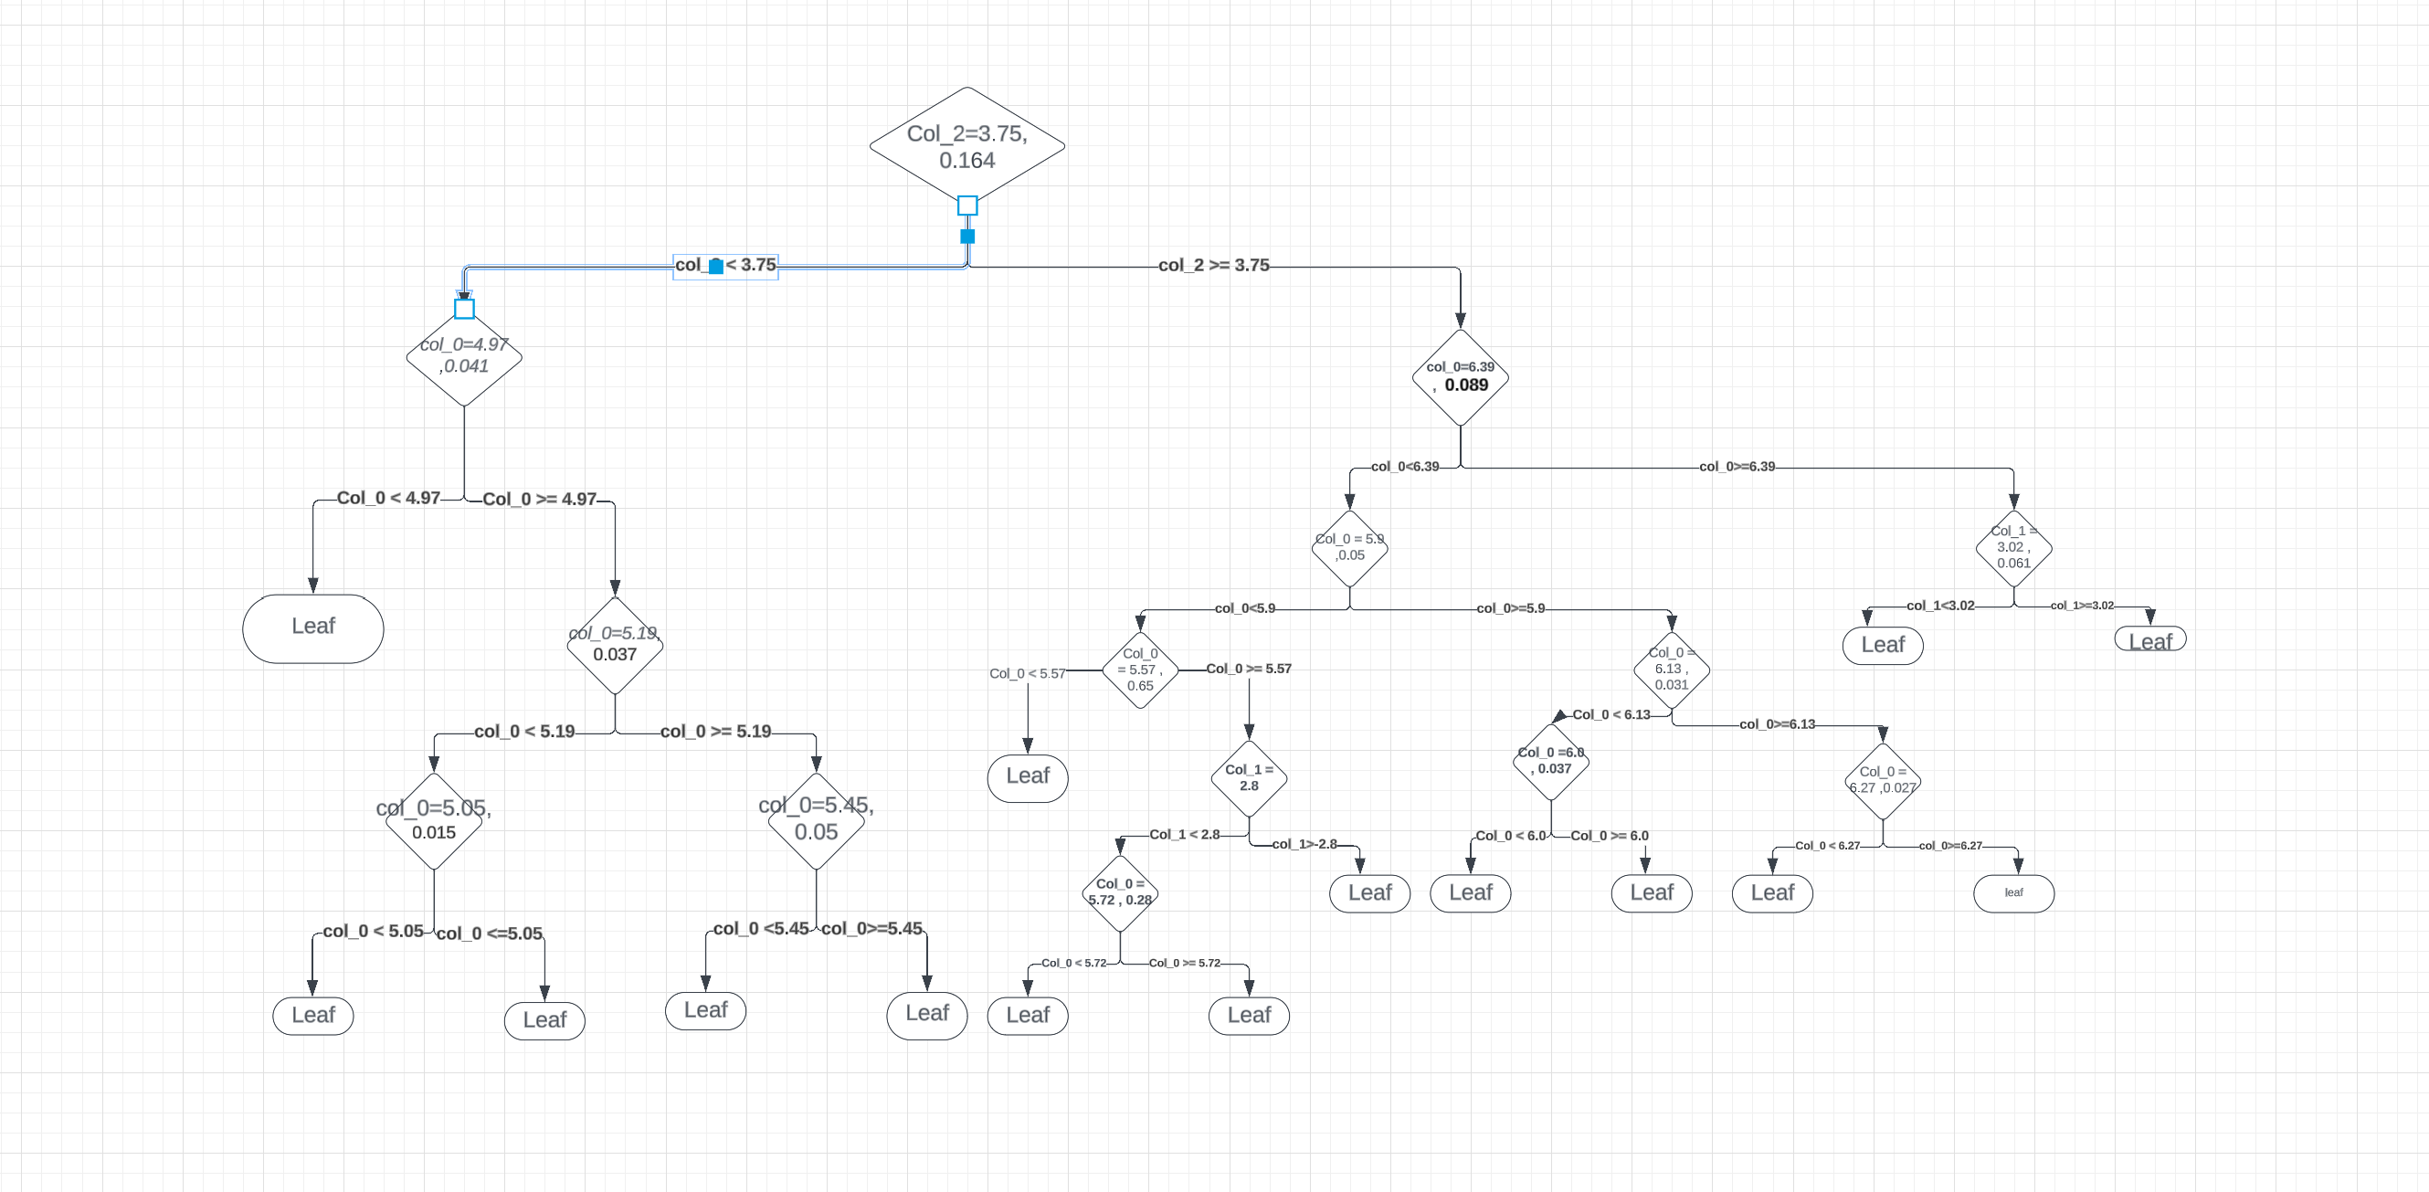
PSPDT overview :
Notes:
Each internal node denotes a test on an attribute, each branch represents an outcome of the test, and each leaf node (terminal node) holds a class label.
A decision node has two or more branches. Leaf node represents a classification or decision.
The topmost decision node in a tree which corresponds to the best predictor called root node
A decision tree is built top-down from a root node and involves partitioning the data into subsets that contain instances with similar values (homogeneous)
Various Algorithms like C4.5/J48 -uses entropy, CART – uses Gini

Slide 16
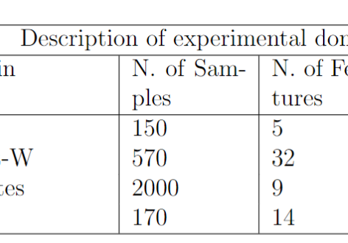
Methodology (1/2):
Data:
UCI repository
Gini index as an impurity measure
Hyperparameters:
Maximum depth
Minimum sample split
Minimum sample leaf
Number of samples
PSPDT, CTC, and CART algorithm ran across all 4 datasets
Notes:
For estimating Gaussian distribution, we follow R. Waitman’s Bootstrap samples to estimate the split point variability
Maximum Depth: This hyperparameter determines the maximum depth or levels of the decision tree. It controls the number of splits and branches the tree can have. Setting a higher maximum depth may result in over-fitting, while a lower value may lead to under-fitting.
Minimum Sample Split: This hyperparameter specifies the minimum number of samples required to split an internal node. If the number of samples at a node falls below this threshold, further splitting is not performed. Adjusting this hyperparameter helps control the complexity of the tree and can prevent over-fitting.
Minimum Sample Leaf: This hyperparameter sets the minimum number of samples required to be at a leaf node. If the number of samples at a leaf node is below this value, a split is not allowed. Similar to the minimum sample split, this hyperparameter helps control the complexity and generalization of the tree
Number of subsamples: This hyperparameter determines the number of subsamples that the training dataset will be split into.

Slide 17
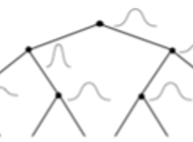
Methodology (2/2):
Accuracy across all the datasets
Accuracy score averaged for 10 runs for each dataset
PSPDT – MP
PSPDT – ε
ε = 0.01, 0.05, 0.1, 0.25
Accuracies for CTC and CART with same hyperparameters of max depth as 10
Notes:
Classification using the most probable leaf in the give data
Return probability of each class given the selected leaves, the probability of each leaf used, and total probability of leaves used

Slide 18
Hypothesis Testing (1/2):
Splits points follow Gaussian distribution:
Shapiro-Wilk test: If continuous data follow a normal distribution, then we present this data in mean value and the same is used to compare between/among the groups to calculate the significance level (P value)
Null hypothesis: Data are taken from a normally distributed population.
When P > 0.05, the null hypothesis is accepted.
Notes:
The standard normal distribution is the most important continuous probability distribution has a bell-shaped density curve described by its mean and SD
However, for large samples the Shapiro-Wilk test is way too sensitive, and will reject the null hypothesis (of normality) with even tiny deviations. It has the highest power of any of the common normality tests, so if you need to be really, really sure that a small-to-medium dataset is normal, Shapiro-Wilk is a pretty good test to start with. If your dataset is large, or you want to use one test statistic to compare against multiple theoretical distributions, K-S is going to be what you want.

Slide 19
Hypothesis Testing (2/2):
PSPDTs have an average accuracy that is not statistically significantly different (at the p=0.05 level) than traditional decision trees built using CART or CTC with similar hyperparameters
T-test: Type of hypothesis testing
Compare the means of two groups and determine whether there is a statisitically significant difference between them
If the p-value is less than 0.05 we reject the null hypothesis
PSPDT vs. CTC and PSPDT vs. CART algorithms
Notes:
The standard normal distribution is the most important continuous probability distribution has a bell-shaped density curve described by its mean and SD
However, for large samples the Shapiro-Wilk test is way too sensitive, and will reject the null hypothesis (of normality) with even tiny deviations. It has the highest power of any of the common normality tests, so if you need to be really, really sure that a small-to-medium dataset is normal, Shapiro-Wilk is a pretty good test to start with. If your dataset is large, or you want to use one test statistic to compare against multiple theoretical distributions, K-S is going to be what you want.

Slide 20
Results:
PSPDT-MP Vs CART VS CTC along with t-test summary:
Dataset | PSPDT-MP | CTC (p-value) | CART (p-Value)
IRIS | 89.5% | 84.97% (0.43) | 91.12% (0.12)
Wine | 87.56% | 88.97% (0.92) | 90.53% (0.06)
Diabetes | 71.25% | 73.86% (0.86) | 80.64% (0.47)
Breast-w | 89.75% | 87.32% (0.93) | 90.56% (0.11)

Slide 21
Leaf distribution and accuracy for ε values IRIS dataset:
 | Mean | Std dev | Min | Max | Accuracy%
ε = 0.01 | 2.43 | 0.96 | 1 | 4 | 93.25
ε = 0.05 | 1.93 | 0.67 | 1 | 3 | 90.85
ε = 0.1 | 1.76 | 0.55 | 1 | 3 | 86.57
ε = 0.25 | 1.26 | 0.44 | 1 | 2 | 89.56
PSPDT-MP | - | - | - | - | 89.5
CART | - | - | - | - | 91.12

Slide 22
Leaf distribution and accuracy for ε values Wine dataset:
 | Mean | Std dev | Min | Max | Accuracy%
ε = 0.01 | 2.16 | 1.16 | 1 | 6 | 83.95
ε = 0.05 | 1.66 | 0.78 | 1 | 4 | 81.23
ε = 0.1 | 1.47 | 0.60 | 1 | 3 | 92.84
ε = 0.25 | 1.22 | 0.415 | 1 | 2 | 93.84
PSPDT-MP | - | - | - | - | 87.56
CART | - | - | - | - | 90.53

Slide 23
Leaf distribution and accuracy for ε values Diabetes dataset:
 | Mean | Std dev | Min | Max | Accuracy%
ε = 0.01 | 1.87 | 1.12 | 1 | 5 | 74.52
ε = 0.05 | 1.63 | 0.86 | 1 | 4 | 68.48
ε = 0.1 | 1.46 | 0.70 | 1 | 3 | 69.87
ε = 0.25 | 1.12 | 0.46 | 1 | 3 | 74.87
PSPDT-MP | - | - | - | - | 71.25
CART | - | - | - | - | 80.64

Slide 24
Leaf distribution and accuracy for ε values Breast-w dataset:
 | Mean | Std dev | Min | Max | Accuracy%
ε = 0.01 | 1.75 | 0.95 | 1 | 5 | 93.71
ε = 0.05 | 1.47 | 0.66 | 1 | 4 | 89.54
ε = 0.1 | 1.32 | 0.53 | 1 | 3 | 90.26
ε = 0.25 | 1.14 | 0.36 | 1 | 2 | 87.66
PSPDT-MP | - | - | - | - | 88.75
CART | - | - | - | - | 90.56

Slide 25
Summary of PSPDT-ε:
As ε value increased from 0.01 to 0.25 maximum number of leaves decreased:
IRIS: 4 to 2, Wine:6 to 2, Breast-w : 5 to 2 and Diabetes: 5 to 3
More leaves are likely to have probabilities of at least ε when its value is lower
As the range decreases, the standard deviation does as well
At least 1 minimum leaf present
Value of epsilon matters
Often allows us to improve PSPDT-MP over CART

Slide 26
For Shapiro-wilk - Gaussian hypothesis testing
Lowest p-value recorded was 0.132
Null hypothesis accepted
Split points follow Gaussian distribution
From the t-test summary it is observed that the p-value was never less than 0.05
PSPDTs are not statistically significantly different than CART and CTC built with same hyperparameters

Slide 27
Conclusion:
Introduced a novel PSPDT algorithm
PSPDT intends to bring trust, transparency, and believability to classification decisions
The research reported in this thesis establishes two fundamental results
Split points follow a Gaussian distribution
This is a core assumption underlying PSPDTs.
The accuracies of PSPDTs is not statistically significantly different from that of CART and CTC algorithms built with the same hyperparameters.
We don't want the probabilistic representation of PSPDTs to result in a sacrifice of classification accuracy.

Slide 28
Future work
Build a more mature/robust implementation in an accepted open-source framework like sklearn (CART) or Weka (CTC)
Extend this work for mixed types of data
Optimize algorithm cost
Handle missing values
Enable tuning of additional hyperparameters like sampling
Extend PSPDTs to allow for pruning
Test using more diverse and larger datasets

Slide 29
Thank You

Slide 30
QUESTIONS?

