Slide 1

Fundamentals of Web
By Sharanam Chotai

Slide 2

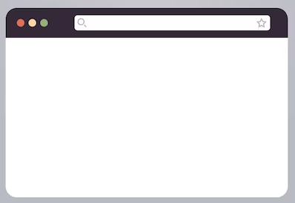



Server-Side vs Client-Side

