Slide 1
Project Name – Dialysis of Patients
Group Members:
Mr. Kuldeep Bagga
Mr. Sharan S.
Ms. Sujata Biswas
Mr. Shankar Mane

Slide 2
Objectives(KPI’s)
Number of Patients across various summaries
Profit Vs Non-Profit Stats
Top 3 Chain Organizations in terms of no. of dialysis stations
Dialysis Stations Stats
# of Category Text - As Expected
# of Score Applied – Improvement
Top 3 Facilities in terms of Total Performance Score
Average Payment Reduction Rate

Slide 3
Number of Patients across various summaries
Survivol summary has highest number of patience due to less mortality rate
Survivol rate is also very high in all dialysis stations which provides all the required clinical environment to patients.
nPCR summary contains very less number of patients that is 980.
nPCR summary is the only summary which is for children and could see the least count is also from those dialysis stations

Slide 4
Profit Vs Non-Profit Stats
Number of profit Facilities are 6854 as these facilities contains maximum Dialysis Satations.
Profitable facilities provides good clinical enivroment and required assist to patients in need of Dialysis procedures.
869 Non-Profit facilities as these are still under improvement in many fields.

Slide 5
Top 3 Chain Organizations in terms of no. of dialysis stations
Total No.Dilysis Station present are 135055.
Davita-2908,Fresenius Medical care-2674, Independent-815.
Davita has highest number of Dialysis stations, Cotains more Five Star ratings i.e.10546, Hence it provides good diagnosis,prescription,good quality service to all patints.
Less mortality rate.

Slide 6
Dialysis Stations Stats
Top 3 states which contains more number of Dialysis stations are California, Florida Texas.
Depending upon number of facility centres we have Houston as a leading city.
Dialysis station (135055) vs five star rating. 34920 Dialysis stations are 5 star rated, 37792 4 star rated, 45939-3 star rated.
Hence there are more 3 star / Average rated Dialysis stations present provides good quality service to all type of patients.

Slide 7
# of Category Text - As Expected
Total No of As expected category -41k PatientIn that hospitalization category. PPPW Category. Fistula Category has highest No Le approx 7k Patients.
Where as SWR category has minimum Le is 4k no patients.
Patients hospitalization category has more survival rate and less mortality rate.

Slide 8
# of Score Applied – Improvement
StrR Measure needs changes and improvement in order to reach the Expected Service.
On the other hand ICH CHAPS has displayed Expected service and have minimum scope for improvement.

Slide 9
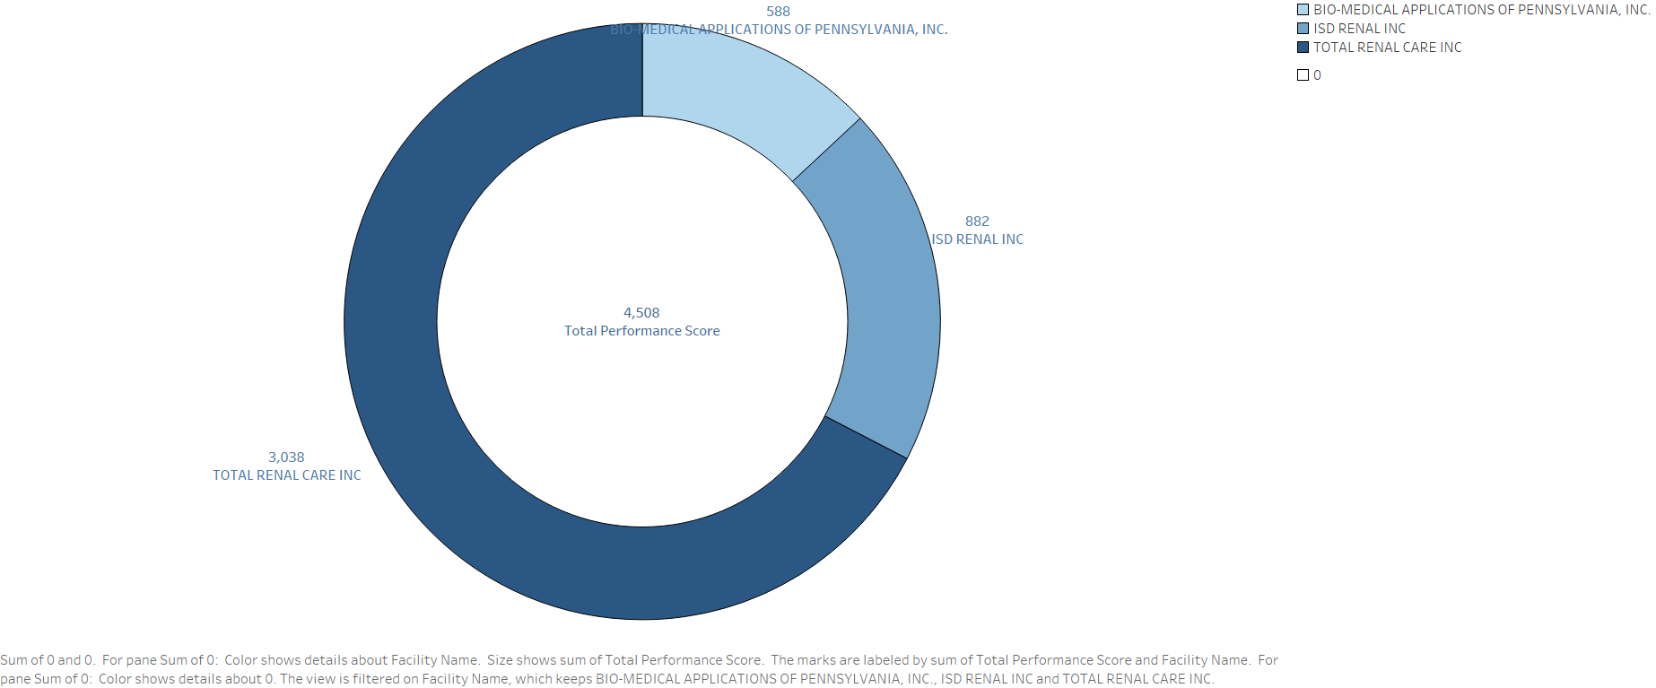
Top 3 Facilities in terms of Total Performance Score
Total Renal Care has the highest performance score, which was achieved based on different categories across the facilities.
Followed by ISD Renal and Bio-Medical Application of Pennsylvania.

Slide 10
Average payment reduction rate
• Average payment reduction rate based on all the factors which had negative impact on the facilities.
There are 4674 Facilities below the average.

Slide 11
Conclusion
Survival summary has more no of patients and less mortality rate whereas nPCR summary has less no of patients.
Davita has highest number of Dialysis stations i.e. 2908 and Contains more Five star ratings i.e. 10546. Hence Top I chain organization which provides good diagnosis and prescription to patients.
Profitable facilities are more compared to non-profitable facilities due to good quality service and assist to required patients.
Top 3 states which contains more number of Dialysis stations are California, Florida Texas.
Patients hospitalization category has more survival rate and less mortality rate.

