Slide 1
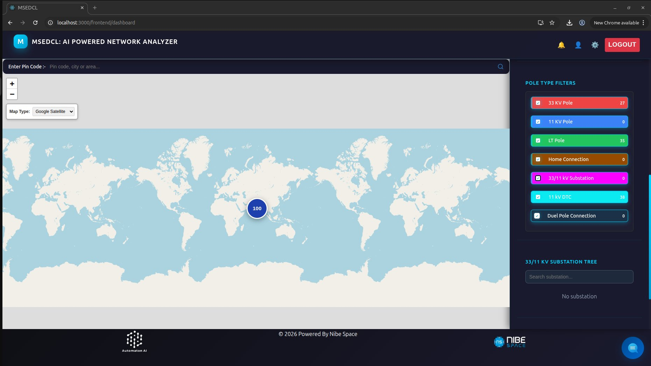
MSEDCL: AI-Powered
GIS Survey & Network Mapping
M
MahaPole — End-to-end pole survey, GPS capture, AI classification, and real-time grid visualization for Maharashtra's power distribution network.
Web Dashboard
Mobile App
Web Dashboard
AI Analysis
GPS Tagging
Approval Workflow
Powered by Nibe Space • © 2026 Automaton AI

Slide 2
System Architecture Overview
📱
🤖
🗺️
Mobile App
(MahaPole)
AI Processing
Engine
Web Dashboard
(MSEDCL)
Field surveyors capture pole photos, GPS coordinates, and QR codes using the Android app. Data is batched and submitted for AI processing.
Anthropic AI + computer vision classify pole type, condition, and assets from submitted images. Results populate the GIS database.
Supervisors and engineers view all poles on an interactive map with real-time filters, substation trees, and fault alerts.
→
→
Nibe Space • MSEDCL GIS Survey Mapping • 2026

Slide 3
Web Dashboard — AI Powered Network Analyzer
📍
Pole Type Filters
33KV, 11KV, LT Poles, DTCs, Substations
🗺️
Map Modes
Google Satellite + Street view toggle
🔍
Pin Code Search
Search by PIN code, city or area
🌳
Substation Tree
33/11 KV hierarchy navigation
🔢
Live Counts
Real-time pole count per category
Nibe Space • MSEDCL GIS Survey Mapping • 2026

Slide 4
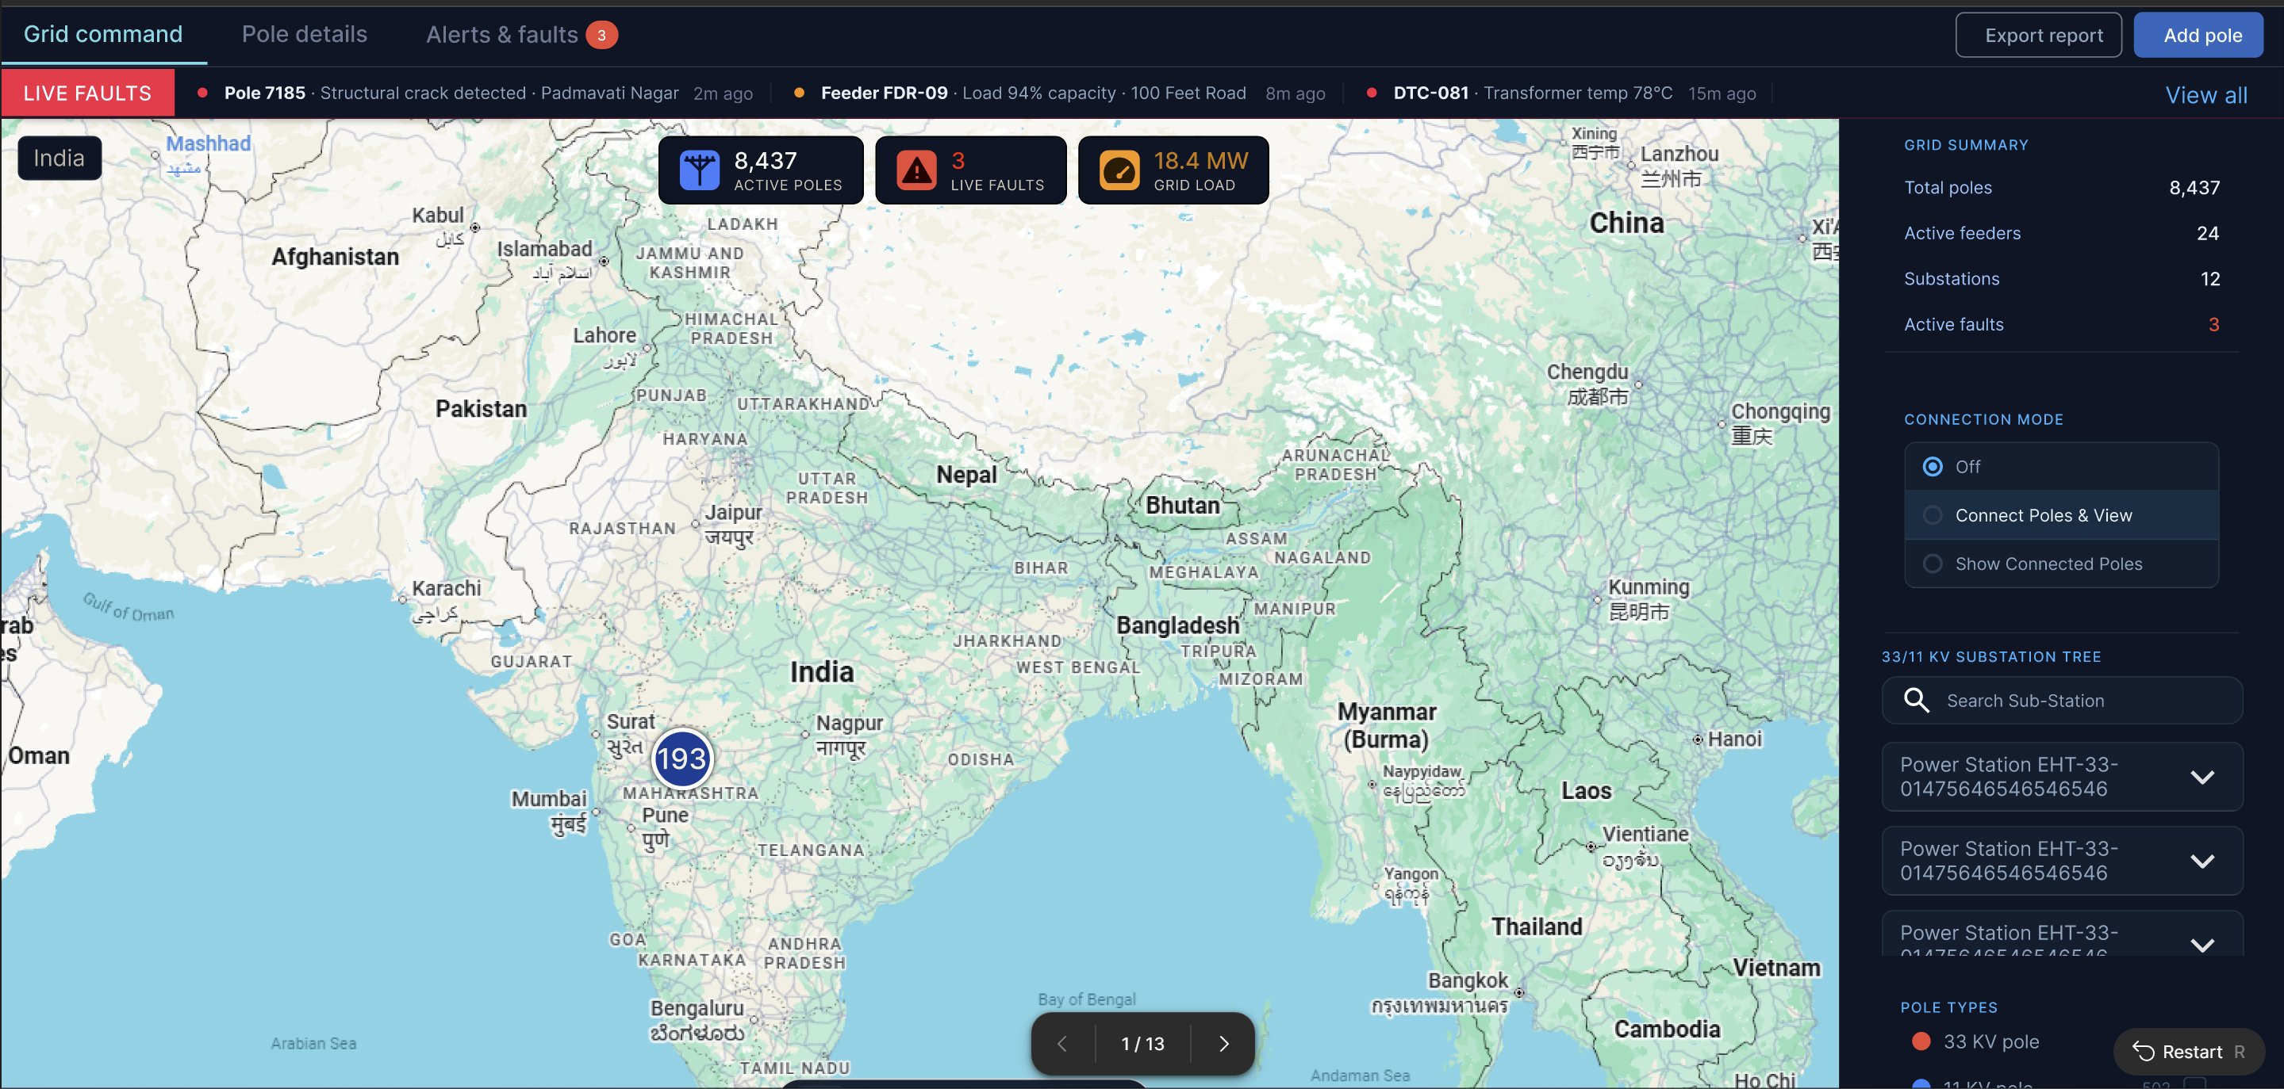
Grid Command — Live Faults & Network Status
8,437
3
Active Poles
Live Faults
18.4MW
24
Grid Load
Active Feeders
▸ Real-time fault alerts — structural cracks, overloads, temperature
▸ Substation tree: 33/11 KV hierarchy with drill-down
▸ Pole connection mode: visualize connected infrastructure
▸ Export report + Add pole directly from dashboard
Nibe Space • MSEDCL GIS Survey Mapping • 2026

Slide 5
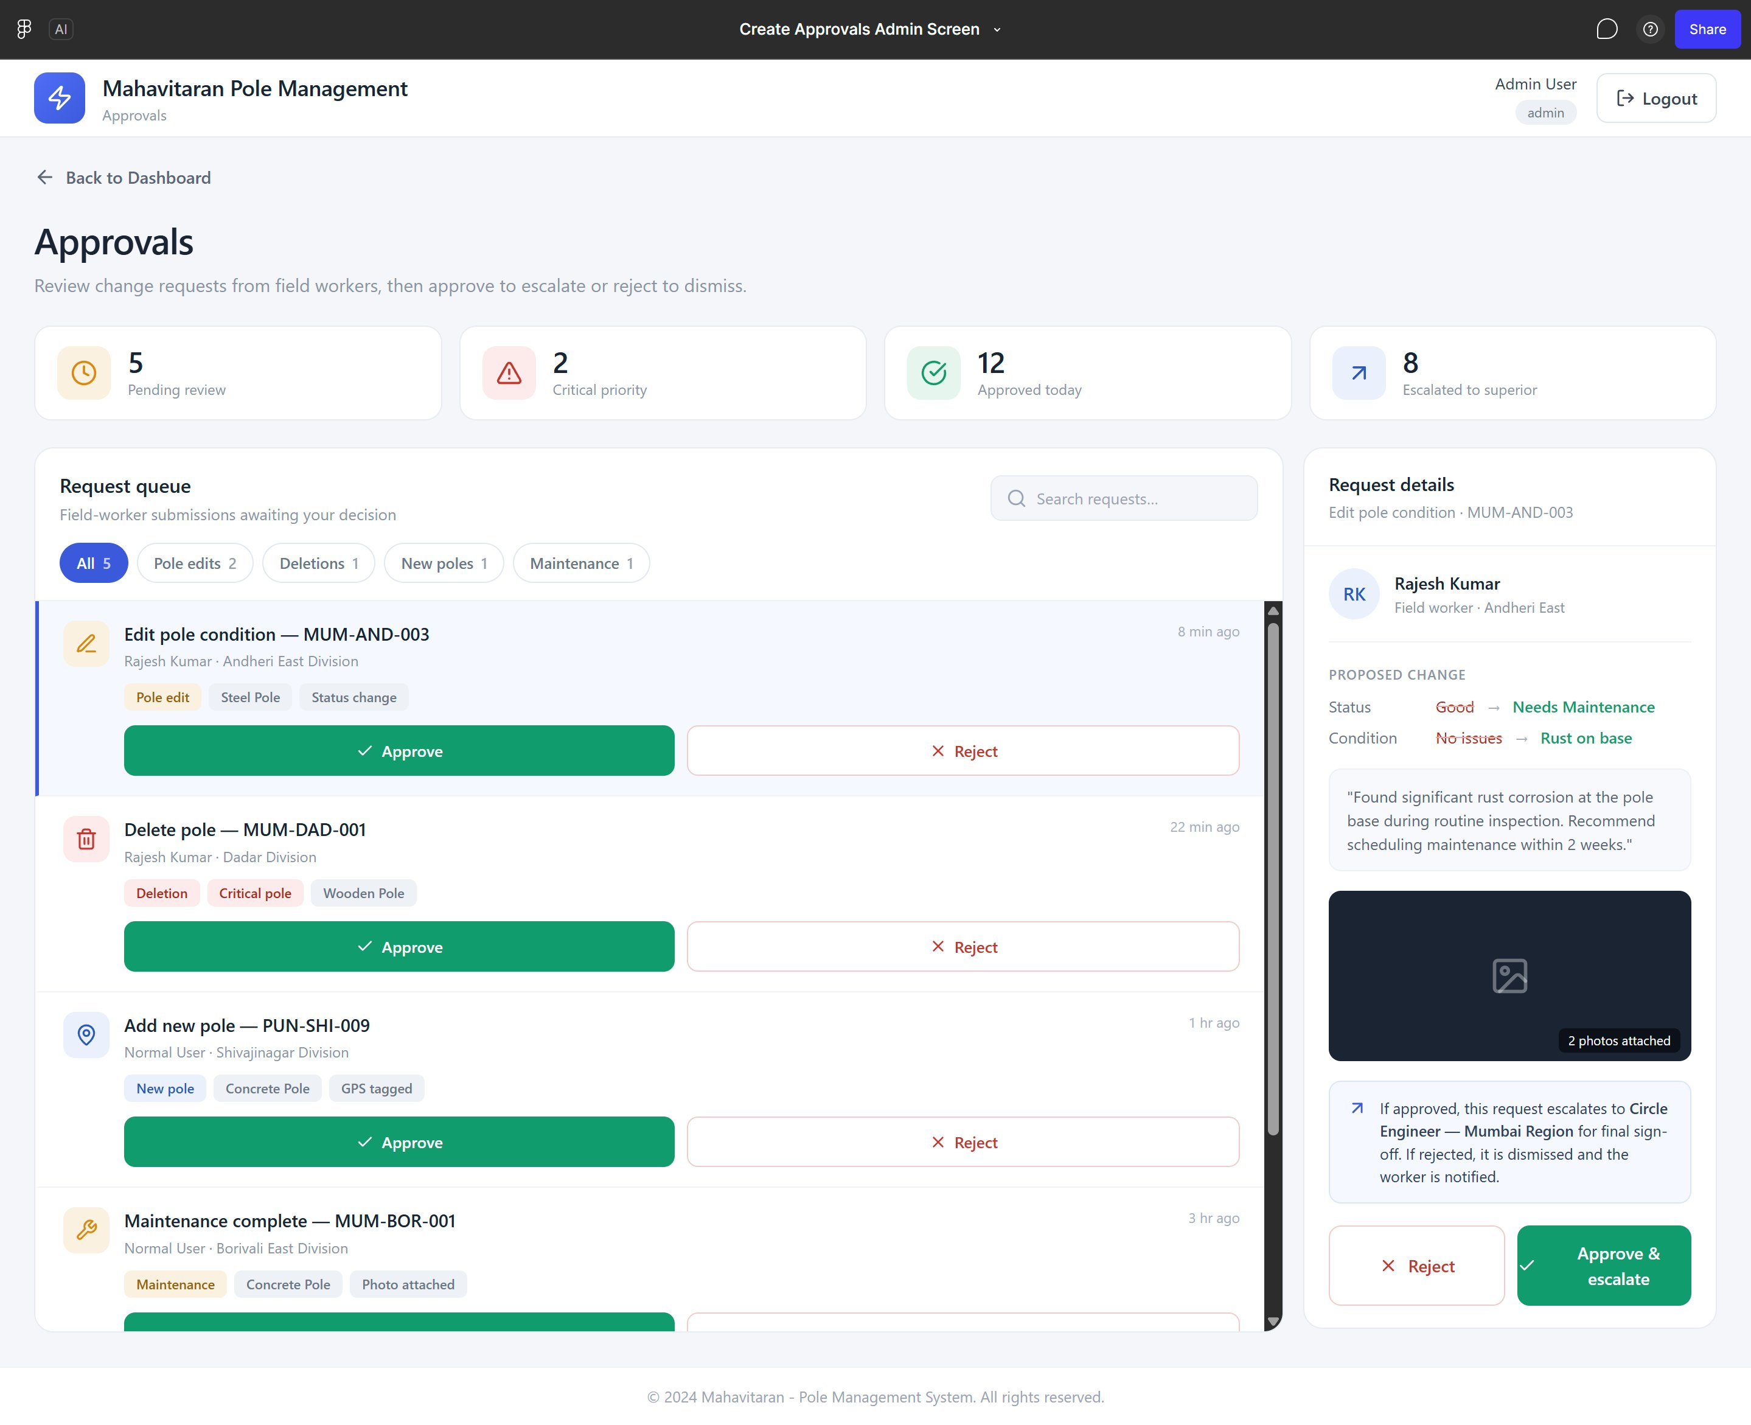
Approvals Admin — Change Request Workflow
1
Field Worker Submits
Pole edit, deletion, new pole, or maintenance request from mobile app
2
Admin Reviews
Pending queue with priority flags; view proposed changes & attached photos
3
Approve or Reject
Approve escalates to Circle Engineer; Reject dismisses with worker notification
4
Final Sign-off
Circle Engineer reviews escalated items for final approval
Nibe Space • MSEDCL GIS Survey Mapping • 2026

Slide 6
📱
MahaPole
Mobile Application
Field survey tool for Network Analysts — capture, GPS tag, and submit pole data from anywhere in Maharashtra
Android App
GPS Capture
QR Scanning
Offline Ready
Upload History
Nibe Space • MSEDCL GIS Survey Mapping • 2026

Slide 7
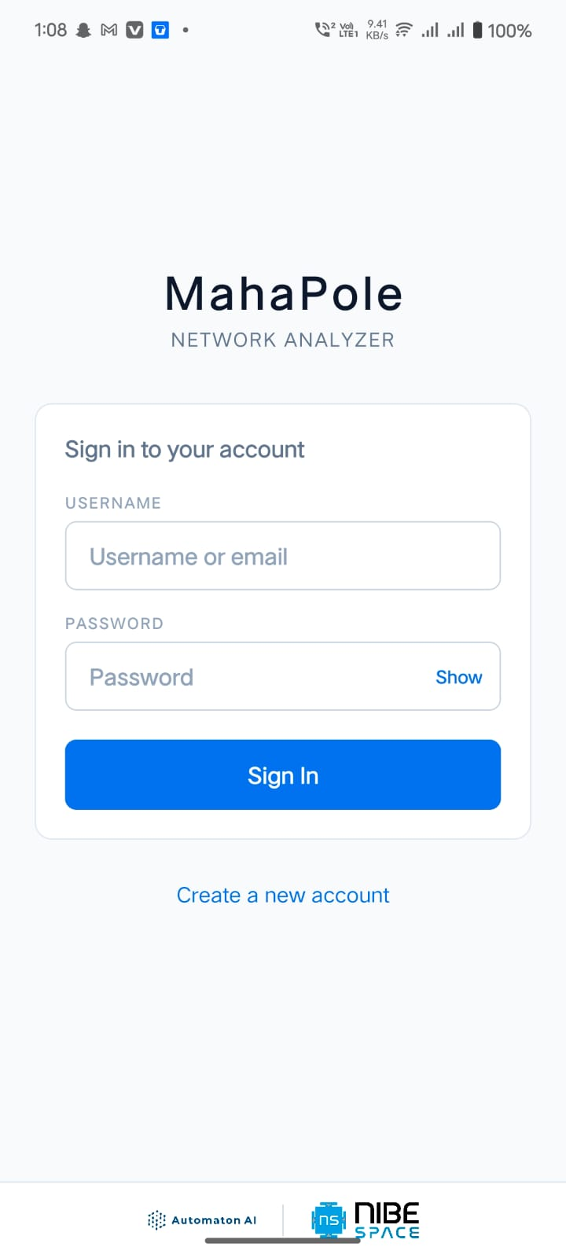
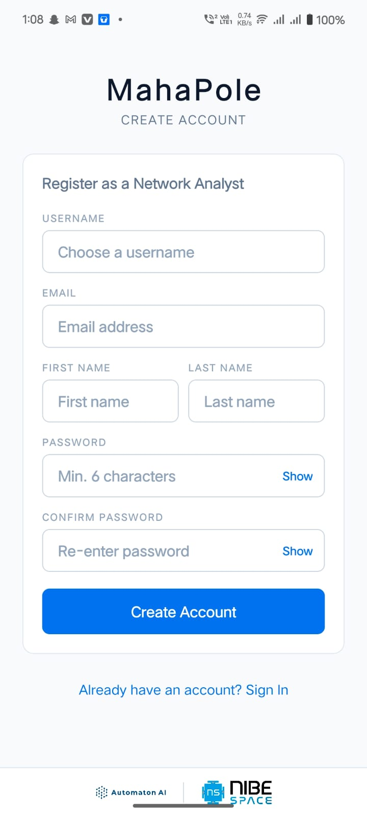
Mobile App — Authentication Screens
Sign In
Create Account
Authentication Features
App Name:
MahaPole — Network Analyzer
Role:
Network Analyst (field worker)
Sign In:
Username or email + password
Register:
Username, email, name, password
Brand:
Automaton AI + Nibe Space
Security:
Password show/hide toggle
Navigation:
Sign In ↔ Create Account links
Nibe Space • MSEDCL GIS Survey Mapping • 2026

Slide 8
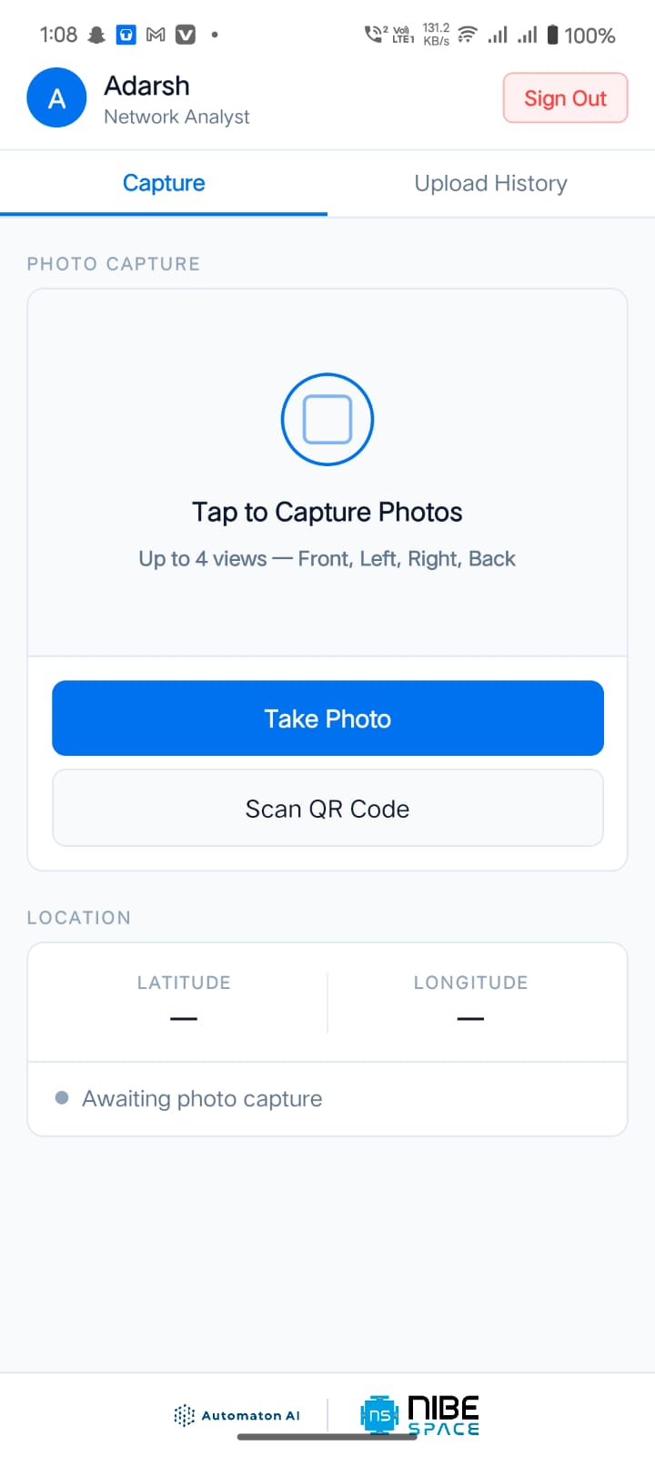
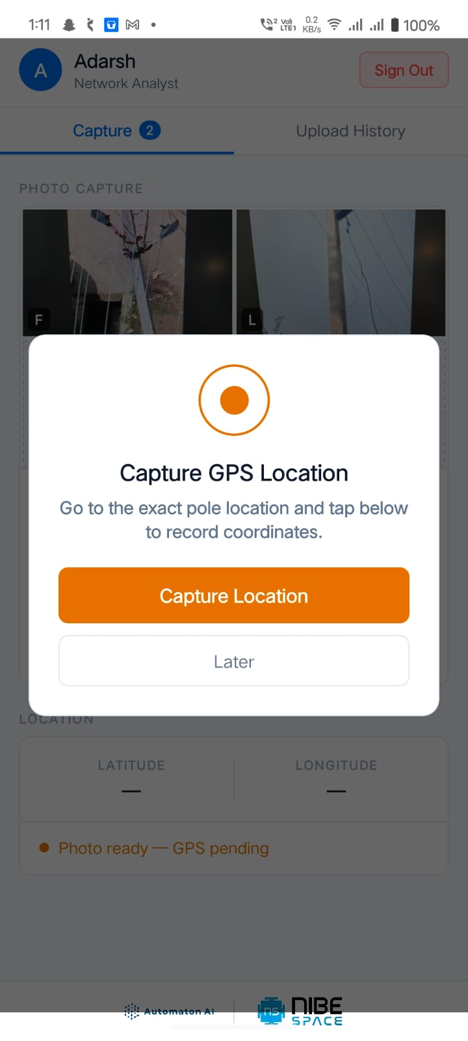
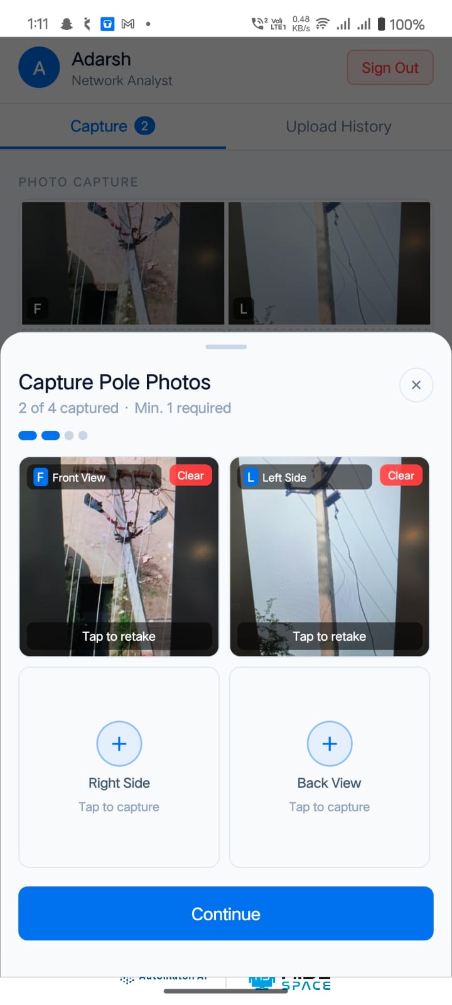
Mobile App — Photo Capture Workflow
Step 1: Tap to Capture
Step 2: Photos Captured
Step 3: Review & Continue
▸ Up to 4 views per pole: Front (F), Left (L), Right, Back • Min. 1 required
▸ 'Capture GPS' button appears after photos • Deferred GPS shown as 'GPS pending'
Nibe Space • MSEDCL GIS Survey Mapping • 2026

Slide 9
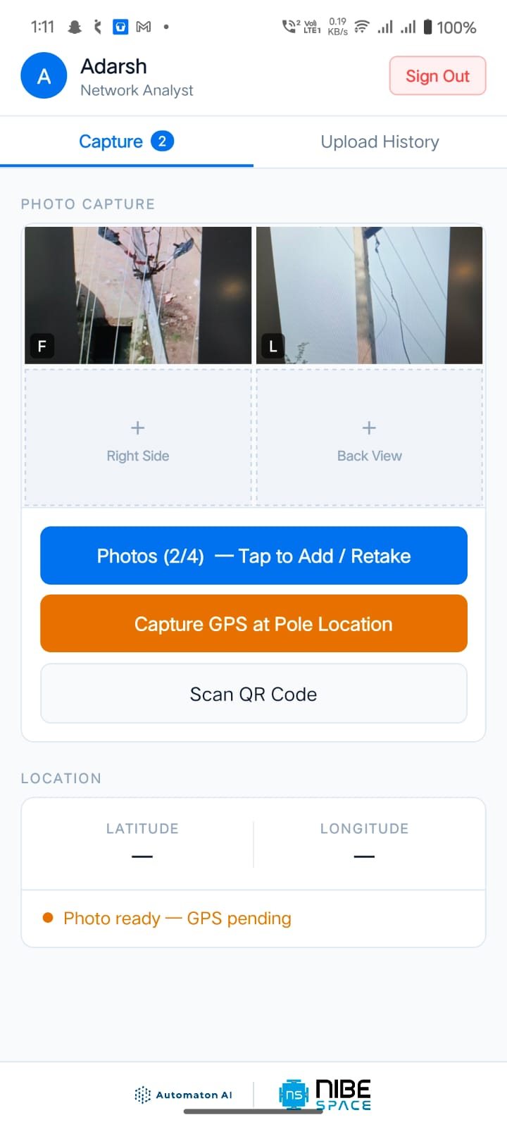
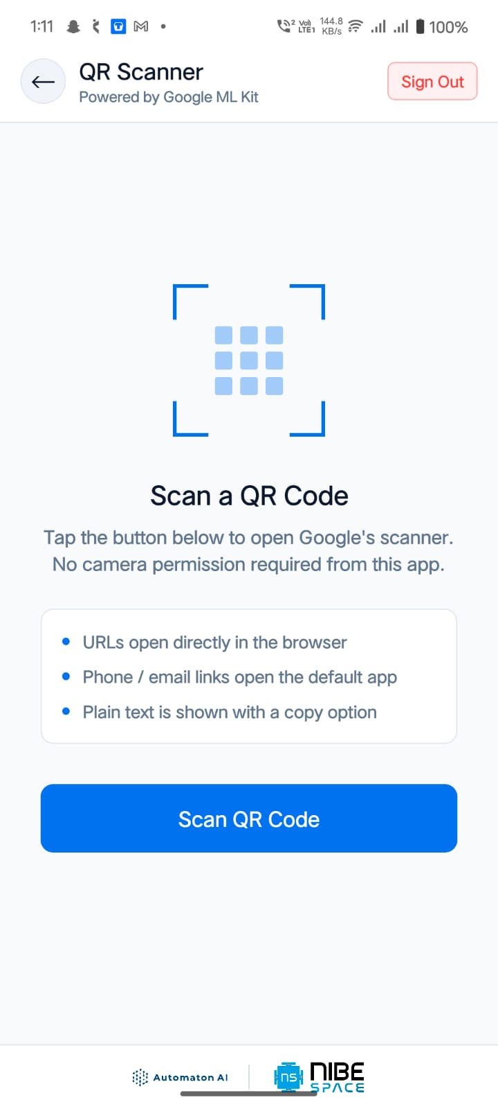
Mobile App — GPS Capture & QR Code Scanner
GPS Location Capture
QR Code Scanner
GPS Module
• Prompt shown after photo capture
• Walk to exact pole base before tapping
• 'Capture Location' records lat/long
• 'Later' defers GPS (shown as pending)
• Status: Photo ready — GPS pending
QR Scanner
• Powered by Google ML Kit
• No camera permission needed from app
• URLs → open in browser
• Phone/email → default app
• Plain text → copy option shown
Nibe Space • MSEDCL GIS Survey Mapping • 2026

Slide 10
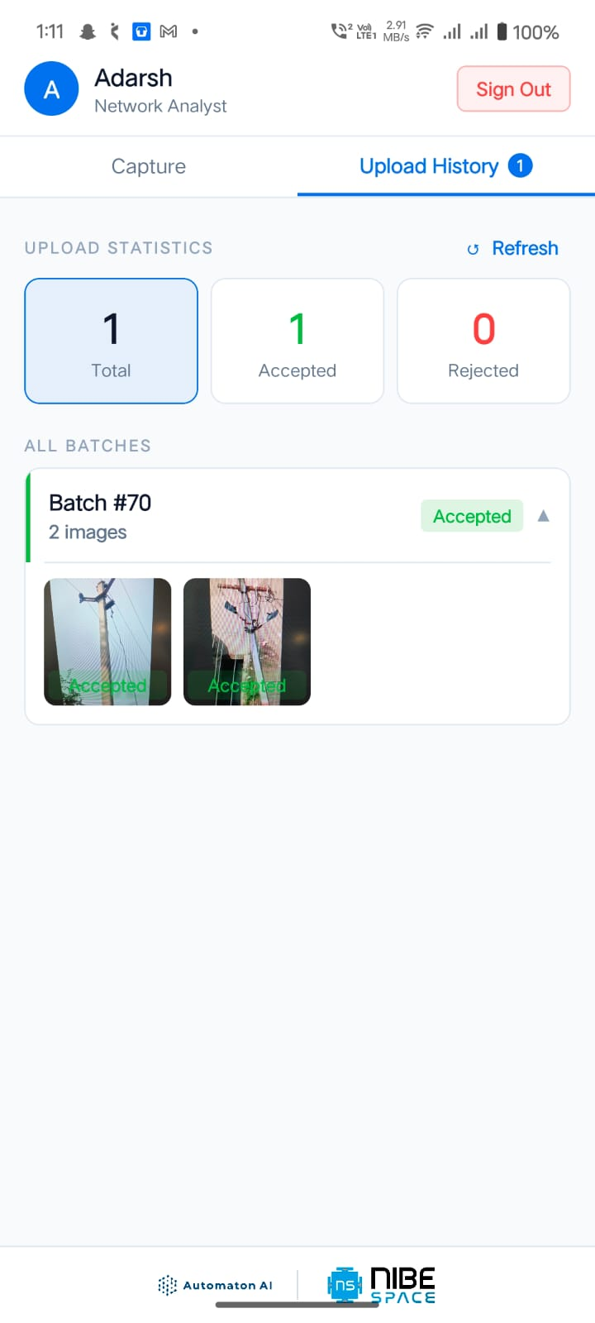
Mobile App — Upload History & Submission Tracking
Upload History
1
1
0
Total Submissions
Accepted
Rejected
BATCH DETAILS
Batch #
70
Images
2 per batch
Status
Accepted (green badge)
AI Review
Both images accepted
History Tab
Badge shows pending count
Refresh
Manual refresh button available
Nibe Space • MSEDCL GIS Survey Mapping • 2026

Slide 11
Solution Summary
📱
🤖
MahaPole Android App
AI-Powered Classification
Field survey tool — photo capture (4 views), GPS tagging, QR scanning, upload tracking
Automated pole type detection, condition analysis, and acceptance/rejection via Anthropic AI
✅
🗺️
Approval Workflow
GIS Web Dashboard
Multi-tier review: Field Worker → Admin → Circle Engineer with full audit trail
Live map with 33KV/11KV/LT/DTC filters, fault alerts, grid load monitoring, substation trees
© 2026 Powered by Nibe Space • Automaton AI

