Slide 1
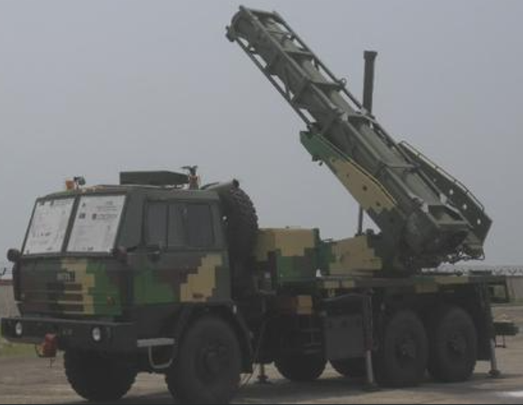

NIBE LIMITED
SHIRDI FACILITY
NL Test
Capabilities
EMI / EMC · RF · Environmental Testing
One-stop compliance & validation facility, Shirdi, Maharashtra
NIBE LIMITED
01

Slide 2






One-Stop Facility for EMI/EMC, RF & Environmental Testing
TRUSTED BRAND BACKED BY A WORLD-CLASS FACILITY
State-of-the-Art Infrastructure
Proven Cross-Industry Expertise
Dedicated Technical Assistance
Home to one of India's largest anechoic chambers, equipped with advanced systems addressing a wide range of compliance and validation requirements to international standards.
Successfully supported leading OEMs from diverse industries, delivering reliable testing services and earning consistent customer confidence.
Our experienced technical team provides end-to-end support throughout testing, validation and certification, ensuring a seamless customer experience.
Highly Qualified Workforce
Strong and Trusted Brand Legacy
Flexible Engagement Models
Staffed by skilled engineers and technicians, including instructor-level certified professionals who undergo regular assessments and audits.
As part of the NIBE Group, a leading Indian defence, automotive and industrial conglomerate, with a reputation for excellence and reliability.
Offers both pre-compliance evaluation and full certification testing, with customizable solutions tailored to requirements, timelines and budget.
NIBE LIMITED
02

Slide 3
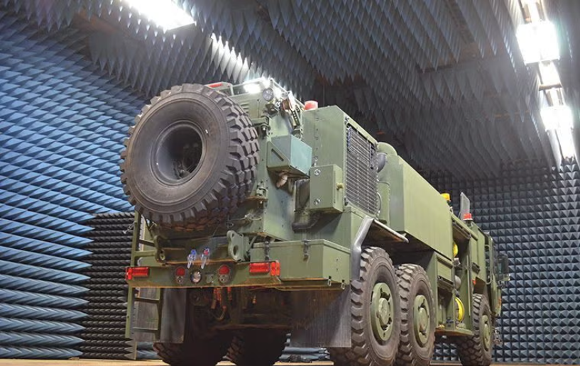

One of the Best-Equipped EMI/EMC Testing Facilities in India
FACILITY OVERVIEW
10m semi-anechoic chamber — one of the largest in India.
Emission & Susceptibility testing — frequency range from 30 Hz to 40 GHz.
Radiated Susceptibility — field strength up to 200 V/m, 10 kHz–40 GHz.
Test frequency — 10 Hz up to 40 GHz.
Fully automated test facility — for complete system / vehicle & sub-system levels.
EM Scanner — for PCB-level EMC testing, pinpointing exact emission components.
DIMENSIONS OF TEST AREA
32m
20m
12m
LENGTH
WIDTH
HEIGHT
NIBE LIMITED
03

Slide 4







Industries & Products Addressed
SECTORS SERVED BY THE SHIRDI TEST FACILITY
Defence &
Aerospace
Automotive
Industry
Household
Railway
Telecom
Medical
NIBE LIMITED
04

Slide 5
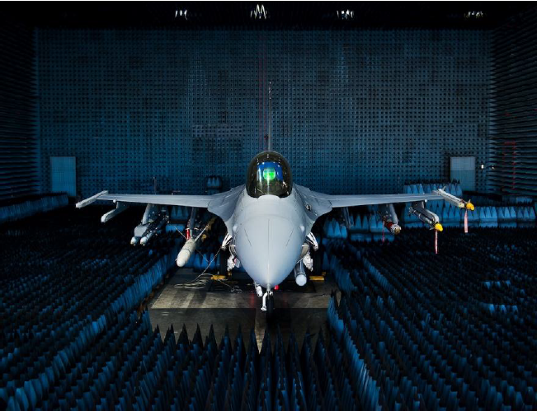
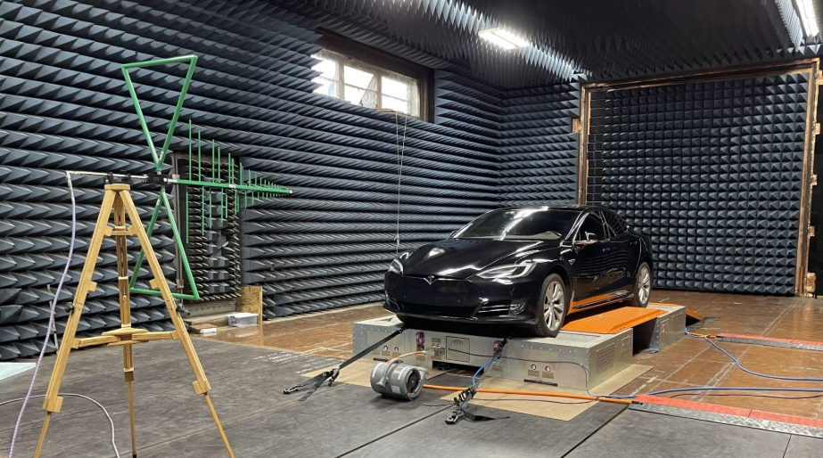
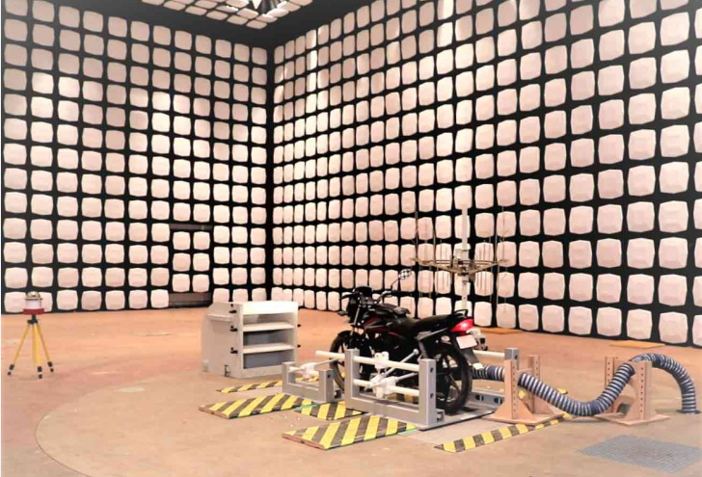
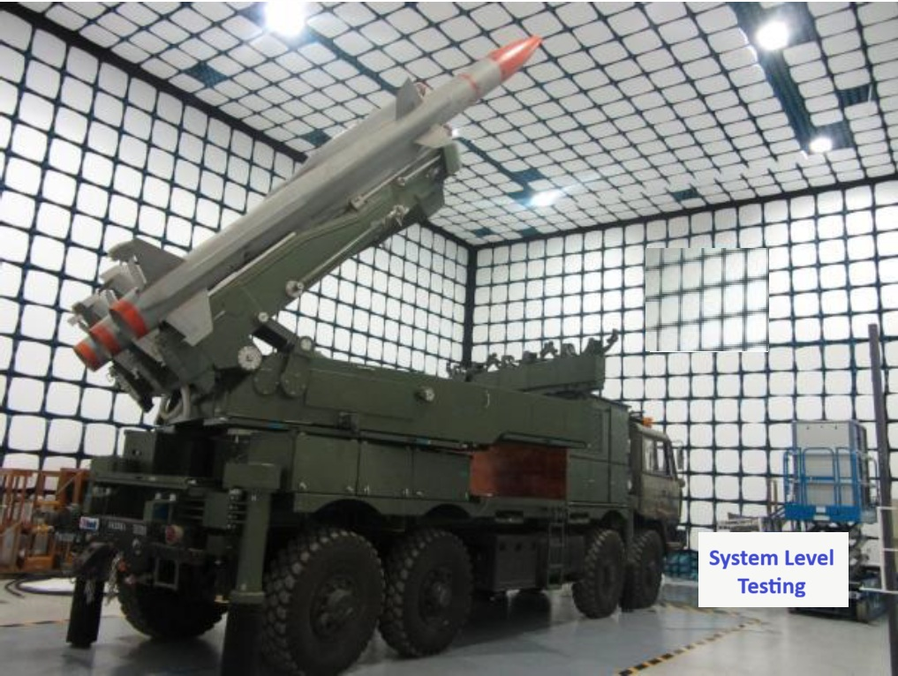
One of the Largest EMI/EMC Facilities in India
NIBE LIMITED
05

Slide 6
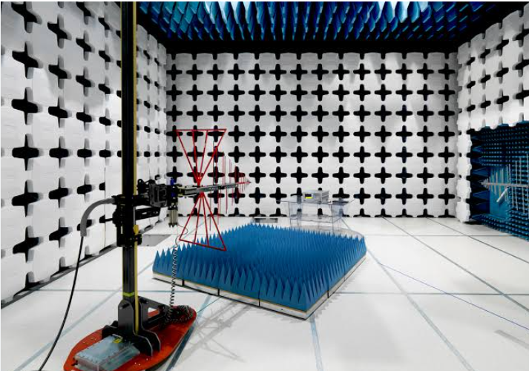
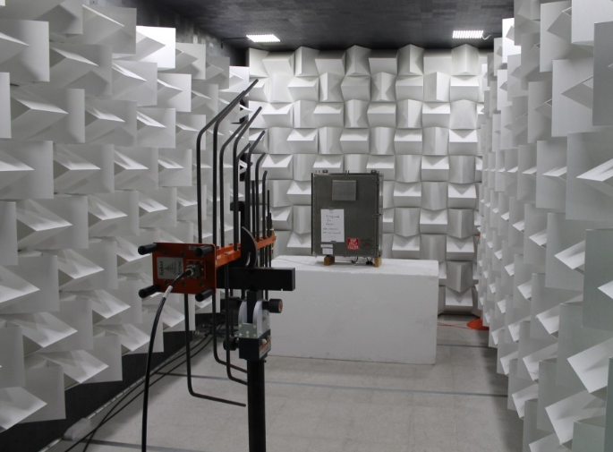
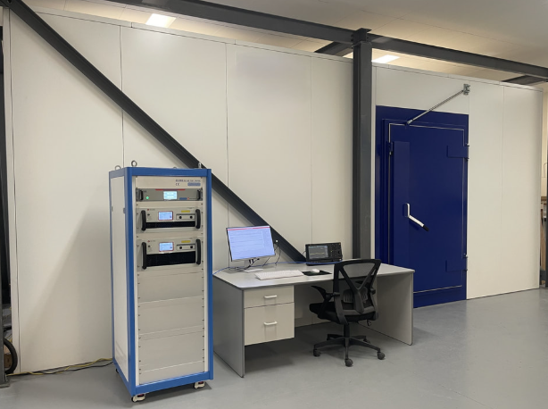
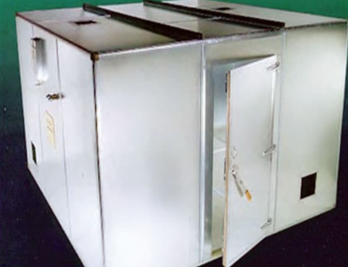
Parallel Testing Across 4 Chambers & Labs
RUN MULTIPLE TEST PROGRAMS SIMULTANEOUSLY, WITHOUT QUEUING
Conducted
Emission Lab
Radiated
Susceptibility Lab
Semi-Anechoic
Chamber
Conducted
Susceptibility Lab
NIBE LIMITED
06

Slide 7

EMC Test Services
Radiated Emission
Electrostatic Discharge (ESD)
Radiated Susceptibility
Voltage Dips & Interruption
Conducted Emission
Harmonic Current Emission
Conducted Susceptibility
Power Frequency Magnetic Field
Flicker & Surge
Electrical Fast Transient
DESIGN & SOLUTION SUPPORT FOR EMC PER-COMPLIANCE
NIBE LIMITED
07

Slide 8
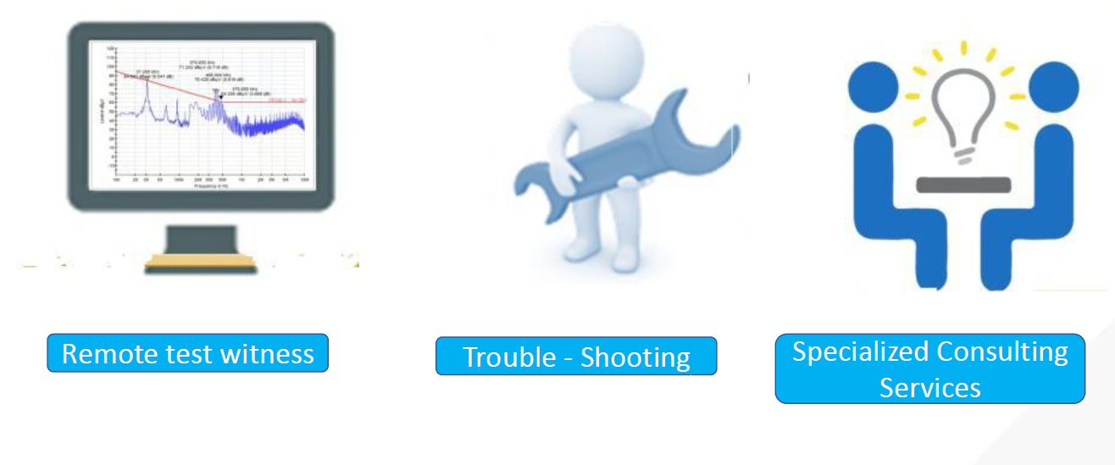



Support Service
Dedicated technical assistance throughout testing, validation and certification — delivered by an experienced team committed to a seamless customer experience.
Remote Test Witness
Trouble-Shooting
Whatever the challenge, our engineers work alongside your team — from first pre-compliance scan to final certification sign-off — so testing never becomes the bottleneck in your product programme.
Specialized Consulting Services
NIBE LIMITED
08

Slide 9
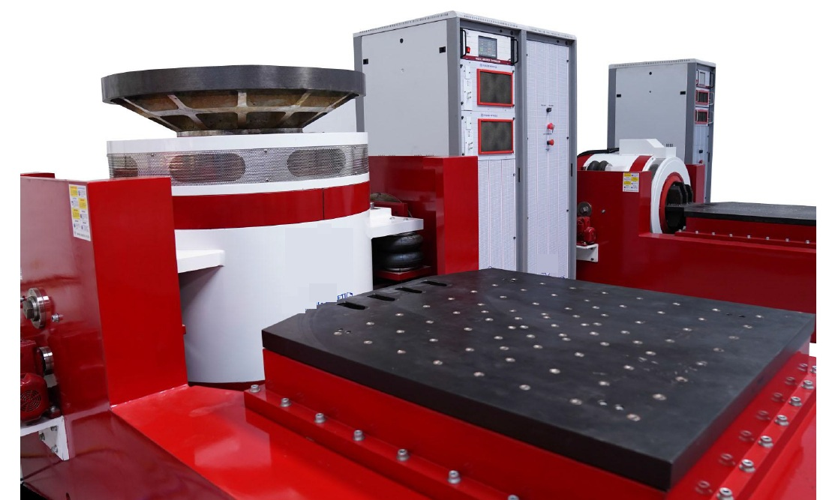

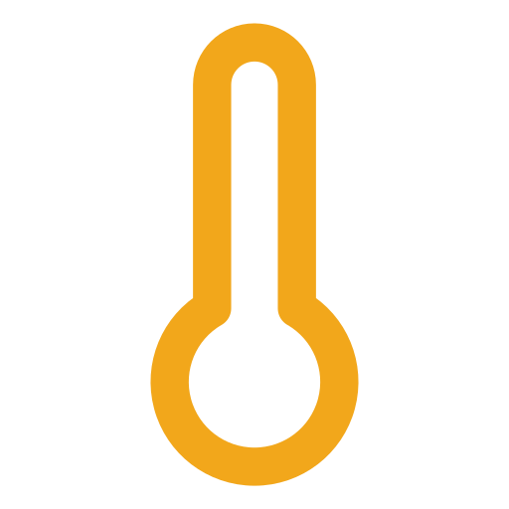
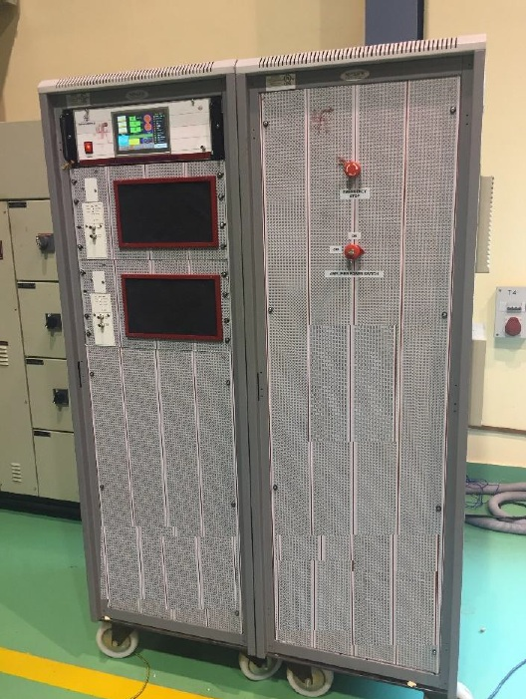
Environmental Test Service
Dynamic Tests
Climatic Tests
Vibration
Low Temperature Test
Bump
High Temperature Test
Drop
Damp Heat / Humidity Test
Altitude Test
Shock
Temperature Cycling Test
Acceleration
Thermal Shock
Dust Test
Rain Test
Salt Corrosion
Tropical Exposure
NIBE LIMITED
09

Slide 10
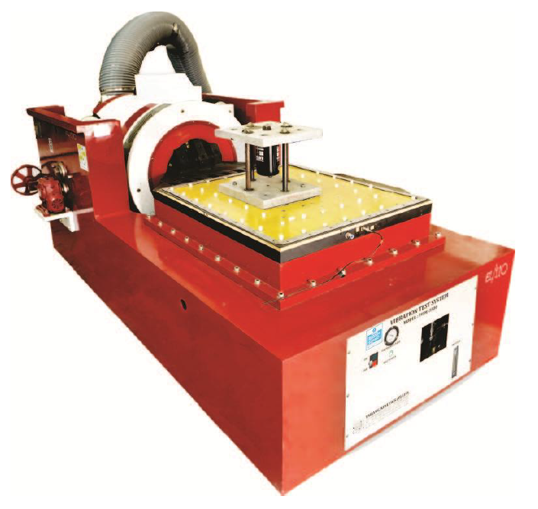



Dynamic Tests — Vibration
CAPACITY
3500 KGF with 75mm displacement, 2m/s velocity and 90g acceleration
RANGE
DC to 3000 Hz
TEST PROFILES
Sine, Random, Shock, RSTD, Recalibration
NIBE LIMITED
10

Slide 11
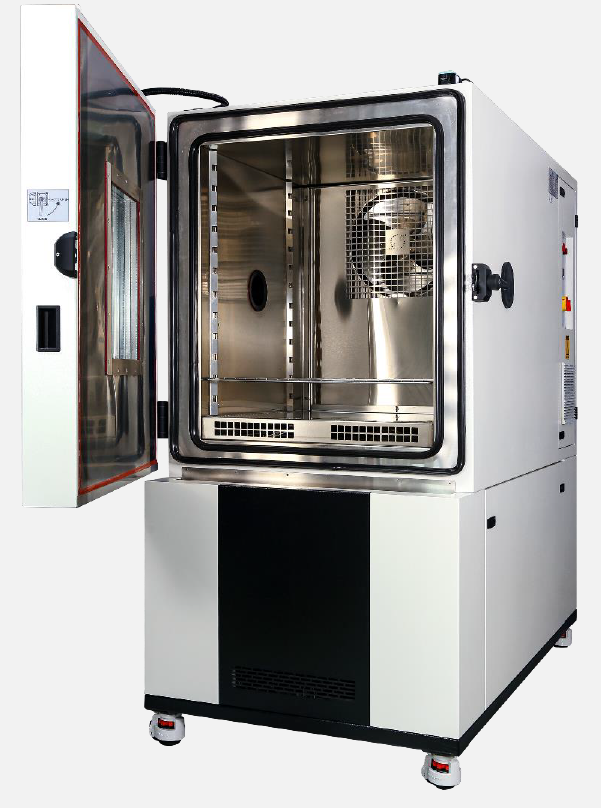
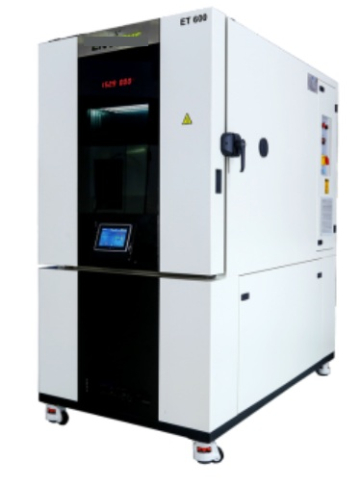
Climatic Test
RAMP RATE
Up to 25°C/min & complies with ESS methods
TEST VOLUME
1000 litres, plus walk-in chamber of 2m³
TYPE OF TEST
Low Temp
High Temp
Damp Heat
Temp Cycling
Thermal Shock
Altitude
NIBE LIMITED
11

Slide 12

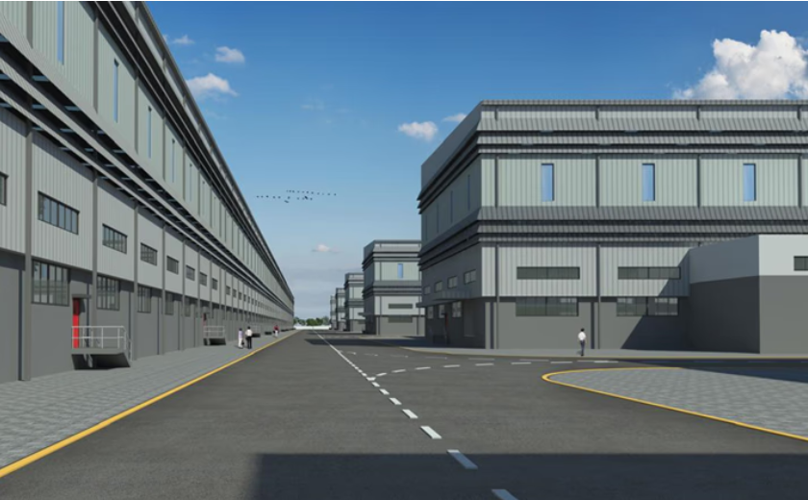


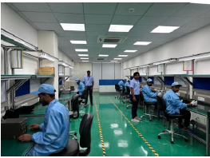
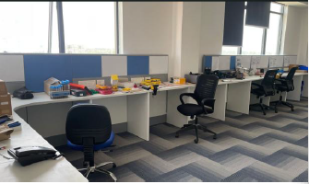
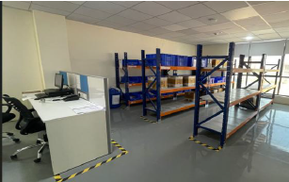

Electronics Labs
ESD Lab
Electrostatic discharge testing for boards and full systems.
Wire Harness Assembly
In-house cable and harness build for test setups.
R&D — Engineering Center
Design support and engineering development.
Material Store
Organized inventory for parts and consumables.
NIBE LIMITED
12

