Slide 1
Detecting Soil pH Using Sentinel-2 Imagery
A Remote Sensing-Based Approach for Agricultural Decision Making
Location: Shelu Bazar, Akola, Maharashtra

Slide 2
Importance of Soil pH in Agriculture
Determines nutrient availability and microbial activity.
Affects crop selection and productivity.
Traditional soil testing is time-consuming and localized.

Slide 3
Sentinel-2 Satellite Overview
Part of ESA's Copernicus Program.
Equipped with 13 multispectral bands (visible, NIR, SWIR).
Useful for vegetation monitoring, soil mapping, and water stress detection.

Slide 4
Detecting Soil pH from Sentinel-2 Imagery
Indirect pH estimation via spectral indices:
• Barren Soil Index (BSI): Indicates exposed, potentially alkaline soil.
• Moisture Stress Index (MSI): High stress often implies alkaline conditions.
Combining indices helps infer pH-related zones.

Slide 5
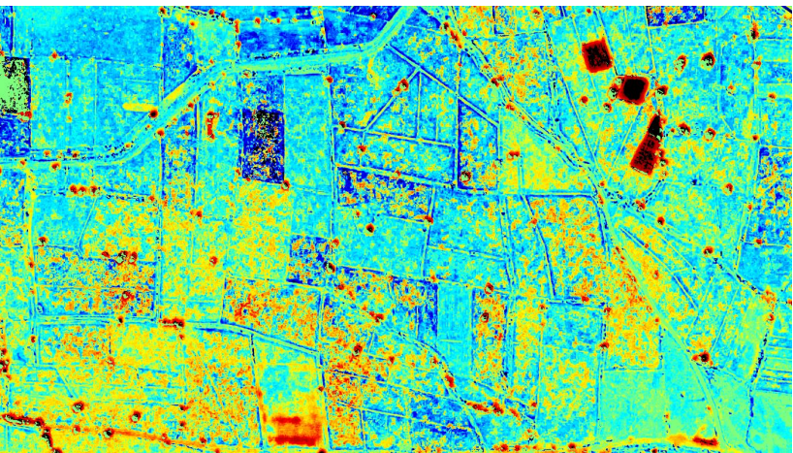
Barren Soil Index (BSI) and pH
BSI = [(SWIR + Red) – (NIR + Blue)] / [(SWIR + Red) + (NIR + Blue)]
Highlights dry, barren, or degraded land.
Areas with high BSI may indicate alkaline soil (high pH).

Slide 6
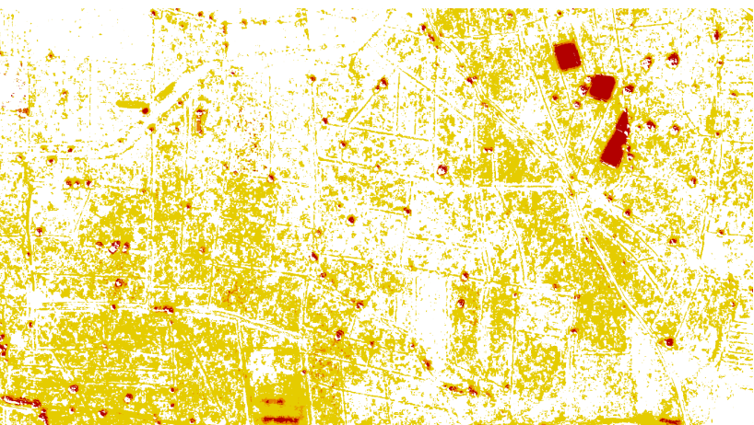
Moisture Stress Index (MSI) and pH
MSI = SWIR / NIR
High MSI values indicate moisture-stressed regions.
Moisture-stressed soils are often alkaline due to salt accumulation.

Slide 7
Visual Interpretation of BSI & MSI
Red/yellow zones in MSI → moisture stress → likely alkaline.
White/blue zones → low stress → neutral pH.
BSI highlights exposed soil areas with possible high pH.

Slide 8
Applications in Precision Farming
Map soil pH zones remotely for large areas.
Recommend pH-tolerant crops for specific zones.
Reduce fertilizer misuse and improve yield.

Slide 9
Conclusion
Sentinel-2 enables scalable, efficient soil health assessment.
BSI and MSI provide indirect but effective pH estimation.
Empowers farmers with actionable, geospatial insights.

