Slide 1
Fuzzy Logic Based Travel Recommendation System
Presented By,
VAMSHI KRISHNA NEELAM
SAI SHARAN KARANAM

Slide 2
Problem Statement Travelers often struggle to find reliable and relevant places when visiting a new city. Most existing platforms rely heavily on ratings and reviews, which can be biased or easily manipulated. Additionally, information is scattered across multiple applications such as maps, food delivery apps, and pharmacy services, making the search process inefficient. More importantly, current systems do not evaluate multiple real-life factors—such as distance, cost, quality, and comfort—together to provide a single, meaningful score. As a result, there is no unified platform that offers an aggregated or sustainability-based recommendation to support better decision-making.
Issues Include:
> Ratings and reviews can be misleading or manipulated > Users must switch between multiple apps to find basic services > Lack of a single unified platform for essential needs > No system provides an aggregated score based on multiple factors > Decision-making becomes time-consuming and less reliable

Slide 3
Proposed System using Fuzzy Systems The proposed system uses fuzzy logic to build a smart recommendation platform for travelers. It considers multiple real-life factors instead of relying only on ratings, helping users make better and more informed decisions. The system outputs both a score and an easy-to-understand result like Good or Very Good.
Develop a Smart Travel Recommendation System using Fuzzy Logic
Provide all essential services in one platform:
> Restaurants > Hotels > Pharmacies > Convenience Stores > Restrooms
Evaluate places using multiple parameters (distance, cost, quality, etc.)
Generate:
Numerical Score (0–100) Human-friendly result (Good, Very Good, etc.)

Slide 4
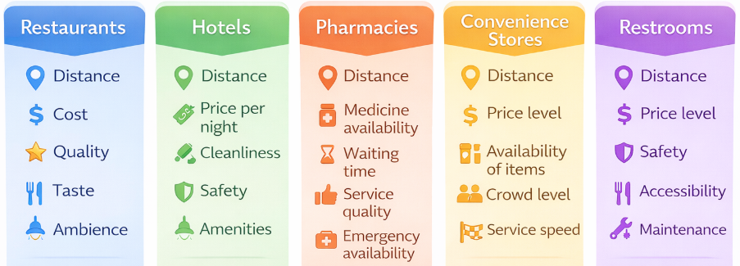
Data Collection & Parameters
The dataset for this project is collected from multiple reliable sources to ensure comprehensive coverage of real-world locations. Geographic data such as location coordinates, place types, and basic details are obtained using OpenStreetMap (OSM). Additional information such as user ratings and reviews is incorporated from Google Maps to enhance decision-making. The collected data is then processed and structured to extract relevant parameters required for the fuzzy logic system. OpenStreetMap (OSM API) — location data (latitude, longitude, place type) Google Maps — ratings, reviews, and popularity indicators Manually generated / simulated data — for parameters not directly available

Slide 5
Data Cleaning & Normalization
The collected data from multiple sources may contain missing values, inconsistencies, and different formats. Therefore, data cleaning is performed to remove duplicates, handle missing entries, and ensure consistency across all attributes. After cleaning, normalization is applied to convert all parameters into a common scale of 0 to 10. This standardization allows fair comparison and enables effective processing in the fuzzy logic system. Data Cleaning Steps: > Removed duplicate entries > Handled missing values (filled or filtered) > Standardized formats (e.g., ratings, distances) > Ensured valid latitude and longitude values > Normalization (0–10 Scale) Different parameters have different units: Distance → kilometers Cost → currency Ratings → 1–5 scale
we convert everything to: 0 - worst 10 - best

Slide 6
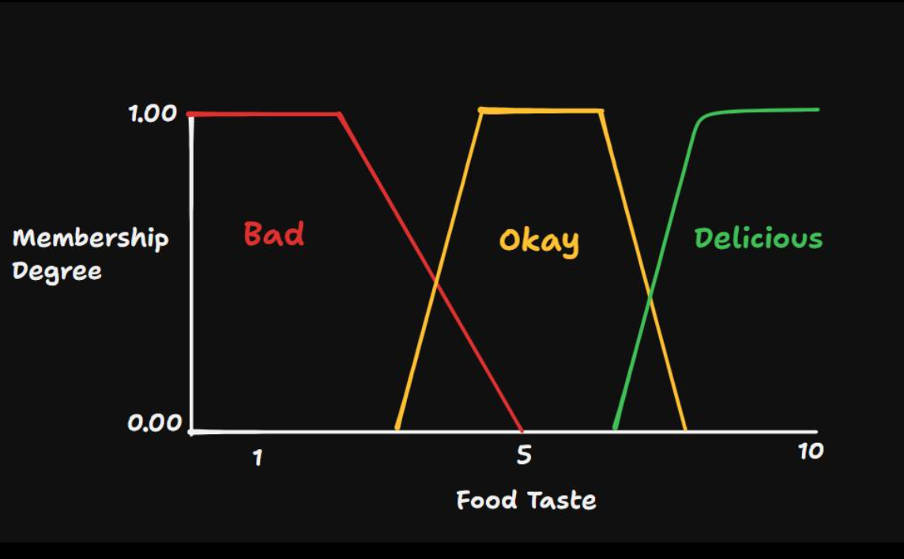
Fuzzification & Membership Functions
In this step, normalized numerical values are converted into fuzzy values such as Low, Medium, and High using membership functions. Each input value does not belong to just one category,but can partially belong to multiple categories. This allows the system to handle uncertainty and mimic human decision-making.
μ(x) ∈ [0,1]
> Uses triangular membership functions > Output values range from 0 to 1 > One input → multiple memberships > Enables smooth transitions between categories Each value (0–10) is mapped using the graph: Example: Taste = 8 From the graph: Bad (Low) → 0 Okay (Medium) → ~0.3–0.4 Delicious (High) → ~0.6–0.7

Slide 7
Fuzzy Inference & Dynamic Priority Engine
Rule Base
The fuzzy rule base consists of a set of IF–THEN rules that model human decision-making. These rules combine different input parameters such as distance, cost, quality, taste, and ambience to determine the overall suitability of a place. Each parameter contributes uniquely before being multiplied by context weights. IF Cost = High AND Distance = High → 30 Each parameter contributes uniquely before being multiplied by context weights. Each parameter contributes uniquely before being multiplied by context weights. Instead of rigid multi-condition matrices, the system individually maps parameters to Zero-Order constants. Rule Evaluation During rule evaluation, multiple rules are activated simultaneously based on the fuzzy input values. The engine applies dynamic weights scaled by the user's physical needs directly to the independent parameter scores. Example
Taste (High) = 0.9 Quality (High) = 0.8
Rule
Each parameter contributes uniquely before being multiplied by context weights.
Rule Strength:
min(0.9, 0.8) = 0.8

Slide 8
The Dynamic Context Priority Engine
Traditional recommendation systems are rigid. To combat this, we built a physical context heuristic interceptor.
The UI captures 5 real-time states (Hunger, Fatigue, Restroom Urgency, Hygiene, and Budget).
The Engine mathematically intercepts these states. For example, if a user flags 'Fatigue', the engine calculates an artificial boost multiplier and heavily increases the importance of the 'Distance' parameter.
This allows the fuzzy logic to behave dynamically, solving problems intuitively based on the traveler's exact state of exhaustion.

Slide 9
Defuzzification After rule evaluation, multiple rules produce outputs with different strengths. These outputs are combined using a defuzzification method to generate a single crisp value. This final score represents the overall suitability of the place.
Fuzzy Output → Linguistic Label and Single Numerical Value Weighted Average Method The weighted average method combines the outputs of all activated rules based on their strengths. Each rule’s output is multiplied by its strength, and the final score is obtained by averaging these values proportionally.
Final Score = Σ(output × strength) / Σ(strength)

Slide 10
Output
After applying fuzzy membership functions and evaluating multiple rules, the system combines all partial results using defuzzification to produce a single sustainability score. This score represents the overall suitability of a place by considering multiple factors simultaneously. Although the final output is a crisp value, it is derived from fuzzy reasoning where inputs belong to multiple categories and multiple rules contribute to the decision. Numerical Score(Sustainability Score) Range: 0 – 100
Represents Overall evaluation of a place based on multiple factors such as distance, cost, quality, taste, ambience, etc., computed using fuzzy logic. Linguistic Term(Human-Readable Output)
Result: Very Bad, Bad, Average, Good, Very Good, Excellent
Represents A simplified, human-friendly interpretation of the numerical score, helping users easily understand the quality of a place without needing technical details.

Slide 11
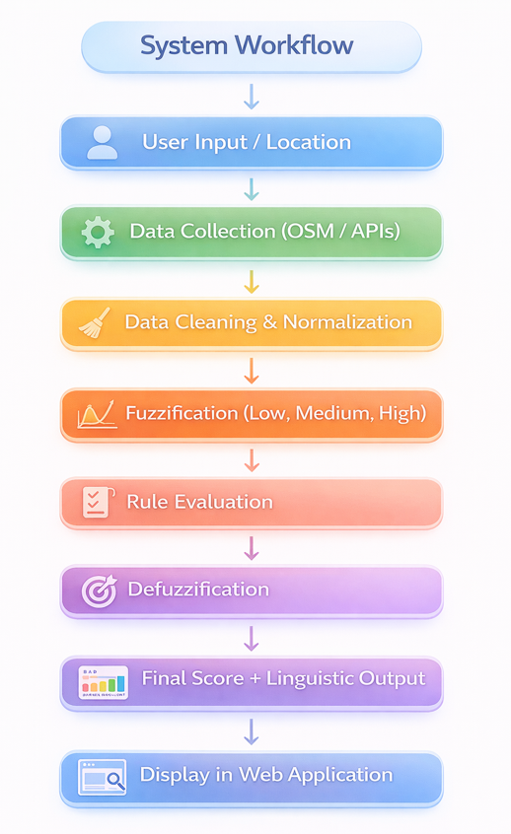
System Implementation
The proposed system is implemented as a web-based application that integrates
data collection, preprocessing, and fuzzy logic evaluation. It processes real-world
data from multiple sources, normalizes it, and applies fuzzy rules to generate a
sustainability score. The results are presented through an interactive user interface
for easy access and decision-making.
Technologies Used
Frontend: HTML, CSS, JavaScript
Backend/Data Processing: JavaScript (Fuzzy Logic Engine)
Data Sources: OpenStreetMap (OSM), Google Maps
Libraries/Tools: CSV Custom Parsers, Vanilla JS Engine

Slide 12
THANK YOU

