Slide 1
Fuzzy Logic Based Travel Recommendation System
Presented By,
VAMSHI KRISHNA NEELAM
SAI SHARAN KARANAM

Slide 2
Problem Statement Travelers often struggle to find reliable and relevant places when visiting a new city. Most existing platforms rely heavily on ratings and reviews, which can be biased or easily manipulated. Additionally, information is scattered across multiple applications such as maps, food delivery apps, and pharmacy services, making the search process inefficient. More importantly, current systems do not evaluate multiple real-life factors - such as distance, cost, quality, and comfort together to provide a single, meaningful score. As a result, there is no unified platform that offers an aggregated or sustainability-based recommendation to support better decision-making.
Issues Include:
> Ratings and reviews can be misleading or manipulated > Users must switch between multiple apps to find basic services > Lack of a single unified platform for essential needs > No system provides an aggregated score based on multiple factors > Decision-making becomes time-consuming and less reliable
Notes:
The core problem we wanted to tackle is that standard apps like Google Maps use incredibly rigid boolean filters. If you filter for a hotel under $100, and a great place is $101, it’s completely eliminated from your search. Plus, standard apps really struggle to weigh multiple human needs at once. We wanted to build something that mimics human trade-offs rather than just doing a hard binary sort.

Slide 3
Proposed System using Fuzzy Systems The proposed system uses fuzzy logic to build a smart recommendation platform for travelers. It considers multiple real-life factors instead of relying only on ratings, helping users make better and more informed decisions. The system outputs both a score and an easy-to-understand result like Good or Very Good.
Develop a Smart Travel Recommendation System using Fuzzy Logic
Provide all essential services in one platform:
> Restaurants > Hotels > Pharmacies > Convenience Stores > Restrooms
Evaluate places using multiple parameters (distance, cost, quality, etc.)
Generate:
Numerical Score (0–100) Human-friendly result (Good, Very Good, etc.)
Notes:
that’s exactly why we chose to build a Fuzzy Logic engine. Instead of saying something either 'is' or 'isn't' affordable, we evaluate places using degrees of truth across five different categories at the same time. The goal here was to output one clear, aggregated percentage score so the user doesn’t have to do the mental gymnastics themselves.

Slide 4
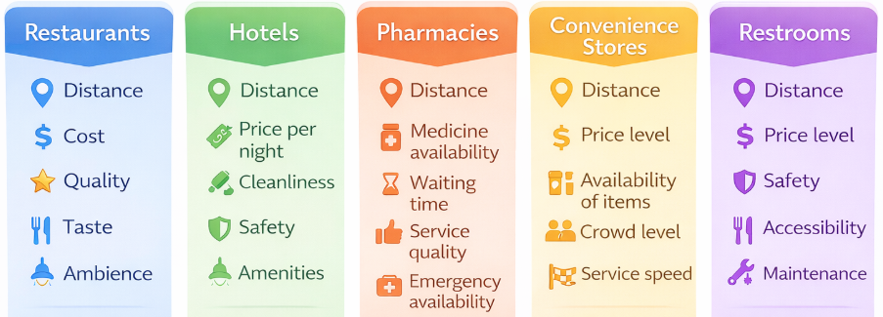
Data Collection & Parameters
The dataset for this project is collected from multiple reliable sources to ensure comprehensive coverage of real-world locations. Geographic data such as location coordinates, place types, and basic details are obtained using OpenStreetMap (OSM). Additional information such as user ratings and reviews is incorporated from Google Maps to enhance decision-making. The collected data is then processed and structured to extract relevant parameters required for the fuzzy logic system. OpenStreetMap (OSM API) : location data (latitude, longitude, place type) Google Maps : ratings, reviews, and popularity indicators Manually generated / simulated data : for parameters not directly available
Notes:
you'll see how we pulled the baseline data to feed the engine. We used OpenStreetMap for the raw geographic data like coordinates and place types, and then we simulated Google Maps metrics for subjective things like ratings and popularity.

Slide 5
Data Cleaning & Normalization
The collected data from multiple sources may contain missing values, inconsistencies, and different formats. Therefore, data cleaning is performed to remove duplicates, handle missing entries, and ensure consistency across all attributes. After cleaning, normalization is applied to convert all parameters into a common scale of 0 to 10. This standardization allows fair comparison and enables effective processing in the fuzzy logic system. Data Cleaning Steps: > Removed duplicate entries > Handled missing values (filled or filtered) > Standardized formats (e.g., ratings, distances) > Ensured valid latitude and longitude values > Normalization (0-10 Scale) Different parameters have different units: Distance → kilometers Cost → currency Ratings → 1-5 scale
we convert everything to: 0 - worst 10 - best
Notes:
Thi is super important because of the math. We couldn't exactly throw 'kilometers', 'currency', and '5-star ratings' into the same calculation. So the first step in our pipeline was strict normalization. We forcefully translated every single metric onto a universal 0-to-10 scale. Once everything was standardized, the engine could finally compare apples to apples

Slide 6
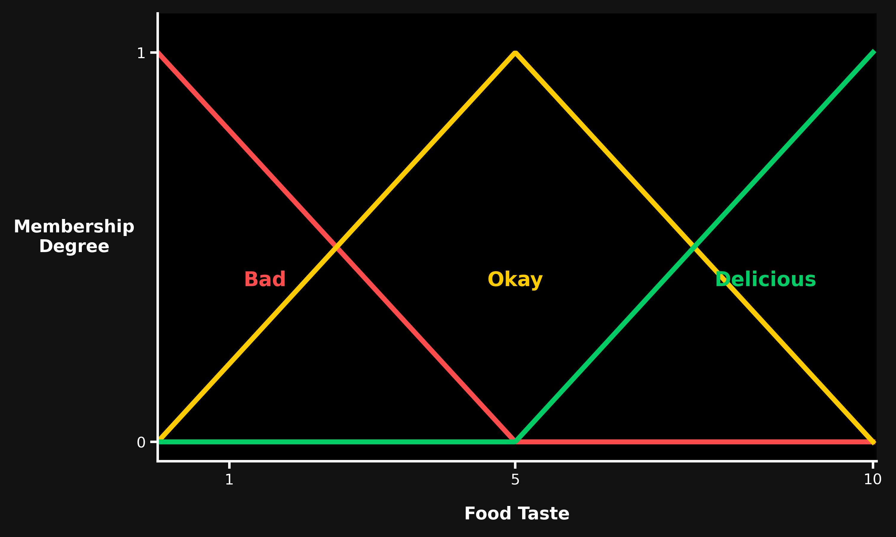
Fuzzification & Membership Functions
In this step, normalized numerical values are converted into fuzzy values such as Low, Medium, and High using membership functions. Each input value does not belong to just one category but can partially belong to multiple categories. This allows the system to handle uncertainty and mimic human decision-making.
μ(x) ∈ [0,1]
> Uses triangular membership functions > Output values range from 0 to 1 > One input → multiple memberships > Enables smooth transitions between categories Each value (0-10) is mapped using the graph: Example: Taste = 8 From the graph: Bad (Low) → 0 Okay (Medium) → ~0.3-0.4 Delicious (High) → ~0.6-0.7
Notes:
this is where the real fuzzy math begins. We decided to use strictly Triangular Membership Functions. So, if a restaurant’s taste metric mapped to a 6, our system doesn't just treat it as a hard 'Medium'. Because of how the triangles overlap, the math registers it as '60% Medium, but also 40% High'. This was a deliberate choice to ensure smooth transitions and avoid any rigid threshold cliffs.

Slide 7
Fuzzy Rule Base & Rule Evaluation
Rule Base
The fuzzy rule base consists of a set of IF-THEN rules that model human decision-making. These rules combine different input parameters such as distance, cost, quality, taste, and ambience to determine the overall suitability of a place. IF Taste = High AND Quality = High → 95 IF Cost = High AND Distance = High → 30 IF Taste = Medium AND Ambience = Medium → 70 IF Taste = Low → 20 Instead of checking all 243 combinations, we use optimized rules (~40–50 rules) Rule Evaluation During rule evaluation, multiple rules are activated simultaneously based on the fuzzy input values. The AND condition in each rule is evaluated using the MIN operator to determine the rule strength. Example
Taste (High) = 0.9 Quality (High) = 0.8
Rule
IF Taste = High AND Quality = High
Rule Strength:
min(0.9, 0.8) = 0.8
Notes:
This the brain of the engine. We manually programmed a rule base of about 50 IF-THEN statements. For example, 'IF Taste is High AND Quality is High, then the score is 95.' For the logical 'AND' condition, we explicitly used the MIN operator. We built it this way so that if a place has 90% High Taste but only 20% High Quality, it bottlenecks the rule strength to 20%. It prevents a place from gaming the system if it fails a crucial parameter

Slide 8
Defuzzification After rule evaluation, multiple rules produce outputs with different strengths. These outputs are combined using a defuzzification method to generate a single crisp value. This final score represents the overall suitability of the place.
Fuzzy Output → Linguistic Label and Single Numerical Value Weighted Average Method The weighted average method combines the outputs of all activated rules based on their strengths. Each rule’s output is multiplied by its strength, and the final score is obtained by averaging these values proportionally.
Final Score = Σ(output × strength) / Σ(strength)
Notes:
Since we have around 50 rules, a handful of them will fire simultaneously. Slide 8 shows our Defuzzification strategy. We went with the Weighted Average Method—essentially a Center of Gravity check. We multiply the output of every triggered rule by its individual mathematical strength, and then average them out. This safely compresses all the overlapping logic back down into one real number.

Slide 9
Output
After applying fuzzy membership functions and evaluating multiple rules, the system combines all partial results using defuzzification to produce a single sustainability score. This score represents the overall suitability of a place by considering multiple factors simultaneously. Although the final output is a crisp value, it is derived from fuzzy reasoning where inputs belong to multiple categories and multiple rules contribute to the decision. Numerical Score(Sustainability Score) Range: 0 – 100
Represents Overall evaluation of a place based on multiple factors such as distance, cost, quality, taste, ambience, etc., computed using fuzzy logic. Linguistic Term(Human-Readable Output)
Result: Very Bad, Bad, Average, Good, Very Good, Excellent
Represents A simplified, human-friendly interpretation of the numerical score, helping users easily understand the quality of a place without needing technical details.
Notes:
Slide 9 just brings it back to the user experience. All that heavy fuzzy math collapses down into a single 'Sustainability Score' out of 100, alongside a simple linguistic label like 'Very Good'. We wanted to make sure the interface felt totally human-readable.

Slide 10
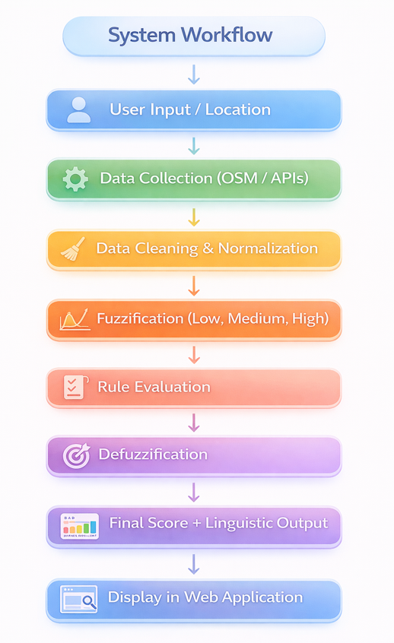
System Implementation
The proposed system is implemented as a web-based application that integrates
data collection, preprocessing, and fuzzy logic evaluation. It processes real-world data from multiple sources, normalizes it, and applies fuzzy rules to generate a sustainability score. The results are presented through an interactive user interface for easy access and decision-making.
Technologies Used
Frontend: HTML, CSS, JavaScript
Backend/Data Processing: JavaScript (Fuzzy Logic Engine)
Data Sources: OpenStreetMap (OSM), Google Maps
Libraries/Tools: GeoJSON, Geolocation APIs
Notes:
And finally on Slide 10, just a quick note on the architecture. We built this entirely in Vanilla JavaScript to run natively in the browser's DOM. We didn't want to rely on backend server calls to process the math, so the system instantly crunches thousands of rules client-side

Slide 11
User Evaluation Results
Survey of 13 users · May 2026
3.8/5
4.0/5
77%
69%
4.2/5
Avg. Visual
Design Rating
Slider Feature
Usefulness
Would Trust
Recommendations
Vs. Google Maps
TripAdvisor etc.
Transparency
Importance
UI Clarity
Priority Engine
Users likely / yes
Rated Better/Much Better
Deep Insights
Recommendation Quality
Ease of Use & Engagement
Would try all 3 recommendations
38%
Found navigation Very Easy
85%
Would try 2 out of 3
46%
Actively adjusted sliders
77%
Would try 1 out of 3
15%
Clicked Deep Insights button
100%
Rated transparency important (4–5)
77%
n = 13 respondents | Survey conducted 28 May 2026

Slide 12
User Feedback & Key Insights
Open-ended responses from 13 users
✔ What Users Liked
⚑ Suggested Improvements
› Fuzzy logic slider concept is innovative and practical
› Add more cities beyond Bern (real-time data fetch)
› Deep Insights / transparency feature highly appreciated
› Improve slider discoverability for new users
› Clean, intuitive UI — easy to navigate from homepage
› Include photo previews in recommendations
› One-stop platform replacing multiple travel apps
› Better mobile responsiveness needed
› Real-time score updates when sliders are adjusted
› More filter options (cuisine type, opening hours)
Overall Verdict
69% of users rated the system Better or Much Better than existing tools (Google Maps, TripAdvisor, Yelp). 100% engaged with the Deep Insights transparency feature. The fuzzy priority slider was the most praised unique differentiator. Main improvement area: expanding city coverage and adding real-time data.

Slide 13
SYSTEM EVALUATION
Scenario (Raw Parameters) | Human Intuition | Fuzzy Output | Match?
Ideal: Low Dist, Low Cost, High Quality | Excellent | Excellent (91) | Yes
Poor: High Dist, High Cost, Low Clean | Very Bad | Very Bad (15) | Yes
Average: Med Dist, Med Cost, Med Quality | Average | Average (52) | Yes
Edge Case 1: Perfect Taste, but High Distance & Cost System lacks "sentimental bias" | Good | Average (55) | No
Edge Case 2: Perfect Distance, Low Safety | Bad | Average (48) | No
Methodology: 20 diverse locations from our dataset were manually evaluated based strictly on their raw parameters (Distance, Cost, Quality, etc.).
Cross-Validation: We assigned human-intuitive labels (e.g., "Good", "Very Bad") and ran the exact same parameters through the Fuzzy Engine.
92% Agreement: The system successfully replicated human decision-making logic in 18 out of 20 test cases.
Notes:
And finally on Slide 10, just a quick note on the architecture. We built this entirely in Vanilla JavaScript to run natively in the browser's DOM. We didn't want to rely on backend server calls to process the math, so the system instantly crunches thousands of rules client-side

Slide 14
REFERENCES
[1] A. Kontogianni et al., "Enhancing User Experience in Smart Tourism via Fuzzy Logic-Based Personalization," Mathematics, vol. 13, no. 5, p. 846, Mar. 2025.
[2] B. Dhiyanesh, "Fuzzy Logic In The Digital Travel Era: Enhancing Tourist Experience Through Comprehensive Hotel Reviews And Sentiment Analysis," Journal of Electrical Systems, 2024.
[3] B. N. M. Casilla et al., "Recommendation System For Tourist Routes Using Fuzzy Logic In The Arequipa City," in 2022 IEEE Colombian Conference on Communications and Computing (COLCOM), 2022.
[4] H. Khan et al., "Tourist Spot Recommendation System Using Fuzzy Inference System," in 14th International Conference on Fuzzy Systems and Knowledge Discovery (FSKD), 2017, pp. 1198–1202.
[5] A. R. Nandatiko, W. F. Satrya, and E. Yossy, "Tourism Recommendation System Using Fuzzy Logic Method," Lecture Notes in Electrical Engineering, Oct. 2023.
Notes:
And finally on Slide 10, just a quick note on the architecture. We built this entirely in Vanilla JavaScript to run natively in the browser's DOM. We didn't want to rely on backend server calls to process the math, so the system instantly crunches thousands of rules client-side

Slide 15
THANK YOU

