Slide 1
HEALTH TRACKER
-BY
Sharankumar D – 727821TUIT136
Rasiga S – 727821TUIT124
Selva Kirubha P S – 727821TUIT133
Shamiksha S L – 727821TUIT134
Vasanth Kumar R – 727821TUIT151
Natarajan S – 727821TUIT162
THE CHOSEN COINS

Slide 2







Slide 3






Slide 4










Slide 5




Slide 6
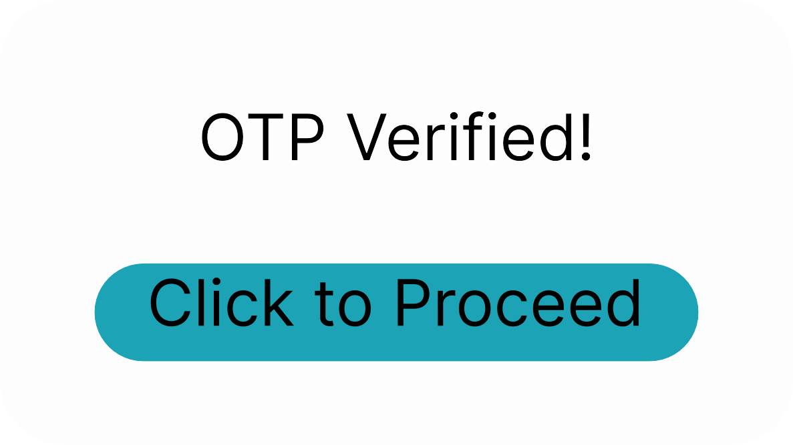

Slide 7








Slide 8






Slide 9
FIGMA LINK:
https://www.figma.com/file/twwbCqY7MMVM0cE7dgvoj2/HealthTracker?node-id=0%3A1&t=RyXt78PY1zPzEZxN-1
GITHUB REPOSITORY LINK:
https://github.com/SharankumarD10/React-Repository.git
THANK YOU

