Slide 1

Hospital Management
System
A RESTful Web API built with ASP.NET Core 8 & SQL Server
ASP.NET Core 8
SQL Server
REST API
Mini Project • Full-Stack Backend • .NET 8

Slide 2




Project Overview
The Hospital Management System is a backend RESTful API that digitises core hospital operations — managing patients, doctors, and appointments with full CRUD support. Built on ASP.NET Core 8, it uses SQL Server stored procedures for all data access and exposes clean endpoints consumed by any client or frontend.
Doctor Management
Patient Management
Appointments
Analytics & Reports
Multiple specializations
Full profile & lifecycle
Book, view & cancel
Revenue & workload APIs

Slide 3





Technology Stack
ASP.NET Core 8
SQL Server
C# 12
Web API framework, routing, DI container, middleware pipeline
Relational database with stored procedures, transactions, constraints
Models, DTOs, services, repositories — all strongly typed
Swagger / OpenAPI
Repository Pattern
Middleware
Auto-generated API documentation and interactive testing UI
Abstraction layer isolating data access from business logic
Custom exception handling and HTTP request logging pipeline

Slide 4

System Architecture
Client / Swagger UI
Controller Layer
Service Layer
Repository Layer
SQL Server DB
Middleware Pipeline: RequestLoggingMiddleware → ExceptionMiddleware → Authorization → Controllers

Slide 5
Database Schema
Patients
Doctors
Appointments
PatientCode (PK)
DoctorCode (PK)
AppointmentId (PK)
FullName
FullName
PatientCode (FK)
DOB
Specialization
DoctorCode (FK)
FK
FK
Gender
Phone (UQ)
AppointmentDate
Phone (UQ)
ConsultationFee
AppointmentStatus
Email
IsAvailable
CancelledAt
IsActive
CreatedAt
CreatedAt
CreatedAt / UpdatedAt

Slide 6
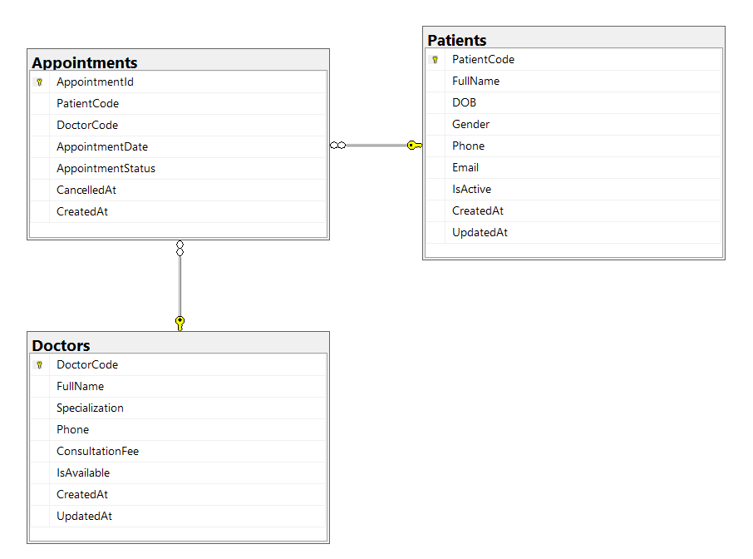
ER DIAGRAM

Slide 7





Patient Management Module
Add Patient
POST /api/patient
Captures FullName, DOB, Gender, Phone, Email via stored proc sp_AddPatient with transaction.
Update Patient
PUT /api/patient/{id}
Partial update using ISNULL pattern — only provided fields are changed.
Get All Patients
GET /api/patient
Returns all active patients (IsActive=1) via sp_GetAllPatients.
Deactivate Patient
DELETE /api/patient/{id}
Soft delete — sets IsActive=0 rather than physically removing the record.

Slide 8

Doctor Management Module
API Endpoints
Doctor Profile Fields
POST
/api/doctor
DoctorCode
Auto-incremented from 100
Register a new doctor
FullName
VARCHAR(100) – required
GET
/api/doctor
Specialization
E.g. Cardiology, Neurology
List all doctors
Phone
Unique constraint enforced
GET
/api/doctor/specialization/{s}
Filter by specialization
ConsultationFee
DECIMAL – must be > 0 (CHECK)
IsAvailable
BIT – default 1 (true)

Slide 9

Appointment Management Module
Appointment Status Lifecycle
Scheduled
Completed
Cancelled
POST
/api/appointment/book
Book appointment — links PatientCode + DoctorCode with date
POST
/api/appointment/cancel/{id}
Cancel appointment — sets status='Cancelled', stamps CancelledAt
GET
/api/appointment/upcoming
List all future appointments with status 'Scheduled'
GET
/api/appointment/doctor/{code}
All appointments for a specific doctor by DoctorCode

Slide 10
Stored Procedures
All data operations go through SQL Server stored procedures — no raw queries in application code.
Patient Procedures
Doctor Procedures
▸ sp_AddPatient
▸ sp_AddDoctor
▸ sp_UpdatePatient
▸ sp_GetAllDoctors
▸ sp_DeactivatePatient
▸ sp_GetDoctorsBySpecialization
▸ sp_GetAllPatients
Appointment Procedures
▸ sp_GetPatientById
Reports Procedures
▸ sp_BookAppointment
▸ sp_GetAppointmentReport
▸ sp_CancelAppointment
▸ sp_GetRevenueBySpecialization
▸ sp_GetUpcomingAppointments
▸ sp_GetDoctorsWithMoreThan2Appointments
▸ sp_GetDoctorAppointments

Slide 11

Error Handling & Middleware
ExceptionMiddleware
RequestLoggingMiddleware
Wraps every request in a global try-catch
Logs each inbound HTTP request (method + path)
Returns JSON error responses with status codes
Records response status code on completion
Custom SQL THROW errors (50001-50003) mapped to 404/400
Measures request duration for performance monitoring
Prevents stack trace leakage to clients
Helps trace issues during development & debugging
Ensures consistent error format across all endpoints
Non-blocking — does not interfere with request flow

Slide 12
Design Patterns & Best Practices
Repository Pattern
Dependency Injection
DTO Pattern
IPatientRepository, IDoctorRepository, IAppointmentRepository, IReportRepository abstract all DB access. Services depend on interfaces, not concrete classes.
All repositories, services, and DatabaseHelper registered as Scoped in Program.cs. Constructor injection used throughout — no Service Locator anti-pattern.
Separate CreateXxxDto, UpdateXxxDto, XxxResponseDto classes decouple API contract from internal domain models. Prevents over-posting vulnerabilities.
Stored Procedure Access
Soft Delete
Async/Await
All queries routed through stored procedures via DatabaseHelper. No inline SQL — prevents SQL injection and centralises DB logic.
Patients are deactivated (IsActive=0) rather than deleted. Appointments are cancelled with a timestamp rather than removed. Preserves audit history.
Every service and repository method is async (Task<T>). Enables the API to handle concurrent requests efficiently without blocking threads.

Slide 13
API Endpoint Summary
Method | Endpoint | Description | Module
POST | /api/patient | Register a new patient | Patient
POST | /api/patient/{id} | Update patient details | Patient
GET | /api/patient/all | Get all active patients | Patient
GET | /api/doctor/all | List all doctors | Doctor
POST | /api/doctor | Register a new doctor | Doctor
GET | /api/doctor/specialization/{s} | Filter doctors by specialization | Doctor
POST | /api/appointment/book | Book a new appointment | Appointment
POST | /api/appointment/cancel/{id} | Cancel an appointment | Appointment
GET | /api/appointment/upcoming-appointments | Get upcoming appointments | Appointment
GET | /api/appointment/doctor/{code} | Get a doctor's appointments | Appointment
GET | /api/report/appointments | Full appointment report | Reports
GET | /api/report/revenue | Revenue by specialization | Reports
GET | /api/report/busy-doctors | Doctors with 2+ appointments | Reports

Slide 14
Key Learnings & Outcomes
01
Full-Stack API Design
02
Separation of Concerns
Built a complete backend system from DB schema to HTTP endpoints following industry-standard REST conventions.
Clean layered architecture — Controller → Service → Repository — makes each layer independently testable and maintainable.
03
SQL Server
04
Robust Error Handling
Designed relational tables with FK constraints, CHECK constraints, IDENTITY columns, and transaction-safe stored procedures.
Custom middleware catches all unhandled exceptions and returns consistent JSON errors, shielding clients from implementation details.
05
DTO-Driven API Contracts
06
Business Analytics via API
Input/output DTOs keep the API surface stable; internal model changes don't break client integrations.
Report endpoints deliver revenue insights and doctor workload data — demonstrating SQL aggregation and JOIN mastery.

Slide 15
Thank You
Hospital Management System — Mini Project
ASP.NET Core 8
SQL Server
REST API
Stored Procedures
Repository Pattern
Middleware
Built with ASP.NET Core 8 · SQL Server · C# 8

