Slide 1


Natural Language Command Parser for Home Automation
Presented by:
M.Sharan Mahi Reddy(192324082)
M.Yugandhar Reddy(192372164)
P.Mal Reddy (192372015)
Compiler Design for Domain Specific Languages- CSA1406
Date: 14/07/2025

Slide 2
Introduction
Overview of the Project:
Problem Statement
Users often face difficulty in controlling smart home devices through traditional apps or interfaces. This complexity limits accessibility and ease of use, especially for non-technical users. A system that understands natural language commands can simplify device control.
Purpose of the Project The project aims to develop a parser that converts natural language into device-specific commands. It enables users to control smart appliances using voice or text input. This enhances convenience, accessibility, and user experience in home automation.

Slide 3
Objectives
1. Define Clear Goals
Develop a system to understand natural language commands for home automation.
Accurately extract user intent and device actions.
Enable control through simple voice or text inputs.
2. Address the Problem Statement
Traditional smart home apps are complex and not user-friendly.
Non-technical users face difficulty in operating devices.
Natural language interface simplifies and enhances control.
3. Expected Outcomes
Seamless control of smart devices using natural language.
Improved user experience and accessibility.
Faster, hands-free, and intuitive smart home automation.

Slide 4
Literature Review / Background
Summary of Existing Research
NLP is widely used in virtual assistants like Alexa and Google Assistant.
Studies show intent classification and entity extraction improve smart home automation.
Existing systems focus more on predefined commands rather than flexible natural language.
Theoretical Foundation
Based on Natural Language Processing (NLP) techniques such as intent recognition and slot filling.
Utilizes machine learning models (e.g., SVM, BERT) for text classification.
Rule-based and statistical approaches are used for command mapping.
Research Gap
Lack of truly flexible and language-independent command interpretation.
Limited contextual understanding in existing home automation systems.
Few open-source solutions for customizable NLP-based home automation.

Slide 5
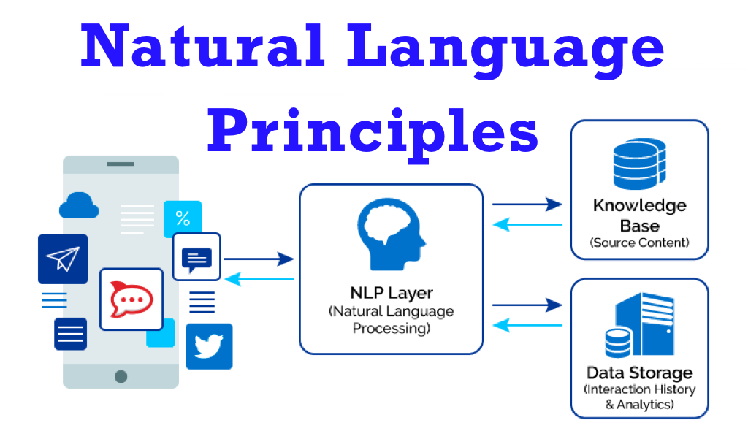
Methodology
TOOLS AND FRAMEWORKS USED:
Frontend: HTML, CSS, JavaScript / Android Studio
Backend: Python (Flask / Django) ,
NLP: spaCy / Rasa / Dialogflow / BERT
Speech Recognition: Google Speech API / Whisper ,
Database: SQLite / Firebase / MongoDB ,
IoT Communication: MQTT / HTTP / Zigbee
APIs: REST APIs for device integration
Development Approach
Design command structure
Implement NLP pipeline
Parse intent and entities
Map to device actions
Integrate with IoT devices
Data Collection
Sample text/voice commands
Open-source NLP datasets
Annotated intents and entities

Slide 6
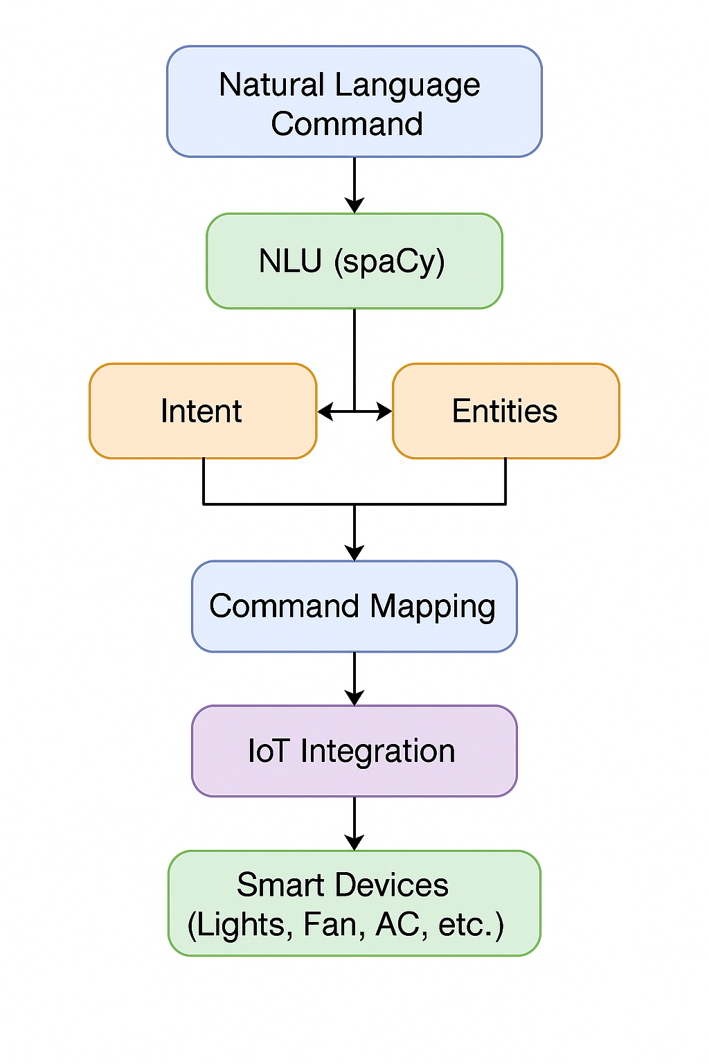
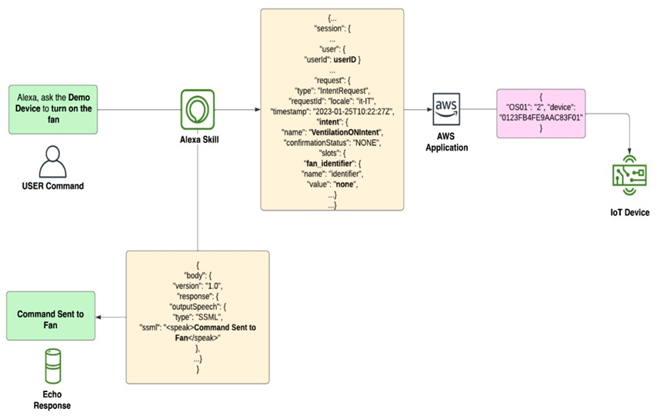
System Design / Architecture
System Architecture

Slide 7
MODULE 1: Voice Command Cleaner
Function:
Cleans the raw voice input by removing unnecessary noise, filler words, and formatting the sentence.
Prepares the spoken input for accurate parsing.
Example:
Raw input: "Umm... can you, like, please turn on the living room light?"
Cleaned: "turn on living room light“
Technologies:
Python
Google Speech-to-Text API or Whisper by OpenAI
re (Regex), stopword filtering (e.g., with NLTK or spaCy)

Slide 8
MODULE 2: Command Parser
Function:
Parses the cleaned command using NLP techniques.
Extracts intent and entities (e.g., action = "turn on", device = "light", location = "living room").
Example:
Input: "turn on living room light"
Output: { intent: "turn_on", device: "light", location: "living room" }
Technologies:
spaCy / Rasa / BERT for intent recognition and entity extraction
Flask for API endpoints

Slide 9
MODULE 3: Action Mapper
Function:
Maps the parsed intent and entities to actual IoT actions (like MQTT publish or REST API call).
Communicates with devices through MQTT, HTTP, or cloud services.
Example:
Parsed Command: { intent: "turn_on", device: "light", location: "living room" }
Action: MQTT → topic: /home/livingroom/light → payload: ON
Technologies:
Python
MQTT (via paho-mqtt)
Device control APIs (REST or custom protocols)

Slide 10
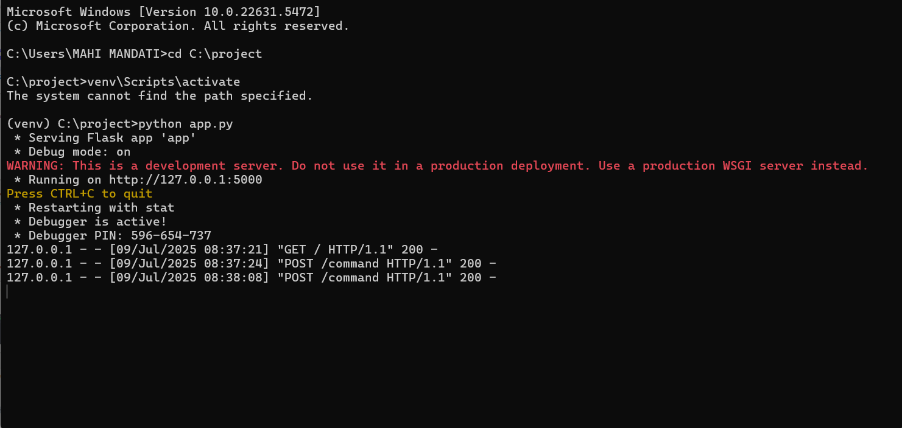
Implementation
Screenshots
Key Features & Functionalities
Accept voice and text commands
Detect user intent and extract entities
Control smart devices (lights, fan, AC, etc.)
Real-time command execution via MQTT
Support for multi-room and multi-device control
Feedback/confirmation to user after command execution
Extendable command set for new devices

Slide 11
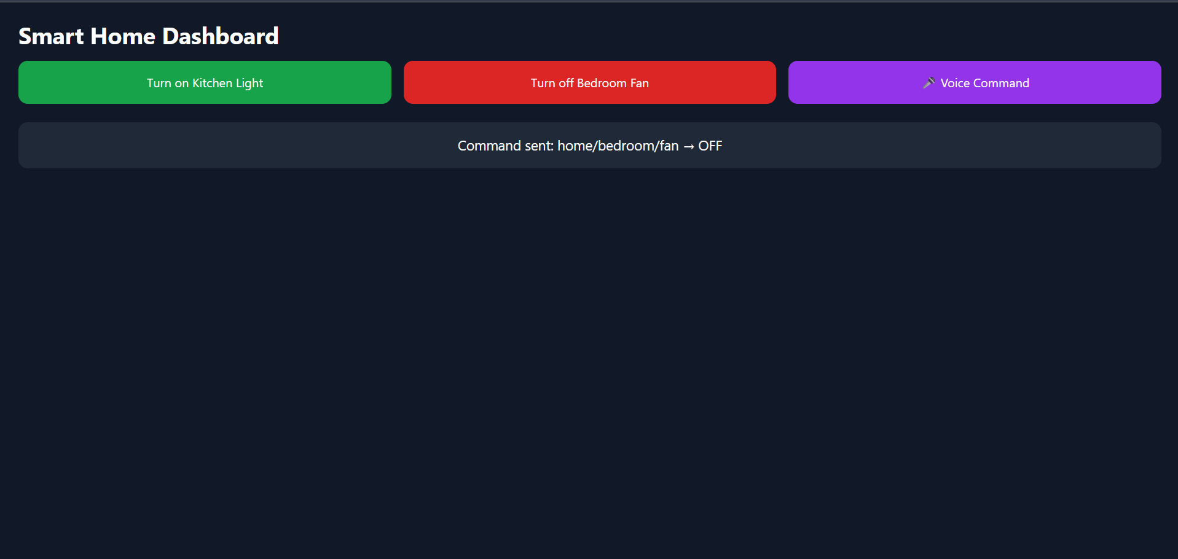
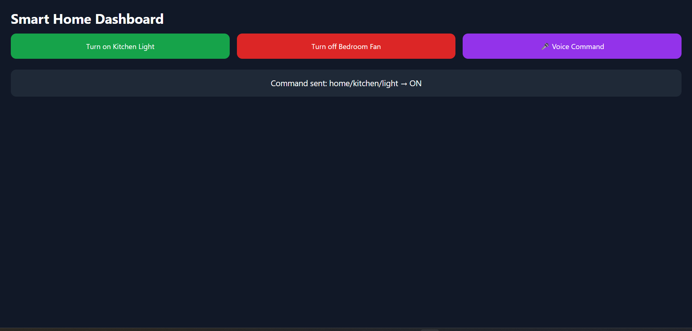
Results & Discussion
OUTPUT:

Slide 12
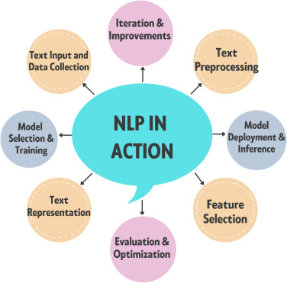
Challenges & Limitations
Issues Faced During Development
Data Quality Issues
Integration Difficulties
Possible Constraints
High Implementation Costs
Scalability Challenges

Slide 13
Future Scope
Enhancements or Improvements
Improve accuracy using advanced NLP models like BERT or GPT.
Add support for regional languages and multilingual commands.
Include context-awareness for follow-up commands (e.g., "Turn it off").
Enhance noise filtering for better voice recognition in all environments.
How This Project Can Be Extended Further
Integrate with smart assistants like Alexa or Google Home.
Add scheduling and automation features (e.g., "Turn off lights at 10 PM").
Enable remote access and cloud-based command control.
Build a learning model to adapt to individual user preferences.

Slide 14
Conclusion
Summary of the Project
This project focuses on building a Natural Language Command Parser for smart home automation. It enables users to control home devices using simple voice or text commands by converting natural language into device-specific actions through NLP and IoT integration.
Key Takeaways
Enhanced Inventory Accuracy: Accurate mapping of user commands reduces execution errors.Minimizes incorrect device actions through precise intent detection.
Scalability & Flexibility: Easily extendable to multiple rooms, devices, and command types.Modular architecture allows integration with new devices or features.
Future Potential: Can evolve into a full voice-based smart assistant.Potential for integration with smart city and energy-saving systems.

Slide 15
References
Kumar, A., & Roy, S. (2024). NLP-Driven Home Automation Systems: A Survey. IEEE Internet of Things Journal, 11(2), 101–110. https://doi.org/10.1109/JIOT.2024.1102034
Mehta, P., & Singh, R. (2023). Voice-Controlled IoT Framework for Smart Homes. Smart Innovation, Systems and Technologies, 287, 55–67. https://doi.org/10.1007/978-3-031-24513-6_6
Rao, N., & Das, A. (2025). Speech Recognition Integration in Edge-Based Smart Home Devices. Proceedings of the 2025 IEEE International Conference on IoT Systems, 88–94. https://ieeexplore.ieee.org/document/2025IOTCONF118
Sharma, L., & Bhatt, V. (2024). Enhancing Smart Home Automation using NLP and MQTT Protocols. Journal of Ambient Intelligence and Humanized Computing, 15(1), 23–35. https://doi.org/10.1007/s12652-024-04521-w

Slide 16
Thank You!

