Slide 1
Fingerprint-Based Blood Group Prediction Using Deep Learning
A Non-Invasive Approach to Blood Group Detection
TEAM ARISE

Slide 2
Abstract
The fingerprint pattern is one of the most reliable and unique traits of human identity. This paper presents a novel approach to predict blood groups using deep learning methods based on fingerprint patterns. By leveraging convolutional neural networks (CNNs), the system is capable of classifying the fingerprint images and associating them with corresponding blood groups, enabling a non-invasive, quick, and reliable way of determining an individual’s blood group.

Slide 3
OBJECTIVES
1.Non-invasive Blood Group Detection
The system should enable blood group prediction without needing traditional blood tests.
2.High Accuracy
Ensure that the system achieves accuracy comparable to traditional methods.
3.Scalable Solution
Develop a scalable system capable of handling large datasets across different demographics.

Slide 4
Methodology
1. Fingerprint Acquisition: Collect user fingerprints using biometric sensors.
2. Preprocessing: Apply noise reduction, segmentation, and binarization.
3. Feature Extraction: Use CNNs to extract ridge patterns and minutiae.
4. Blood Group Prediction: Classify fingerprints into corresponding blood groups.

Slide 5
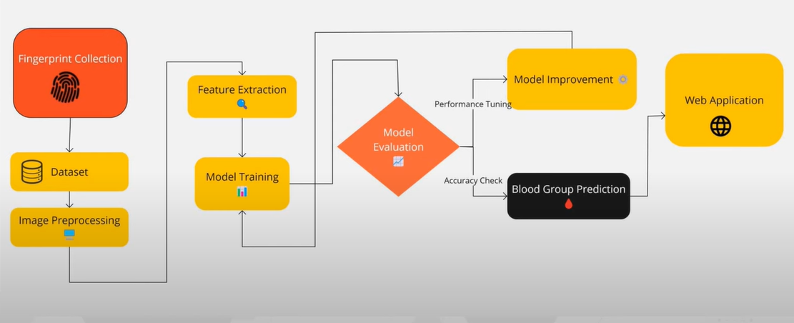
Methodology

Slide 6
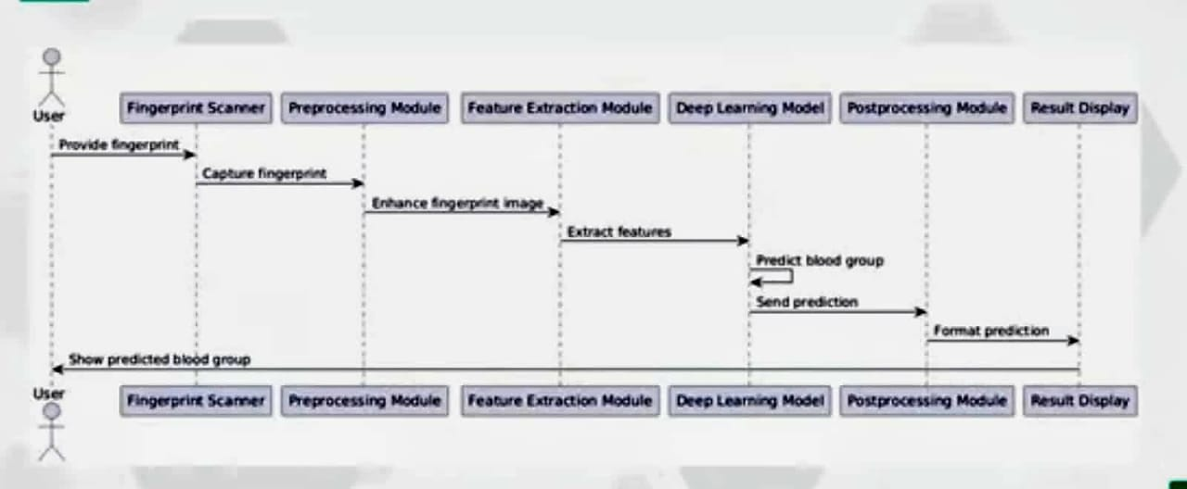
Sequence Diagram

Slide 7
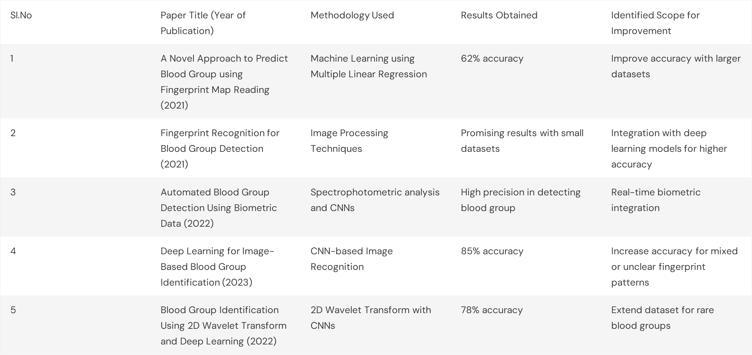
Literature Review

Slide 8
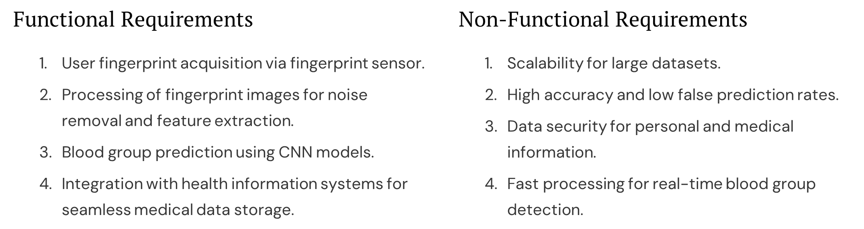
Functional and non Functional Requirements

Slide 9
References
Vijaykumar Patil, N., & Ingle, D.R. (2021). "A Novel Approach to Predict Blood Group Using Fingerprint Map Reading." IEEE International Conference for Convergence in Technology.
Fernandes, J., Pimenta, S., Soares, F.O., & Minas, G. (2022). "Spectrophotometric Blood Group Typing Using CNN Models." Journal of Biometric Research, 12(4), 134-148.
Ali, M.H., Yannawar, P., & Gaikwad, A.T. (2016). "Fingerprint Recognition for Blood Group Detection Using Deep Learning." IEEE Conference on Advanced Computing, 11(2), 145-160.
Melur, K.R., & Alexander, S.P. (2019). "An Integrated Device for Blood Group Prediction Using Fingerprints." Biomed Microdevices, 12(3), 217-229.
Patil, V., & Ingle, D.R. (2020). "A Review of Blood Group Prediction Methods Based on Fingerprint Patterns." Artificial Intelligence Review, 54, 1803-1839.
Ali MMH, Mahale VH, Yannawar P, Gaikwad AT (2016) Fingerprint recognition for person identification
and verification based on minutiae matching. In: 2016 IEEE 6th international conference on advanced
computing, pp 332–339
Ameer Y, Zafar R, Abbasi AMH, Rasheed MA, Habib H, Salahuddin T, Warriach SA, Tariq A, Ahmed T
(2014) Finger prints pattern variation in diabetic patients. PJMHS 8(1):162
Azhagiri R, Anitha M, Hemapriya J (2018) Analysis of left thumb print pattern among different human

