Slide 1

VIRTUAL INTERNSHIP
WEEK 2 TASK - 4

Slide 2

Wavecon Telecom Analysis
By Sharanya Shukla

Slide 3
Agenda Overview
1. About Wavecon
2. Data Overview
3. Revenue impact of 5G Launch
4. Underperforming KPI after 5G Launch
5. Top Performing Plans Post 5G Launch
6. Underperforming Plans post 5G Launch
7. Plan Discontinuation After 5G Launch
8. Recommendations

Slide 4
ABOUT WAVECON
Wavecon is one of the leading telecom companies known for its exceptional services and customer satisfaction.
The company has a strong market presence and a reputation for innovation in the field of telecommunications.
Recently, Wavecon launched its 5G services, aiming to provide faster and more reliable connectivity to its users.
This presentation evaluates the performance of the 5G launch and its impact on Wavecon’s business and customers.

Slide 5
DATA OVERVIEW
Wavecon is present in 15 different cities.
The data that we are using here is mainly focusing on 8 months timeline.

Slide 6
DATA OVERVIEW
JAN TO APRIL
MAY
JUNE TO SEP
BEFORE 5G
5G ROLLED OUT
AFTER 5G

Slide 7
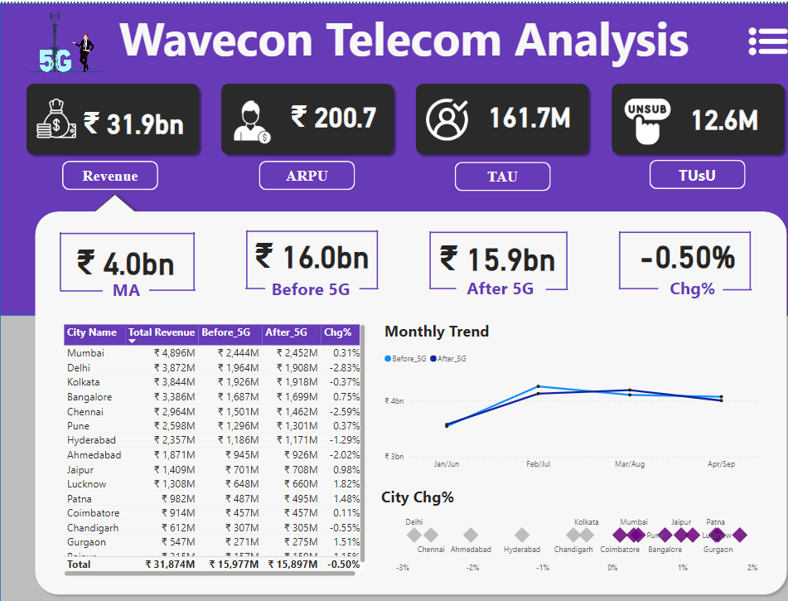

Slide 8
1. What is the impact of 5G launch on our revenue?

Slide 9
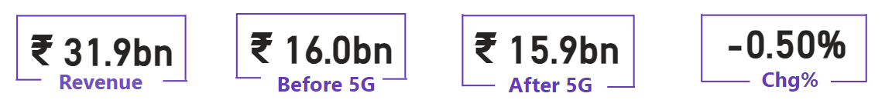
INSIGHTS - 1
The impact of 5G Launch resulted in a decrease of revenue by 0.1 bn, which indicates an overall 0.50% of decline.

Slide 10
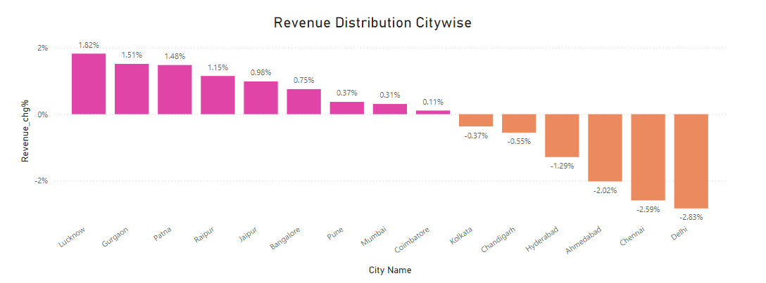
IMPACT ON DIFFERENT CITIES

Slide 11
Positive Impact
Cities like Lucknow, Patna and Gurgaon experienced revenue growth by 1.82% ,1.51% and 1.48% respectively, indicating successful 5G adoption.
Negative Impact
Cities like Ahmedabad, Chennai and Delhi experienced revenue decline by
2.02% , 2.59% and 2.83%, indicating challenges in market adaptation or
increased competition.

Slide 12
2. Which KPI is underperfoming after the 5G Launch?

Slide 13
INSIGHTS - 2
 | BEFORE 5G | AFTER 5G | CHG%
REVENUE | ₹16.0 bn | ₹15.9 bn | -0.50%
TAU | 84.4 M | 77.4 M | -8.20%
TUsU | 5.6 M | 7.0 M | 23.50%
ARPU | ₹190.2 | ₹211.3 | 11.05%

Slide 14
There are 3 KPIs which are underperforming
are as follows :
Revenue : We saw a slight decline of 0.50% in the revenue.There is a great need for the company to investigate about the reasons in the downfall of revenue even after the introduction of 5G Services.
Total Active Users(TAU) : There was a major drop in total active users which could be one of the major factors affecting revenue.This decline suggests potential issues with customer retention.
Total Unsubscribed Users(TUsU) : There was a drastic increase of 23.50% in unsubscribed users which indicates that there is dissatisfaction among the customers regarding the 5G services.

Slide 15
3. After the 5G launch, which plans are performing well in terms of revenue? Which plans are not performing well?

Slide 16
INSIGHTS - 3
PLANS | PLAN DESCRIPTION | REVENUE
P1 | Smart Recharge Pack(2 GB/Day Combo for 3 months) | ₹ 4199 M
P2 | Super Saviour Pack(1.5 GB/Day Combo for 56 days) | ₹ 2975 M
P3 | Elite Saver Pack(1 GB/Day) Valid : 28 days | ₹ 2615 M
P4 | Mini Data Saver Pack (500 MB/day) : 20 days | ₹ 1952 M
P5 | RS. 99 Full Talktime Combo Pack | ₹ 1656 M
P6 | Xstream Mobile Data Pack : 15 GB Data | 28 days | ₹ 1244 M
P7 | 25 GB Combo 3G/4G Data Pack | ₹ 738 M

Slide 17
PLANS | PLAN DESCRIPTION | REVENUE
P8 | Daily Saviour : 1 GB/Day validity : 1 Day | ₹ 434 M
P9 | Combo Topup : 14.95 Talktime and 300 MB data | ₹ 227 M
P10 | Big Combo Pack 6 GB/day Validity : 3 days | ₹ 131 M
P11 | Ultra Fast Mega Pack( 3 GB /day Combo for 80 days) | ₹ 1860 M
P12 | Ultra Duo Data Pack( 1.8 GB/day Combo for 55 days) | ₹ 1161 M
P13 | Mini Ultra Saver Pack (750 MB/day for 28 days) | ₹ 315 M

Slide 18
IMPACT ON MOBILE PLANS
 | BEFORE 5G | AFTER 5G | CHG%
P1 | ₹1.8 bn | ₹2.4 bn | 33.33%
P4 | ₹1.1 bn | ₹876.8 M | -20.29%
P5 | ₹1.0 bn | ₹651.5 M | -34.85%
P6 | ₹749.1 M | ₹494.6 M | -33.97%
P7 | ₹582.4 M | ₹155.6 M | -73.28%

Slide 19
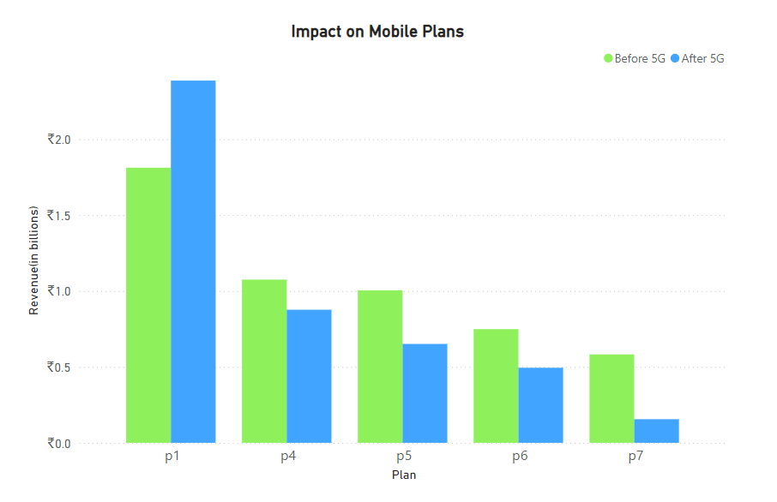

Slide 20
IMPACT ON MOBILE PLANS
Plan P1 i.e. Smart Recharge Pack(2 GB/dayCombo for 3 months) performed well with a 33.33% increase in revenue,making it one of the best performing plans after the 5G Launch.
Plans P4, P5, P6 and P7 are the plans that did not perform well after the lauch of 5G launch as they experienced revenue declines of 20.29% , 34.85% , 33.97% and 73.28%.

Slide 21
4. Is there any plan affected largely by the 5G launch? Should we continue or discontinue that plan?

Slide 22
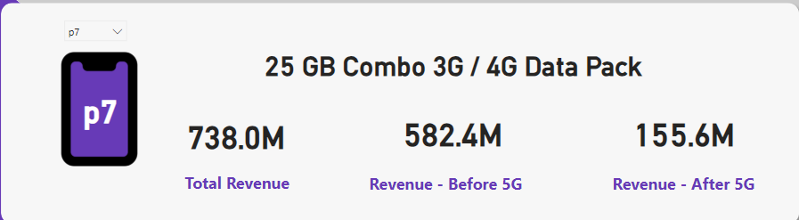
INSIGHTS - 4
Plan P7 is largely affected by the 5G launch and the company should discontinue this plan as it experienced a significant drop in the revenue from 582.4 M to 155.6M, which is equal to 73.28% decline.
One of the major reasons could be customers shifting to new advanced technology leaving behind 3G/4G services.

Slide 23
5. Is there any plan that is discontinued after the 5G launch? What is the reason for it?

Slide 24
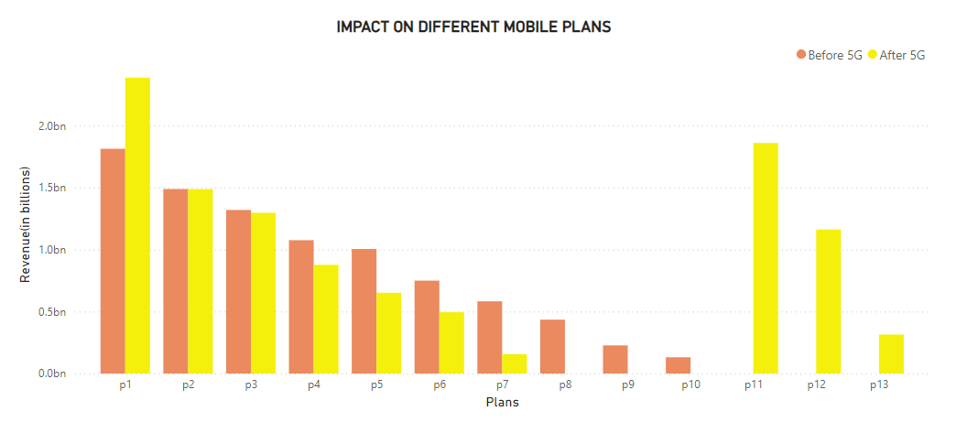
Insights - 5

Slide 25
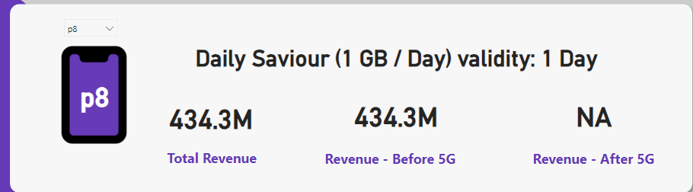
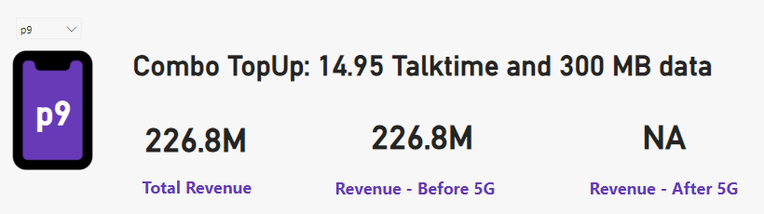
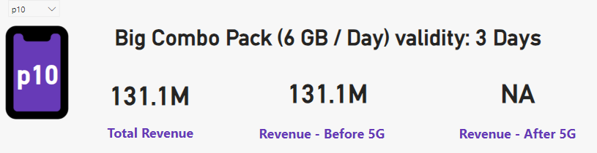

Slide 26
INSIGHTS - 5
Plans P8, P9 and P10 are discontinued after the lauch of 5G services as these plans provided low data limits.
These plans were the least popular among all the plans and generated very less revenue.
The customers generally prefer those plans which provide good data limits along with a longer time period but plans P8, P9 and P10 were valid for a shorter period.
Discontinuing these plans was a good move by the company in order to revive the losses.

Slide 27
RECOMMENDATIONS
Focus on 5G Plans : Develop and promote new 5G- specific plans for better speed and performance.
Revise Data Limits : Upgrade data limits for discontinued and underperforming plans to better align with 5G user needs.
Improve Customer Retention : Address the increase in unsubscribed users by enhancing customer support and offering more competitive data plans.
Rewarding the Customers : Reward early adopters of 5G technology with special incentives, discounts or exclusive services in order to create a sense of loyalty and make customers feel appreciated for embracing new technology.
Improve Connectivity : Focus on improving the connectivity as the customers would stay with the provider who offers good connectivity.

Slide 28
Thankyou

