Slide 1
DESIGN THINKING
FINAL PRESENTATION
GROUP NUMBER : 07

Slide 2
Students JourneyT
Team Members
M22W0375 - Sharanya Bhongade
M22W0396 -Preeti shrestha
M22W0322 – Rumesh Wickramasekara
M22W0315 – Udalamaththa Gamage Chathurika Jayamini
M22W0363 - Srijana khadka

Slide 3
Content
EMPATHISE
DEFINE
PROTOTYPE
IDEATE

Slide 4

IMPROVING THE EXPERIENCE OF NEW INTERNATIONAL STUDENTS ARRVING TO KYOTO
Approximately 12,500 students are arriving
Having various academic purposes
High presence in Asian countries
Students cannot enjoy life and improve their experiences due to these challenges and problems to face
Students face vast number of challenges as an international students
No proper solution still available to improve the experience
Students struggle to adjust to new culture & new life
To make students feel comfort and enjoy their studies and new cultural adaptations

Slide 5




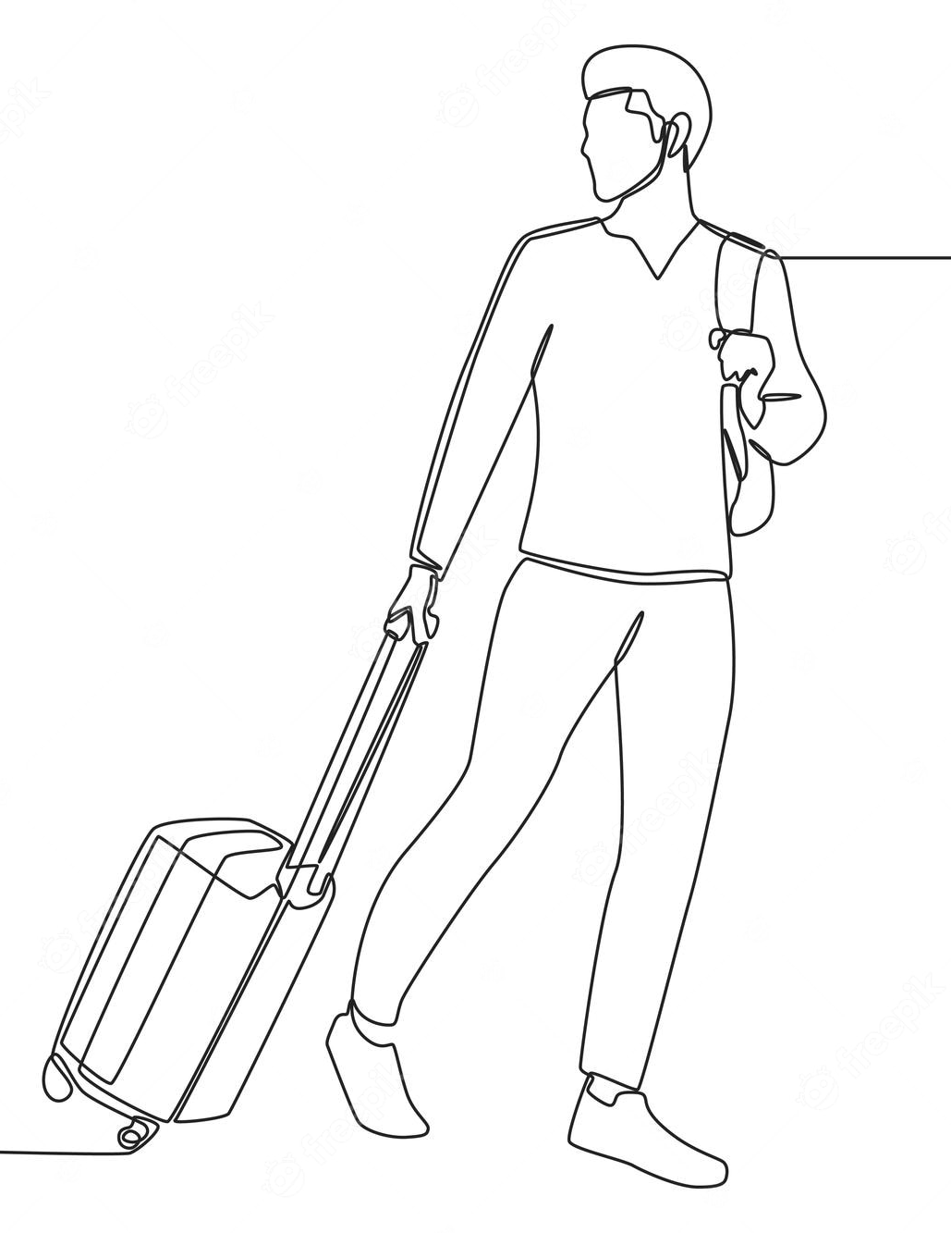




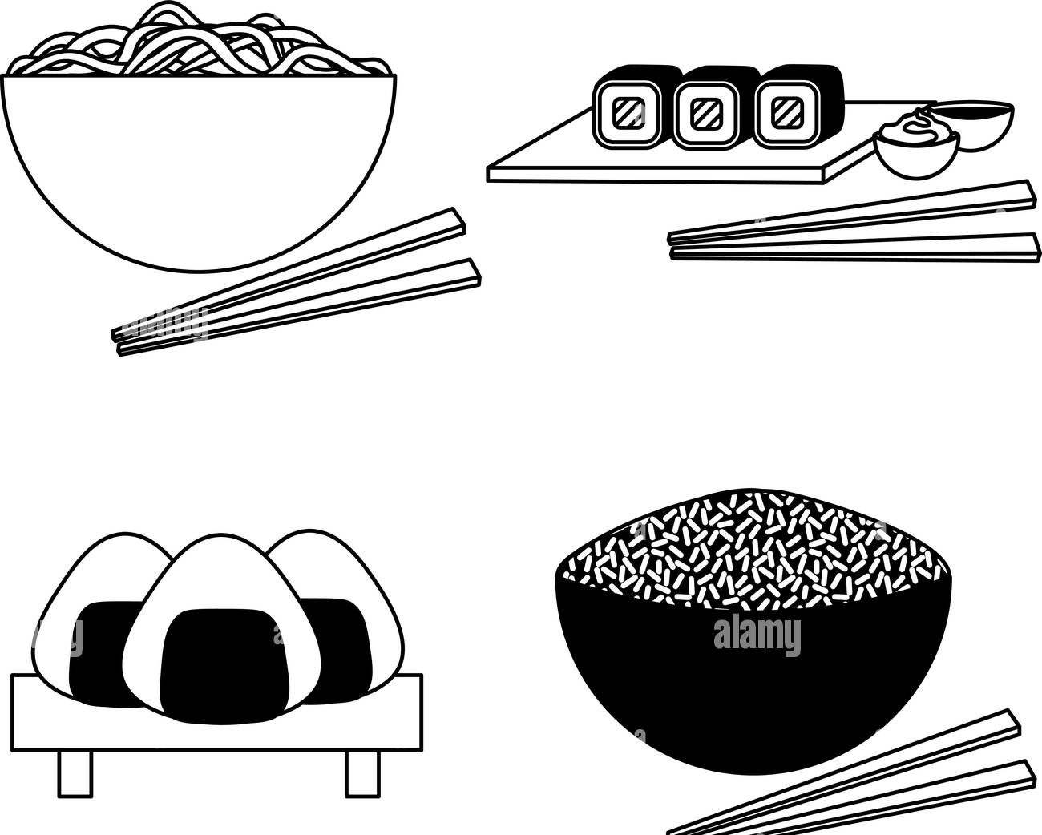

International Students Journey
Arrive to Kyoto
Settle in the Apartment
Buying Necessities
Lectures and assignments
Language Difference
Food Experiences
Transport and other
Deal with cultural differences
Part-time jobs

Slide 6
empathy
01.

Slide 7


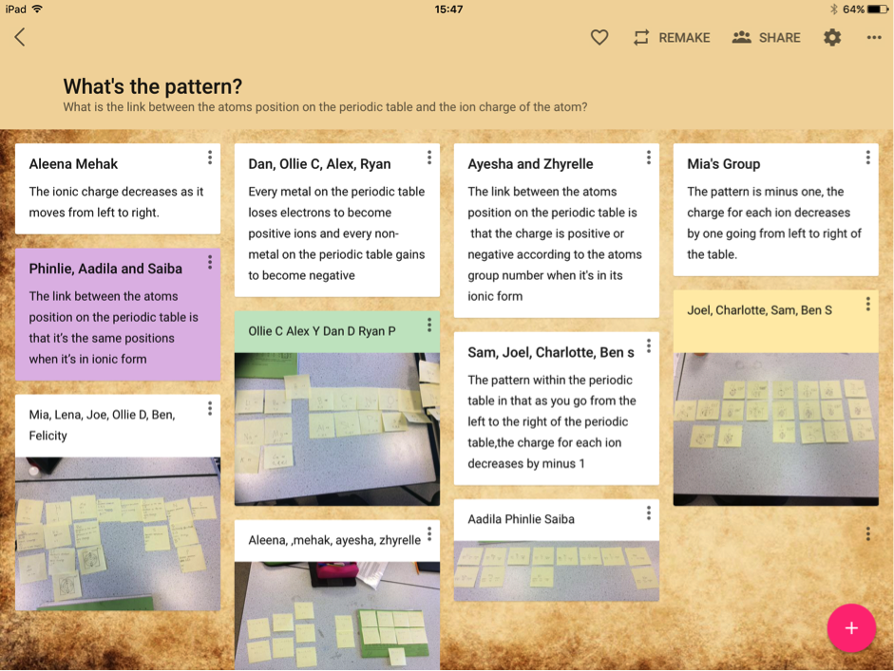

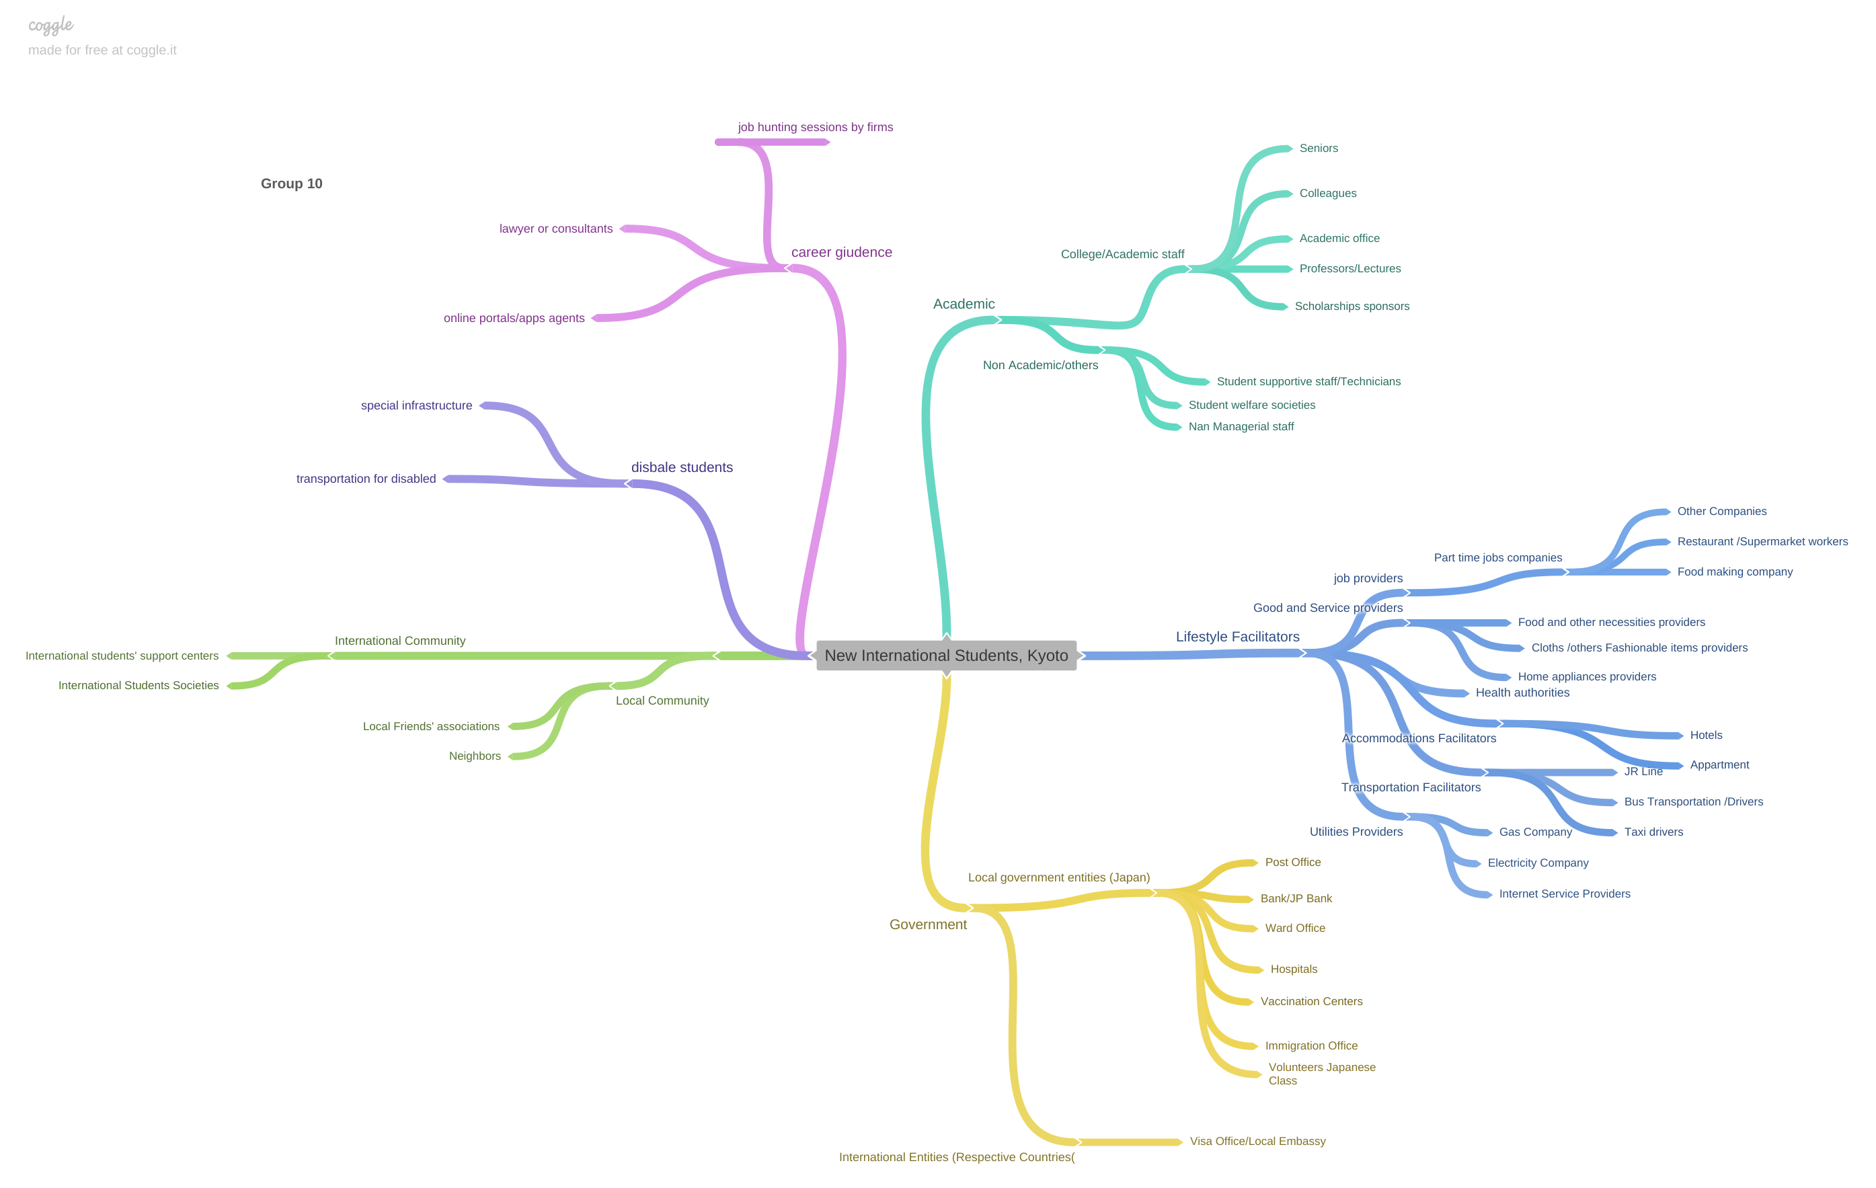
Stakeholders Mapping
Less understand about our users due to biases – Gathered more information
Analyze all the stakeholders on padlet and removed repeated ones
Online meet ups
Developed stakeholders mind map on coggles
Conducted brainstorming session to write down all the stake holders on Padlet
Online brainstorming session was not effective until we used to it and it was quite difficult to share thoughts as offline
Identified extreme users
Initially Extreme users identification was not properly done due to lack of brainstorming –rearranged proper brainstorming session to extreme out for a holistic picture

Slide 8
Developed Stakeholders Map

Slide 9
Data Collection methods

Slide 10




THEORY LESSON
Qualitative Data Collection Methods
Quantitative Data Collection Method
04. Survey
02. Focus Group
03. Ethnography
01. Interview
Online Survey using Google Form . Targeted 20 Respondents
Senior Student (5)
Part Time Job provider
Japanese Community-A Japanese lady (2)
Class room arranged focus group-(Share the experiences )
Self-Ethnography 3
Passive Participation –Volunteer Japanese language center
Scheduling one to one interviews were really challenging due to busy lifestyles
Changed appointments based on their flexibility

Slide 11

Data Analysis
Qualitative Methods
Quantitative Methods
01.Thematic Analysis
01.Descriptive and inferential statistics
Sample Size -20
Mean (Age ) – Average age of respondents 27 years
80% students following Masters and 20% other courses.
Identifying Similarities and Relationships by analyzing qualitative data gathered through the above methods in order to create themes
ENTREPRENEUR
Foods
Mental Health (Homesick & Loneliness)
Part Time Jobs
High expenses & Taxes
Language Issues
Some questions did not make sense and could not able to get actual insights – Redeveloped the questionnaire to approach real insights

Slide 12
Data Analysis
Types of problems Facing
Citizenship
Majority from Nepal ,35% followed by Sri Lanka
Language issue is the main problem faced followed by Homesick and loneliness (Mental Health issue ,Food and Taxes
High presence on Female ,55% among respondents

Slide 13

Insights
01.
02.
04.
Japanese language is one of the main problem which was faced while adopting Kyoto life.
Faced Difficulties whilst dealing with Japanese people and entities
Lack of knowledge of where to buy home appliances and other necessary items and difficult to operate them
Adopting lifestyle without your parents , family and loved ones/ Homesickness and most the times mental frustrations happen , not having entertainment programs and other programs
Japan Food culture quite challenging
Not having complete details of ingredients
Food portion is not enough
Eat with chopsticks
Less availability of Vegetarian foods
Missed home country foods
Living expenses is really high due to taxes
Maintain an effective balance between studies and part time jobs is pretty much challenging.

Slide 14
Insights - continued
01.
02.
04.
Got confused with complex routes and Map
Be punctual for all works and Some Japanese Do not love foreigners as they make so much noises
Not having enough idea to spate and place the Trash
In detail packaging available
Not enough awareness on earthquake or cycle
Post mails ,bill are all in Japanese and on-Google translating is not accurate
Websites which provide jobs to international students usually don't give response. They need high level of Japanese

Slide 15
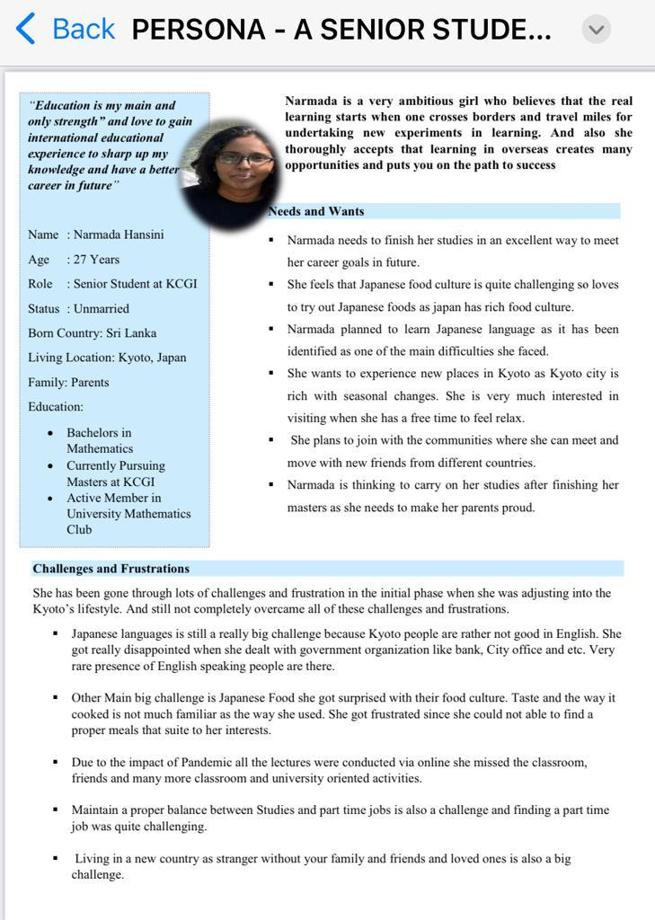
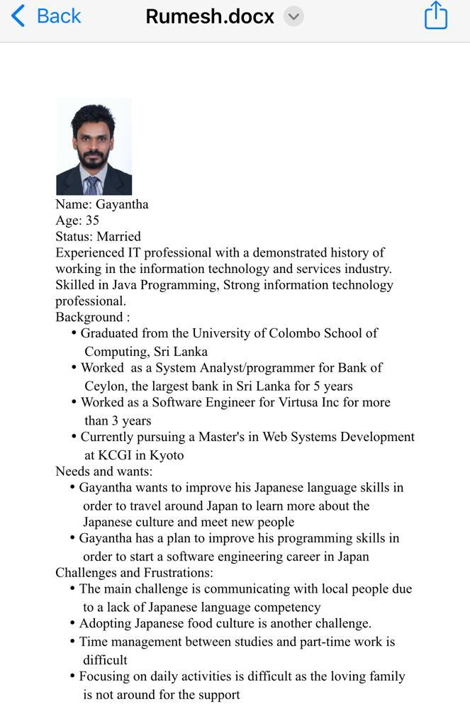
Created Personas
Senior Student
Senior Student
EARTH
JUPITER
mercury

Slide 16
Problem Redefinition Activity
Turn Insights into POV statements
POV statements into design problems
Frame your final design problem statements
Students do not like to feel and stay alone (Homesick/Depression)- Insight
Frequency of each problem
MERCURY
Saturn
jupiter
Importance
How might we create a comfort zone by addressing the frustrations of foreign students during their period of stay?
Students need to get connected with friends and engaged with entertaining activities- POV Statement
Relationship between the problems
Feasibility
Group Interest
Improving the mental health of new International students arriving to Kyoto

Slide 17
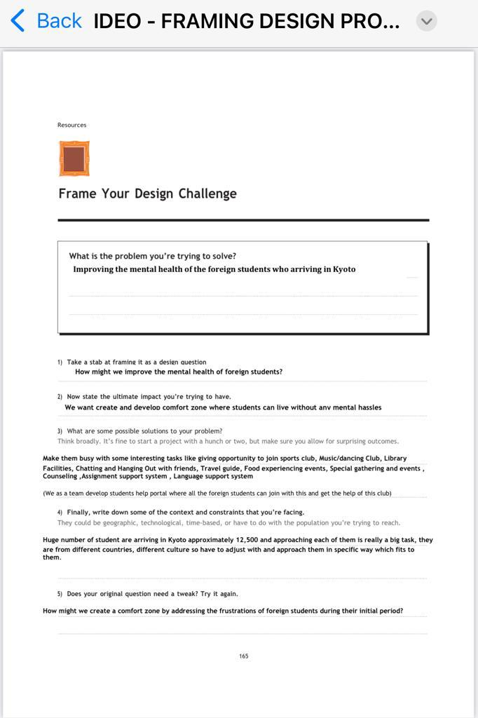
Problem Redefinition Activity
MERCURY
Saturn
jupiter

Slide 18
IDEATION
03.

Slide 19



Brainstorming
Brain Writing
75 Ideas Generated
Divergent Thinking
—SOMEONE FAMOUS
Chatting App
General Themes
Entertainment Activities App
Yoga/ Meditation video Clips
Senior student support Portal
Information Support app
Travel Activities club
Finance Management support App

Slide 20
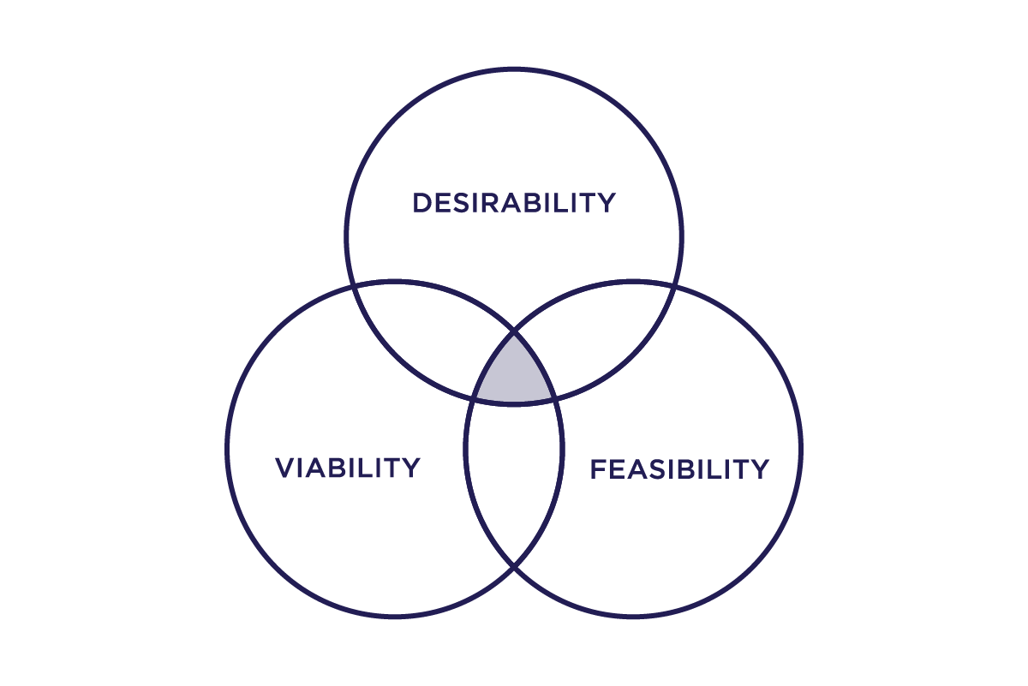

Selecting Solutions
FEASIBILITY - Something functionally possible
VIABILITY - Something economically sustainable
DESIRABILITY - Something people want/need

Slide 21
Selection of Ideas/Solutions
Create and develop a PORTAL “Kyoto Students Portal” targeting new entries which will be facilitated different mental relaxing activities,
Create and Develop Mobile app targeting mental relaxing activities
Dancing /Singing clubs/Instrument playing ( Yanni Music)
Yoga /Meditation & exercises
Art/ Photography clubs/event
Travel hub
Sports club
Chatting and hanging out
Education/Assignments support system (Senior Based , Senpai-Kohai support system)
Japanese documents translation app ( Well developed app which will delivered important points and actions to take in selected language)
Information app – Provide all the details home appliances , Grocery items , cloths and other necessities( Availability , available places, prices , etc) based on their locations.
Forming a Club with the help of senior students and lectures to strong their mental health

Slide 22
Final Soluation
Create and Develop app targeting mental relaxing activities,
Dancing /Singing clubs/Instrument playing1 ( Yanni Music)
Yoga /Meditation & exercises
Art/ Photography clubs/event
Travel hub
Sports club
Chatting and hanging out
Senior students assignment guidance
MERCURY
MARS
EARTH

Slide 23
04.
PROTOTYPE

Slide 24
THANK You!

