Slide 1

TITLE:Unite- Global connection
to Startups
Category: Software
Ministry Name: Central Ministry
Organization Name: DIPP
Problem Statement: Platform to connect
Startup with Corporate
Team Name: int elligence ;
Team Leader Name: Akshay Singh Thakur
College Code: 1-3516306350

Slide 2



Sign in/Sign up
Rural Community
Who are you?
Mediator
Technology
Technology
Urban
Community
Choose
Domain
STARTUP
CORPORATE
Attend
Events
Contest
Participation
Create profile
Discussion Forum
Contest
Creation
Organise
Events
Profile info
Solutions to
idea
Funding
Evaluation
Criteria
About
Growth
Rate
feedback
Network
Funding
Add
Challenges
Add cash
Prize
date& time
Deadline
Evaluation
Criteria
Queries/
Answer
Feedback
Follow
Seminar
Location
Date &
time
Fees
Alert
messages
Webinar
Deadline
Workshop
Share
Notification
Conference
Expert Talk
Figure: Idea to connect Startups and Corporates

Slide 3






HIGHLIGHTS
EXCLUS
I
V
E
EXCLUSIVE
Unite website
Unite website
Bidding on best Idea
Innovative Idea Contracter
Corporate post Requirement
Corporate Incubator
Startup
What if I have an idea?
Unite
Website Finds the best match for you!!
EXCLUS
I
V
E
EXCLUSIVE
Startup
Corporate
95%
Rural Community
Unite website
Audio/Video sharing medium
Customer
Unite website

Slide 4
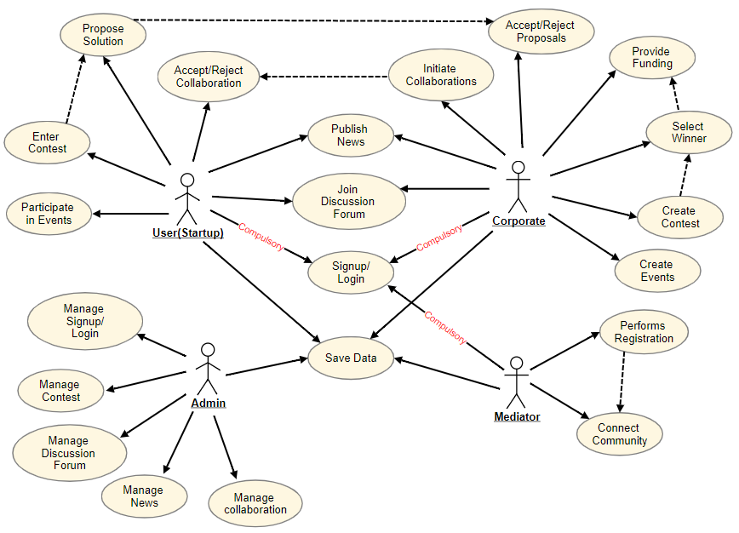
USE CASE DIAGRAM
TECHNOLOGY STACK
HTML
ANGULAR.JS
CSS
NODE.JS
JAVASCRIPT
MACHINE
LEARNING
PHP
PYTHON
DEPENDENCIES
Data of Corporate and Startups
Use of Machine Learning in matching Startup with Corporate
Language Barrier
SHOW STOPPER
Connecting Rural community to the Unite website.
Finding an appropriate mediator

