Slide 1
IMAGE CLASSIFICATION USING CNN ON CIFAR-10 DATASET
PRESENTED BY:
K SARANYA
513121104037
THANTHAI PERIYAR GOVERNMENT INSTITUTE
OF TECHNOLOGY VELLORE

Slide 2
PROJECT TITLE
IMAGE CLASSIFICATION USING CNN ON CIFAR-10 DATASET

Slide 3


AGENDA
Problem Statement
Project overview
End Users
Solution and its proposition
The WOW in the solution
Modeling
Results
Conclusion
3/21/2024 Annual Review

Slide 4

PROBLEM STATEMENT
Develop a Convolutional Neural Network (CNN) model to accurately classify 32x32 color images from the CIFAR-10 dataset into one of the ten predefined categories.The goal is to create an efficient, scalable, and interpretable image classification system applicable to various real-world scenarios.

Slide 5

PROJECT OVERVIEW
This project aims to implement an image classification system using Convolutional Neural Networks (CNN) on the CIFAR-10 dataset.
It involves Data Preparation, Model Design,
Training, Evaluation, Interpretation and Visualization,
and Deployment.
The task is to develop a CNN model that can accurately classify these images into their respective categories

Slide 6
WHO ARE THE END USERS?
Researchers
Developers
Businesses
Consumers
Educators and students

Slide 7

YOUR SOLUTION AND ITS VALUE PROPOSITION
Enhance preprocessing with techniques like data augmentation.
Explore advanced CNN architectures.
Optimize hyperparameters.
Apply regularization techniques.
Visualize and interpret model performance.
Deploy models for production use.

Slide 8

THE WOW IN YOUR SOLUTION
Translation Invariance
Data Efficiency
Regularization
State-of-the-Art Performance
Transfer Learning
3/21/2024 Annual Review
8

Slide 9
MODELLING
CNN Architecture:
The CNN architecture is modified to include additional convolutional layers and a dense layer with regularization to prevent overfitting.
Optimization Algorithm:
The Adam optimizer is used for faster convergence and better performance.
Regularization:
L2 regularization is added to the dense layer to penalize large weights and improve model generalization.
9

Slide 10
Training:
The model is trained for 20 epochs to allow for more learning iterations and better convergence.
Evaluation:
The model's accuracy is evaluated on the test dataset, providing a more reliable measure of performance.
Visualization:
Training history (accuracy and validation accuracy) is plotted to visualize model performance over epochs

Slide 11
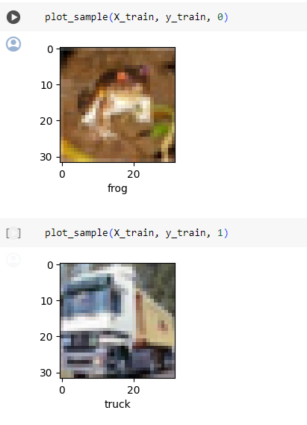
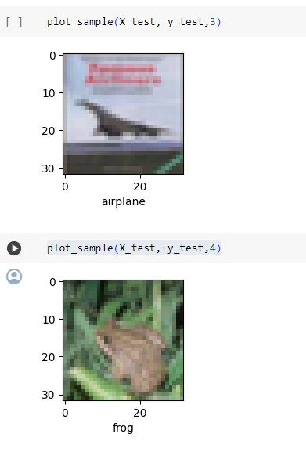
RESULTS
11

Slide 12
CONCLUSION
The provided CNN model achieved an accuracy of approximately 71% on the CIFAR-10 test dataset after training for 20 epochs.
Further optimizations and adjustments could potentially improve performance, but the model demonstrates reasonable effectiveness in image classification tasks.

Slide 13
THANK YOU!

