Slide 1
Code coverage - Exclusion
24-06-2025

Slide 2
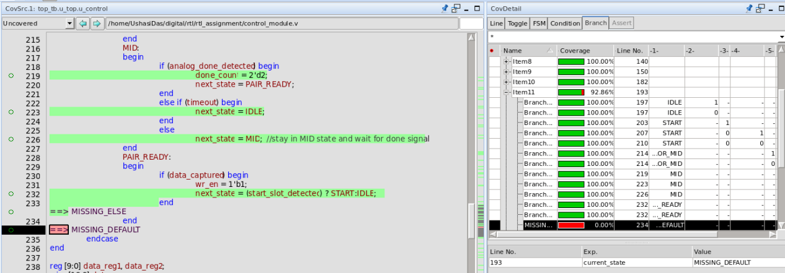
Exclusion 1 Branch cov : there is missing default case , excluded : can't do anything about it from testbench perspective

Slide 3
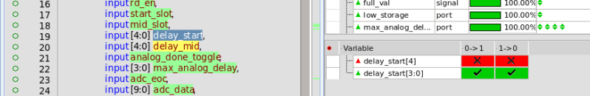
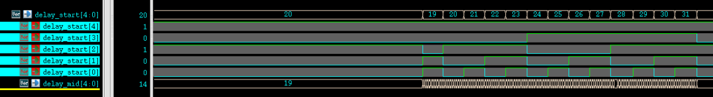
Exclusion 2 Toggle cov : lower limit excluded : delay_start and delay_mid has a range of 19 to 31 , in this range the 5th bit is always 1

Slide 4
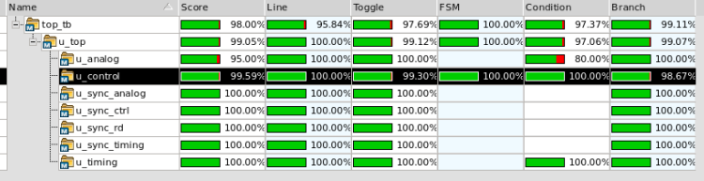
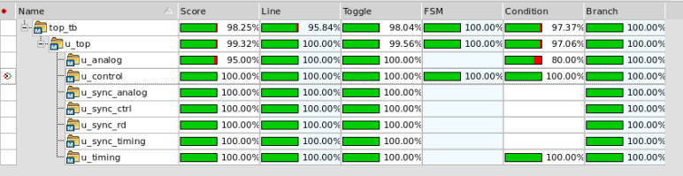
Without Exclusion CODE COVERAGE : 99.59%
With Exclusion CODE COVERAGE : 100%

Slide 5
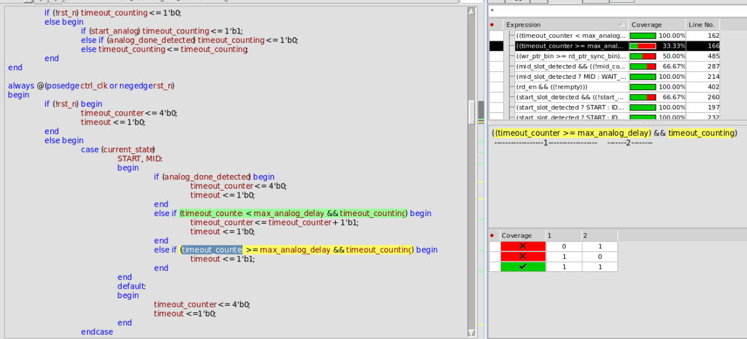
Redundant code : Has been removed Condition cov : if-else, excluded : due to the prev else if condition , timeout_counter cant be 0 , and due to logic timeout_counting is not 0 as analog_done hasn’t arrived note: no requirement of timeout_counting

Slide 6
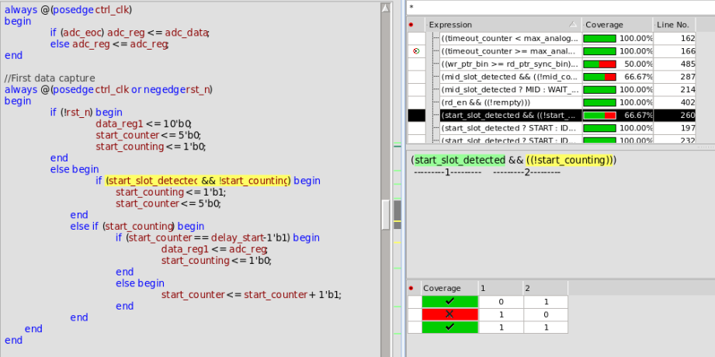
Redundant code: Has been removed Condition cov : if-else, excluded : start_counting becomes 1 after the start_slot_detected note: no requirement of !start_counting

Slide 7
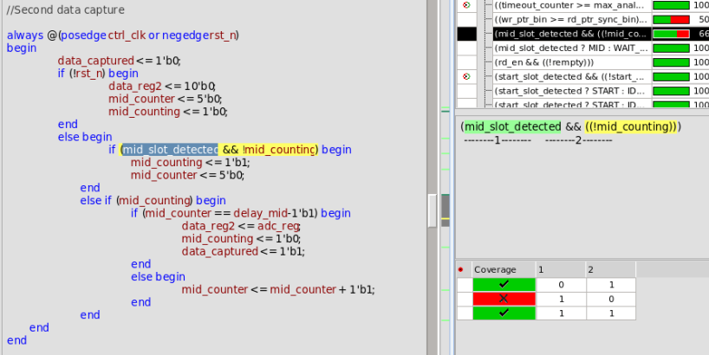
Redundant code: Has been removed Condition cov : if-else, excluded : mid_counting becomes 1 after the mid_slot_detected note: no requirement of !mid_counting

