Slide 1
Inside the High Efficiency Video Coding (HEVC) loop
How blocks, residuals, and encoder decisions become a decodable bitstream
1
2
3
4
5
6
PARTITION
PREDICT
TRANSFORM
QUANTIZE
CODE
RECONSTRUCT
H.265 / High Efficiency Video Coding (HEVC) — Presentation 2
01 / 19
Notes:
Opening: Last time we focused on prediction—how intra and inter coding remove spatial and temporal redundancy. This presentation follows the information that remains. The goal is to understand the complete HEVC coding loop, especially the distinction between the block hierarchy and the residual-coding path.
[Sources]
- https://doi.org/10.1109/TCSVT.2012.2221191
- https://link.springer.com/book/10.1007/978-3-319-06895-4

Slide 2
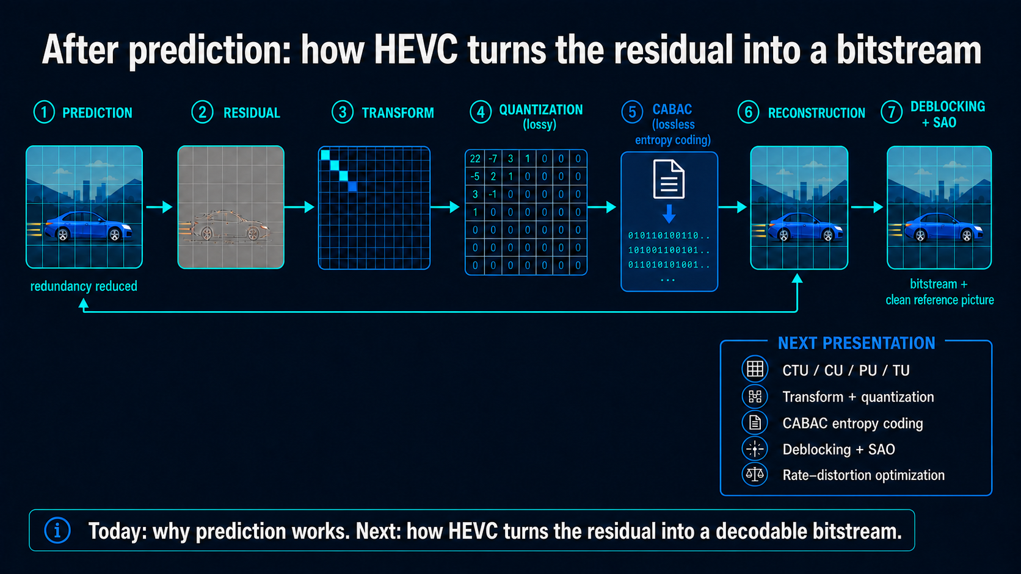
Prediction reduces repetition—but it does not finish compression
The unresolved questions
1
How large should each coding block be?
2
How is the residual represented compactly?
3
How does the encoder choose among many legal options?
4
Why must the encoder reconstruct its own output?
HEVC: High Efficiency Video Coding • CTU: Coding Tree Unit • CU: Coding Unit • PU: Prediction Unit • TU: Transform Unit
CABAC: Context-Adaptive Binary Arithmetic Coding • SAO: Sample Adaptive Offset
Today: follow one block from partitioning to a filtered reference picture.
02 / 19
Notes:
Use this slide as the handoff from Presentation 1. Prediction creates a much smaller error signal, but the codec still needs to describe block decisions, compress the residual, and reconstruct exactly what the decoder will reconstruct. Those four questions organize the rest of the talk.
[Sources]
- https://doi.org/10.1109/TCSVT.2012.2221191

Slide 3
The bitstream path and reconstruction path form one closed loop
Partition
Predict
Residual
Transform
Quantize
Entropy code
Lossy decision
Lossless packing
BITSTREAM
Deblocking + Sample Adaptive Offset
+ prediction
Inverse quantization + transform
reference picture used by future prediction
03 / 19
Notes:
Read the upper path from left to right: partition, predict, form the residual, transform it, quantize it, then entropy-code the result. Quantization is where information is deliberately discarded. CABAC only packs the remaining syntax without further loss. The lower path reconstructs the same block the decoder will see and filters it before it can become a future reference.
[Sources]
- https://doi.org/10.1109/TCSVT.2012.2221191
- https://link.springer.com/book/10.1007/978-3-319-06895-4

Slide 4
One block size cannot represent every part of an image efficiently
Smooth region
Object boundary
Fine texture
Large block
Split around the edge
Smaller blocks
High Efficiency Video Coding spends partitioning detail only where the picture needs it.
04 / 19
Notes:
The encoder should not describe smooth sky with the same granularity as leaves or an object boundary. A large block reduces signaling overhead in uniform regions; smaller blocks can follow local detail and improve prediction. HEVC's recursive partitioning is therefore an efficiency tool, not just a geometric description.
[Sources]
- https://doi.org/10.1109/TCSVT.2012.2221191
- https://link.springer.com/book/10.1007/978-3-319-06895-4

Slide 5
Coding Tree Units are the largest High Efficiency Video Coding workspaces
Coding Tree Unit (CTU)
1
A picture is tiled into CTUs.
2
A CTU contains one luma coding-tree block and corresponding chroma blocks.
3
The encoder can keep it large or recursively split it.
4
CTU size improves flexibility and parallel-processing opportunities.
64 × 64 luma samples
Think: the encoder's current workspace.
05 / 19
Notes:
A CTU is the top-level region for coding decisions. In the commonly discussed Main-profile case, the maximum luma CTB is 64 by 64. Do not say that every final coded block is 64 by 64—the CTU is the workspace, and its coding tree can be split into smaller units.
[Sources]
- https://doi.org/10.1109/TCSVT.2012.2221191
- https://link.springer.com/book/10.1007/978-3-319-06895-4

Slide 6
The Coding Unit (CU) quadtree splits only where more detail is useful
Coding Unit (CU)
At each node, the encoder asks:
large CU
smaller CUs
Keep this CU as one region?
Or split it into four smaller CUs?
Use intra or inter coding here?
complex region → deeper split
The split pattern itself must be signaled in the bitstream.
06 / 19
Notes:
A CU is a node in the coding quadtree. The encoder evaluates whether a region should remain large or be split into four children. Each leaf CU carries coding decisions such as intra or inter. Flexible splitting improves prediction but also costs signaling bits and computation, which is why the best visual split is not automatically the best compression decision.
[Sources]
- https://doi.org/10.1109/TCSVT.2012.2221191
- https://link.springer.com/book/10.1007/978-3-319-06895-4

Slide 7
Prediction Units (PUs) define how Coding Units (CUs) are predicted
2N × 2N
2N × N
N × 2N
N × N
N = half of the Coding Unit width or height.
Intra Prediction Unit (PU): which spatial mode?
Inter Prediction Unit (PU): which reference + motion vector?
Prediction Unit boundaries group samples that share prediction information.
07 / 19
Notes:
The Prediction Unit is the region associated with prediction information. For intra coding, the PU identifies the block using a spatial prediction mode. For inter coding, it identifies regions sharing reference-picture and motion information. Keep this level intuitive; HEVC also provides asymmetric inter partitions, but listing every legal shape would distract from the main distinction.
[Sources]
- https://doi.org/10.1109/TCSVT.2012.2221191
- https://link.springer.com/book/10.1007/978-3-319-06895-4

Slide 8
TU partitioning can differ from prediction partitioning
Prediction Unit (PU) partition
Transform Unit (TU) residual partition
large TU
PU 1
PU 2
smaller TUs where residual is complex
Prediction geometry and transform geometry solve different problems.
08 / 19
Notes:
The Transform Unit is the block over which the prediction residual is transformed and quantized. Its partitioning can differ from the PU structure because a good prediction shape does not necessarily create a uniformly simple residual. This independence is one of the most important reasons not to treat CTU, CU, PU, and TU as interchangeable block names.
[Sources]
- https://doi.org/10.1109/TCSVT.2012.2221191
- https://link.springer.com/book/10.1007/978-3-319-06895-4

Slide 9
The four coding units answer four different questions
CTU
Where is the encoder working?
plot of land
Coding Tree Unit (CTU): largest workspace
CU
Should this region split?
how the plot is divided
Coding Unit (CU): coding-decision node
PU
How is it predicted?
how each parcel is predicted
Prediction Unit (PU): prediction geometry
TU
How is the residual transformed?
how leftover error is processed
Transform Unit (TU): residual geometry
09 / 19
Notes:
Pause here and make the vocabulary explicit. CTU is the workspace, CU is the recursive coding decision, PU carries prediction information, and TU carries transform information for the residual. A useful analogy is land: the CTU is the plot, CUs describe subdivision, PUs describe how parcels are predicted, and TUs describe how leftover error is processed.
[Sources]
- https://doi.org/10.1109/TCSVT.2012.2221191
- https://link.springer.com/book/10.1007/978-3-319-06895-4

Slide 10
One Coding Tree Unit (CTU) can adapt to smooth and detailed regions
What the encoder evaluates
large smooth Coding Unit (CU)
1
Coding Unit (CU) split
Does smaller geometry reduce prediction error enough?
2
Prediction Unit (PU) choice
Which intra mode or motion model predicts each area?
3
Transform Unit (TU) split
Where does the residual need a smaller transform?
4
Bit cost
deeper split near detail
Are the extra split flags worth transmitting?
10 / 19
Notes:
This example is the anchor for the rest of the deck. The sky can remain in a large CU because it is smooth and predictable. The building boundary and windows create more complex prediction and residual patterns, so deeper splits may pay off. But every split also requires syntax bits, so the encoder must compare total rate and distortion rather than simply chasing visual complexity.
[Sources]
- https://doi.org/10.1109/TCSVT.2012.2221191
- https://link.springer.com/book/10.1007/978-3-319-06895-4

Slide 11
The transform concentrates residual energy into fewer coefficients
Correlated residual samples
Energy moves toward low-frequency positions
8
7
6
5
3
2
1
0
42
-12
4
1
0
0
0
0
7
7
6
4
3
2
1
0
-9
5
-2
0
0
0
0
0
6
6
5
4
3
2
1
0
3
-1
1
0
0
0
0
0
transform
4
4
4
3
2
1
0
0
1
0
0
0
0
0
0
0
2
2
2
2
1
1
0
0
0
0
0
0
0
0
0
0
1
1
1
1
1
0
0
0
0
0
0
0
0
0
0
0
0
0
0
0
0
0
0
0
0
0
0
0
0
0
0
0
0
0
0
0
0
0
0
0
0
0
0
0
0
0
0
0
Transform coding reorganizes information; it does not yet discard it.
11 / 19
Notes:
The transform converts spatial residual samples into coefficients that describe different spatial patterns or frequencies. Because nearby residual values are correlated, much of the energy often gathers in a relatively small group of coefficients. The transform itself is reversible apart from implementation details; the deliberate information loss occurs in quantization on the next slide.
[Sources]
- https://doi.org/10.1109/TCSVT.2012.2221191
- https://link.springer.com/book/10.1007/978-3-319-06895-4

Slide 12
Quantization creates zeros and sets the rate–quality trade-off
Transform coefficients
Quantized coefficients
42
-12
4
1
0
0
10
-3
1
0
0
0
-9
5
-2
0
0
0
-2
1
0
0
0
0
3
-1
1
0
0
0
÷ step + round
1
0
0
0
0
0
1
0
0
0
0
0
0
0
0
0
0
0
0
0
0
0
0
0
0
0
0
0
0
0
0
0
0
0
0
0
0
0
0
0
0
0
Quantization Parameter (QP)
Lower
more coefficients • more bits • less loss
Higher
more zeros • fewer bits • more loss
12 / 19
Notes:
Quantization divides coefficients by a step size and rounds them. Small values become zero, making the coefficient map sparse and easier to entropy-code. QP controls the effective step size: increasing QP usually lowers bitrate but increases reconstruction error. This is the main explicitly lossy operation in the residual-coding path.
[Sources]
- https://doi.org/10.1109/TCSVT.2012.2221191
- https://link.springer.com/book/10.1007/978-3-319-06895-4
- https://arxiv.org/abs/2406.16358

Slide 13
Context-Adaptive Binary Arithmetic Coding (CABAC)
packs coefficients and coding decisions losslessly
1
Binarize
2
Model context
3
Arithmetic-code
split flag = 1
motion index = 3
coefficient = −2
P(0) = 0.86
P(1) = 0.14
010110100101…
probabilities adapt as symbols arrive
compact bitstream
1 • 011 • 010
Context-Adaptive Binary Arithmetic Coding adds no distortion—but limits parallelism.
13 / 19
Notes:
CABAC means Context-Adaptive Binary Arithmetic Coding. First, syntax elements are represented as binary decisions called bins. Second, context models estimate probabilities using previously coded information. Third, arithmetic coding converts those probabilities into a compact bitstream. CABAC is lossless, but updating context state symbol by symbol creates serial dependency and makes high-throughput implementation challenging.
[Sources]
- https://doi.org/10.1109/TCSVT.2012.2221191
- https://link.springer.com/book/10.1007/978-3-319-06895-4

Slide 14
The encoder reconstructs locally to prevent prediction drift
1
Quantized
2
Inverse quantization
3
Inverse transform
4
+ prediction
5
Rebuilt
Encoder reference
Decoder reference
must equal
=
same inverse operations
what the decoder reconstructs
same prediction base
If references differ, the error propagates through future inter prediction.
14 / 19
Notes:
The decoder never sees the original picture; it only sees the quantized information. Therefore the encoder cannot use the original picture as the future reference. It runs inverse quantization and inverse transform, adds the prediction, and stores the same reconstructed block the decoder will obtain. If the references diverged, future motion-compensated predictions would diverge too, causing drift.
[Sources]
- https://doi.org/10.1109/TCSVT.2012.2221191
- https://link.springer.com/book/10.1007/978-3-319-06895-4

Slide 15
Deblocking and Sample Adaptive Offset (SAO) improve the next reference
1 Deblocking filter
2 Sample Adaptive Offset
then
+2
+2
0
−1
−1
reduces visible discontinuities across selected block edges
adds signaled offsets to sample classes to reduce systematic error
Order: deblocking → Sample Adaptive Offset (SAO) → reference memory
15 / 19
Notes:
Deblocking targets discontinuities created at coding boundaries. It selectively smooths edges rather than blurring the whole image. SAO follows deblocking and applies signaled offsets to categories of samples, such as intensity bands or edge classes, to reduce systematic reconstruction error. Because both filters operate inside the coding loop, they improve not only display quality but also future reference pictures.
[Sources]
- https://doi.org/10.1109/TCSVT.2012.2221191
- https://link.springer.com/book/10.1007/978-3-319-06895-4

Slide 16
Rate–Distortion Optimization (RDO) balances quality against bit cost
J = D + λR
A
large Coding Unit + simple mode
D = 18 R = 6 J = 30
J: total cost • D: distortion • R: rate (bits)
B
smaller Coding Units + better prediction
λ controls the trade-off
D = 8 R = 10 J = 28
C
deep split + many flags
Rate–Distortion Optimization can compare
D = 5 R = 16 J = 37
Coding Unit splits • prediction modes • motion vectors
Transform Unit splits • Quantization Parameter choices • filters
16 / 19
Notes:
Rate–distortion optimization formalizes the encoder's trade-off. D measures reconstruction error, R measures the number of bits needed to signal the choice, and lambda gives the relative price of bits. The lowest-distortion candidate can lose if it requires too many bits. This enormous search across partitions, modes, motion data, transforms, and quantization choices is a major source of HEVC encoder complexity.
[Sources]
- https://doi.org/10.1109/TCSVT.2012.2221191
- https://link.springer.com/book/10.1007/978-3-319-06895-4

Slide 17
One block's journey through the High Efficiency Video Coding encoder
1
2
3
4
5
6
7
PARTITION
PREDICT
SUBTRACT
TRANSFORM
QUANTIZE
ENTROPY CODE
RECONSTRUCT
+2 0 −1
0 −1 0
+1 0 0
18 −4 1
−3 1 0
1 0 0
5 −1 0
−1 0 0
0 0 0
01011010
10100101
001…
reference
picture
Coding Tree Unit → Coding Unit
Prediction Unit mode
residual
Transform Unit coefficients
many zeros
bitstream
filter + store
feedback: future prediction uses the reconstructed, filtered picture
Rate–Distortion Optimization (RDO) keeps the lowest-cost journey.
17 / 19
Notes:
Now combine the entire talk. The encoder partitions a CTU into coding units, selects prediction through PUs, subtracts the prediction, transforms residual blocks through TUs, quantizes coefficients, and packs syntax using CABAC. It then reconstructs and filters the result for reference memory. RDO does not occur only at one box—it evaluates alternatives throughout this journey and chooses the best complete coding decision.
[Sources]
- https://doi.org/10.1109/TCSVT.2012.2221191
- https://link.springer.com/book/10.1007/978-3-319-06895-4

Slide 18
High Efficiency Video Coding (HEVC) expands encoder choices
1
Partition adaptively
Coding Tree Units and Coding Units place detail where it is useful.
2
Code the residual
Prediction Units predict; Transform Units transform; quantization creates zeros.
3
Stay decoder-consistent
Inverse operations and in-loop filters prevent drift.
4
Optimize the full choice
Rate–Distortion Optimization balances distortion against bitrate.
Next research question:
How do we search this space in real time with less energy?
18 / 19
Notes:
Close by resolving the story: HEVC's efficiency comes from adaptive partitioning, prediction, residual coding, decoder-consistent reconstruction, filtering, and rate–distortion decisions. The price is a very large encoder search space. That naturally motivates the next presentation and the connection to Professor Sen's lab: fast mode decisions, parallel processing, hardware acceleration, and energy-efficient or approximate transform-and-quantization datapaths.
[Sources]
- https://doi.org/10.1109/TCSVT.2012.2221191
- https://link.springer.com/book/10.1007/978-3-319-06895-4
- https://arxiv.org/abs/2406.16358

Slide 19
What's next: searching HEVC's decision space efficiently
1
Fast mode and partition search
Early termination and learned heuristics shrink the Rate–Distortion search.
2
Parallel processing
Tiles and Wavefront Parallel Processing recover speed despite CABAC's serial coding.
3
Hardware acceleration
Dedicated silicon speeds up motion estimation, the transform, and entropy coding.
4
Approximate computing
Low-power transform and quantization datapaths trade accuracy for energy savings.
Coming in Presentation 3:
How Professor Sen's lab searches this space in real time, with less energy.
19 / 19

