Slide 1

Breast Cancer Detection using Machine Learning
Guide: Dr. Selva Kumar S
Designation: Assistant Professor
Department of Computer Science & Engineering
B.M.S. College of Engineering
Kizhakel Sharat Prasad 1BM19CS074 M Vamshi Krishna 1BM19CS080
Notes:
Arpana

Slide 2
OUTLINE
Problem Statement
Proposed Methodology
Tools used for implementation
Implementation
Testing
Results and Discussion
References
Notes:
ap

Slide 3
Problem Statement
Predicting if the cancer diagnosis is benign or malignant based on several observations/features. We extract out of the images some features, when we see features that mean some characteristics out of the image such as radius, for example the cells such as texture perimeter area smoothness and so on. And then we feed all these features into kind of our machine learning model.
Some features to be considered are:
radius (mean of distances from center to points on the perimeter)
texture (standard deviation of gray-scale values) - perimeter
area - smoothness (local variation in radius lengths)
compactness (perimeter^2 / area - 1.0)
concavity (severity of concave portions of the contour)
concave points (number of concave portions of the contour)
symmetry
fractal dimension ("coastline approximation" - 1)
Datasets are linearly separable using all 30 input features
Number of Instances: 569
Class Distribution: 212 Malignant, 357 Benign
Target class:
Malignant - Benign
Notes:
Anusree

Slide 4
Proposed Methodology
The goal is to classify whether the breast cancer is benign or malignant. To achieve
this we have used machine learning classification methods to fit a function that can
predict the discrete class of new input. The methodology followed includes the fol-
lowing phases:
Phase 1 — Data Exploration
Phase 2 — Categorical Data
Phase 3 — Feature Scaling
Phase 4 — Model Selection
We will use Classification Accuracy method to find the accuracy of our models. Clas-
sification Accuracy is what we usually mean, when we use the term accuracy. It is
the ratio of number of correct predictions to the total number of input samples.
Notes:
Pooja

Slide 5
Tools used for Implementation
Front end app framework: Stream lit
Web framework: Flask
Language: Python
Libraries: scikit-learn, pandas, numpy, seaborn, matplotlib
Notes:
Pooja

Slide 6
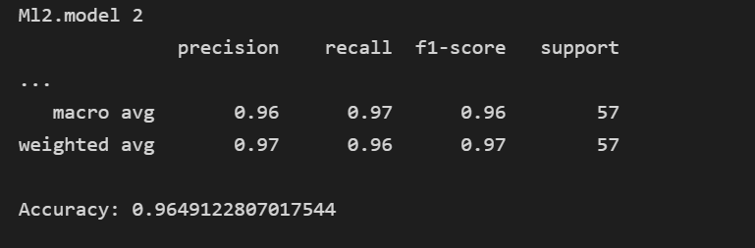
Implementation
Logistic regression
Logistic regression is one of the most popular Machine Learning algorithms,
which comes under the Supervised Learning technique. It is used for predicting the
categorical dependent variable using a given set of independent variables. Logistic
regression predicts the output of a categorical dependent variable. Therefore the out-
come must be a categorical or discrete value. It can be either Yes or No, 0 or 1, true
or False, etc. but instead of giving the exact value as 0 and 1, it gives the probabilistic
values which lie between 0 and 1. In Logistic regression, instead of fitting a regression
line, we fit an ”S” shaped logistic function, which predicts two maximum values (0
or 1).
Notes:
Pooja

Slide 7
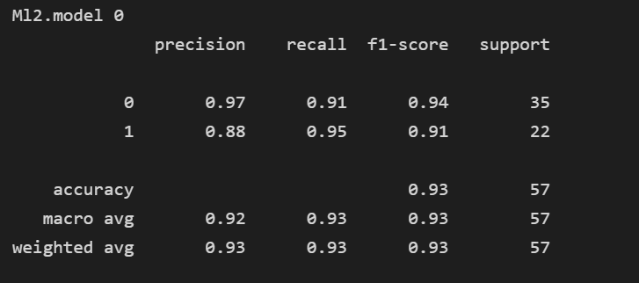
Implementation
Decision Tree
Decision Tree is a Supervised learning technique that can be used for both classification and Regression problems, but mostly it is preferred for solving Classification problems. It is a tree-structured classifier, where internal nodes represent the features of a dataset, branches represent the decision rules and each leaf node represents the outcome.
In a Decision tree, there are two nodes, which are the Decision Node and Leaf Node. Decision nodes are used to make any decision and have multiple branches, whereas Leaf nodes are the output of those decisions and do not contain any further branches.
The decisions or the test are performed on the basis of features of the given dataset.
Notes:
Pooja

Slide 8
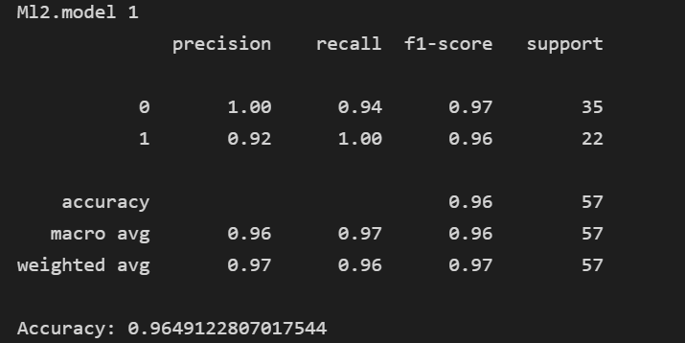
Implementation
Random Forest
Random Forest is a popular machine learning algorithm that belongs to the supervised learning technique. It can be used for both Classification and Regression problems in ML. It is based on the concept of ensemble learning, which is a process of combining multiple classifiers to solve a complex problem and to improve the performance of the model.
As the name suggests, "Random Forest is a classifier that contains a number of decision trees on various subsets of the given dataset and takes the average to improve the predictive accuracy of that dataset." Instead of relying on one decision tree, the random forest takes the prediction from each tree and based on the majority votes of predictions, and it predicts the final output.
Notes:
Pooja

Slide 9
Testing
In this project ,we test our datasets with different algorithms and we predict which algorithm works better and faster for our dataset .we calculate the accuracy of the algorithms and compare them with other algorithms . The best algorithm which works on this dataset is taken and we are predicting the factors that are causing the employee attrition.
Notes:
Pooja

Slide 10
Results and Discussion
Out of all algorithms it was found that decision tree gave highest accuracy of 1.0. However this is a case of overfitting. Over-fitting occurs when the tree is designed so as to perfectly fit all samples in the training data set. Thus it ends up with branches with strict rules of sparse data. Thus this effects the accuracy when predicting samples that are not part of the training set.
One of the methods used to address over-fitting in decision tree is called pruning which is done after the initial training is complete. In pruning, you trim off the branches of the tree, i.e., remove the decision nodes starting from the leaf node such that the overall accuracy is not disturbed. This is done by segregating the actual training set into two sets: training data set, D and validation data set, V. Prepare the decision tree using the segregated training data set D. Then continue trimming the tree accordingly to optimize the accuracy of the validation data set V. Random Forest was found to have an accuracy of 0.998046875. Random forests overcome several problems with decision trees, including:

Slide 11
Results and Discussion
Reduction in overfitting: by averaging several trees, there is a significantly lower
risk of overfitting.
• Less variance: By using multiple trees, you reduce the chance of stumbling
across a classifier that doesn’t perform well because of the relationship between
the train and test data.
• It can also maintain accuracy when a large proportion of data is missing.
As a result in almost all cases, random forests are more accurate than
decision trees. Hence we shall be concluding by stating random forest to
be the best performing algorithm.

Slide 12
Results and Discussion
A Receiver Operator Characteristic (ROC) curve is a graphical plot used to show the diagnostic ability of binary classifiers. It was first used in signal detection theory but is now used in many other areas such as medicine, radiology, natural hazards and machine learning. A ROC curve is constructed by plotting the true positive rate (TPR) against the false positive rate (FPR). The true positive rate is the proportion of observations that were correctly predicted to be positive out of all positive observations (TP/(TP + FN)). Similarly, the false positive rate is the proportion of observations that are incorrectly predicted to be positive out of all negative observations (FP/(TN + FP)). For example, in medical testing, the true positive rate is the rate in which people are correctly identified to test positive for the disease in question.

Slide 13
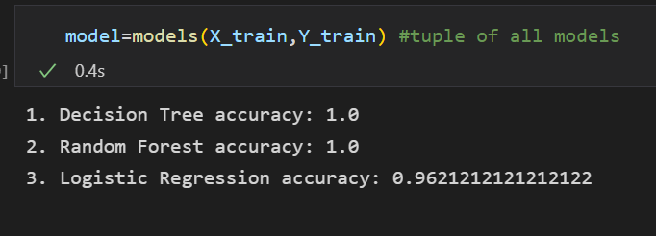
Results and Discussion
Figure: Result After Dropping 120 Rows

Slide 14
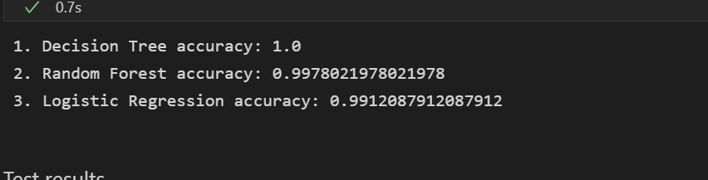
Results and Discussion
Figure: Result After Dropping 2 Columns

Slide 15
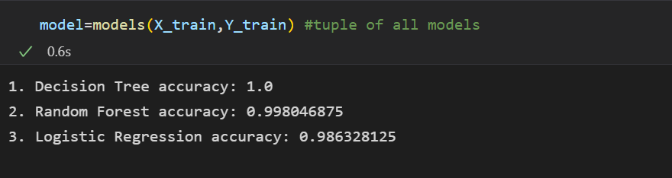
Results and Discussion
Figure: Result After Dropping 2 Columns

Slide 16
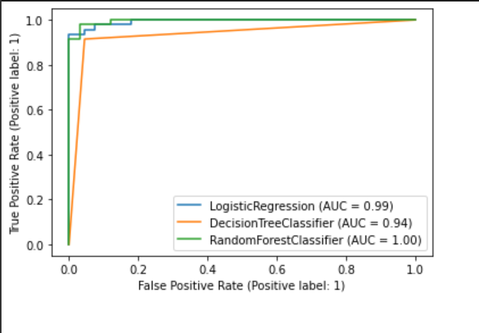
Results and Discussion
Figure: ROC Curve

Slide 17
Applications or Relevance of the Project
There are two types of breast cancer, Malignant and Benign. The first is classified as harmful has the ability to infect other organs and is cancerous, Benign is classified as non-cancerous. This disease infects the women's chest and specifically glands and milk ducts, the spread of breast cancer to other organs is frequent and could be through the bloodstream. A variety of techniques are used to capture breast cancer such as Ultrasound Sonography, Computerized Thermography, Biopsy.Machine learning and Data mining techniques are straightforward and effective ways to understand and predict data. Radiologist examines and analyses himself and then he / she decides the result after participating with other experts. This process takes time and the results depend on the knowledge and experience of the staff. In addition there is a dearth of experts in every field of the world. Thus the research community made a proposal for automatic A system called CAD (Computer-Aided Diagnosis) for better classification of tumours, accurate results and faster Implementation without the need for radiologists or specialists. Machine learning algorithms (MLs) are indicated as one Option of human vision and experience to make final decisions with high accuracy. The early diagnosis of BC can improve the prognosis and chance of survival significantly, as it can promote timely clinical treatment to patients. Further accurate classification of benign tumors can prevent patients undergoing unnecessary treatments. Thus, the correct diagnosis of BC and classification of patients into malignant or benign groups is the subject of much research.

Slide 18
Applications or Relevance of the Project
In this paper we examined different machine learning techniques for breast cancer detection. We performed a comparative analysis of Decision Tree, Random Forest and Logistic regression. It was observed that Random Forest outperforms the existing methods on issues related to accuracy, precision and also size of the data set. As future work on this project we plan to apply boosting. Boosting is an ensemble modelling, technique that attempts to build a strong classifier from the number of weak classifiers. It is done by building a model by using weak models in series. Firstly, a model is built from the training data. Then the second model is built which tries to correct the errors present in the first model. This procedure is continued and models are added until either the complete training data set is predicted correctly or the maximum number of models are added. XGBoost is an implementation of Gradient Boosted decision trees. In this algorithm, decision trees are created in sequential form. Weights play an important role in XGBoost. Weights are assigned to all the independent variables which are then fed into the decision tree which predicts results. The weight of variables predicted wrong by the tree is increased and these variables are then fed to the second decision tree. These individual classifiers/predictors then ensemble to give a strong and more precise model.

Slide 19
References
[1] Sharma, S., Aggarwal, A. and Choudhury, T., 2018, December. Breast cancer detection using machine learning algorithms. In 2018 International Conference on Computational Techniques, Electronics and Mechanical Systems (CTEMS) (pp. 114-118). IEEE.
[2] Hussain, L., Aziz, W., Saeed, S., Rathore, S. and Rafique, M., 2018, August. Automated breast cancer detection using machine learning techniques by extracting different feature extracting strategies. In 2018 17th IEEE International Conference On Trust, Security And Privacy In Computing And Communications/12th IEEE International Conference On Big Data Science And Engineering (TrustCom/BigDataSE) (pp. 327-331). IEEE.
[3] Mangukiya, M., Vaghani, A. and Savani, M., 2022. Breast Cancer Detection with Machine Learning. International Journal for Research in Applied Science and Engineering Technology, 10(2), pp.141-145.
[4] Amrane, M., Oukid, S., Gagaoua, I. and Ensari, T., 2018, April. Breast cancer classification using machine learning. In 2018 electric electronics, computer science, biomedical engineerings' meeting (EBBT) (pp. 1-4). IEEE.
[5] Tahmooresi, M., Afshar, A., Rad, B.B., Nowshath, K.B. and Bamiah, M.A., 2018. Early detection of breast cancer using machine learning techniques. Journal of Telecommunication, Electronic and Computer Engineering (JTEC), 10(3-2), pp.21-27.
[6] Basker N., Theetchenya S., Vidyabharathi D., Dhaynithi J., Mohanraj G., Marimuthu M., Vidhya G. (2021) “Breast Cancer Detection Using Machine Learning Algorithms”, Annals of the Romanian Society for Cell Biology, pp. 2551–2562.
[7] Bayrak, E.A., Kırcı, P. and Ensari, T., 2019, April. Comparison of machine learning methods for breast cancer diagnosis. In 2019 Scientific meeting on electrical-electronics & biomedical engineering and computer science (EBBT) (pp. 1-3). IEEE.
[8] Vaka, A.R., Soni, B. and Reddy, S., 2020. Breast cancer detection by leveraging Machine Learning. ICT Express, 6(4), pp.320-324.
[9] Omondiagbe, D.A., Veeramani, S. and Sidhu, A.S., 2019, April. Machine learning classification techniques for breast cancer diagnosis. In IOP Conference Series: Materials Science and Engineering (Vol. 495, No. 1, p. 012033). IOP Publishing.
[10] Islam, M., Haque, M., Iqbal, H., Hasan, M., Hasan, M. and Kabir, M.N., 2020. Breast cancer prediction: a comparative study using machine learning techniques. SN Computer Science, 1(5), pp.1-14.

Slide 20
References
[11] Chugh, G., Kumar, S. and Singh, N., 2021. Survey on machine learning and deep learning applications in breast cancer diagnosis. Cognitive Computation, 13(6), pp.1451-1470.
[12] Wu, J. and Hicks, C., 2021. Breast cancer type classification using machine learning. Journal of personalized medicine, 11(2), p.61.
[13] Saoud, H., Ghadi, A. and Ghailani, M., 2019, October. Proposed approach for breast cancer diagnosis using machine learning. In Proceedings of the 4th International Conference on Smart City Applications (pp. 1-5).
[14] Bharat, A., Pooja, N. and Reddy, R.A., 2018, October. Using machine learning algorithms for breast cancer risk prediction and diagnosis. In 2018 3rd International Conference on Circuits, Control, Communication and Computing (I4C) (pp. 1-4). IEEE.
[15] Kajala, A. and Jain, V.K., 2020, February. Diagnosis of breast cancer using machine learning algorithms-a review. In 2020 International Conference on Emerging Trends in Communication, Control and Computing (ICONC3) (pp. 1-5). IEEE.
[16] Liu, L., 2018, May. Research on logistic regression algorithm of breast cancer diagnose data by machine learning. In 2018 International Conference on Robots & Intelligent System (ICRIS) (pp. 157-160). IEEE.
[17] Rawal, R., 2020. Breast cancer prediction using machine learning. Journal of Emerging Technologies and Innovative Research (JETIR), 13(24), p.7.
[18] Kumar, M., Khatri, S.K. and Mohammadian, M., 2020. Breast cancer identification and prognosis with machine learning techniques-an elucidative review. Journal of Interdisciplinary Mathematics, 23(2), pp.503-521.
[19] Abdel-Ilah, L. and Šahinbegović, H., 2017. Using machine learning tool in classification of breast cancer. In CMBEBIH 2017 (pp. 3-8). Springer, Singapore.
[20] Adel, M., Kotb, A., Farag, O., Darweesh, M.S. and Mostafa, H., 2019, May. Breast cancer diagnosis using image processing and machine learning for elastography images. In 2019 8th International Conference on Modern Circuits and Systems Technologies (MOCAST) (pp. 1-4). IEEE.

Slide 21
THANK YOU
Notes:
ap

