Slide 1
CS352: Sample Web App using Flask
Meghana T (meghana.thiyyakat@gmail.com)
Centre for Cloud Computing and Big Data
PES University

Slide 2
About this presentation
This is a short tutorial on how to create a sample web app using Flask
Done on request of some students.
More details can be found online. This is meant to just start you off.
Look at the notes on each slide for a detailed explanation

Slide 3
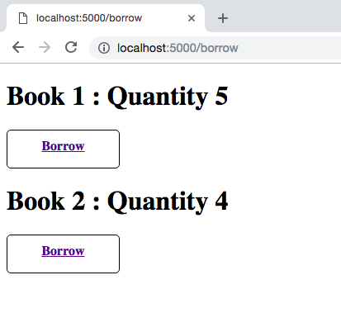
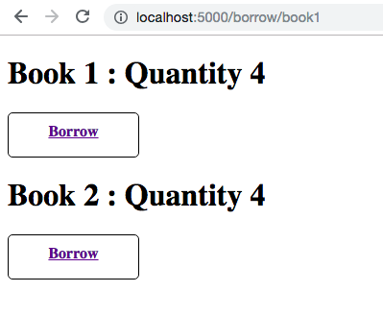
Simple Library App: Borrow Book (GET)
On clicking on the Borrow button for Book 1
Notes:
What the App Does: On clicking on the Borrow button, the quantity of the corresponding book is decremented by 1 and a page with the new quantities is displayed.

Slide 4
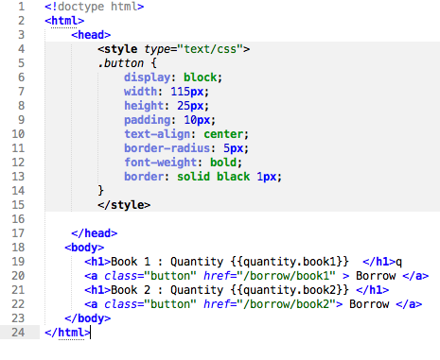
Borrow Book (GET)
from flask import Flask, render_template
app=Flask(__name__)
quantity={}
quantity["book1"]=5
quantity["book2"]=4
@app.route('/borrow/')
def hello_world():
return render_template('books.html', quantity=quantity)
@app.route('/borrow/<book>')
def borrow_book(book):
quantity[book]=quantity[book]-1
return render_template('books.html', quantity=quantity)
if __name__ == '__main__':
app.run()
Notes:
Flask is a web framework written in Python.
The route() function of the Flask class is a decorator, which tells the application which URL should call the associated function.
The run() method of Flask class runs the application on the server.
In the above example, when the Borrow button is clicked, a GET request is made. The name of the book is passed as a part of the request URL as “/borrow/<book>”. Here, <book> is “Book1” or “Book2”.
At the backend, the request matches the route “/borrow/<book>”, and the value of <book> is extracted from the URL and passed to the borrow_book() function using the variable book. For instance, if the button for Book1 is clicked, then the request URL is “/borrow/book1”, and the variable book contains the value “book1”.
Templates: Instead of returning hardcoded HTML from the function, a HTML file can be rendered by the render_template() function. The template engine uses the following delimiters for escaping from HTML.
{% ... %} for Statements
{{ ... }} for Expressions to print to the template output
{# ... #} for Comments not included in the template output
# ... ## for Line Statements
In the above example {{quantity.book1}} is an expression that is evaluated based on the quantity object passed to the render_template() function and then printed to the template output.

Slide 5
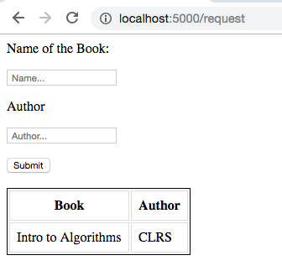
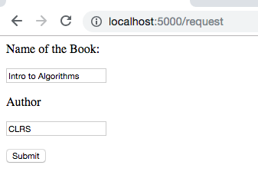
Simple Library App: Request Book
On clicking on Submit
Notes:
What the App Does: On entering the book name and author name and clicking on submit, a table containing the column headers and a row with the two values is displayed. On further submissions, new rows are added to this table with the values entered.

Slide 6
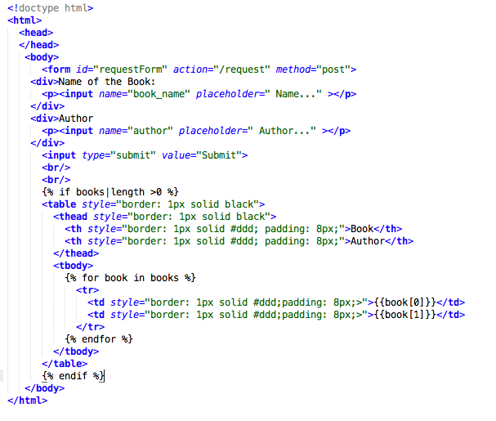
Request Book (GET & POST)
iterate over variable passed to render_template()
Notes:
On clicking on the submit button of a form, a request is made to the URL indicated by the action parameter in the form element. The request method is specified by the method parameter. In the above example, on clicking on Submit, a POST request is made to the URL “/request”. See next slide for backend implementation.
For the above template, a list of (bookname, author) tuples are passed as an argument to the render_template function. If the length of the list is greater than 0, the if condition evaluates to true and a table is drawn. The for loop iterates over the list and a row is drawn for each tuple.

Slide 7
Request Book (GET & POST)
request_books=[]
@app.route('/request', methods=["GET","POST"])
def request():
if(flask.request.method == "GET"):
return render_template('request.html',books=request_books)
if(flask.request.method == "POST"):
book_name=flask.request.values.get("book_name") author=flask.request.values.get("author”)
request_books.append((book_name,author))
return render_template("request.html", books=request_books)
Multiple methods
Form data
Notes:
When a GET request is made to /request, the first if condition evaluates to true and the server returns the request.html page that is rendered using the existing values in request_books.
When a POST request is made to /request, the second if condition evaluates to true and the server extracts the data from the request by using the flask.request.values.get(). A tuple is created with the bookname and author, and appended to the request_books list. The server then returns the request.html page which is rendered with the updated request_books list.

Slide 8
Flask Tutorials
https://www.tutorialspoint.com/flask/index.htm
https://www.datasciencebytes.com/bytes/2015/02/24/running-a-flask-app-on-aws-ec2/

