Slide 1
Capstone Project-3
Credit Card Default Prediction
Team Members
Abdul Rahman Talha
Mohd Danish
Sharath Diwakar

Slide 2
Table of contents:-
Overview and Objective
● (EDA)-Exploratory Data Analysis
● Feature Engineering
● Model Building
● Model Evaluation
● Conclusion

Slide 3
Overview and Objective
Overview
In today’s world credit cards have become a lifeline to a lot of people so banks provide us with credit cards. Now we know the most common issue there is in providing these kind of deals are people not being able to pay the bills. These people are what we call “defaulters”.
Objective
The main objective of this project is aimed at predicting the case of customers default payments in Taiwan. From the perspective of risk management, the result of predictive accuracy of the estimated probability of default will be more valuable than the binary result of classification - credible or not credible clients.

Slide 4
Data Description
Attributes of dataset:-
ID: ID of each client
LIMIT_BAL: Amount of given credit in NT dollars (includes ind ividual and family/supplementary credit
SEX: Gender (1=Male, 2=Female)
EDUCATION: (1=Graduate school, 2=University, 3=High school, 0,4,5,6=others
MARRIAGE: Marital status (1=married, 2=single, 0,3=others)
6. AGE: Age in years

Slide 5
Continued….
7. PAY_0-6 : Repayment status in September 2005 - April, 2005
BILL_AMT1-6:
2005 (NT dollar)
PAY_AMT1-6:
2005 (NT dollar)
Amount of bill statement in September- April
Amount of previous payment in September- April,
10. default.payment.next.month: Default payment (1=yes, 0=no)

Slide 6
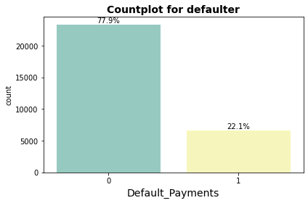
Exploratory Data Analysis (EDA)
Approximately 78% are Non Defaulters and 22% are Defaulters respectively.

Slide 7
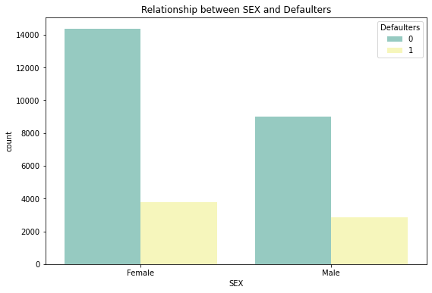
EDA Continued…
●
SEX
Number of Male credit holder is less than Female.
The ratio of defaulters is High in Male.

Slide 8
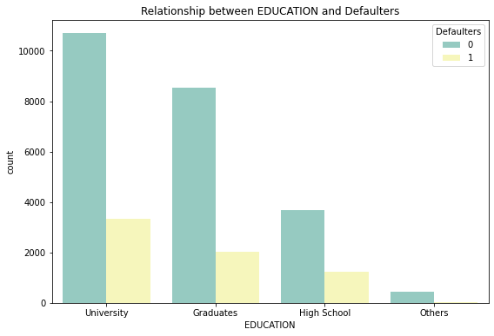
EDA Continued…
EDUCATION
More number of credit holders are university students followed by Graduates and then High school students.
University students have higher default payment than graduates and high school people.
From university 11% are default, from graduate 7% are default, and from high school 4% are default.

Slide 9
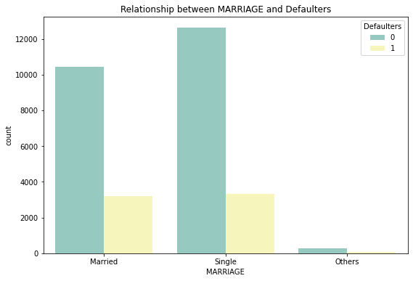
EDA Continued…
●
MARRIAGE
From graph, we can say that more number of credit cards holders are Single as compared to Married and others
Here it seems that married are more likely to default than single.
From single 11% are default and from married approx 11% are defaulter.

Slide 10
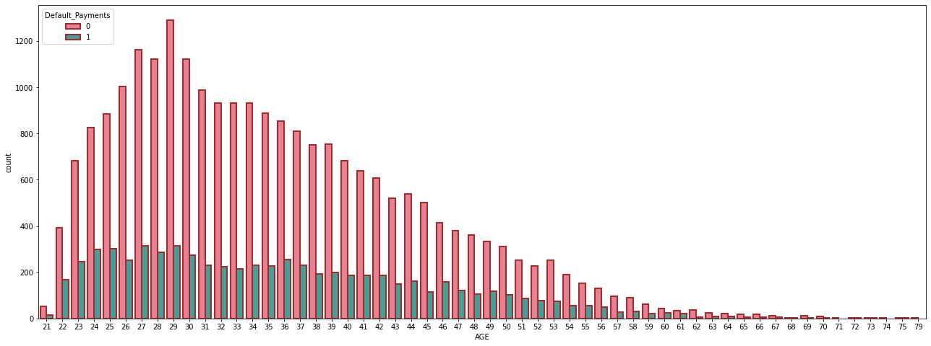
EDA Continued…
AGE
More number of credit card holders age between 26-3.
Also more number of Defaulters are between 27-29 years.

Slide 11
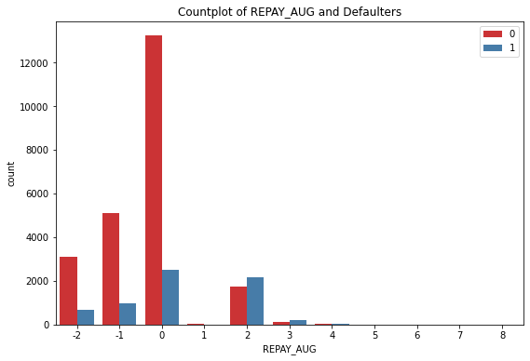
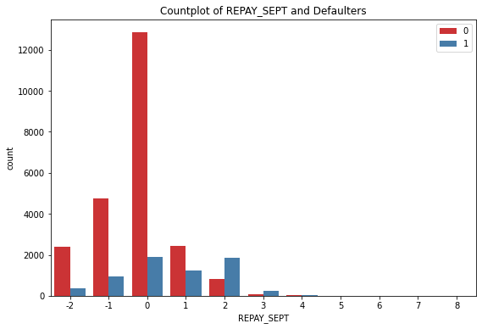
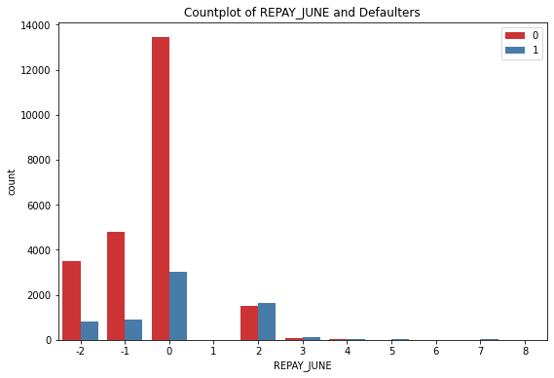
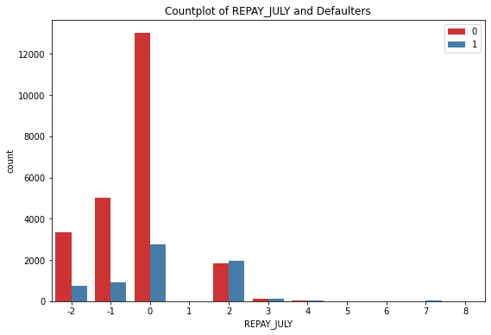
Repayment Status
Repayment of different months.
Red – Non Defaulters
Blue – Defaulter
-2 = No consumption
-1 = paid in full
0 = use of revolving credit (paid minimum only)
1 = payment delay for one month
2 – 8 (for consecutive months)

Slide 12
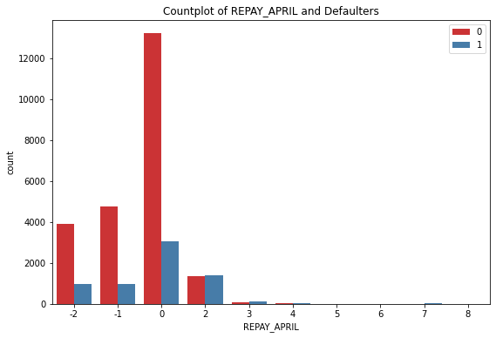
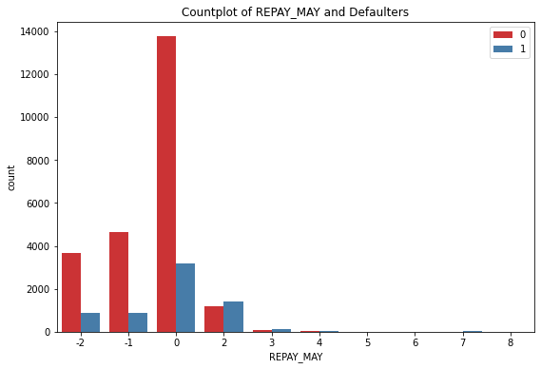
Repayment Cont.
Contd.

Slide 13
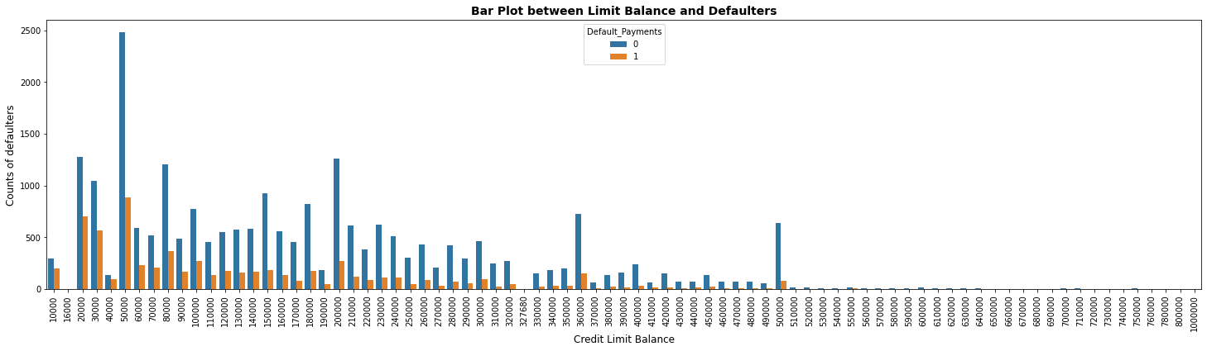
EDA Continued…
LIMIT BALANCE
Majority of defaulters are those who have credit limit between 20k to 300k
After Cred limit 500k, numbers of defaulters are almost negligible

Slide 14
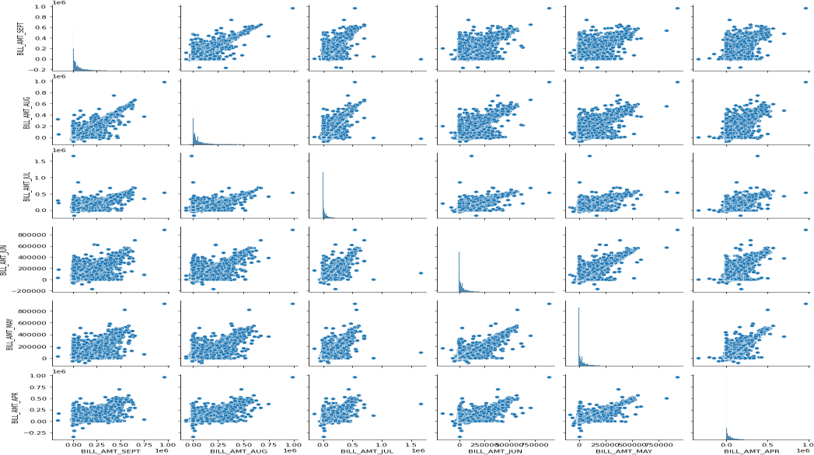
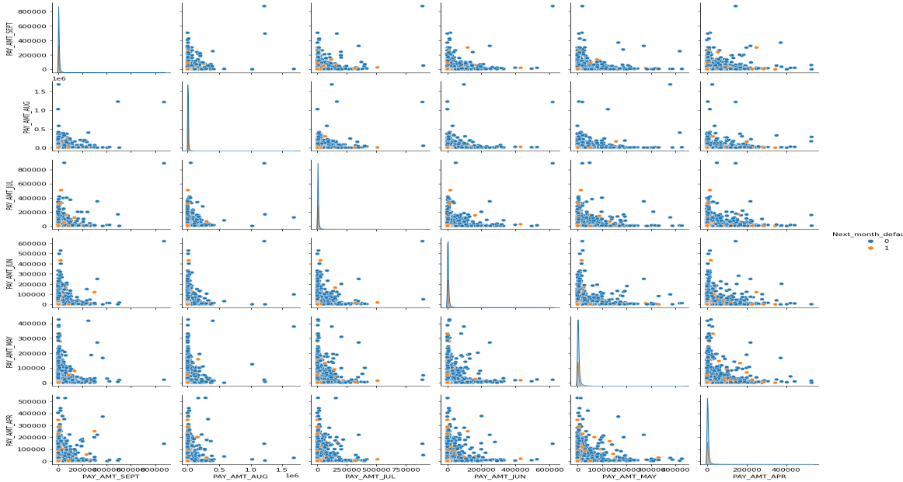
EDA Continued…
Pairplot of bill
Pairplot of pay
The 1st pairplot shows the distribution of bill amount statements for each month explicitly for defaulters and non-defaulters.
The 2nd pairplot shows the distribution of payment statements for each month
explicitly for defaulters and non-defaulters.

Slide 15
FEATURE ENGINEERING
ONE HOT ENCODING:
One-hot encoding is a technique which is used to convert or transform a categorical feature having string labels into K numerical features in such a manner that the value of one out of K (one-of-K) features is 1 and the value of rest (K-1) features is 0. It is also called as dummy encoding as the features created as part of these techniques are dummy features which don’t represent any real world features. Rather they are created for encoding the different values of categorical feature using dummy numerical features.
The primary need for using one-hot encoding technique is to transform or convert the categorical features into numerical features such that machine learning libraries can use the values to train the model .
Here we perform one hot encoding on 'EDUCATION', 'MARRIAGE', and 'SEX’.

Slide 16
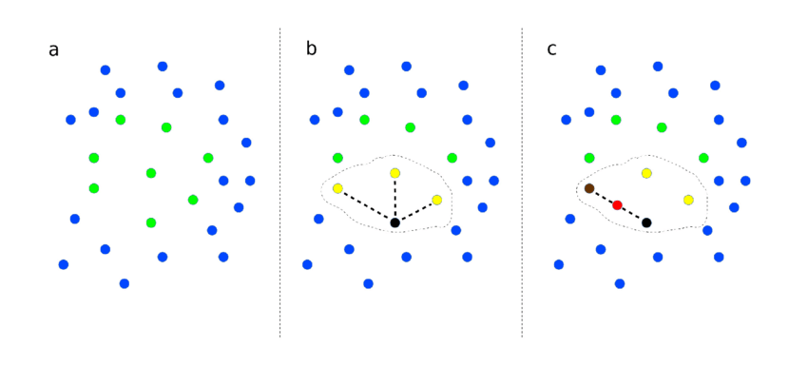
Synthetic Minority Oversampling Technique(SMOTE):
Our dataset is imbalanced which can lead to Biasness While Building Model.
For Balancing We Use SMOTE. SMOTE is an algorithm that performs data augmentation by creating synthetic data points based on the original data points.
The advantage of SMOTE is that you are not generating duplicates, but rather creating synthetic data points that are slightly different from the original data points.

Slide 17
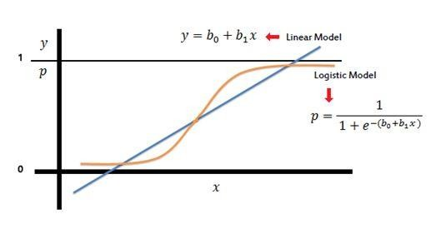
MODEL BUILDING:
LOGISTIC REGRESSION
Logistic Regression is a Machine Learning algorithm and is basically used for binary classifications like yes-no, true-false, male-Female, etc.
It take the linear combination and apply a sigmoid function (logit).The Sigmoid curve gives value between 0 & 1.

Slide 18
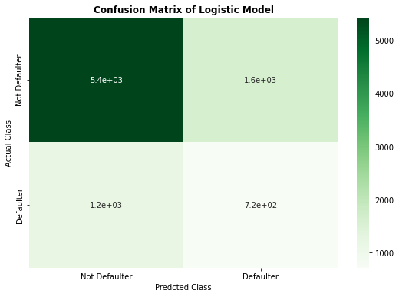
Confusion Matrix of Logistic Model
Precision score of logistic model: 0.3064
Recall score of logistic model: 0.3701
F1 score of logistic model: 0.3352
ROC AUC score of logistic model: 0.5699

Slide 19
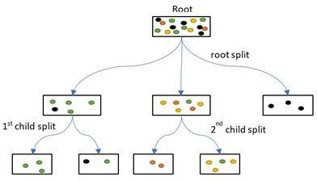
MODEL BUILDING (continued):
DECISION TREE CLASSIFIER
It is a graphical representation for getting all the possible solutions to a problem/decision based on given conditions.
The objective of Decision tree algorithm is to find the relationship between the target column and the independent variables and Express it as a tree structure.

Slide 20
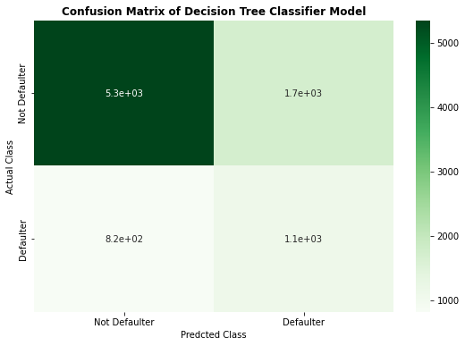
Confusion Matrix of Decision tree Classifier
Recall score of Decision Tree Classifier: 0.5773
Precision score of Decision Tree Classifier: 0.5773
F1 score of Decision Tree Classifier: 0.4691
6 ROC-AUC score of Decision Tree Classifier: 0.667200

Slide 21
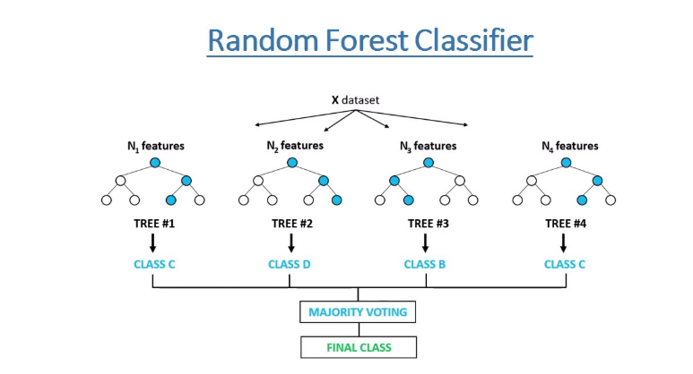
MODEL BUILDING (continued):
Random Forest Classifier
The random forest is a classification algorithm consisting of many decisions trees. It uses bagging and feature randomness when building each individual tree to try to create an uncorrelated forest of trees whose prediction by committee is more accurate than that of any individual tree.

Slide 22
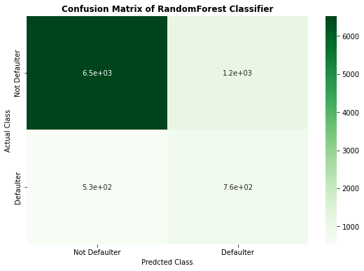
Confusion Matrix of Random Forest Classifier:-
Precision Score of Random Forest with Hyperparameter Tuning: 0.39381
Recall Score of Random Forest with Hyperparameter Tuning: 0.59087
F1 Score of Random Forest with Hyperparameter Tuning: 0.47262
ROC AUC Score of Random Forest with Hyperparameter Tuning: 0.71914

Slide 23
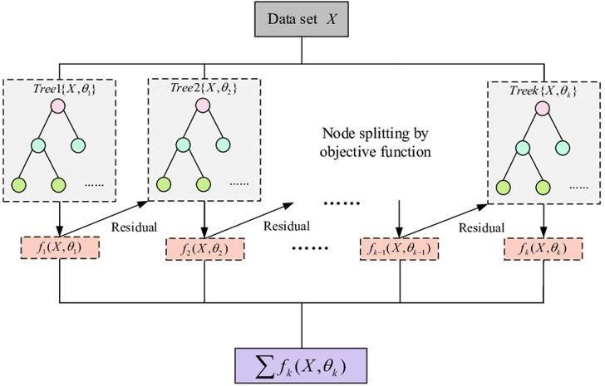
MODEL BUILDING (continued):
XG BOOST CLASSIFIER
Stands for:– eXtreme Gradient Boosting.
XGBoost is a powerful iterative learning algorithm based on gradient boosting.
Regularisation to avoid overfitting
Tree pruning using depth-first approach
It is generally used for very large dataset

Slide 24
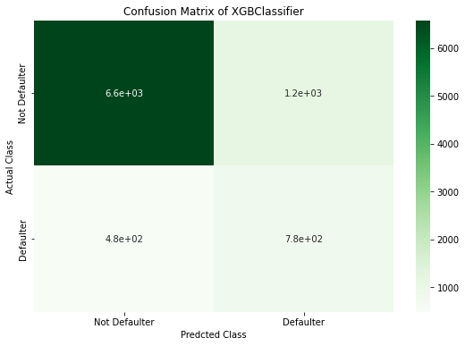
Confusion Matrix of XG Boost Classifier
Precision Score of Random Forest with Hyperparameter Tuning: 0.400515
Recall Score of Random Forest with Hyperparameter Tuning: 0.617647
F1 Score of Random Forest with Hyperparameter Tuning: 0.485928
ROC AUC Score of Random Forest with Hyperparameter Tuning: 0.7337137

Slide 25
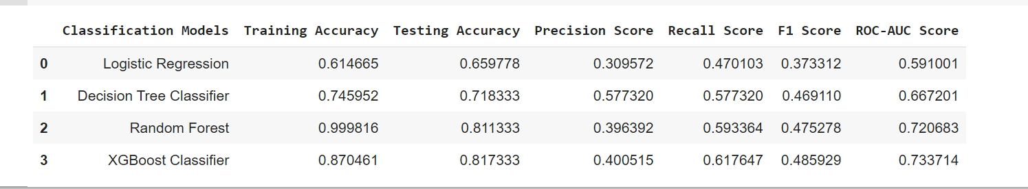
MODEL EVALUATION:

Slide 26
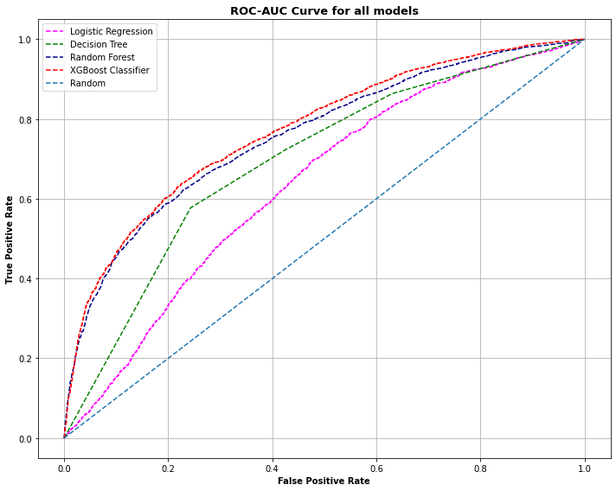
ROC Curve!!
Receiver Operating Characteristic (ROC) summarizes the model’s performance by evaluating the trade offs between true positive rate (sensitivity) and false positive rate(1- specificity). For plotting ROC, it is advisable to assume p > 0.5 since we are more concerned about success rate.

Slide 27
Conclusion:
1.Distribution of defaulter vs non defaulter - around 78% are non defaulter and 22% are defaulter. Also we check for Marriage, Education, Sex with respect to defaulter and we found in marriage more number of defaulter are Male, in Education more no. of defaulter are University Students & in Marriage more no. of defaulter are Married.
2. After that we build the Four models Logistic Regression, Decision Tree, Default XGBoost Classifier & Random Forest . The best accuracy is obtained from the Default XGBoost Classifier.

Slide 28
Continued…
Using a Logistic Regression classifier, we can predict with 65.97% accuracy, whether a customer is likely to default next month.
With Decision Tree classifier having precision 57.77%, we can predict with accuracy of 71.83%, whether customer is likely to default next month.
Using Random Forest, we can predict with accuracy of 81.13%, whether customer will be defaulter in next month.
XG Boost Classifier with recall 61.77%, accuracy of 81.73%, we can predict whether customer is likely to default next month.
From the models that are applied on the dataset, XG Boost and Random Forest are giving the best evaluation metrices(precision, F1-score and ROC-AUC score).
On behalf of these metrices we can predict whether customers would be defaulter or not in the next month.
From the ROC-AUC curve, Random Forest and XG Boost classifier are more able to distinguish between positive and negative class.

Slide 29
THANK YOU!!

