Slide 1
Capstone Project
Online Retail Customer Prediction
Sharath Diwakar

Slide 2
Contents
Introduction and Problem Statement
Data Description
Data Pipeline
Data Cleaning
Feature Engineering
Exploratory Data Analysis
Data Transformation
RFM Table
Modeling
Pretty Table
Conclusion

Slide 3
Introduction
Customer segmentation is one of the key aspects of business decision support system. In order to grow the business intelligently in competitive market, identification of potential customer should be done timely. All over the world business is growing in every field With the help of online platform and new technologies it strengthen its root more deeper, having access to wider market and large customers Online Retail business is also one of them, Customer segmentation refers to categorizing customers into different groups with similar characteristics. It can help to each customer group in a different way, in order to maximize their business and deliver true services who actually deserve.

Slide 4
Problem Statement
To identify major customer segments on a transnational data set which contains all the transactions occurring between 01/12/2010 and 09/12/2011 for a UK-based and registered non-store online retail. The company mainly sells unique all-occasion gifts. Many customers of the company are wholesalers.

Slide 5
Data Description
We have been provided with UK-based and registered online retail company which contains transaction between 01/12/2010 and 09/12/2011 with 541909 instances and 8 features.
InvoiceNo: A 6-digit integral number uniquely assigned to each transaction. If
this code starts with letter ‘c’, it indicates a cancellation.
StockCode: It is a 5-digit number assigned to each distinct product.
Description: Name of each product.
Quantity: Number of a particular product sold on per transaction.
InvoiceDate: It holds the information of Date and time when transaction was generated.
UnitPrice: Price per unit of a particular product sold
CustomerID: A 5-digit number uniquely assigned to each customer.
Country: The name of the country where customer resides

Slide 6
Data Pipeline
Exploratory Data Analysis (EDA): In this part we have done some EDA on the features to see the trend.
Data Processing: In this part we went through each attributes and encoded the categorical features.
Data Transformation: In this the Recency, Frequency and Monetary (RFM) of the given data set is created.
Modeling: Finally in this part, created various clustering models. The optimal clusters obtained from each models were analysed.

Slide 7
Data Cleaning
The given dataset has 541909 rows and 8 features(columns).
The dataset possess high number of null values in Description and CustomerID columns:
Feature Description CustomerID
Percentage of null values
0.2683%
24.92%
Dropped all the null values because each customer IDs are uniquely assigned to a customer. If it is missing from the dataset, then we can impute it with other values, but it does not make any sense and if we do then we end up with biased results.

Slide 8
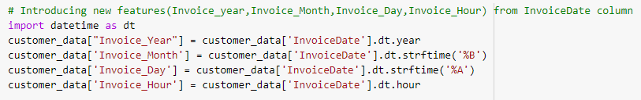
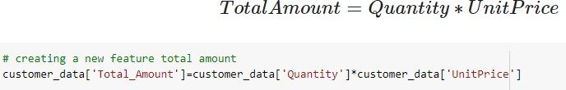
Feature Engineering
Introduced new features: Invoice_Year, Invoice_Month, Invoice_Day,
Invoice_Hour from InvoiceDate feature & Total_Amount

Slide 9
Exploratory Data Analysis (EDA)

Slide 10
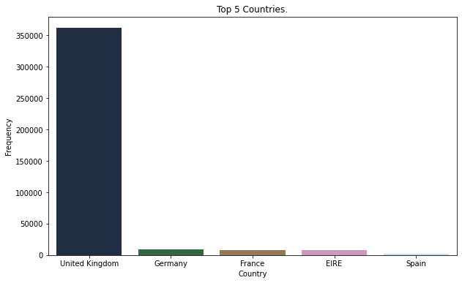
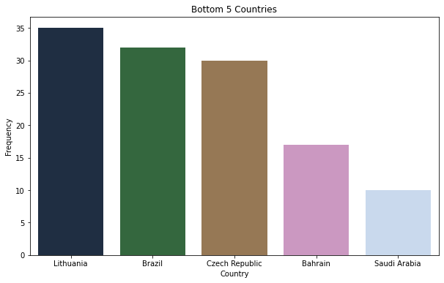
Countries

Slide 11
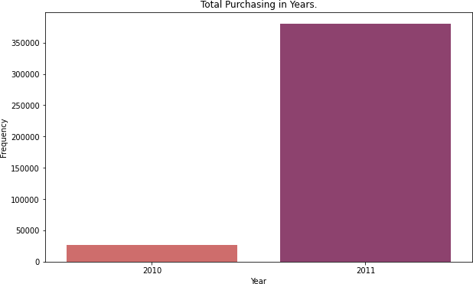
Total Purchasing in Years

Slide 12
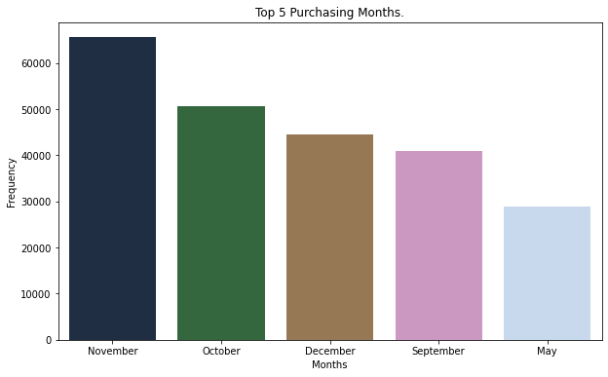
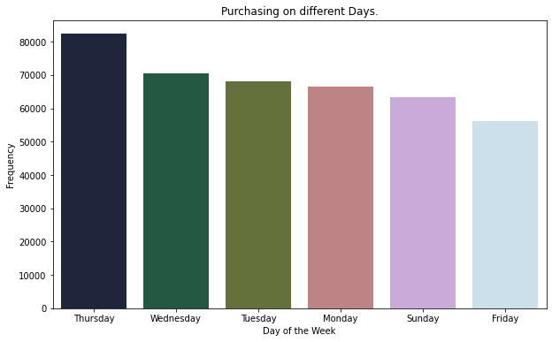
Effect of days & months on purchasing frequency

Slide 13
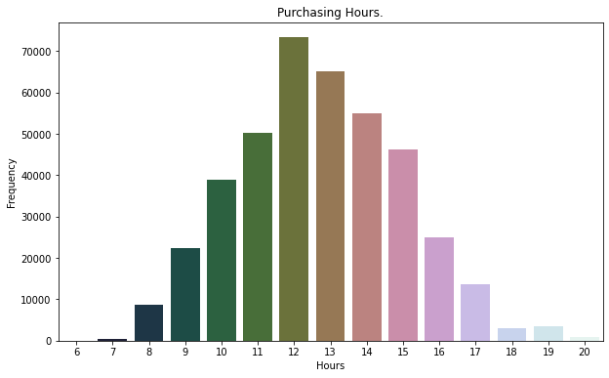
Effect of time on purchasing frequency

Slide 14
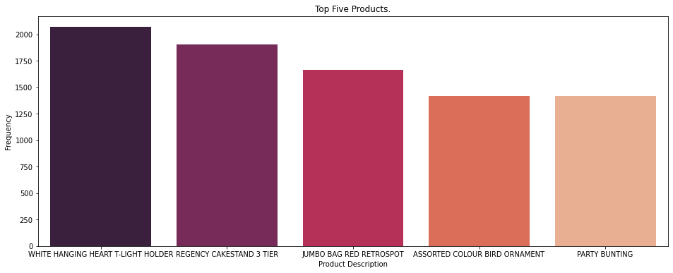
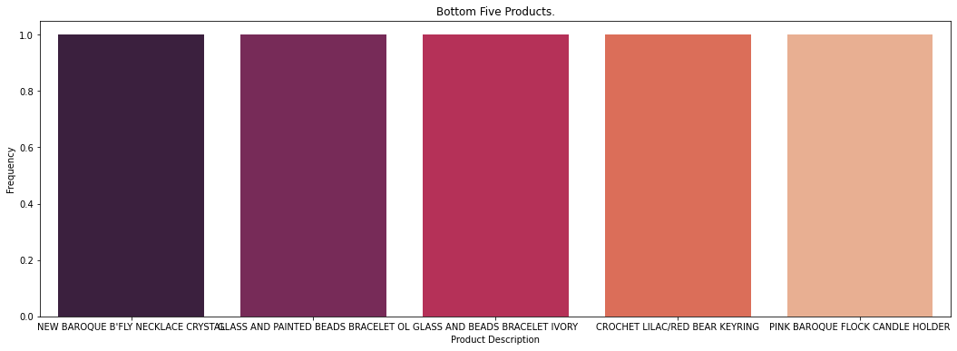
Products

Slide 15
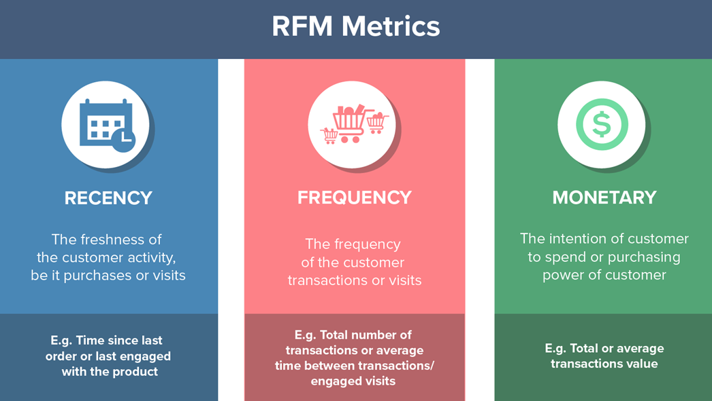
Data Transformation
In this Recency, Frequency and Monetary (RFM) analysis about the data is done. Recency signifies the days since order, Frequency signifies the number of times the customer is been billed and Monetary signifies the sales each customer has provided.

Slide 16
Data Transformation (continued)
The RFM DataFrame is grouped on the basis of customer ID. The given dataset contains 4192 rows or customers.
There are some outliers present in the RFM table & to get rid of this problem, the IQR (Inter Quantile Range) method was applied.
IQR = Q3 – Q1
Q3: Third quartile Q1: First quartile

Slide 17
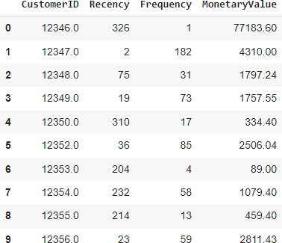
RFM of the given dataset

Slide 18
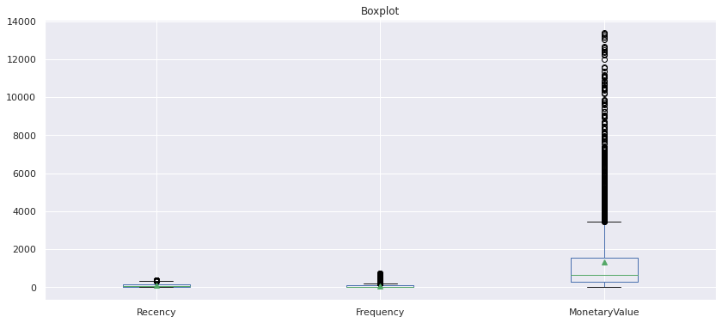
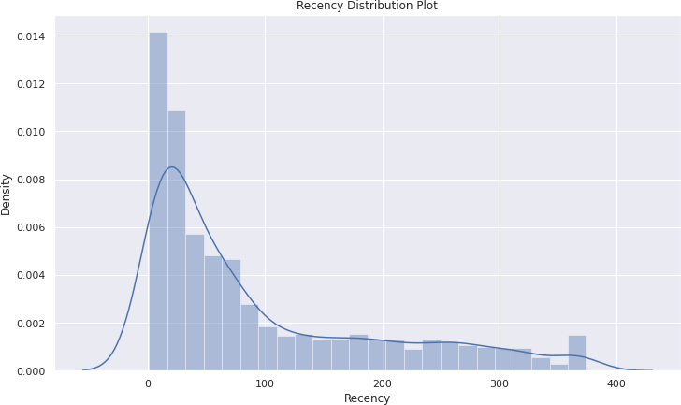
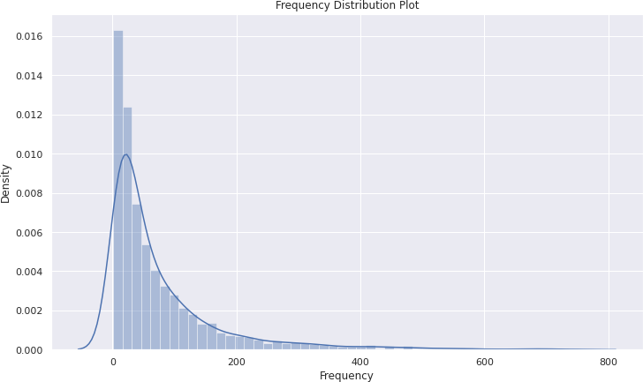
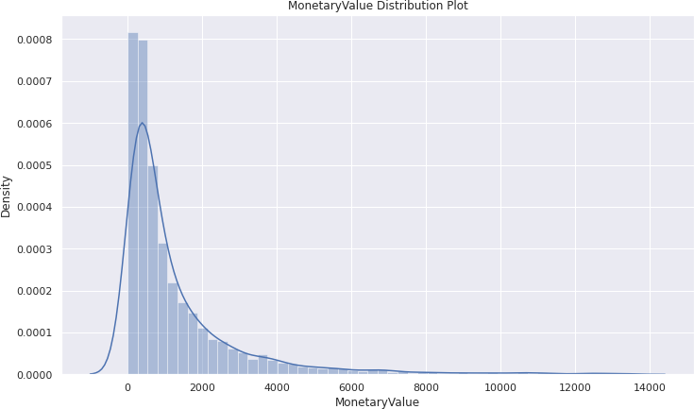
Continued
After applying IQR on RFM most of the outliers are removed from the dataset

Slide 19
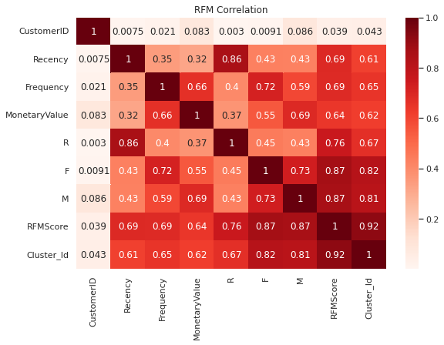
Correlation among RFM
Frequency and Monetary value is positively correlated, somehow frequency of purchasing affects monetary value too.
Frequency and Recency is also positive correlated but not having very high correlation between them.

Slide 20
Modeling

Slide 21
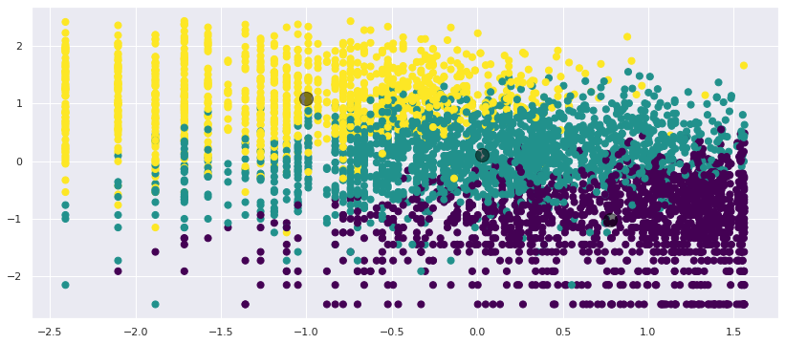
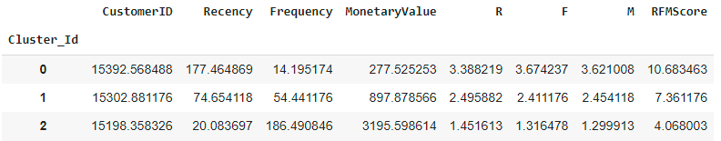
K-Means Clustering

Slide 22
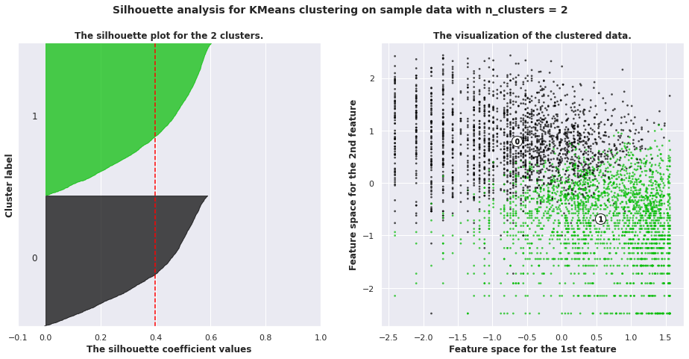
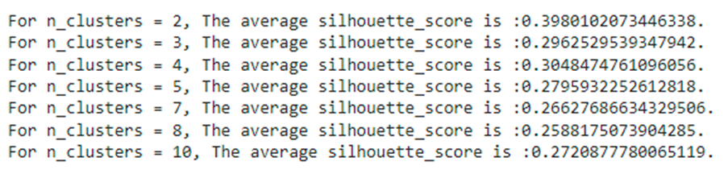
K-means Clustering with Silhouette Analysis

Slide 23
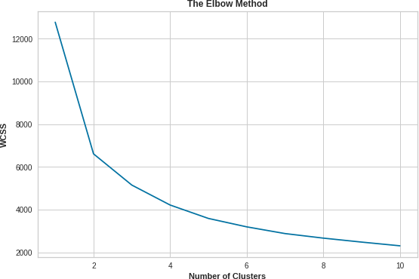
K-means with Elbow Method

Slide 24
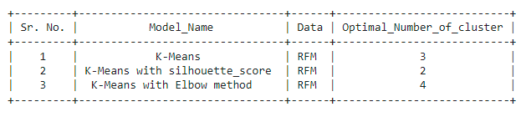
Pretty Table

Slide 25
Conclusion
Missing and duplicate values were found in the given dataset.
Most of the purchases are from United Kingdom followed by Germany, France, Ireland and Spain.
Most of the customers purchased items on Thursday, Wednesday, Tuesday.
Most of the customers purchased items in the month of November, October, December, and the
least number of purchases in April, January, February.
Most of the customers start their purchase from 10:00 A.M till 2:00 P.M & the 12th hour of the day is the peak
for purchasing. After 2:00 P.M the purchasing frequency gradually reduces.
Top Five purchased products on the basis of their frequency:
WHITE HANGING HEART T-LIGHT HOLDER
REGENCY CAKESTAND 3 TIER
JUMBO BAG RED RETROSPOT
ASSORTED COLOUR BIRD ORNAMENT
PARTY BUNTING
RFM (Recency, Frequency and Monetary) analysis of the data was carried out to understand the behavior of
the customer and the market, as it makes easy to recommend and display newly launched products to the
customers and understand their choices.
Applied Clustering Algorithms:
K-Means Clustering - Optimal number of Clusters (3)
K-Means with Silhouette Analysis - Optimal number of Clusters (2)
K-Means with Elbow Method - Optimal number of Clusters (4)

Slide 26
THANK YOU
Q & A

