Slide 1

Seasonal Agriculture Performance Analysis
Tanagala Sharath Kumar Reddy G.Pullaiah College Of Engineering and Technology
AICTE STU ID: STU672cb1436a2c11730982211

Slide 2

PROBLEM STATEMENT
Agricultural activities are influenced by seasonal variations in environmental conditions, farming practices, resource availability and market conditions. As a result, agricultural performance may differ from one season to another. However, raw agricultural data does not clearly explain how agricultural performance changes across seasons or what patterns can be observed in different seasonal conditions.
The problem is to analyze the given agricultural dataset and investigate seasonal differences in agricultural performance by identifying meaningful patterns, trends, relationships and variations within the available data

Slide 3
The project uses data visualization and exploratory analysis to study how agricultural performance changes across seasons. The workflow includes data preparation, descriptive analysis, seasonal comparison, visual storytelling and insight generation. The final output is designed to help users understand agricultural trends quickly and support evidence-based planning.

Slide 4

WHO ARE THE END USERS?
Farmers and agricultural producers - compare seasonal performance and identify favorable conditions
Agricultural officers and extension teams - communicate trends and prioritize interventions
Researchers and students - explore relationships among crops, seasons and performance measures
Policy makers and planners - support data-driven resource allocation and agricultural programs

Slide 5

TECHNOLOGY USED
Python for data preparation and analysis
Pandas and NumPy for data wrangling
Matplotlib and Seaborn for visual exploration
Jupyter Notebook for reproducible analysis
PowerPoint for communicating insights and recommendations
GitHub for version control and project sharing

Slide 6
Results
This project analyzed agricultural data from Kharif, Rabi, and Zaid seasons to identify seasonal patterns, relationships, variations, and differences in agricultural performance. The analysis showed clear descriptive differences in environmental conditions, resource usage, productivity, and economic outcomes across seasons. Kharif recorded the highest average yield and profit, while Zaid recorded the lowest average yield and negative average profit. Environmental analysis showed that Kharif had higher rainfall, humidity, and soil moisture, whereas Zaid experienced lower rainfall and soil moisture along with higher temperature and sunlight. Zaid also recorded the highest average water usage. Crop-wise analysis showed that all eight crop categories had their highest observed average yield during Kharif and lowest during Zaid. However, state-level analysis demonstrated that seasonal patterns can vary substantially across regions, with Punjab performing best during Rabi and Karnataka performing best during Zaid. Correlation analysis identified important associations among productivity, production, revenue, profit, and water efficiency. However, these relationships were interpreted carefully because correlation does not establish causation. Statistical testing provided an important distinction between descriptive patterns and statistically supported conclusions. One-way ANOVA did not identify a statistically significant difference in mean yield across seasons. In contrast, profit showed a statistically significant difference across seasons. Tukey's HSD test further showed that each pair of seasons differed significantly in mean profit. Overall, the analysis indicates that seasonal differences are particularly important when considering agricultural profitability. The findings highlight the importance of efficient resource management, region-specific planning, water-use efficiency, and further investigation of the factors contributing to seasonal economic performance.

Slide 7
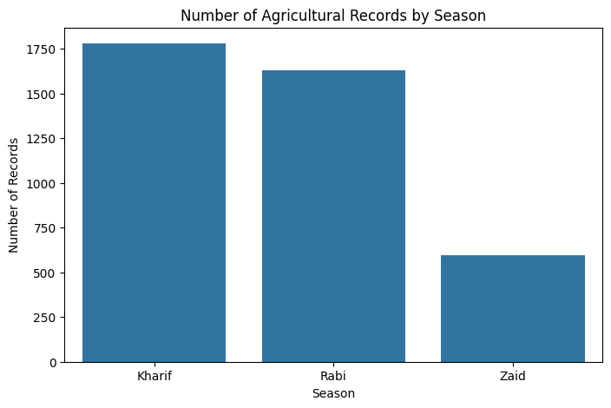
Results

Slide 8
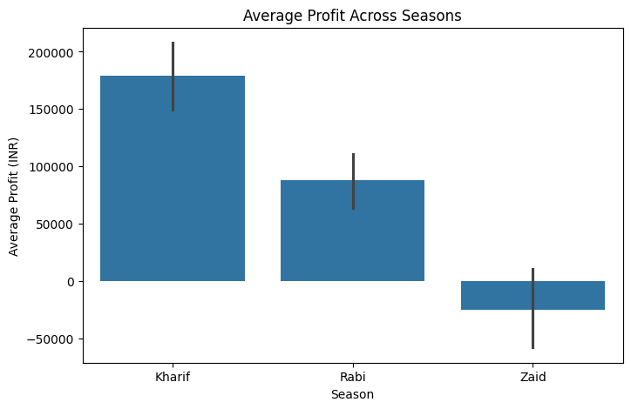
Results

Slide 9
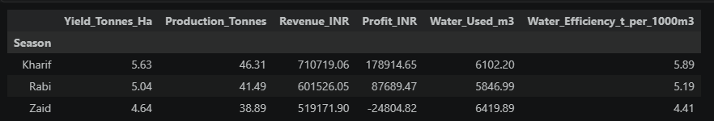
Results

Slide 10
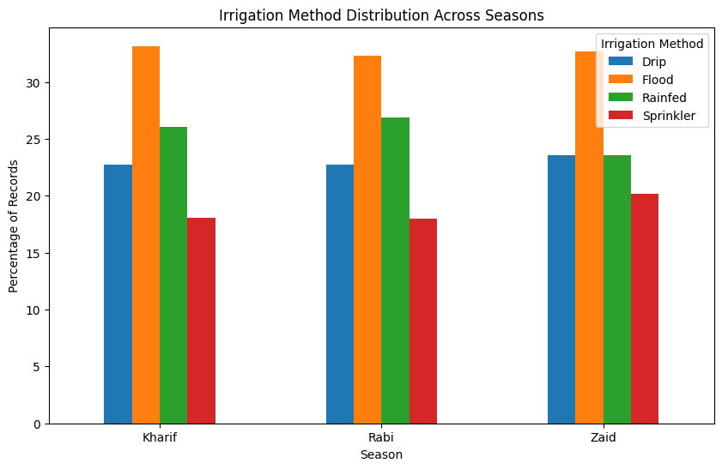
Results

Slide 11
FUTURE SCOPE
The project can be extended by developing machine learning models to predict crop yield, profit, and disease/pest risk based on seasonal, environmental, soil, irrigation, and farming parameters. Real-time weather and soil sensor data can be integrated to provide dynamic recommendations to farmers. A smart crop recommendation system can also be developed to suggest suitable crops and seasons based on soil conditions, rainfall, temperature, water availability, and expected profitability. Further, the system can be enhanced with real-time market-price data to help farmers select crops with better economic returns. A user-friendly web or mobile application could eventually provide personalized farming recommendations and alerts.

Slide 12
GITHUB LINK
https://github.com/Sharath4515/Seasonal-Agriculture-Performance-Analysis

Slide 13
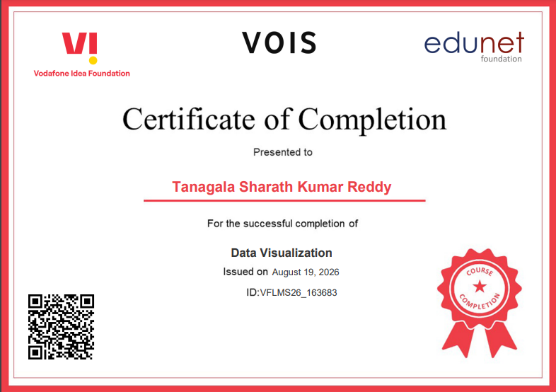
VOIS COURSE COMPLETION CERTIFICATE

Slide 14
Thank you
Tanagala Sharath Kumar Reddy
G.Pullaiah College Of Engineering and Technology
[reddysharath701@gmail.com / 8897986952]
.
.

